Slide 1
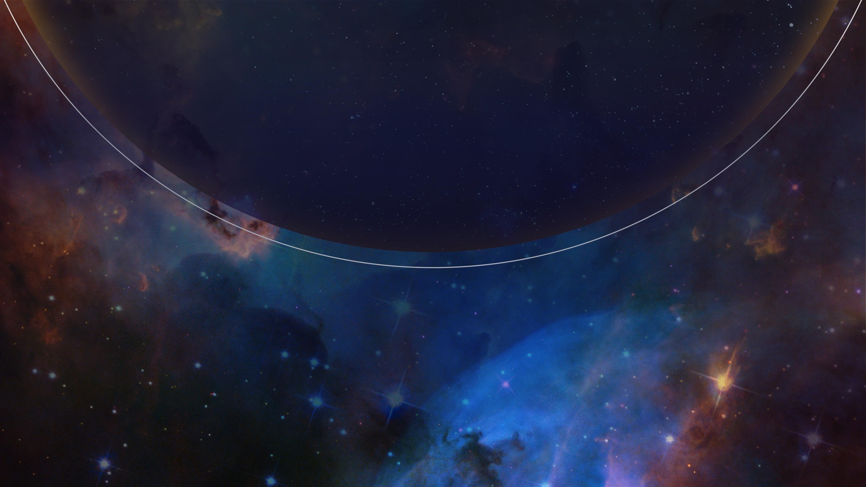


JWST NIRSpec MOS Observation Planning in APT
EXPANDING THE FRONTIERS OF SPACE ASTRONOMY
Dan Coe
ESA/AURA Astronomer
NIRSpec Instrument Scientist
since 2024

Slide 2
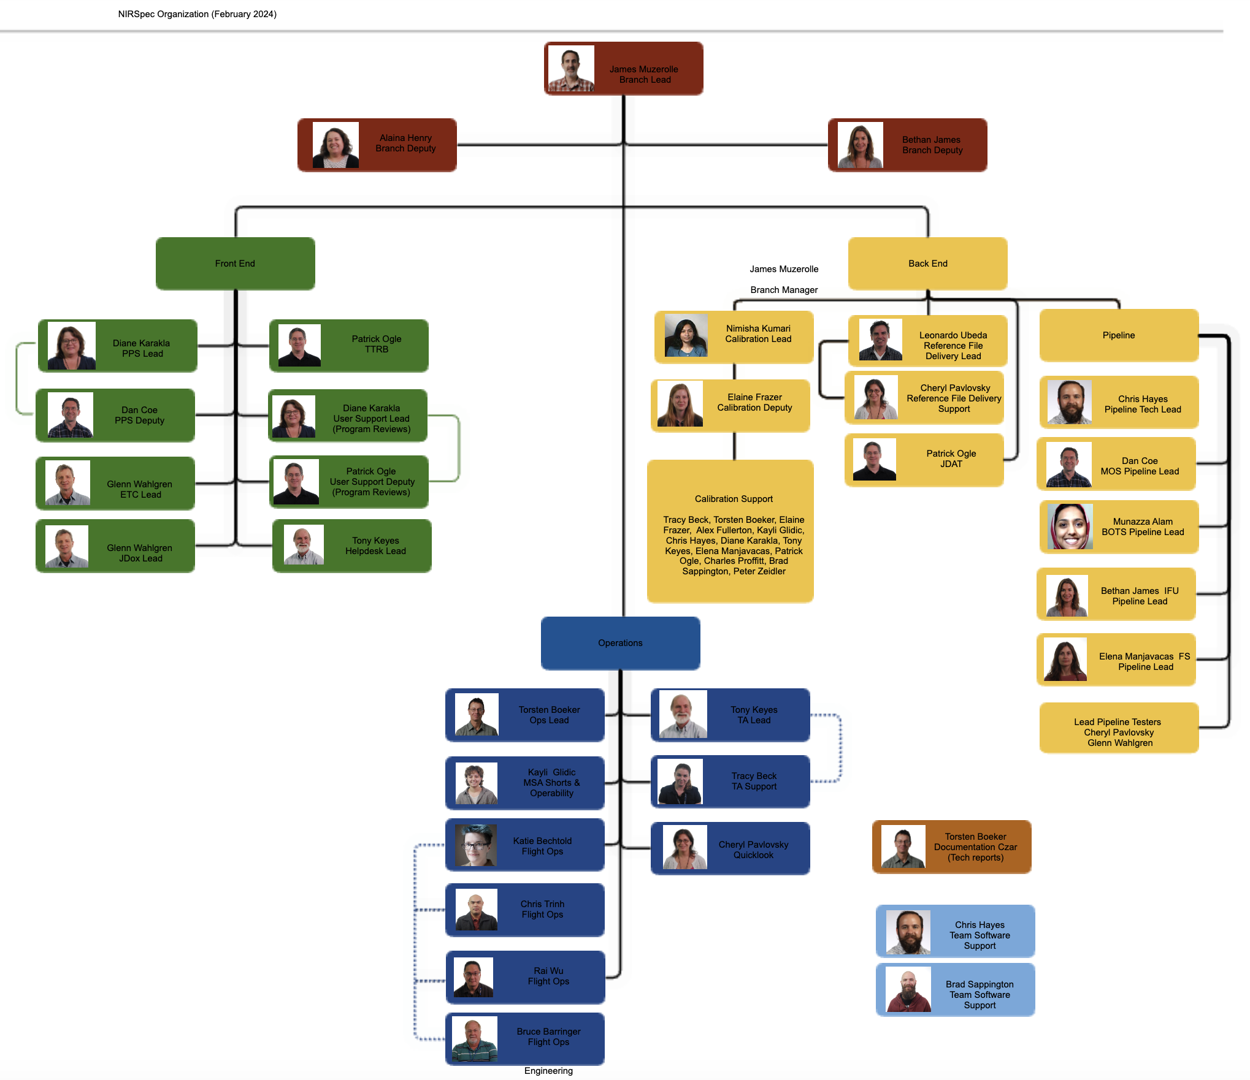
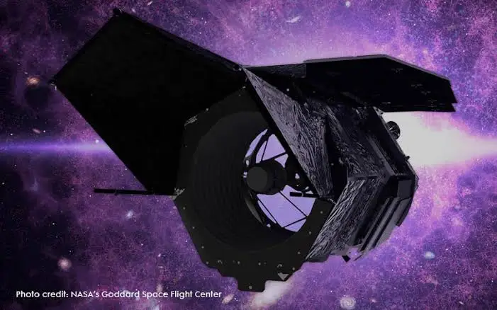
NIRSpec team @ STScI
Roman
NIRSpec (Feb 2024)
James Muzerolle: Branch Lead, Branch Manager
Alaina Henry: Branch Deputy
Bethan James: Branch Deputy, IFU Pipeline Lead –> Roman
Diane Karakla: PPS Lead, User Support Lead, Calibration Support
Dan Coe: PPS Deputy, MOS Pipeline Lead
Glenn Wahlgren: ETC Lead, JDox Lead, Lead Pipeline Tester
Patrick Ogle: TTRB, User Support Deputy, JDAT, Calibration Support
Tony Keyes: Helpdesk Lead, TA Lead, Calibration Support
Torsten Boeker: Ops Lead, Documentation Czar, Calibration Support
Kayli Glidic: MSA Shorts & Operability, Calibration Support
Katie Bechtold: Flight Ops
Chris Trinh: Flight Ops
Rai Wu: Flight Ops
Bruce Barringer: Flight Ops
Tracy Beck: TA Support, Calibration Support
Cheryl Pavlovsky: Quicklook, Reference File Delivery Support, Lead Pipeline Tester
Nimisha Kumari: Calibration Lead
Elaine Frazer: Calibration Deputy, Calibration Support
Leonardo Ubeda: Reference File Delivery Lead
Chris Hayes: Pipeline Tech Lead, Team Software Support, Calibration Support
Munazza Alam: BOTS Pipeline Lead
Elena Manjavacas: FS Pipeline Lead, Calibration Support
Brad Sappington: Team Software Support, Calibration Support
Alex Fullerton: Calibration Support
Charles Proffitt: Calibration Support
Peter Zeidler: Calibration Support

Slide 3

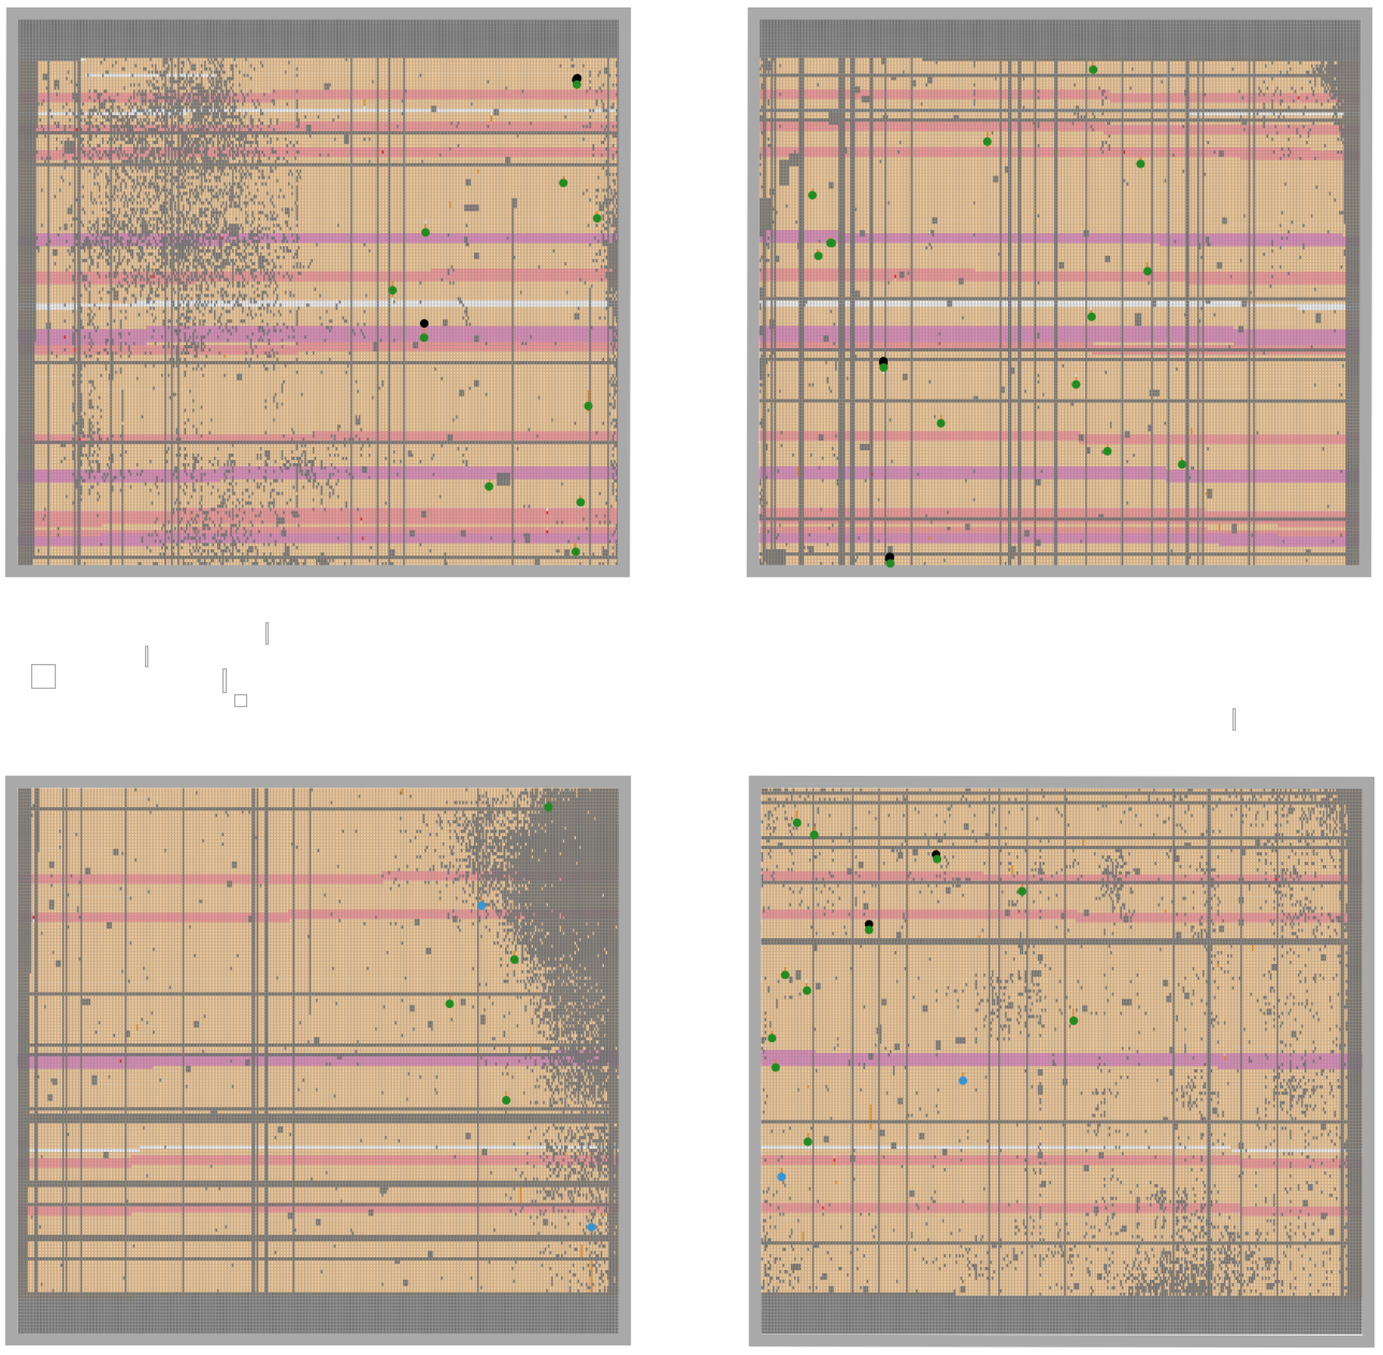
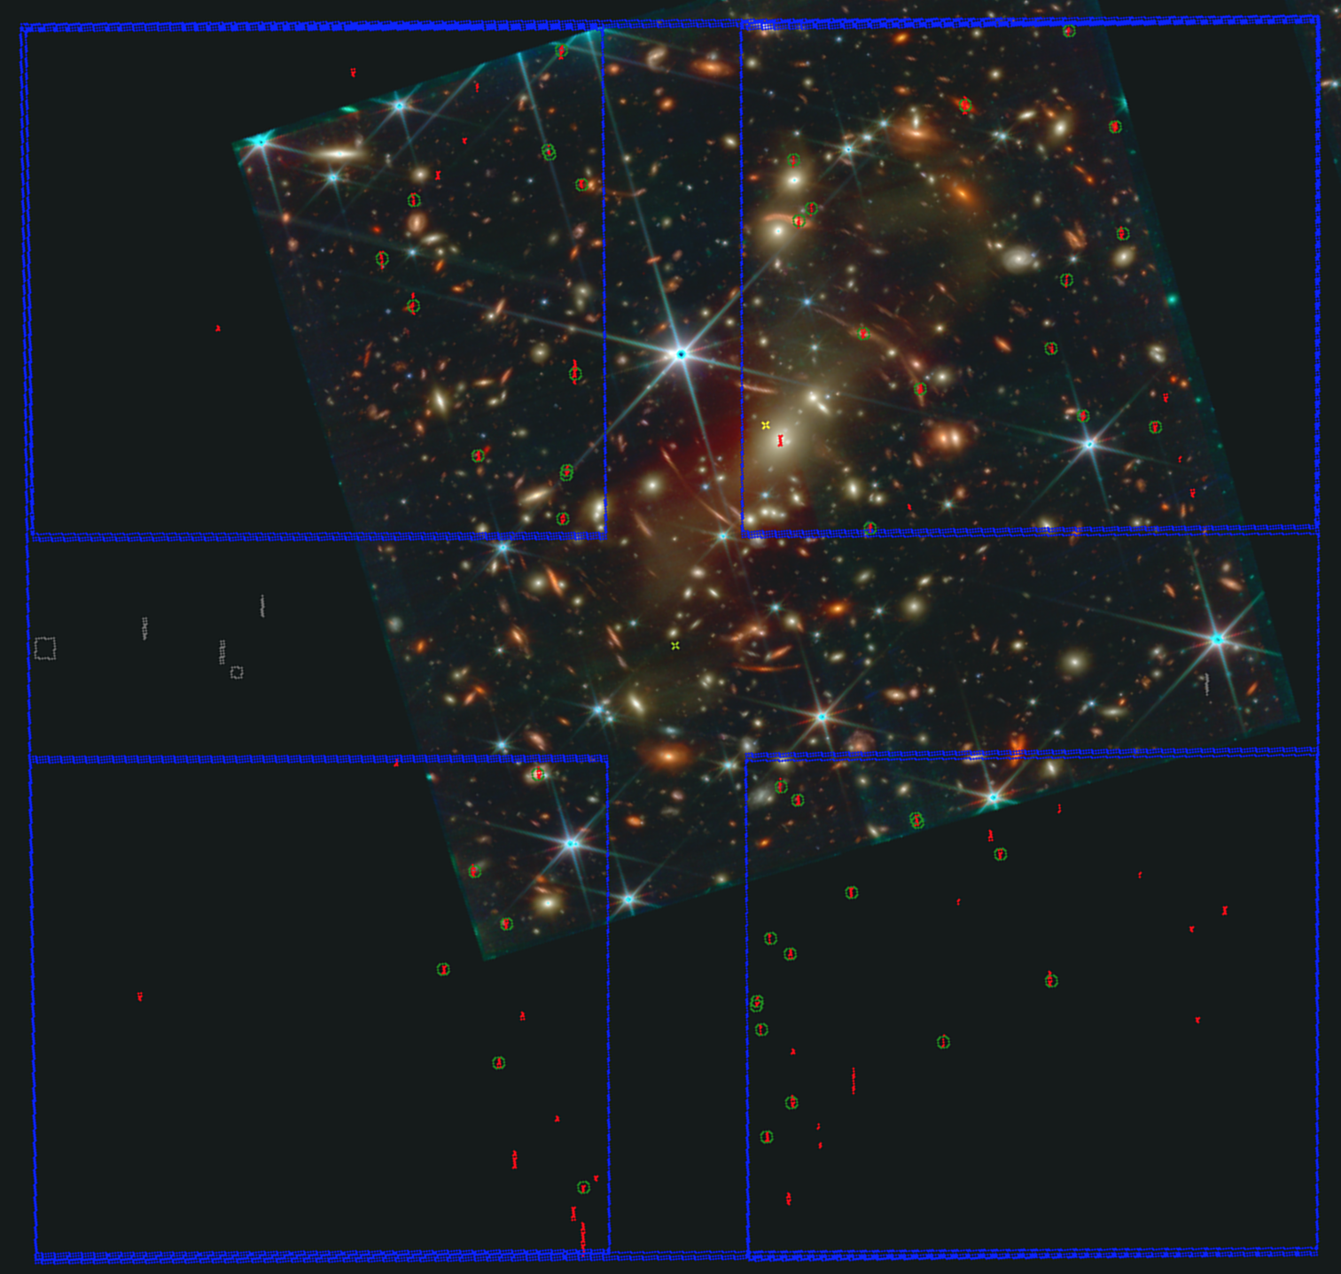
NIRSpec MOS Observation Planning in APT w/ MPT
JWST Cycle 5 is ~ half NIRSpec. ~Half of that is MOS.
JWebbinars #30, #33
Diane Karakla
Dan Coe, Kayli Glidic
APT Aladin
MPT (MSA Planning Tool)
MSA (micro-shutter assembly)

Slide 4
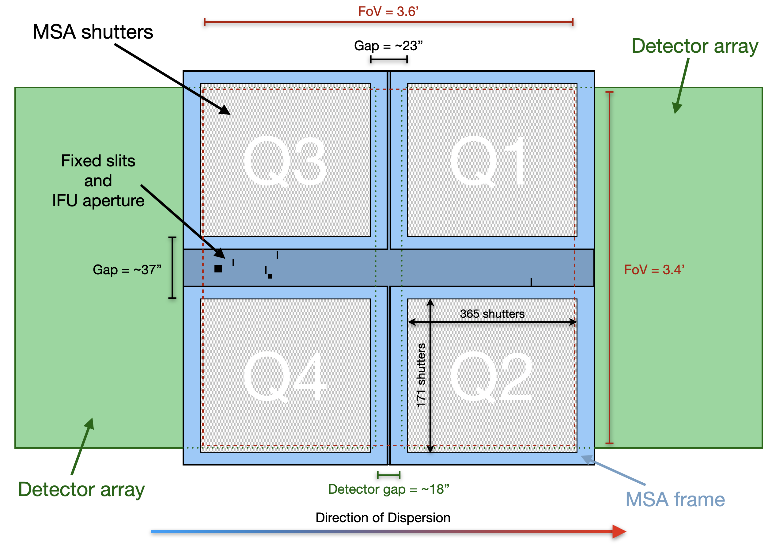
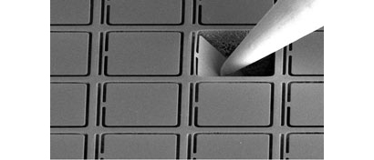
NIRSpec MOS Observation Planning in APT w/ MPT
JWebbinars #30, #33
Diane Karakla
Dan Coe, Kayli Glidic
MPT (MSA Planning Tool)
MSA (micro-shutter assembly)

Slide 5
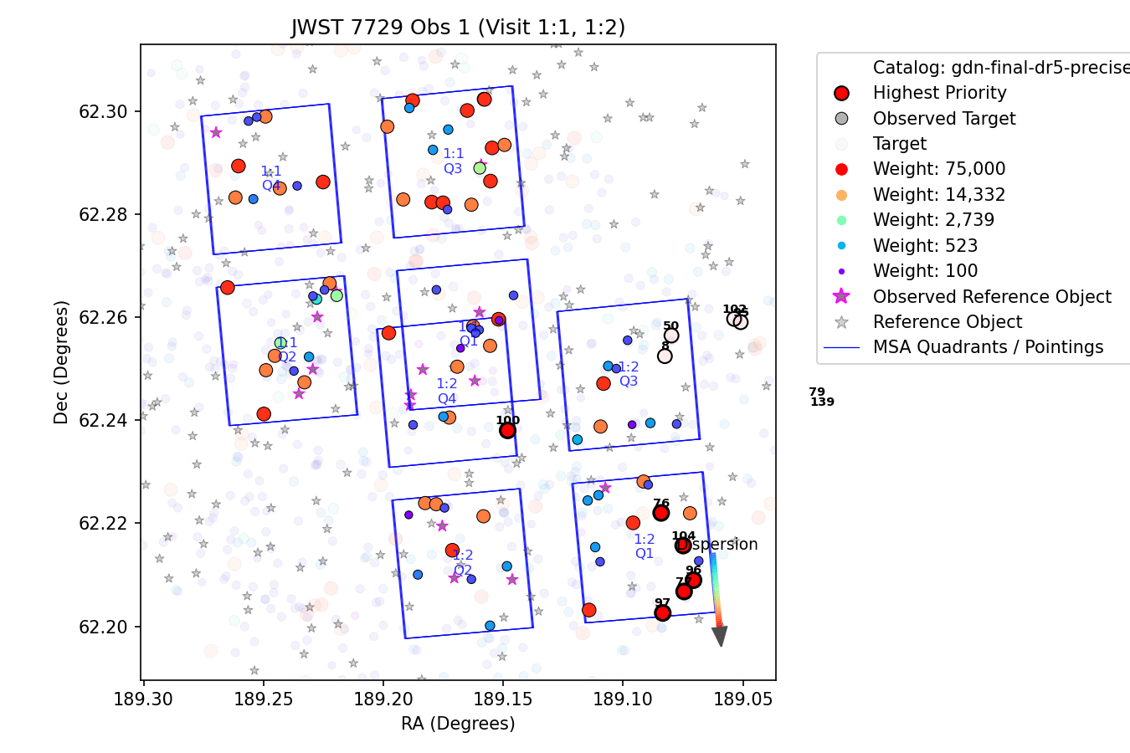
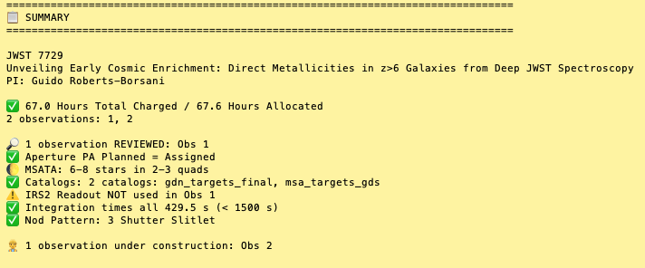
MPT tries to optimize pointings and slits on your catalog targets
new review assistant
You assign target priority weights
MPT tries to maximize total

Slide 6

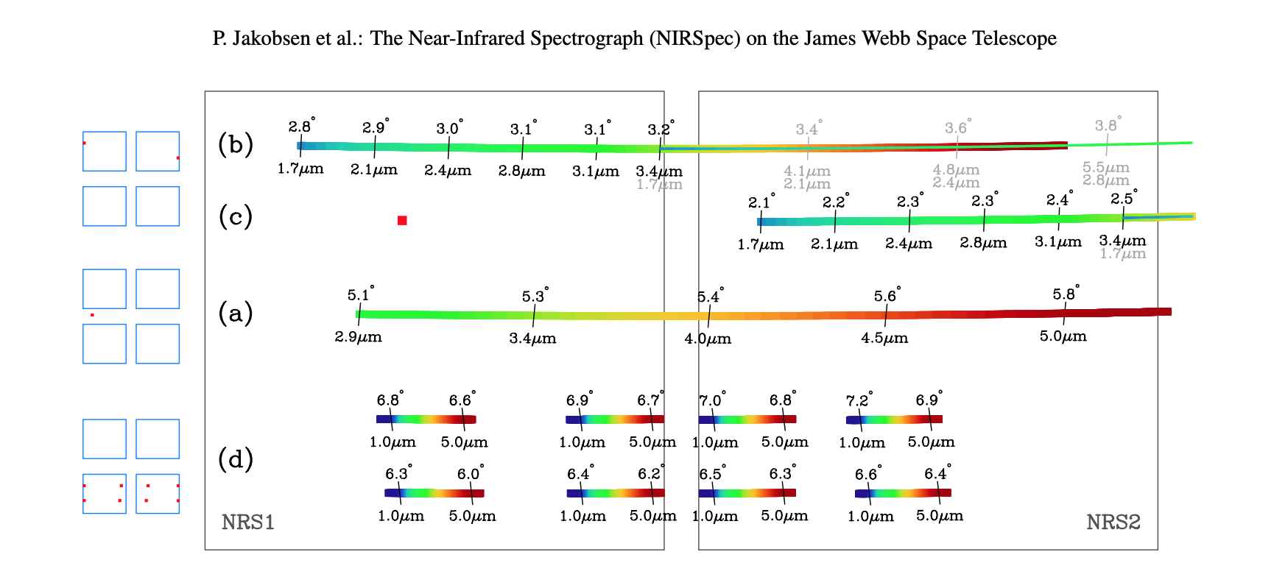
NIRSpec MSA slits → detectors

Slide 7
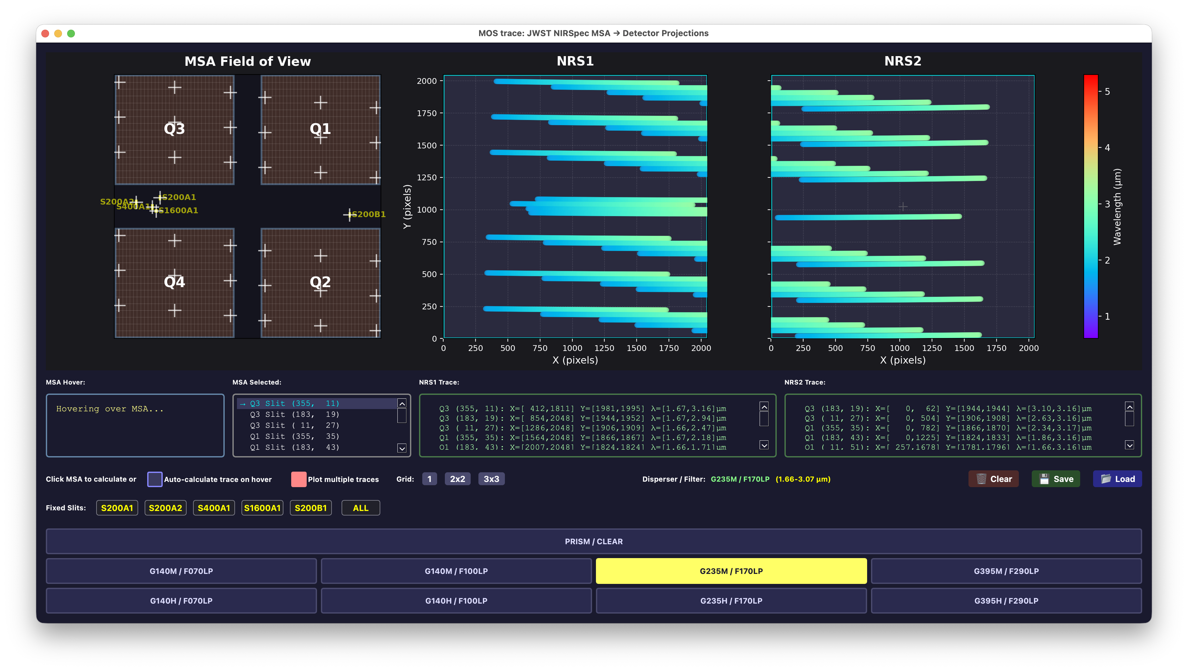
NIRSpec MSA slits → detectors

Slide 8
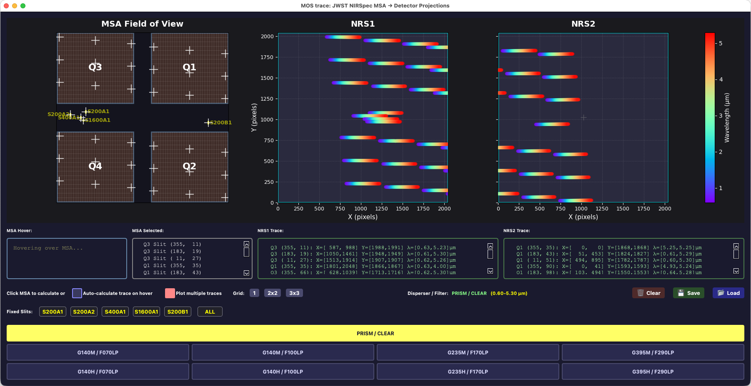
NIRSpec MSA slits → detectors

Slide 9
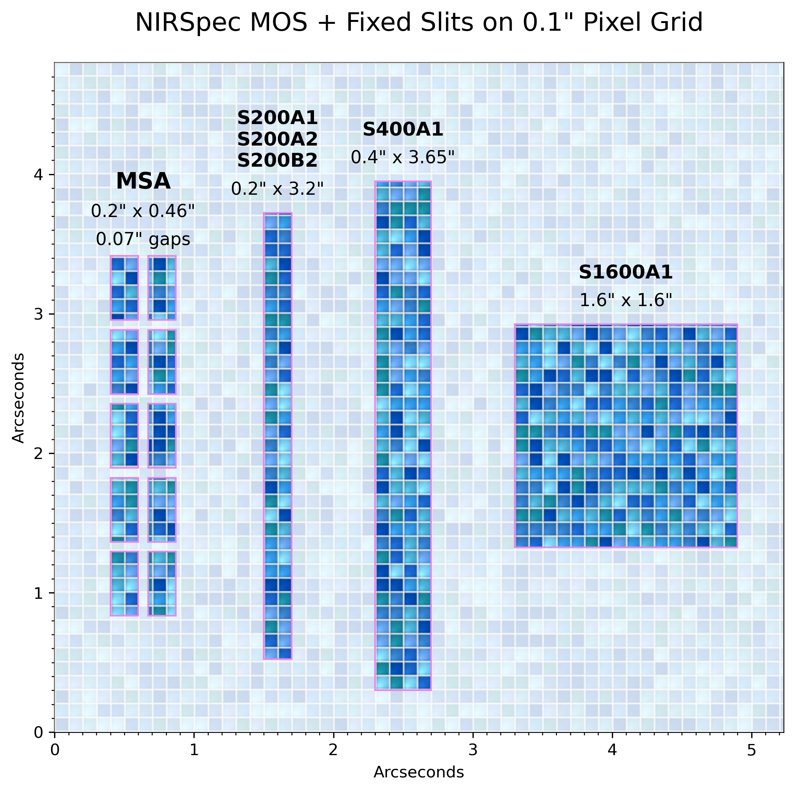
NIRSpec MOS + Fixed Slits + detector pixels
0.2” S200A2
0.2” S200A1
IFU
0.4” S400A1
1.6” S1600A1
0.2” S200B1

Slide 10
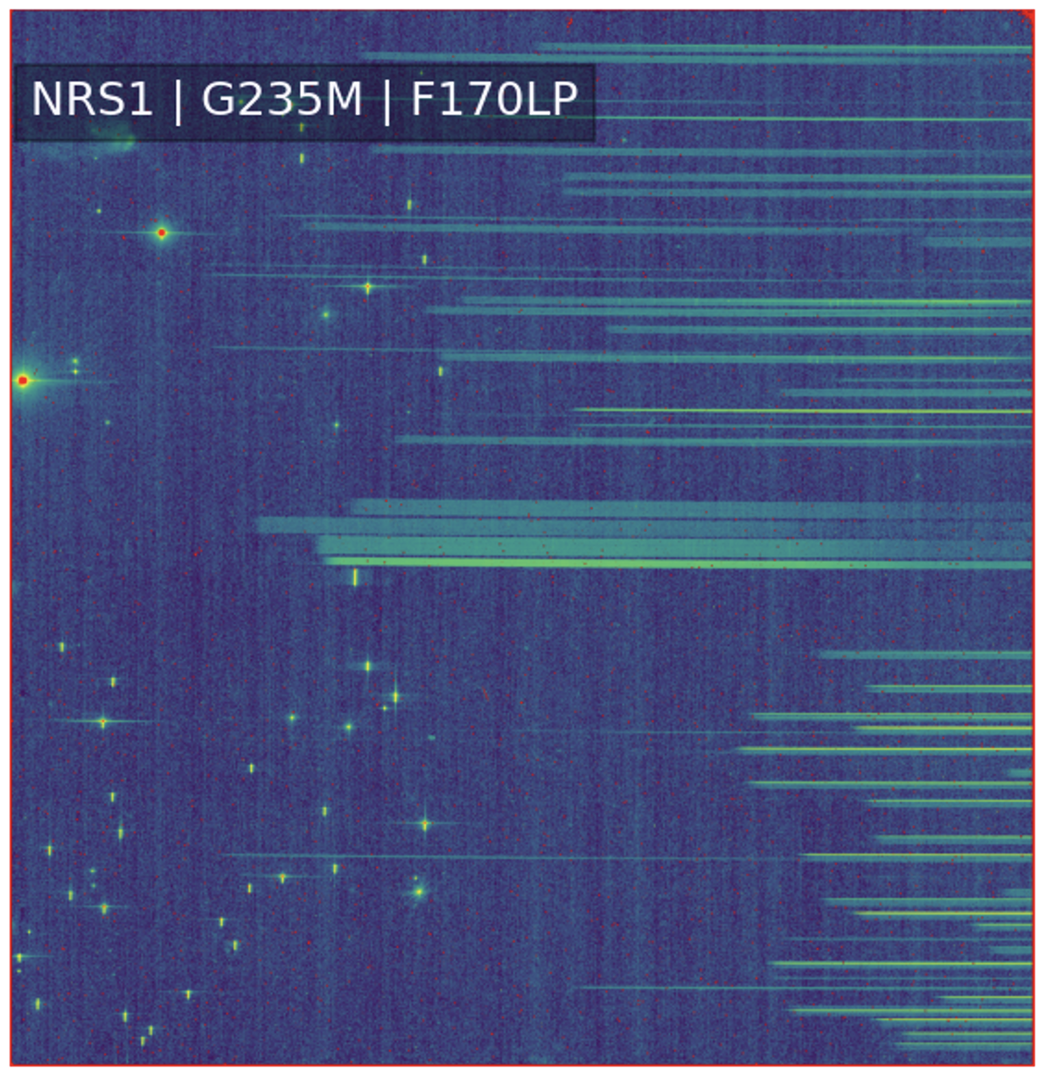
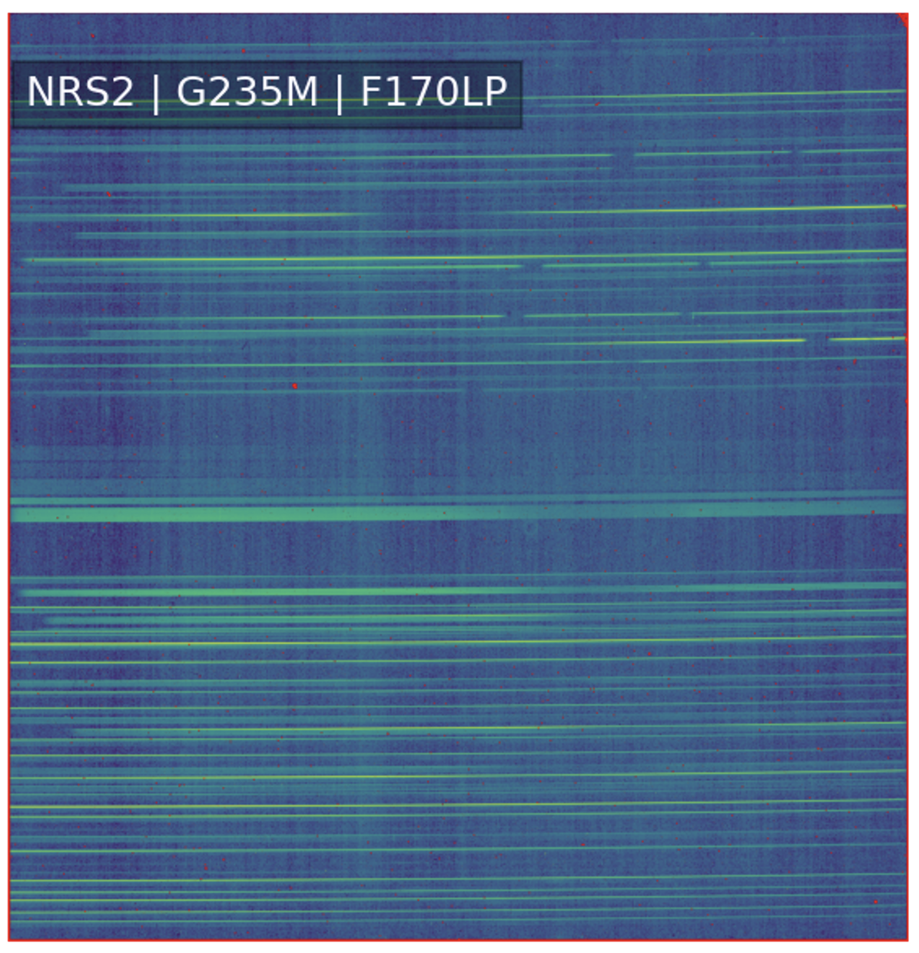
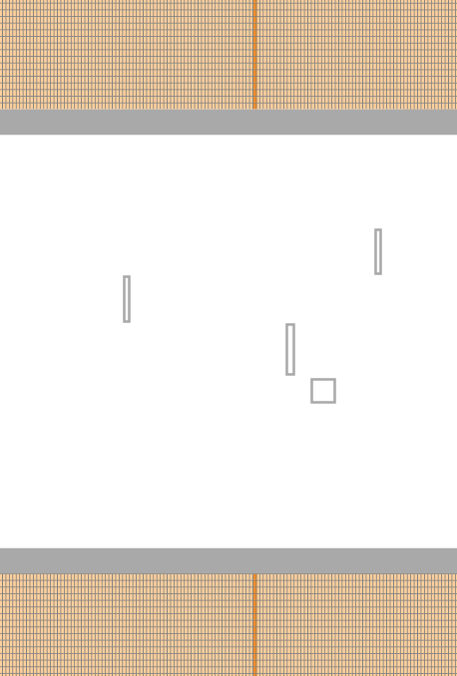
NIRSpec MOS always obtains Fixed Slit data too
can extract with our JDAT notebook
0.2” S200A2
0.2” S200A1
0.4” S400A1
1.6” S1600A1
0.2” S200B1
PID 1166 Obs 7
Confirmation images

Slide 11
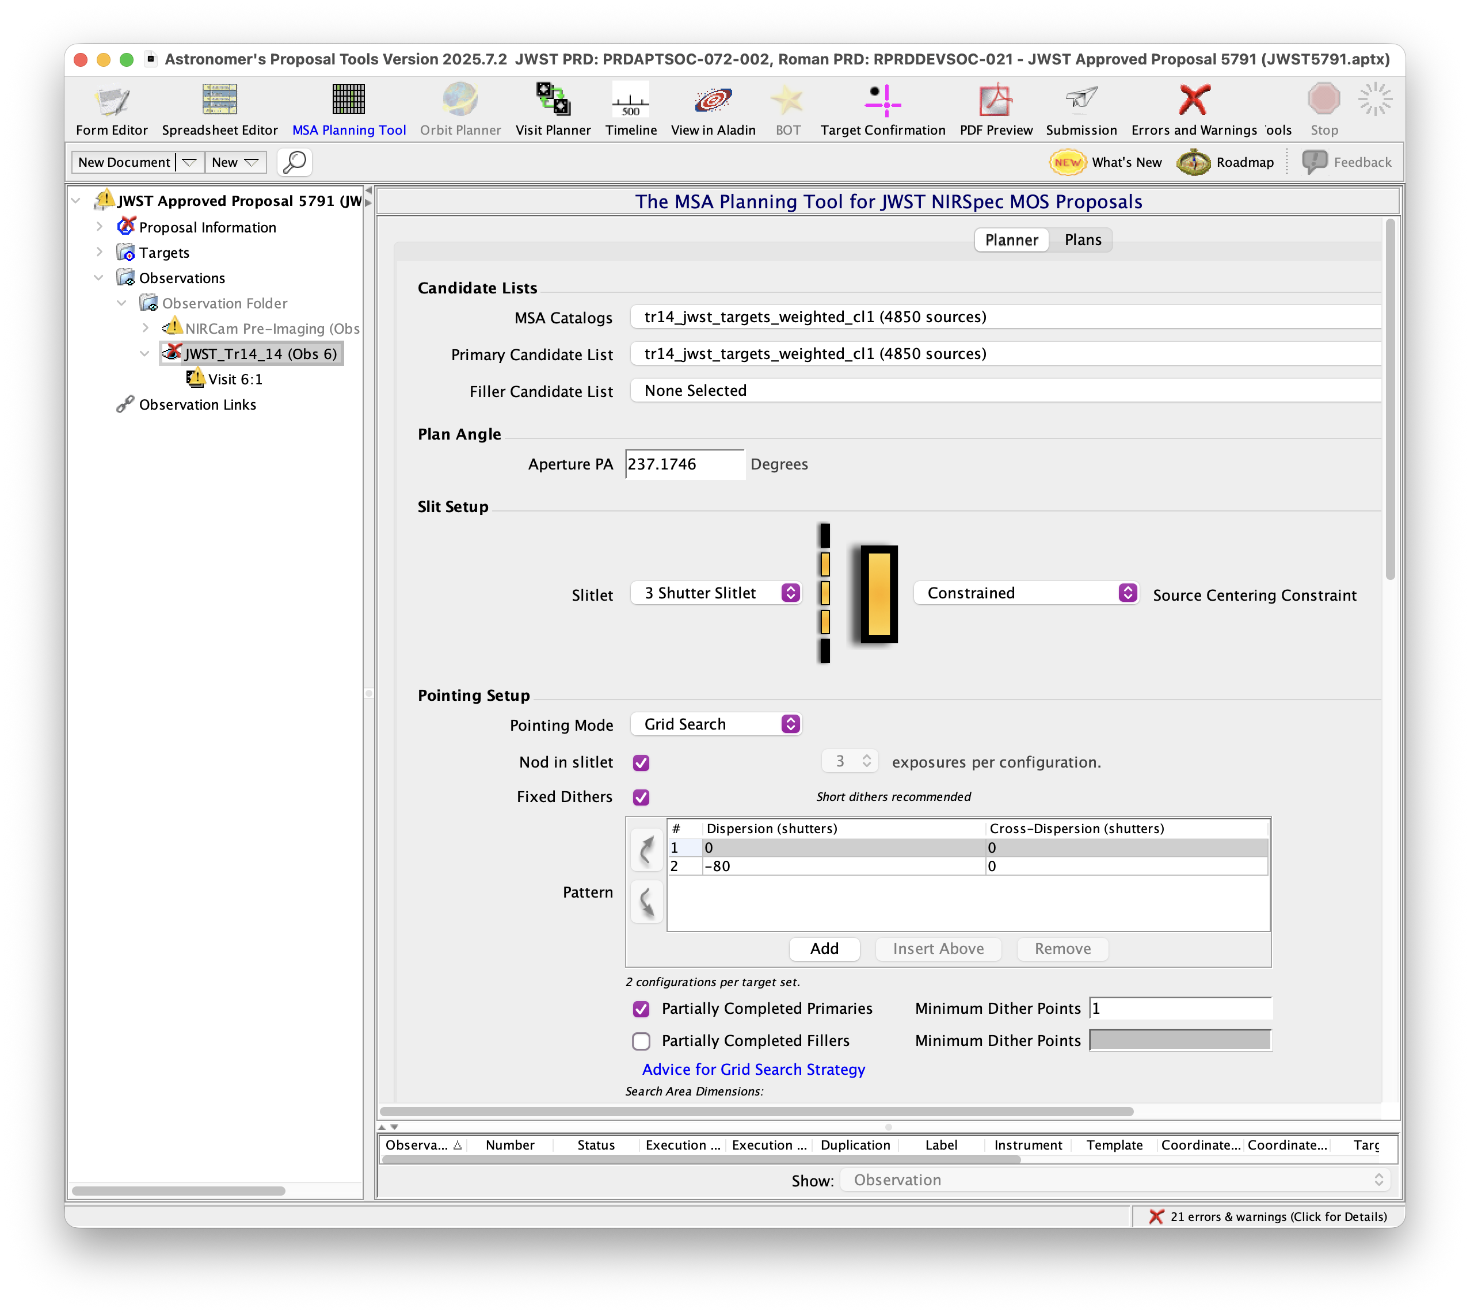
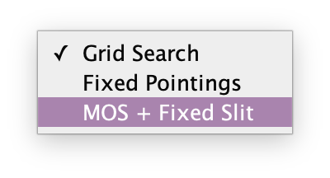
MPT
MSA
Planning
Tool

Slide 12
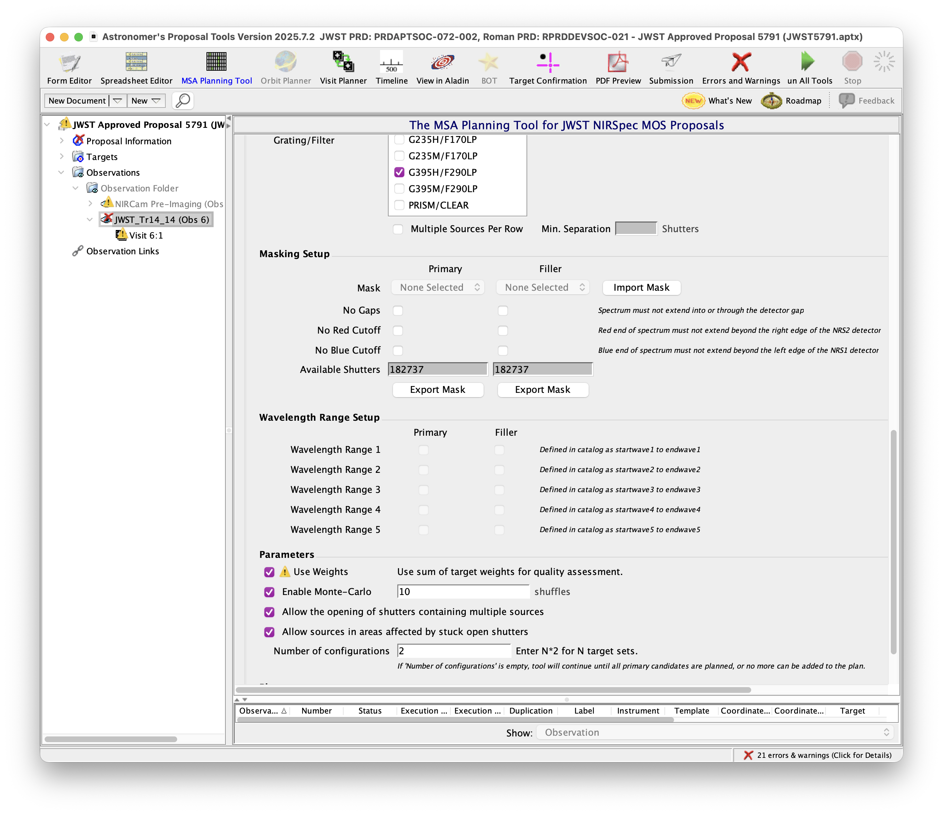
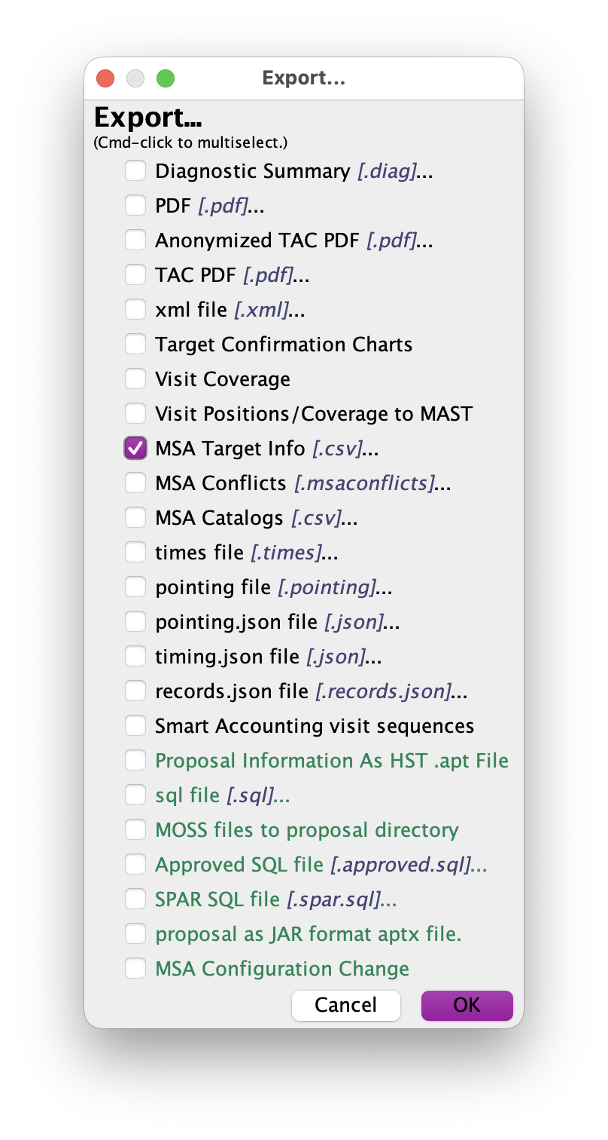
MPT
Wavelength
Ranges
Export to check
Require range
for any object

Slide 13
NIRSpec MOS APT – Common Suggestions / Requirements
  Catalog aligned to Gaia
  Enough reference stars / compact galaxies (FWHM < 0.2”)
  Integration times < 1,500 s
  Dither if deep
  High priority targets:
    Full depth
    Wavelength coverage
    Open more shutters? (e.g., 5 long)
    Fixed Slit + MOS?

Slide 14

NIRSpec MOS APT Submission Timeline
  Proposal
  Acceptance? Congrats!
  Revisions? – # visits, pointings; constraints?
  Scheduling + Angle Assignment
  -8 weeks: MOS at assigned angle
  -4 weeks: Finalize APT
  -2 weeks (Wed.) Flight Ready
  Plan window start

Slide 15
JWST NIRSpec MOS pipeline
EXPANDING THE FRONTIERS OF SPACE ASTRONOMY
Dan Coe
ESA/AURA Astronomer
NIRSpec Instrument Scientist

Slide 16
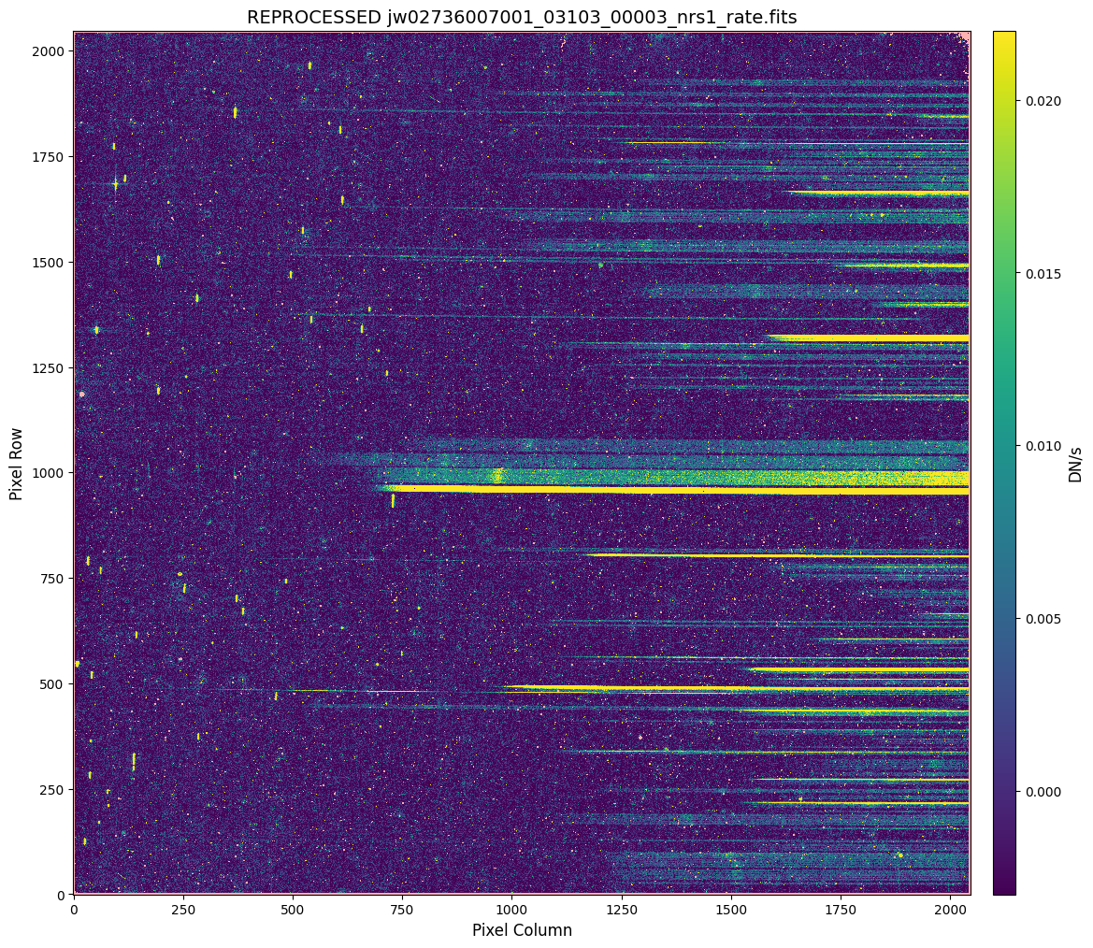
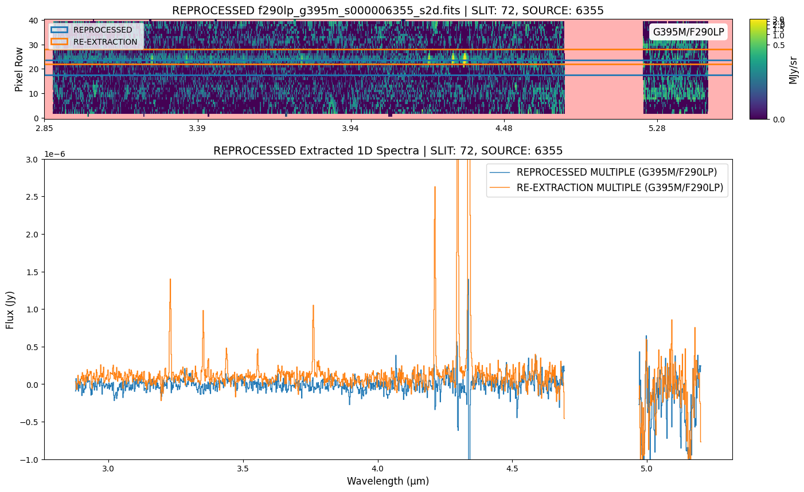
https://github.com/spacetelescope/jwst-pipeline-notebooks
https://github.com/spacetelescope/jdat_notebooks
NIRSpec MOS pipeline

Slide 17
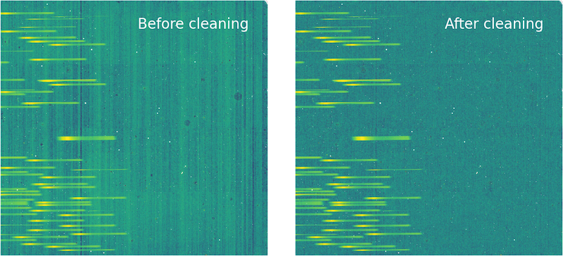
NIRSpec MOS – 1/f noise stripe removal – clean_flicker_noise

Slide 18
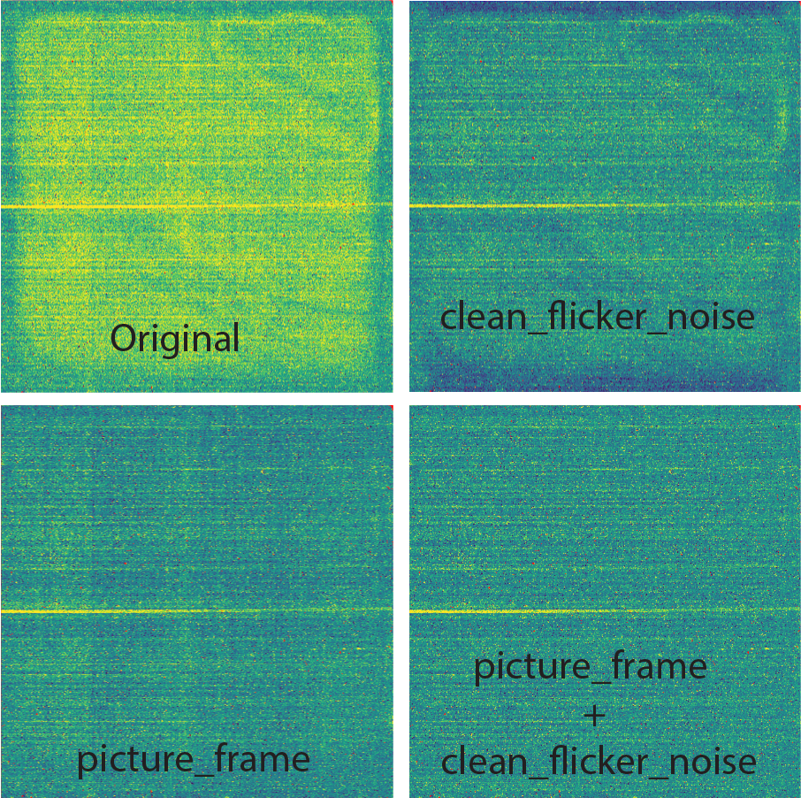
NIRSpec MOS
Picture Frame Correction
JDAT = JWST Data Analysis Tools
https://github.com/spacetelescope/jdat_notebooks

Slide 19
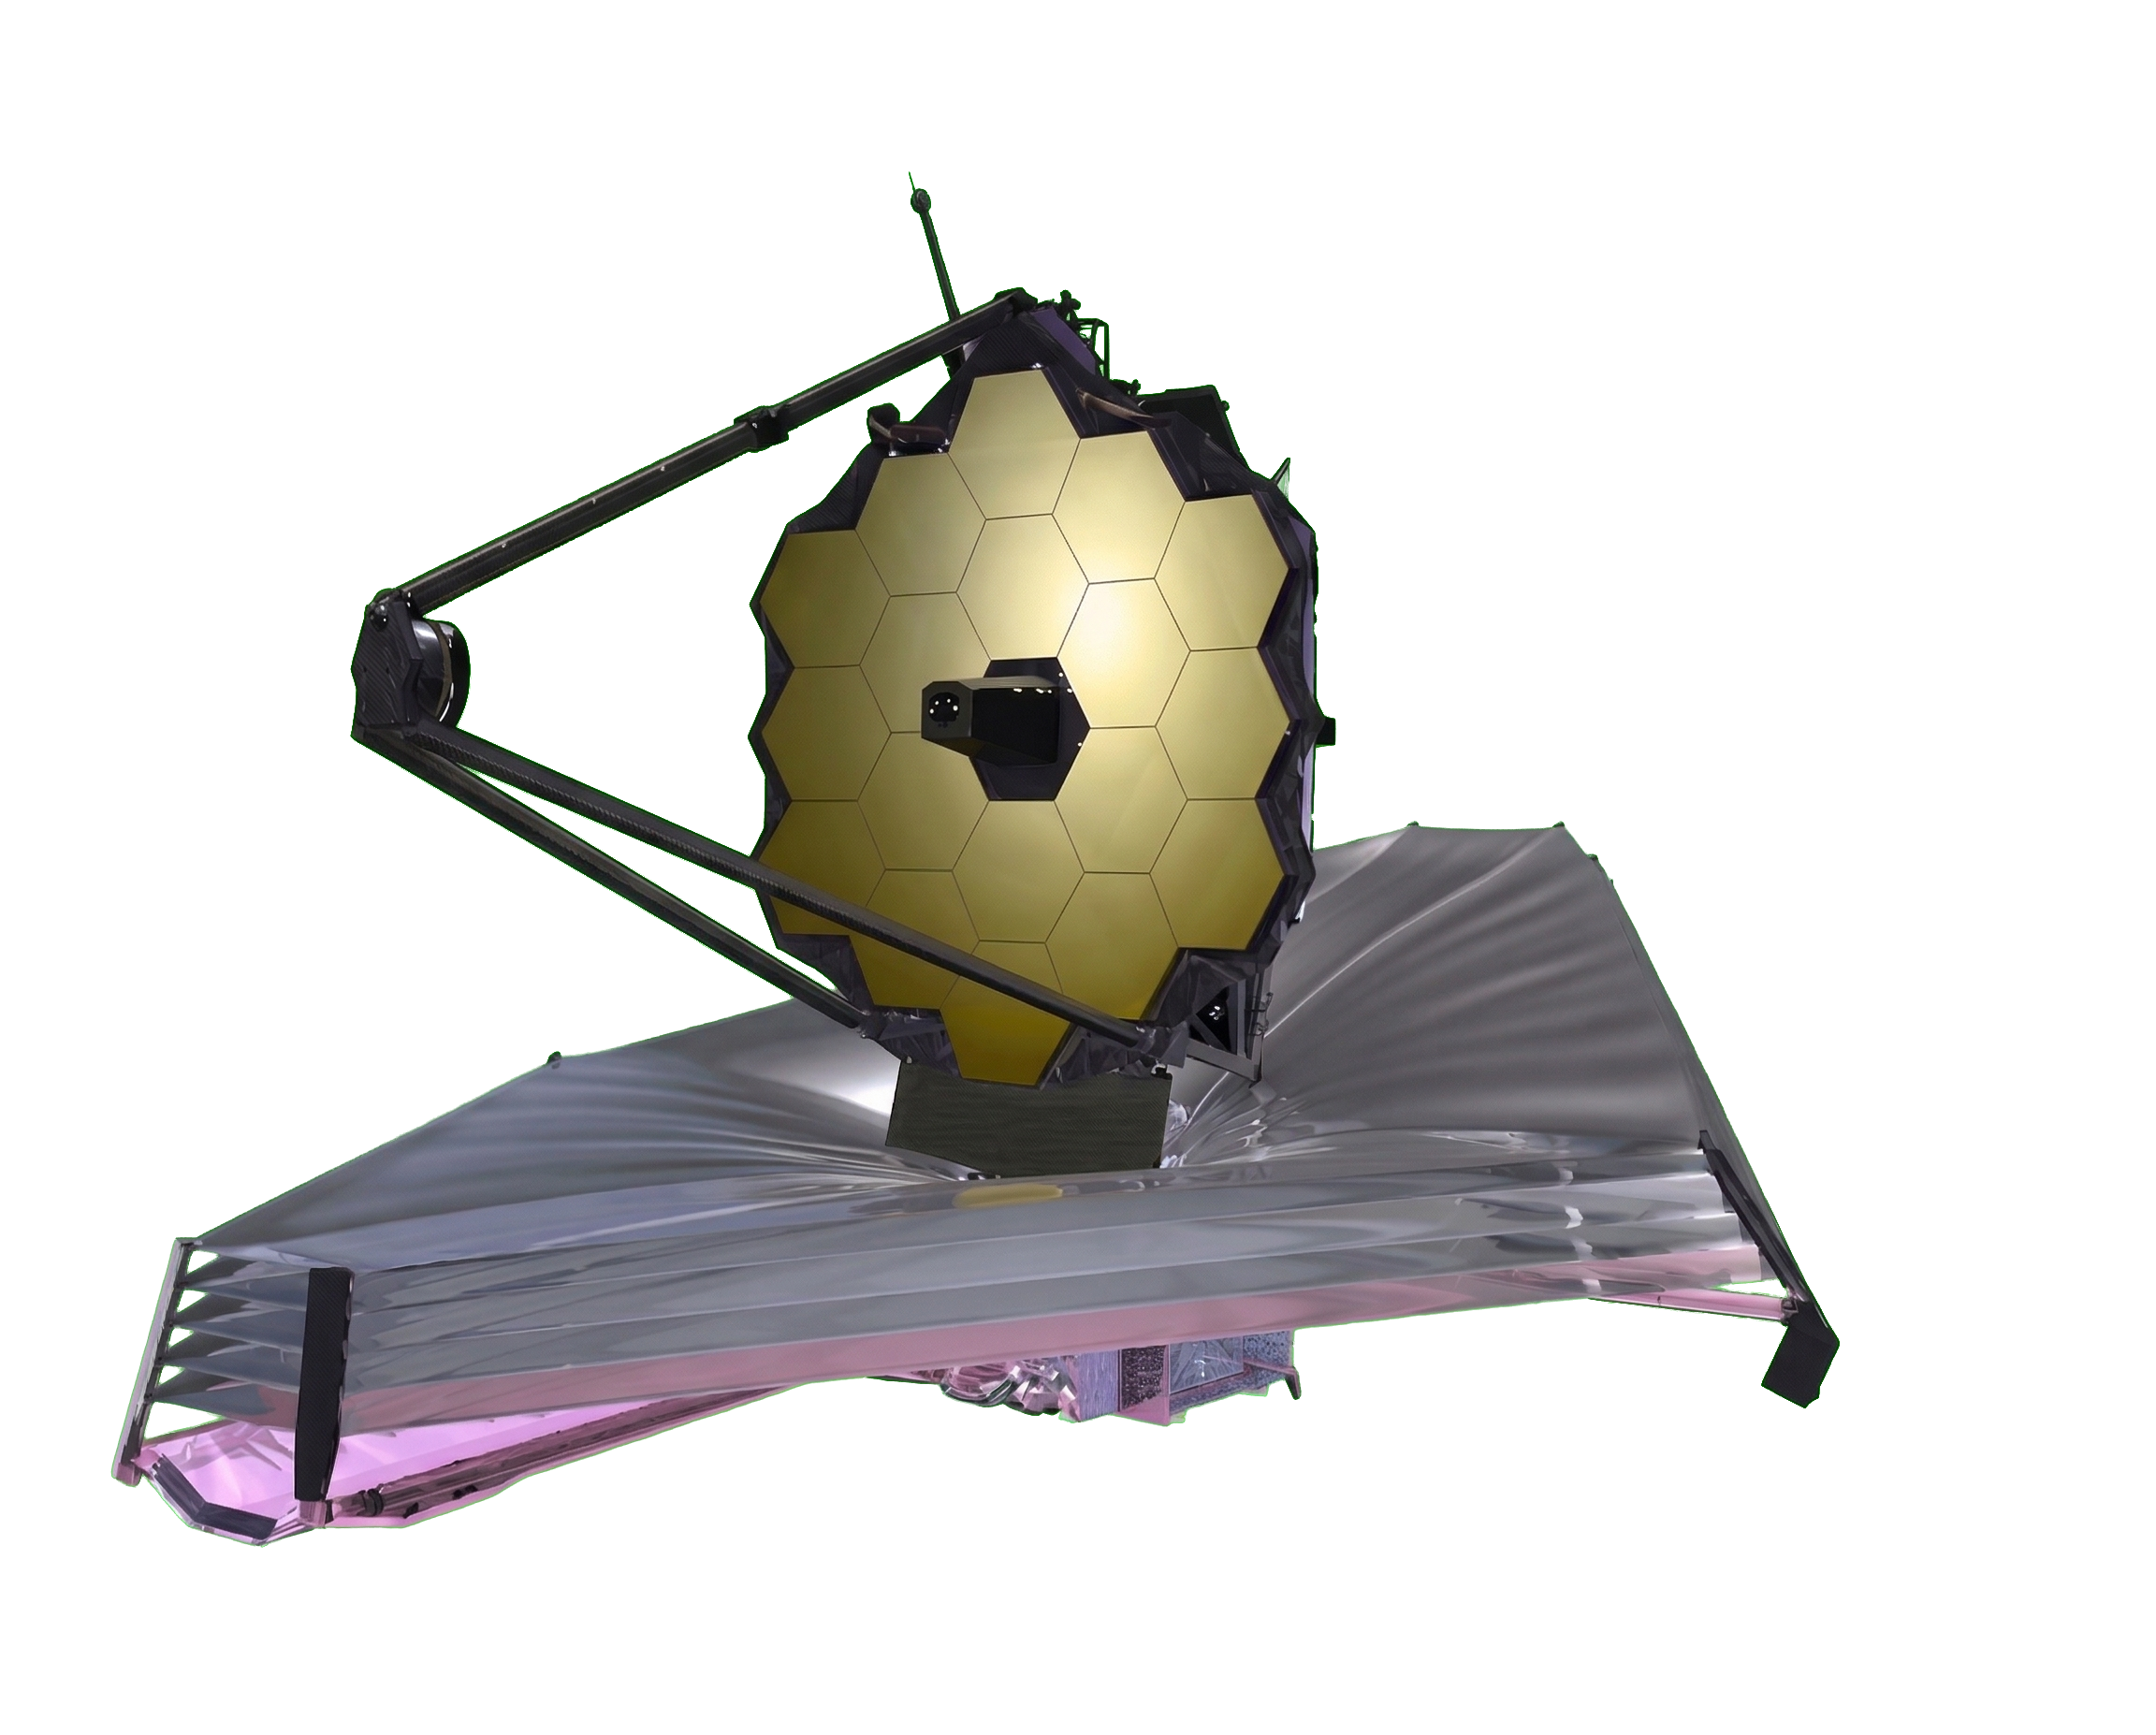

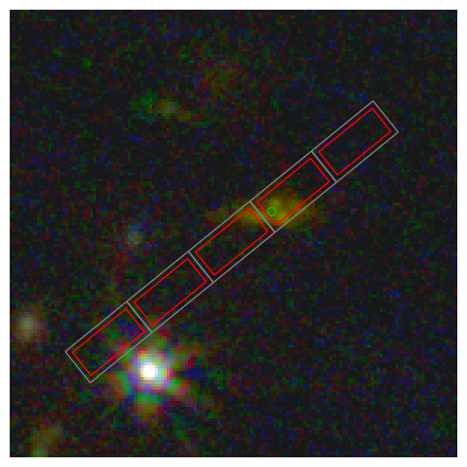
JWST Pipeline v 2.0 coming April 17
fundamental changes include:
memory usage reduced
empty datamodels changed
association yaml files deprecated
to replace v 1.20.2
https://jwst-pipeline.readthedocs.io
open source – pull requests welcome!
NIRSpec notebooks demo recent updates and provide tools:
https://github.com/spacetelescope/jdat_notebooks/tree/main/notebooks/NIRSpec
1/f noise removal clean_flicker_noise
master background
extract fixed slit from MOS data (coming soon)
slits to sky mapping
MSA metafile
and more…
slits to sky

Slide 20
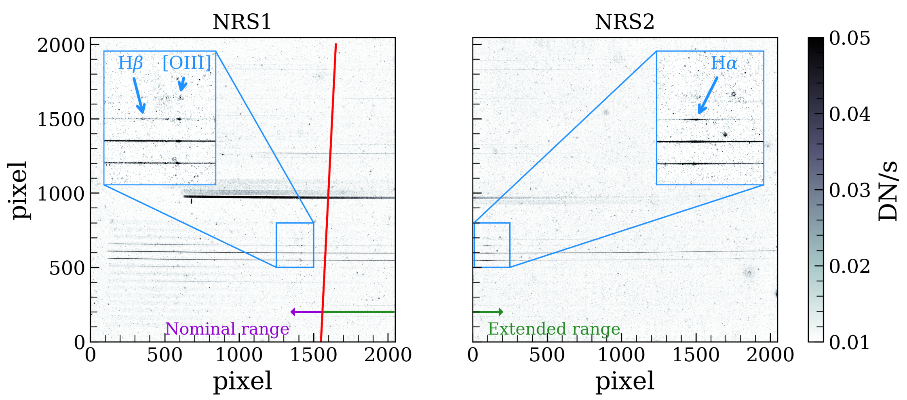
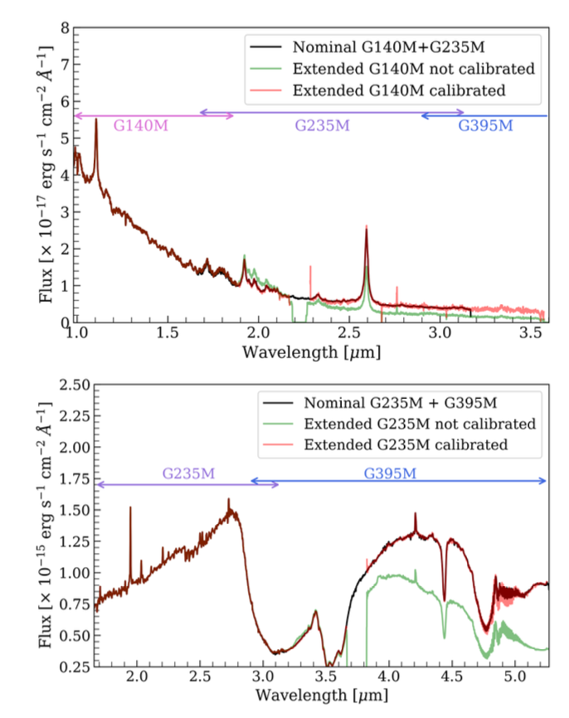
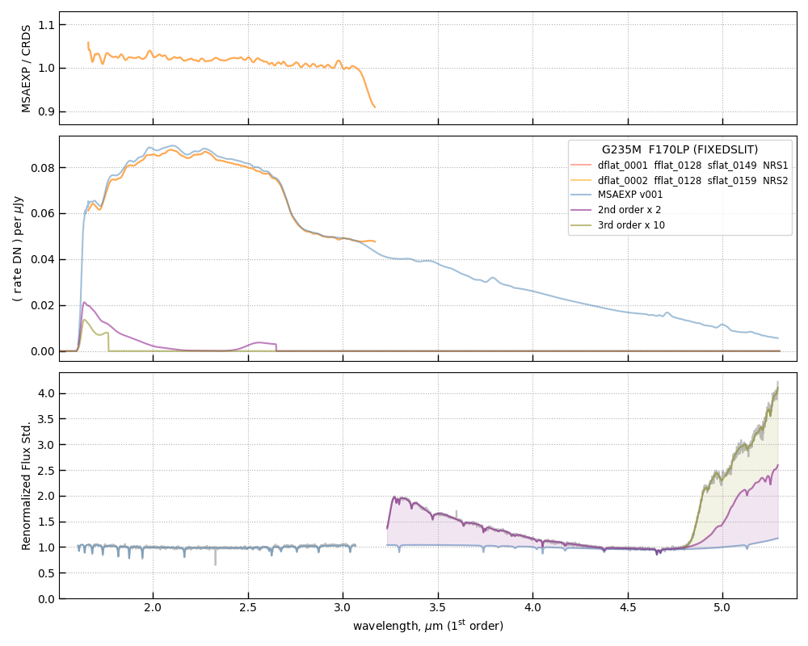
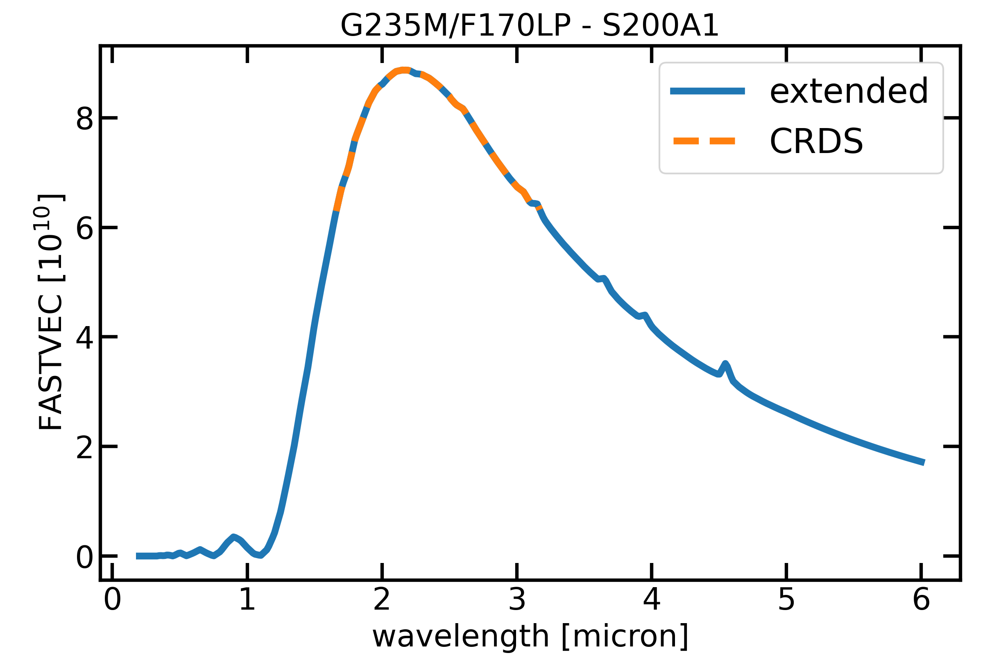

NIRSpec Wavelengh Extension (~doubled for G140M & G235M!)
Eleonora
Parlanti
et al.
Parlanti+
Preliminary
in progress

Slide 21
JWST NIRSpec MOS calibration
EXPANDING THE FRONTIERS OF SPACE ASTRONOMY
Dan Coe
ESA/AURA Astronomer
NIRSpec Instrument Scientist

Slide 22
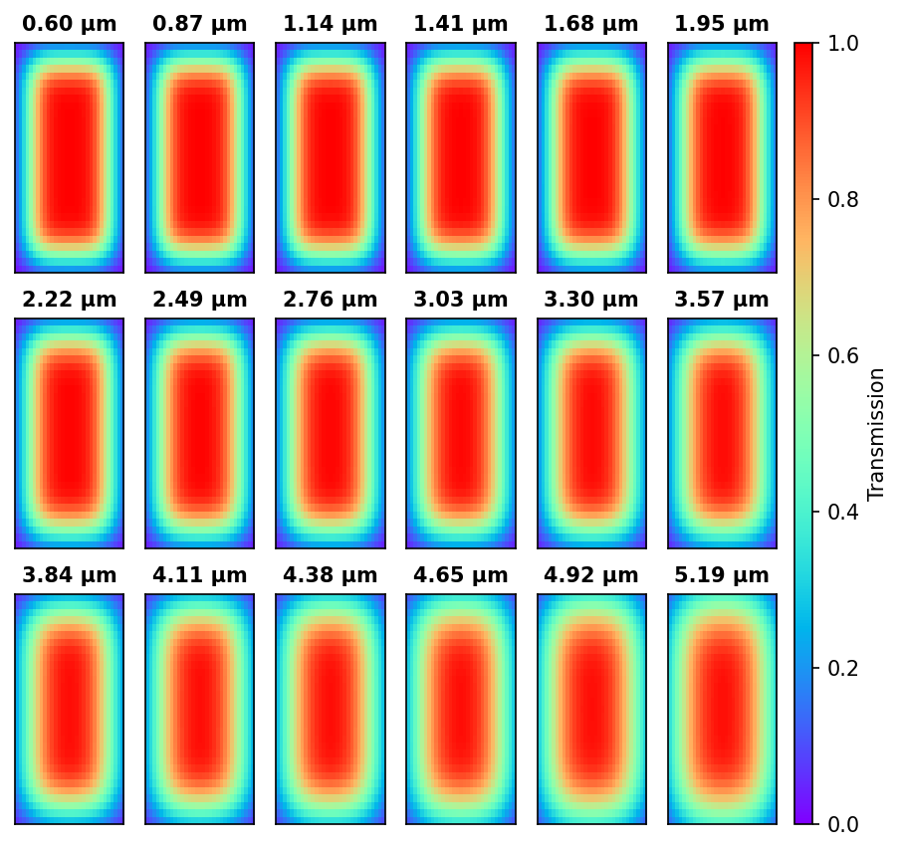
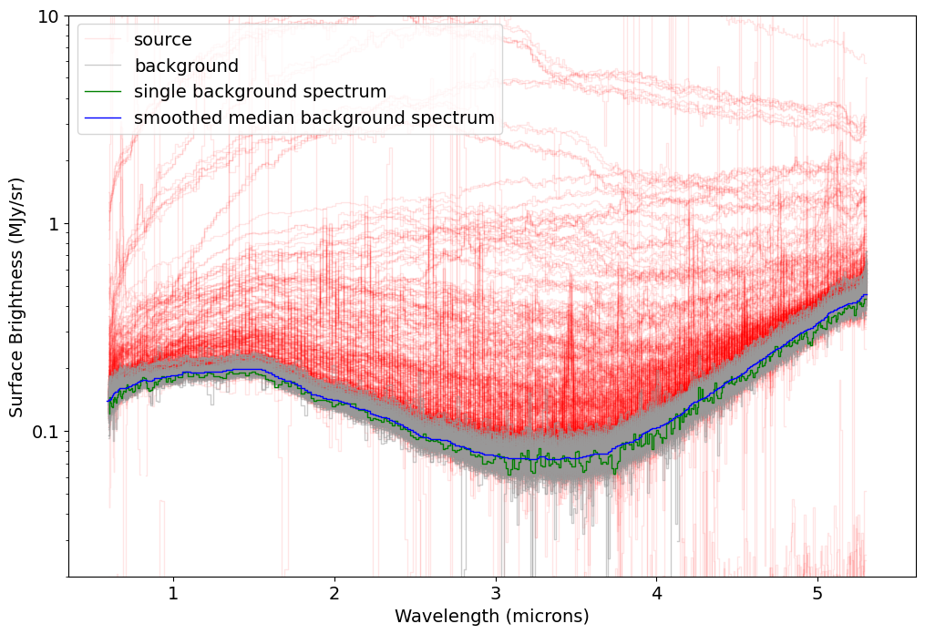
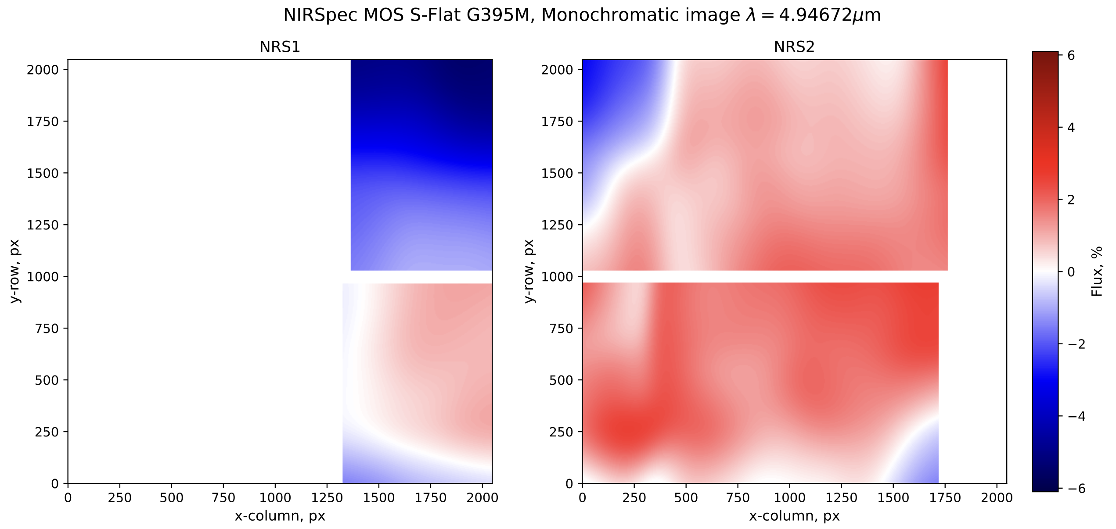
MOS Pathloss
NIRSpec Calibration
JWebbinar #48
next Wed Apr 22
Peter Zeidler
Recent updates:
Flats (MOS, FS, IFU)
Pathloss (MOS, FS)
Background subtraction
IFU “wiggles”
IFU distortion model
In progress:
Wavelength extension
LSF = line spread function
IFU PSF centroid wander
Planned:
PSF-based extraction
IFU S-Flat
IFU wavelength gap – F-flat H-grating

Slide 23

NIRSpec Pathloss

Slide 24
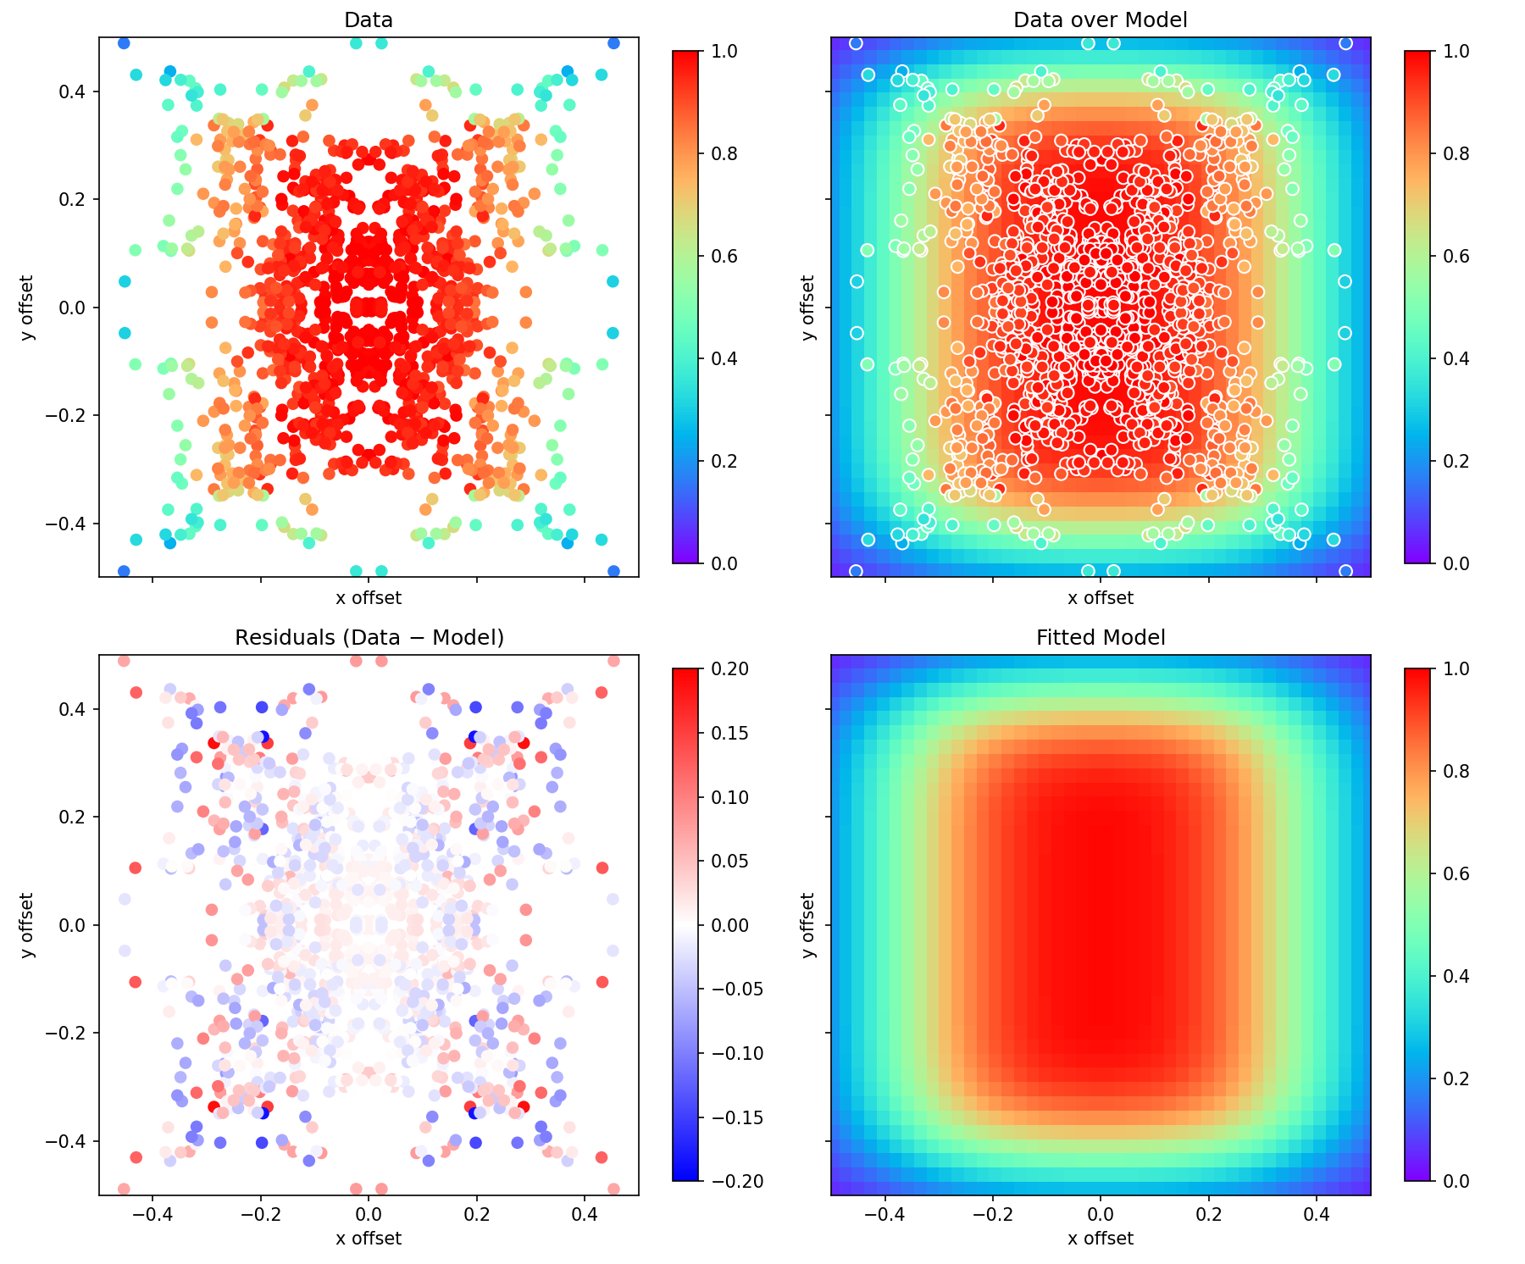
NIRSpec Pathloss
2.95 µm

Slide 25
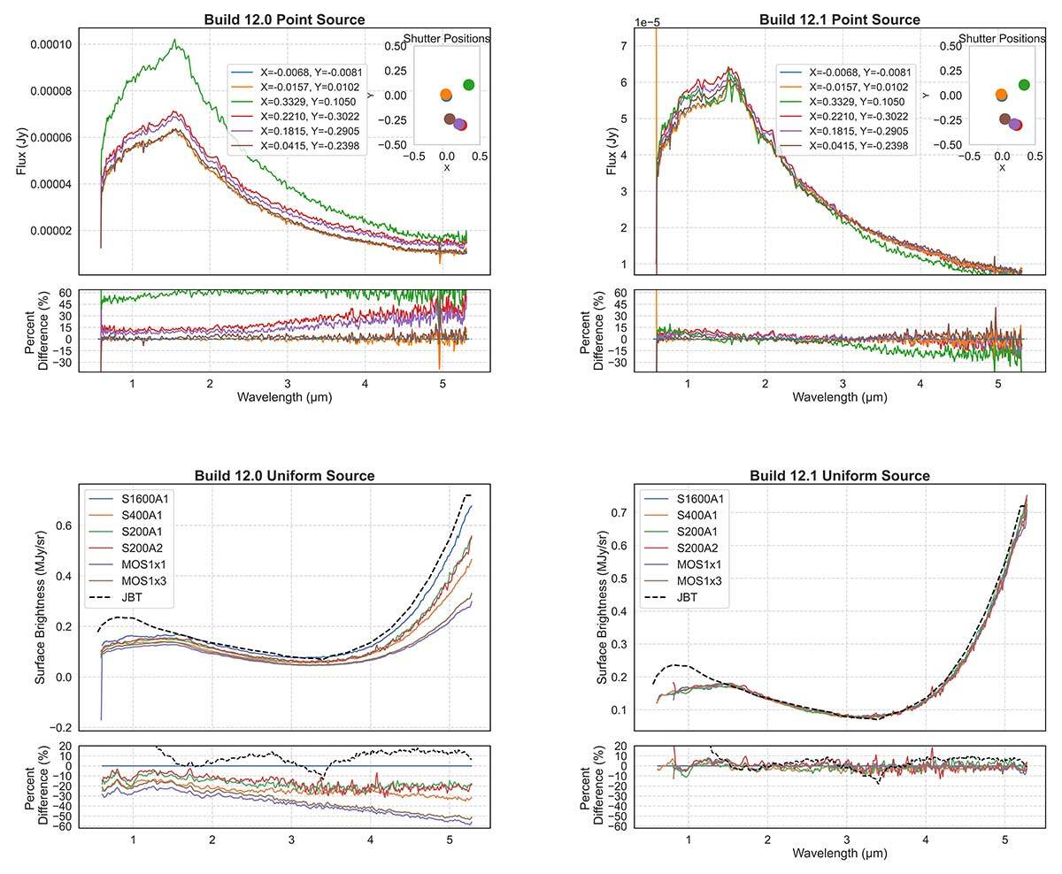
NIRSpec Pathloss
Improvement

Slide 26
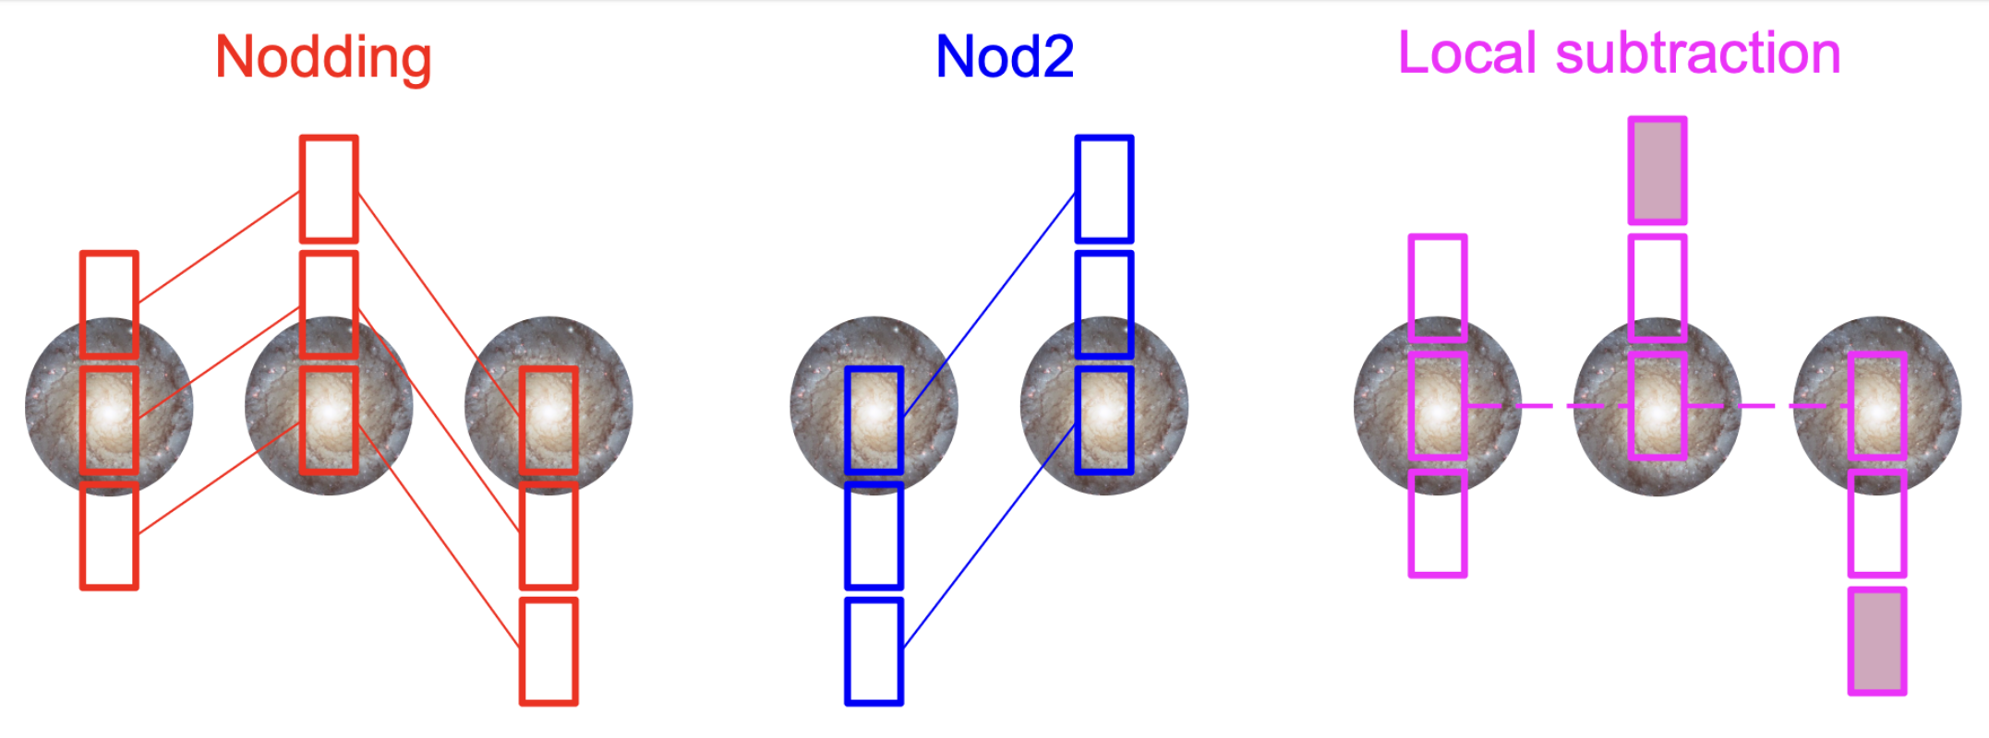
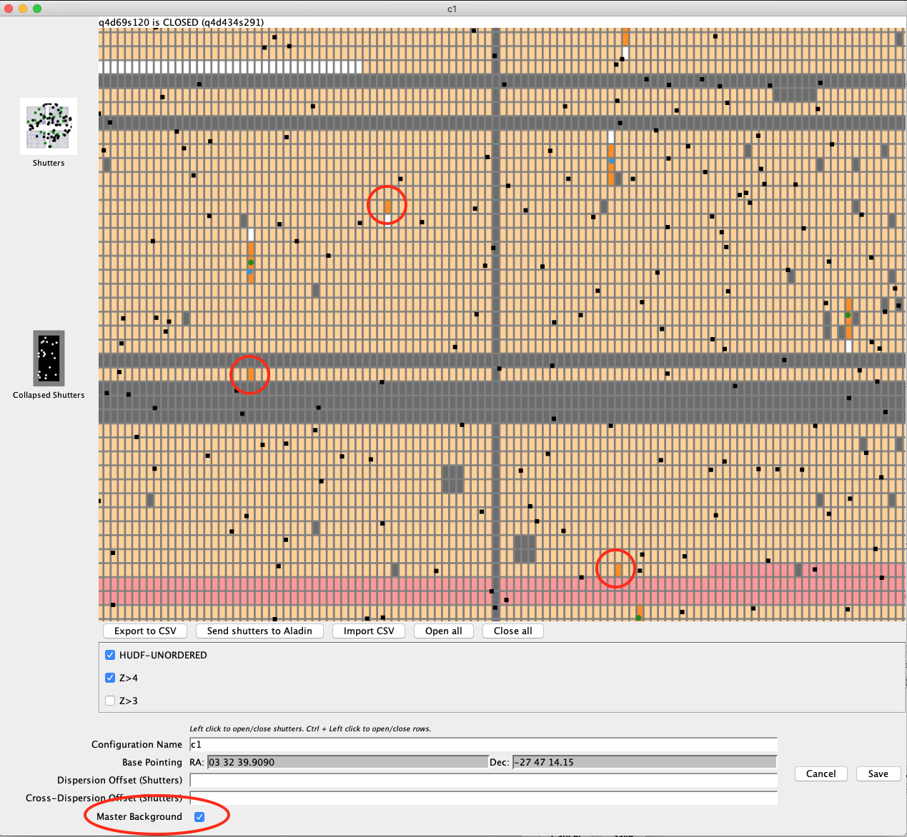
Background measurement & subtraction
median from nearby empty slits
Cataldi et al.
MARTA

Slide 27
Median background measurement improvement
median from nearby empty slits

Slide 28
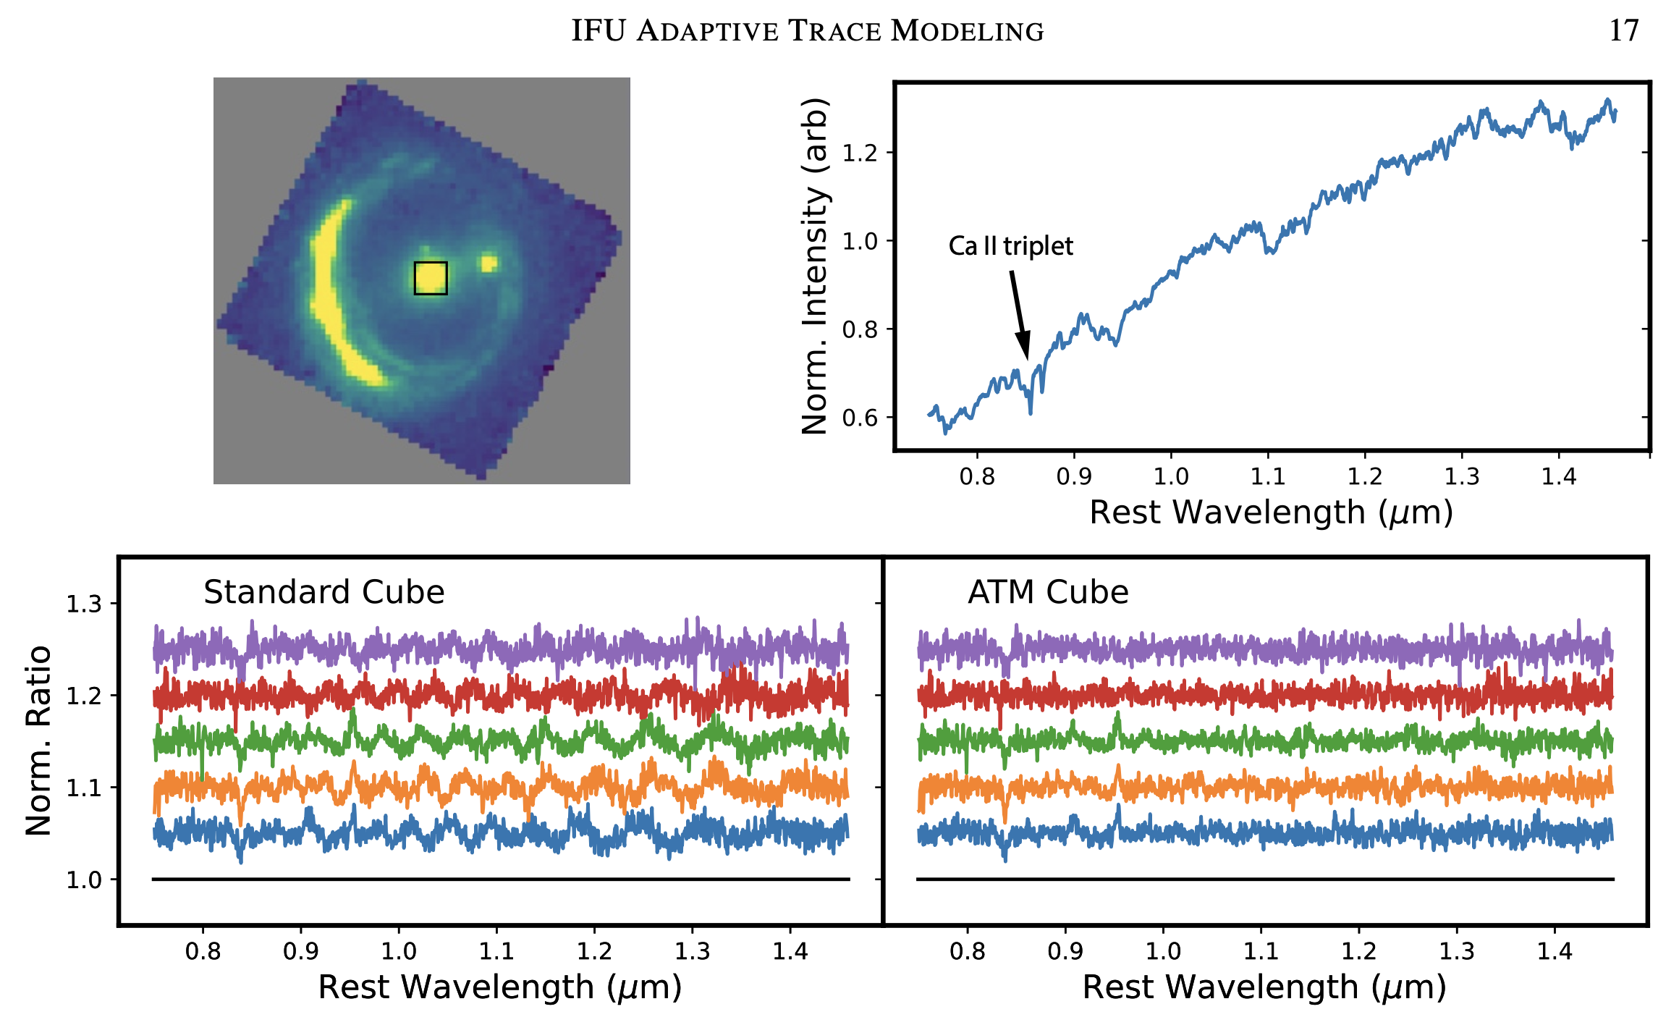
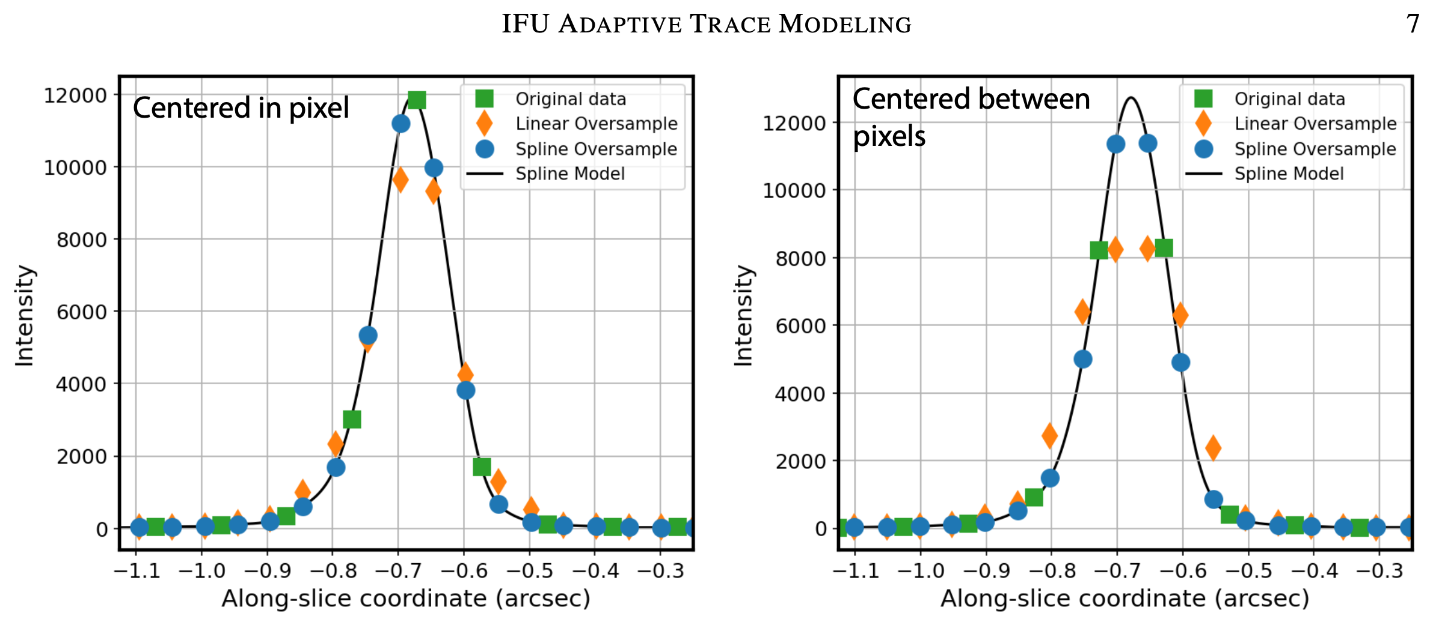
IFU Wiggles Corrected in individual spaxels: NIRSpec MOS, MIRI MRS
IFU Adaptive Trace Model
David Law & Melanie Clarke
(2026) arXiv:2603.2691
Not on by default; reprocess
Requires continuum bright enough
Data
❌ Linear
✅ Spline

Slide 29
JWebbinar #47

Slide 30

JWST Documentation, Help, Notebooks
JDox – JWST Documentation https://jwst-docs.stsci.edu
JWST Help Desk – https://jwsthelp.stsci.edu
JWST Office Hours – https://outerspace.stsci.edu/spaces/JEA/pages/232358818/Webb+Office+Hours
JWebbinars – https://www.stsci.edu/jwst/science-execution/jwebbinars
JWST pipeline (open source; pull requests welcome!)
https://jwst-pipeline.readthedocs.io
JWST pipeline notebooks
https://github.com/spacetelescope/jwst-pipeline-notebooks + outputs = https://spacetelescope.github.io/jwst-pipeline-notebooks
JDAT = JWST Data Analysis Tools
https://github.com/spacetelescope/jdat_notebooks + outputs = https://spacetelescope.github.io/jdat_notebooks
Our high-z community
can organize to
share best practices
(as they do for exoplanets?)

