Slide 1
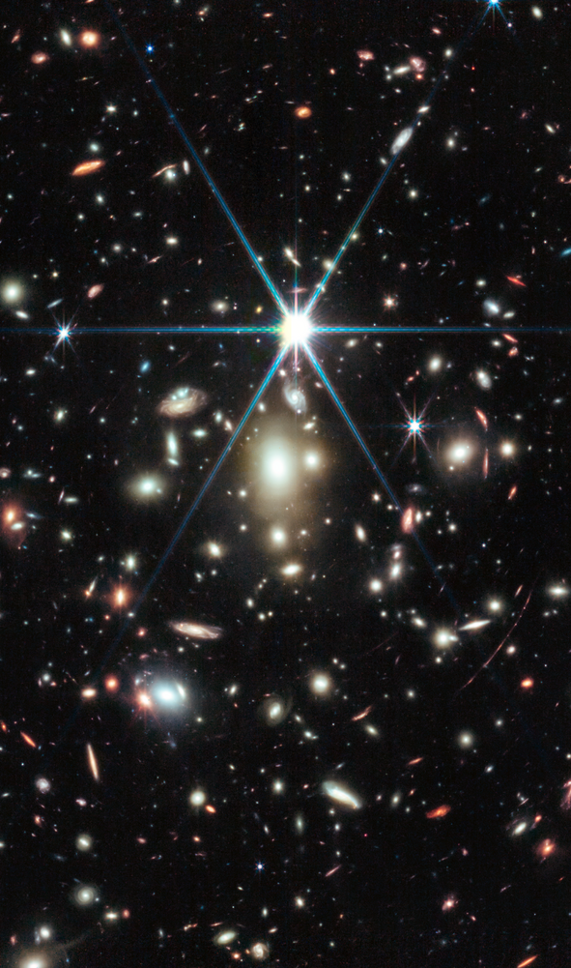
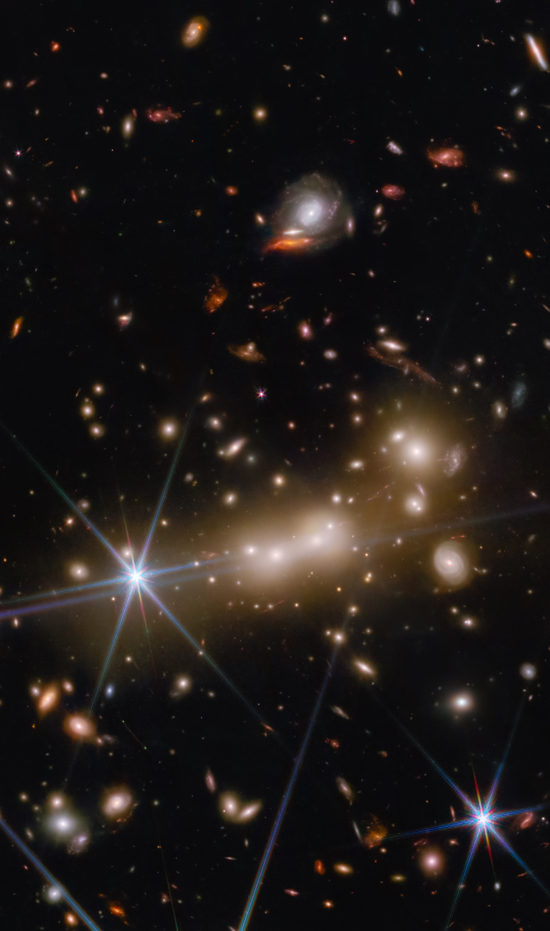
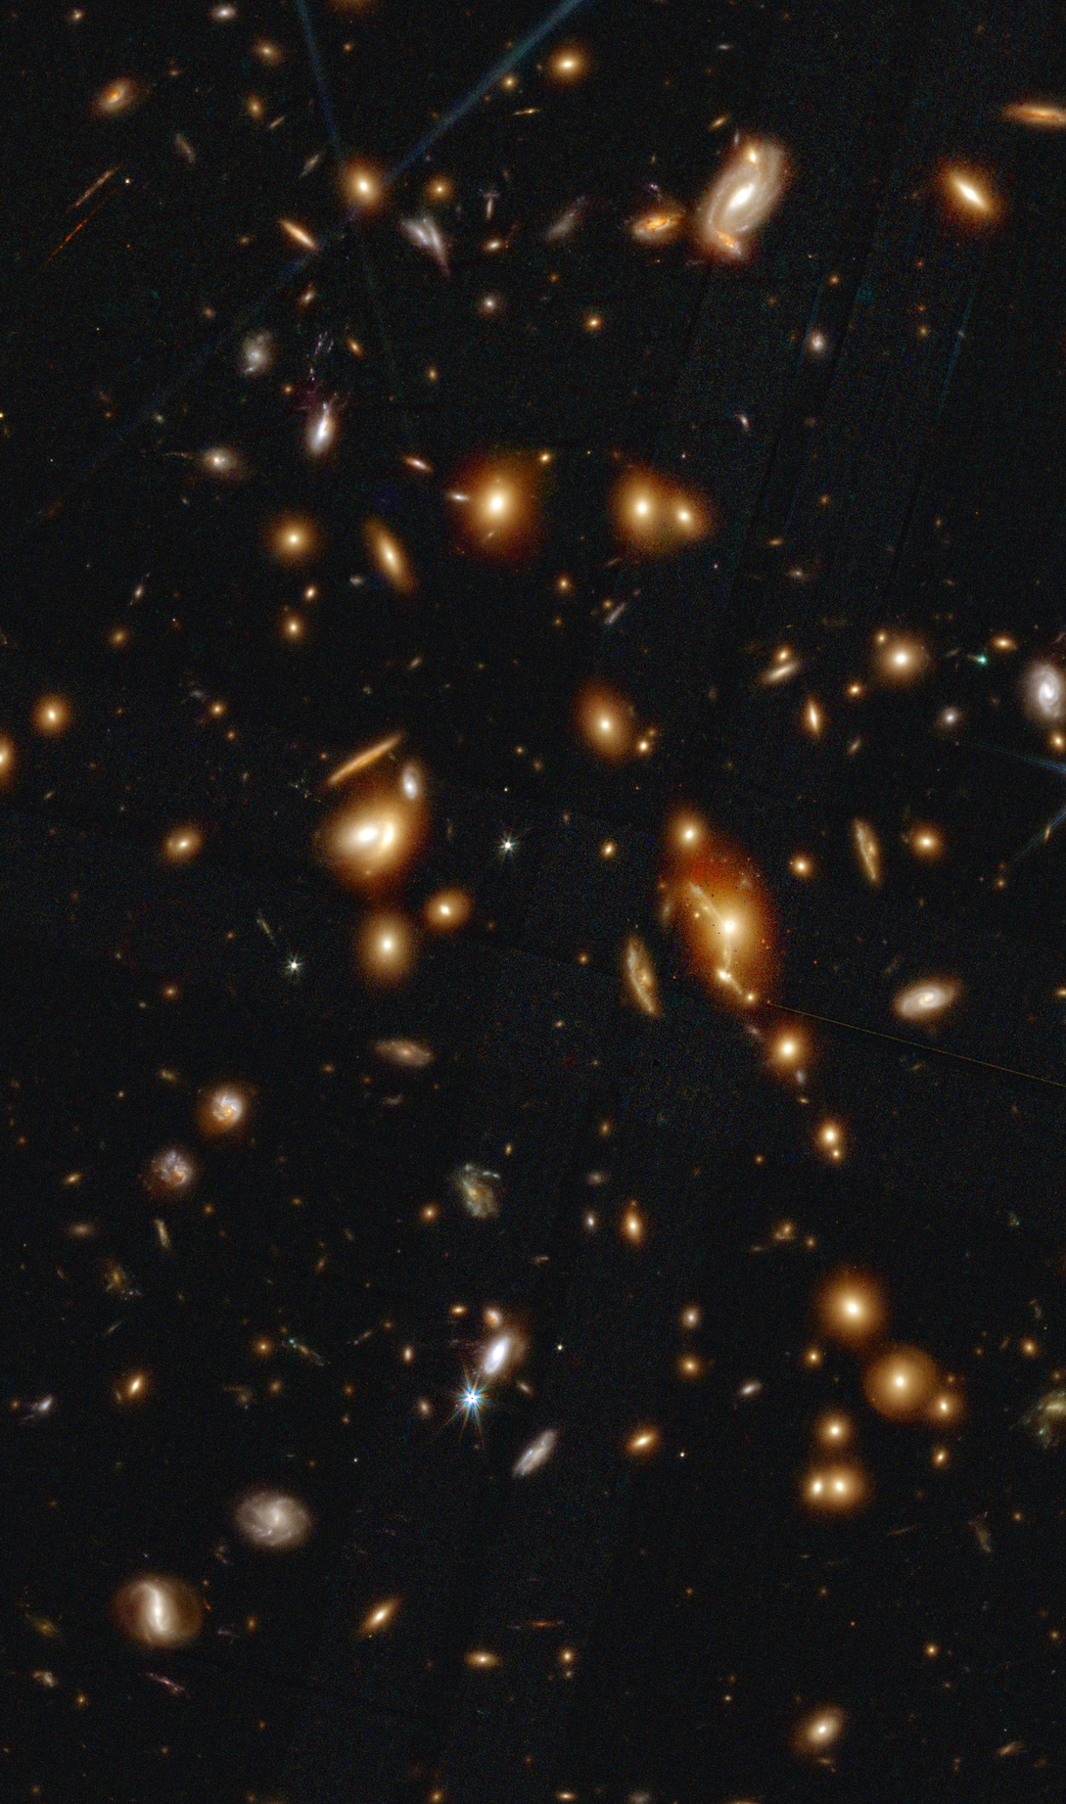
WHL0137 + Sunrise Arc + Earendel
Cycle 1 GO 2282 (PI Coe)
MACS0647–JD
Cycle 1 GO 1433 (PI Coe)
Cycle 2 GO 4246 (PI Abdurro’uf)
Cosmic Gems Arc SPT0615–JD
Cycle 2 GO 4212 (PI Bradley)
Cycle 3 GO 5917 (PI Vanzella)
Image: Zolt Levay
Image: Alyssa Pagan
Image: Dan Coe (Trilogy)

Slide 2
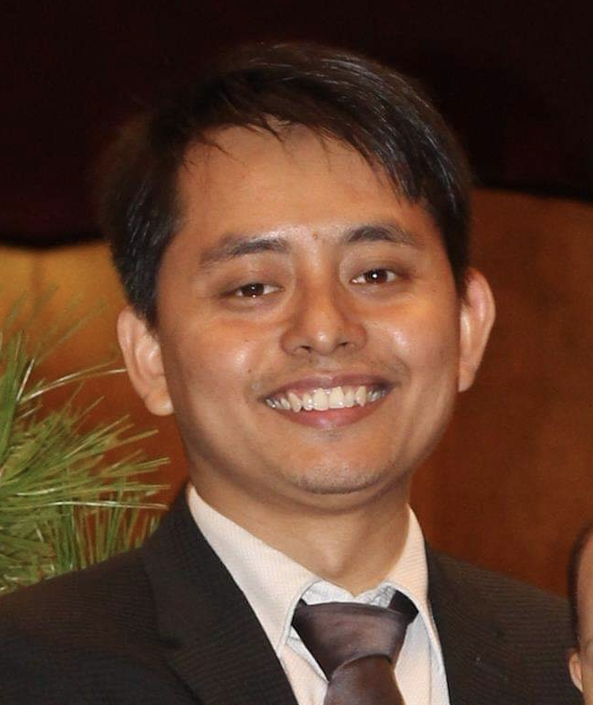
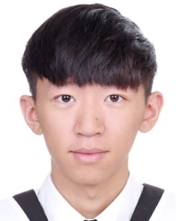
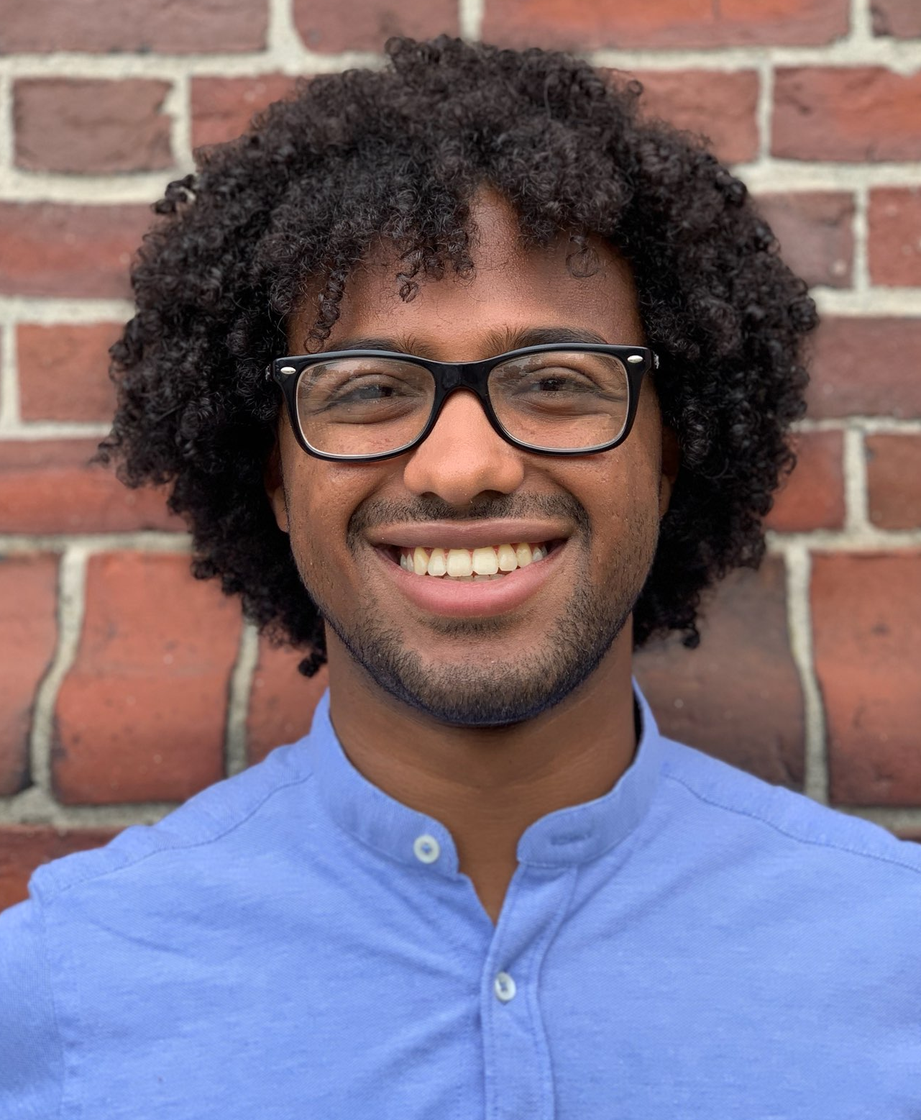
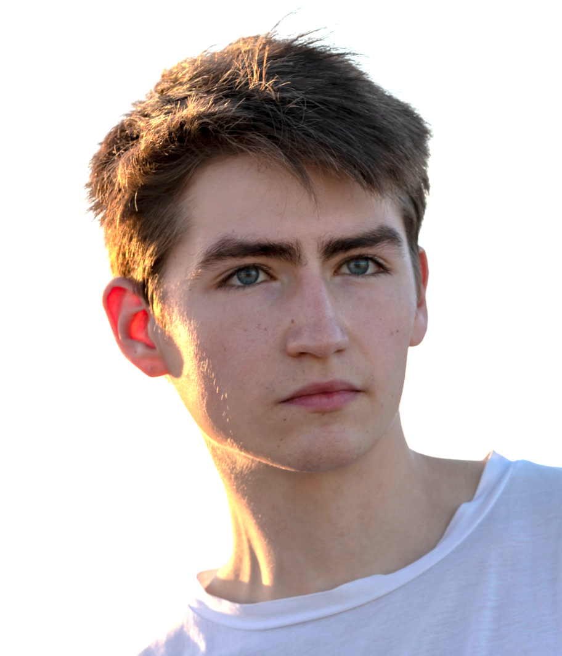
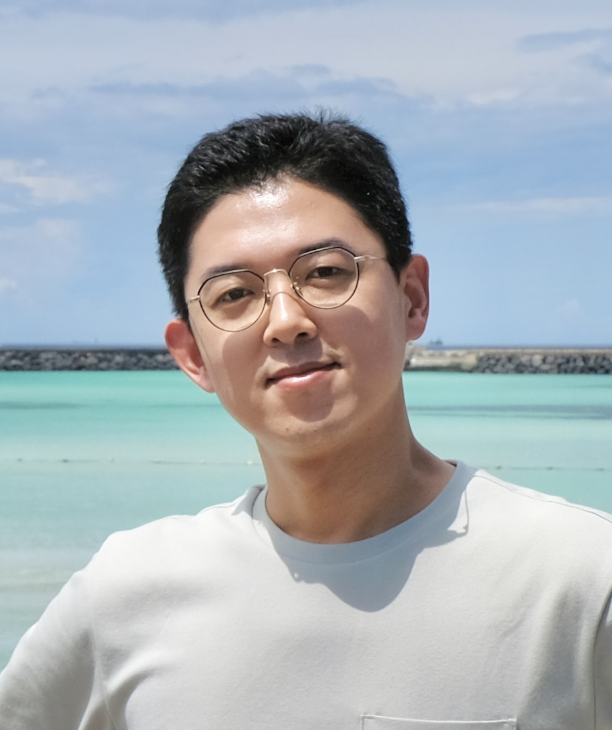
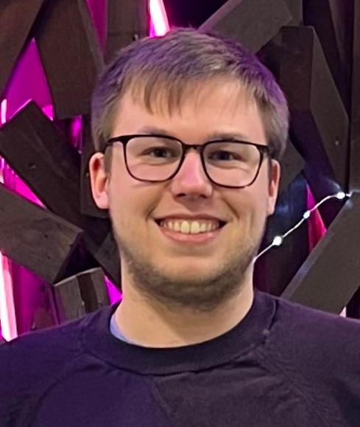
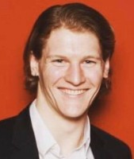

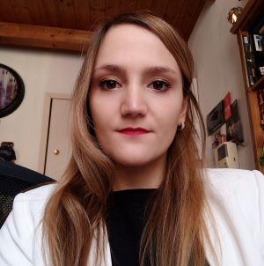
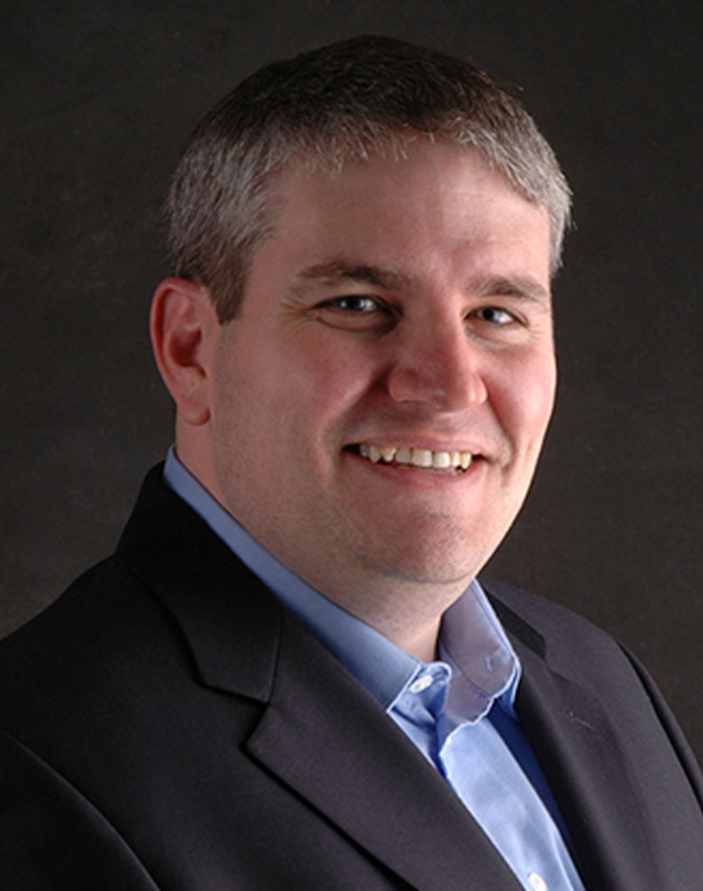
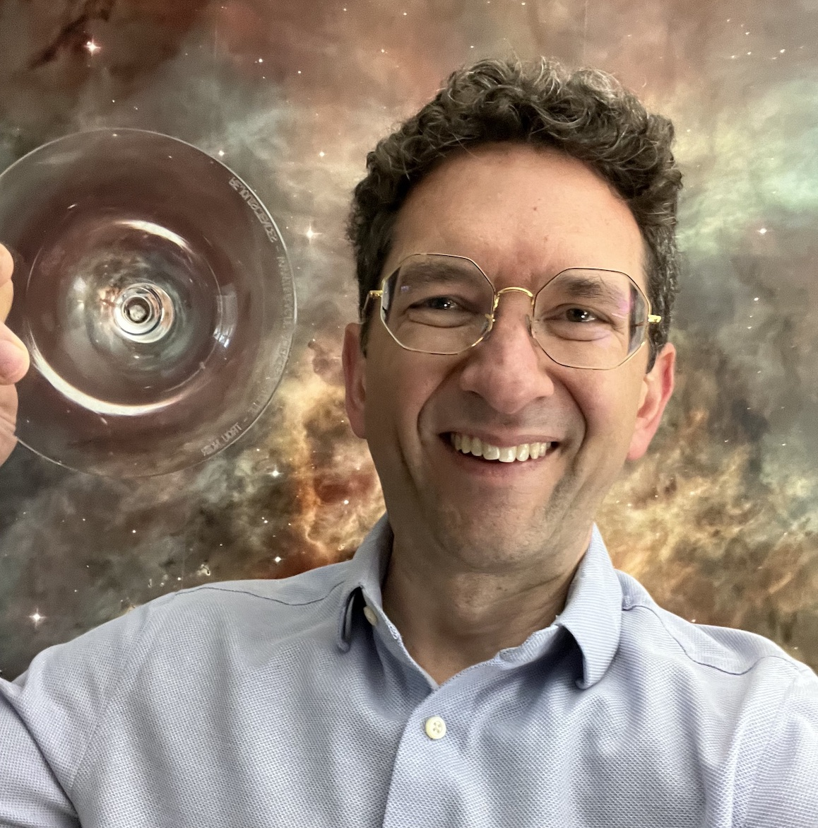
WHL0137 + Sunrise Arc + Earendel
Cycle 1 GO 2282 (PI Coe)
MACS0647–JD
Cycle 1 GO 1433 (PI Coe)
Cycle 2 GO 4246 (PI Abdurro’uf)
Cosmic Gems Arc SPT0615–JD
Cycle 2 GO 4212 (PI Bradley)
Cycle 3 GO 5917 (PI Vanzella)
arXiv | Lead author | Object(s) | Redshift
2208.09007 | Brian Welch | Earendel star | z ~ 6
2210.01777 | Larry Bradley | 12 galaxies | z ~ 9 – 13
2210.14123 | Tiger Hsiao | MACS0647-JD | z ~ 11
2211.09839 | Eros Vanzella | Sunrise Arc | z ~ 6
2211.13334 | Ashish Kumar Meena | lensed star | z ~ 5
2301.02209 | Abdurro’uf | 444 galaxies | z = 0.3 – 6
2305.03042 | Tiger Hsiao | MACS0647-JD | z = 10.17
2308.00042 | Lukas Furtak | lensed star | z = 4.76
2309.02504 | Anton Vikaeus | Balmer breaks | z ~ 6 – 11
2312.03065 | Meghana Killi | AGN | z = 4.53
2401.03224 | Angela Adamo | Cosmic Gems | z ~ 10
2404.10770 | Larry Bradley | Cosmic Gems | z ~ 10
2404.16201 | Abdurro’uf | MACS0647-JD | z = 10.17
2404.16200 | Tiger Hsiao | MACS0647-JD | z = 10.17
Abdurro’uf
JHU
Tiger Hsiao
JHU
Keduse Worku
JHU
Tom Resseguier
JHU
Intae Jung
STScI
Calum Hawcroft
STScI
Brian Welch
GSFC
Taylor Hutchison
GSFC
also including locally:
Bethan James
Jinmi Yoon
Massimo Ricotti (UMD)
Steve McCandliss
Jay Anderson
Sebastian Gomez
Justin Pierel
Alaina Henry
Nimisha Kumari
Meredith Joyce
Namrata Roy
Valentina Abril Melgarejo
Marc Postman
Colin Norman
Lou Strolger
Susan Kassin
Nor Pirzkal
Russel Ryan
David Law
Svea Hernandez
Amanda Pagul
(add your name here)
Cosmic Spring
cosmic-spring.github.io
Matilde Mingozzi
STScI
Larry Bradley
STScI
Dan Coe
STScI
Jan 17, 2024
Dan Coe – STScI – CoolSci mixer

