Slide 1
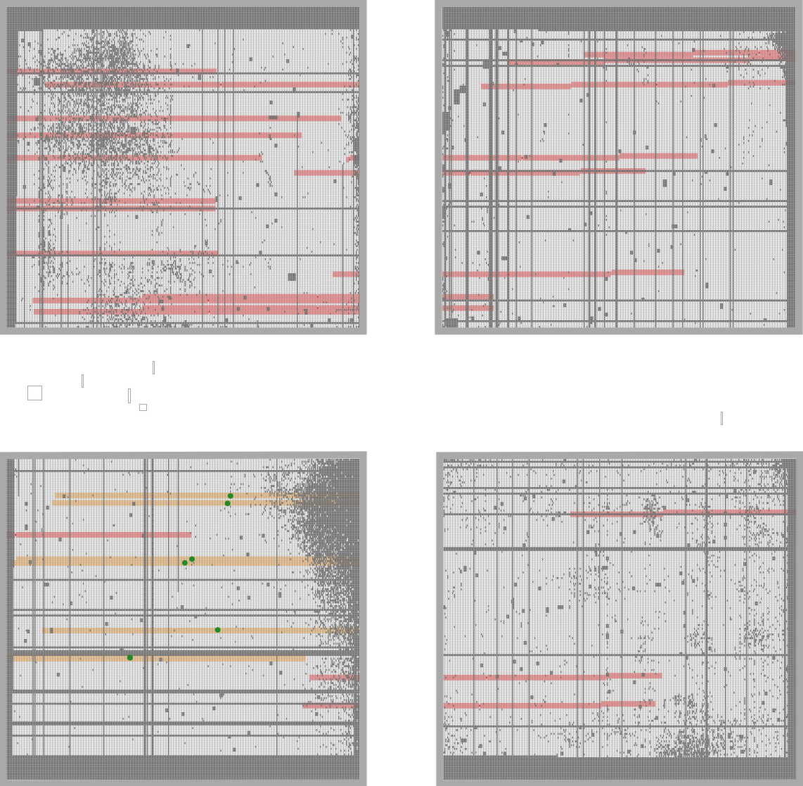
Can’t shift detectors over to capture 5.3µm
or we’d pick up the star!
I suppose JD1 would be fine
and at z = 10.17, you only need to get out to 4.848 µm
to capture Hgamma 4340Å
But then what about 15a 3533 z ~ 11…
you could still get the other lines …
though it is fainter and Hgamma is one of the stronger lines
Too bad I guess…
It’s worth it to get more targets in the other module!
JD2c 3314
5.3µm
JD2a 33491
JD1a 35931
JD1c 3621
15a 3533 z ~ 11?
41050
41053

Slide 2
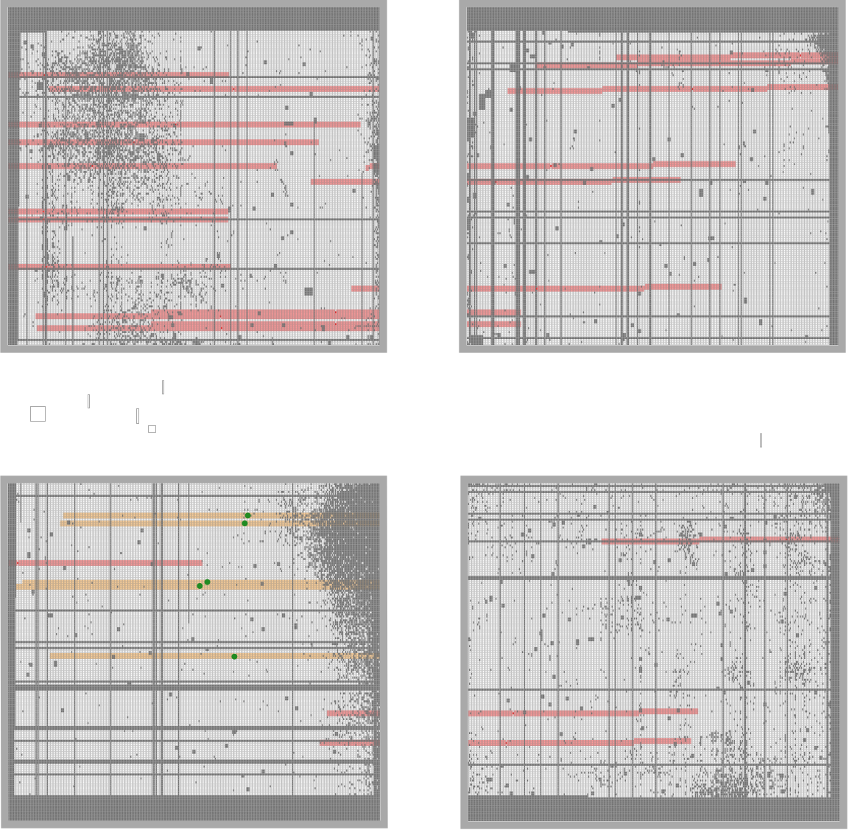
Can’t shift detectors over to capture 5.3µm
or we’d pick up the star!
I suppose JD1 would be fine
and at z = 10.17, you only need to get out to 4.848 µm
to capture Hgamma 4340Å
But then what about 15a 3533 z ~ 11…
you could still get the other lines …
though it is fainter and Hgamma is one of the stronger lines
Too bad I guess…
It’s worth it to get more targets in the other module!
JD2c 3314
5.3µm
JD2a 33491
JD1a 35931
JD1c 3621
15a 3533 z ~ 11?

Slide 3
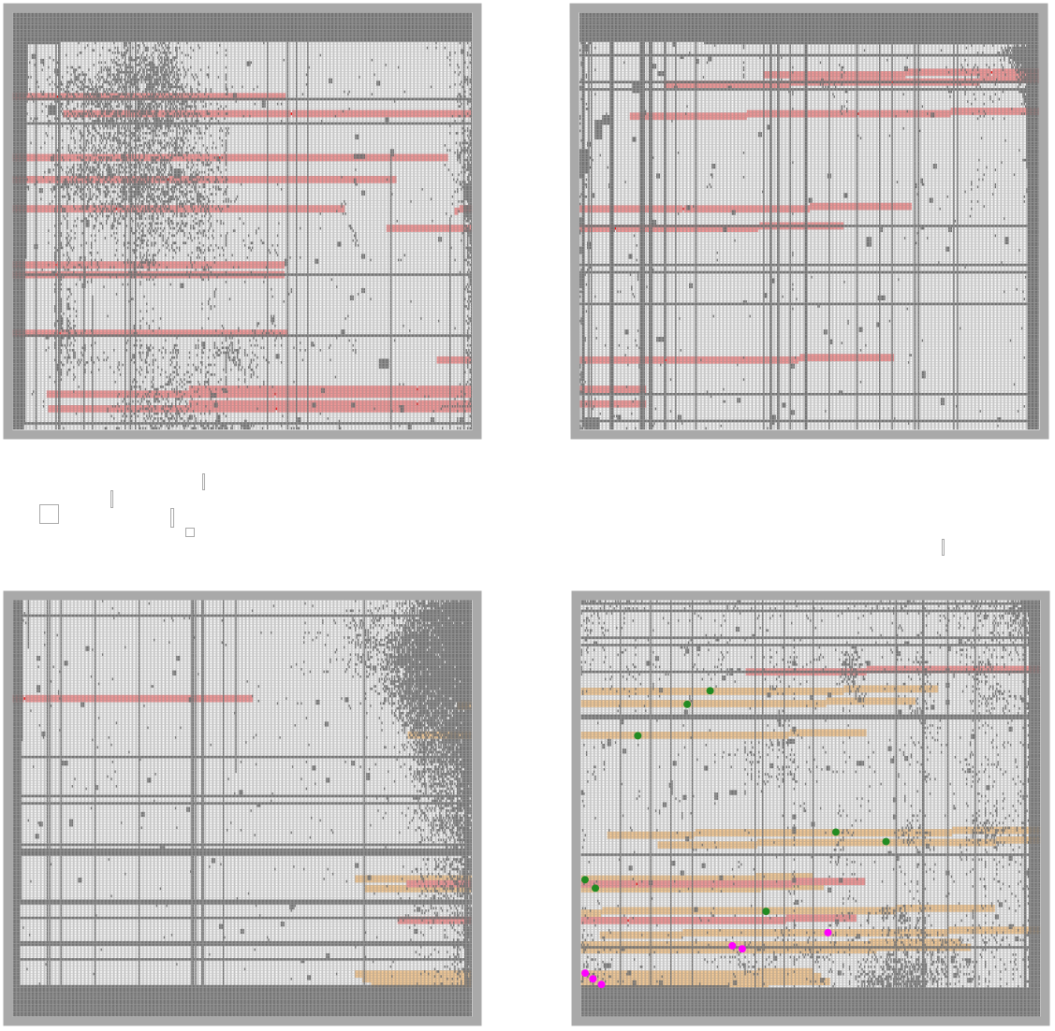
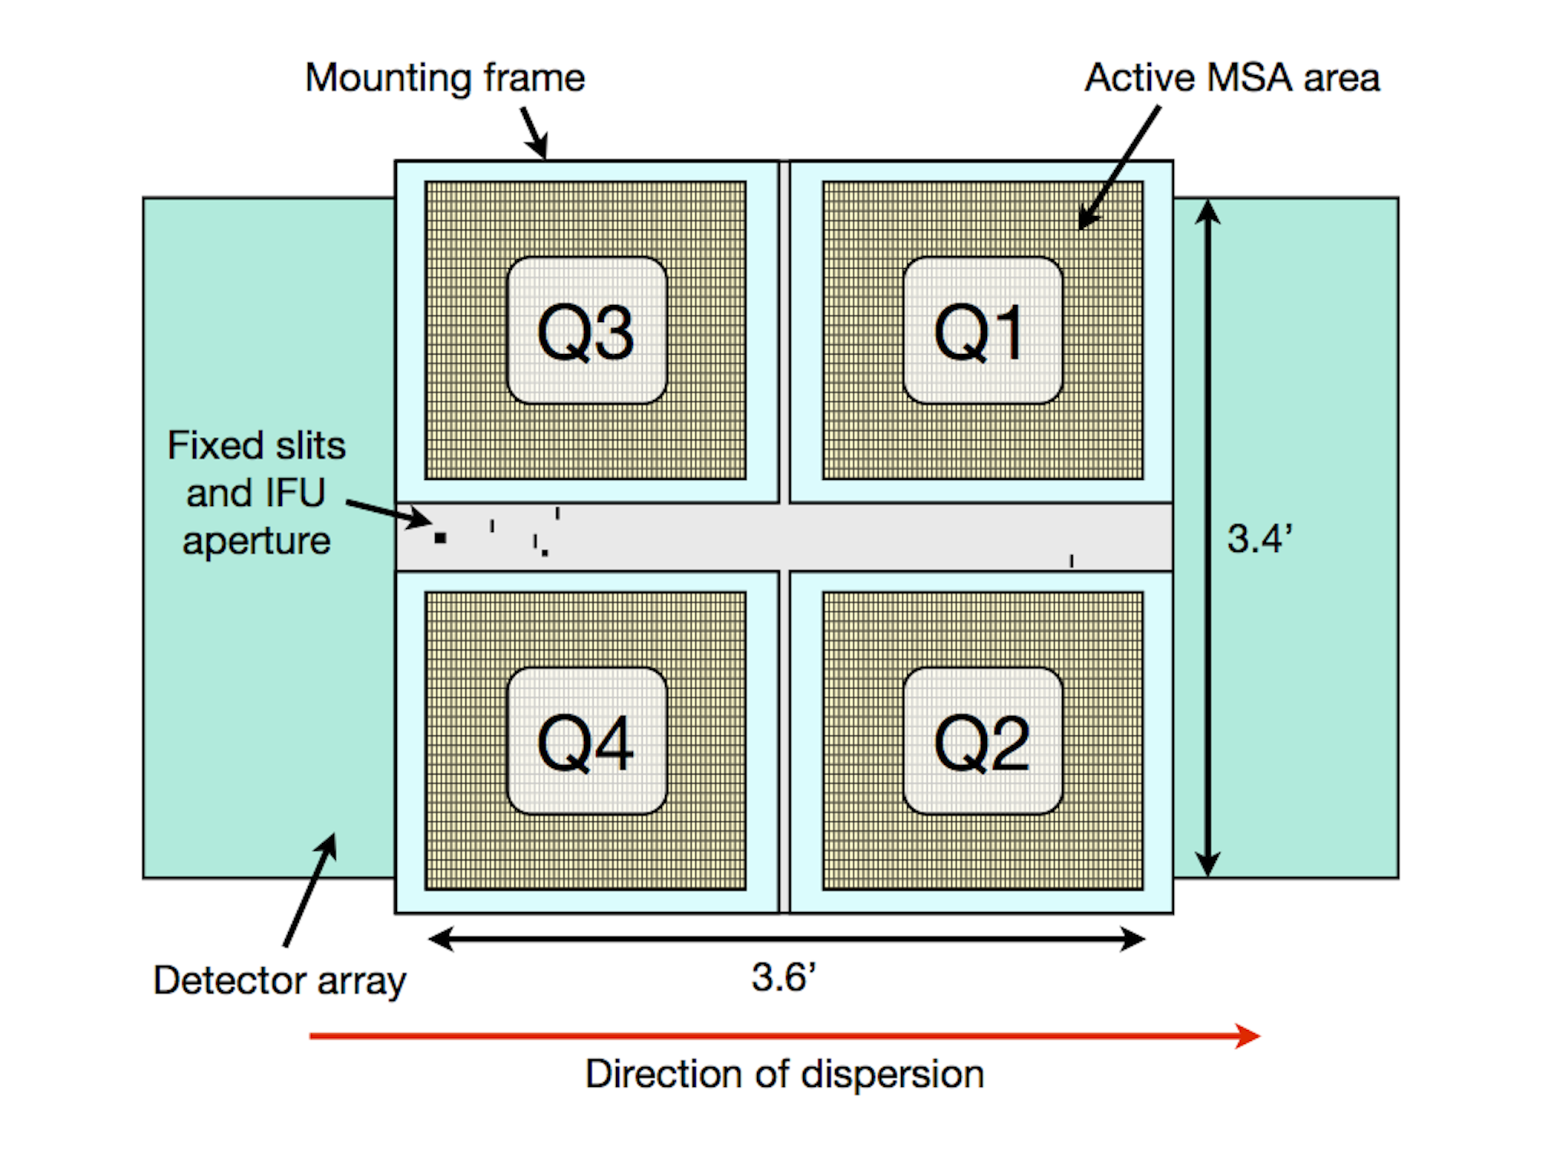
center Q2_2
JD1c
JD2c
JD1
JD2

Slide 4
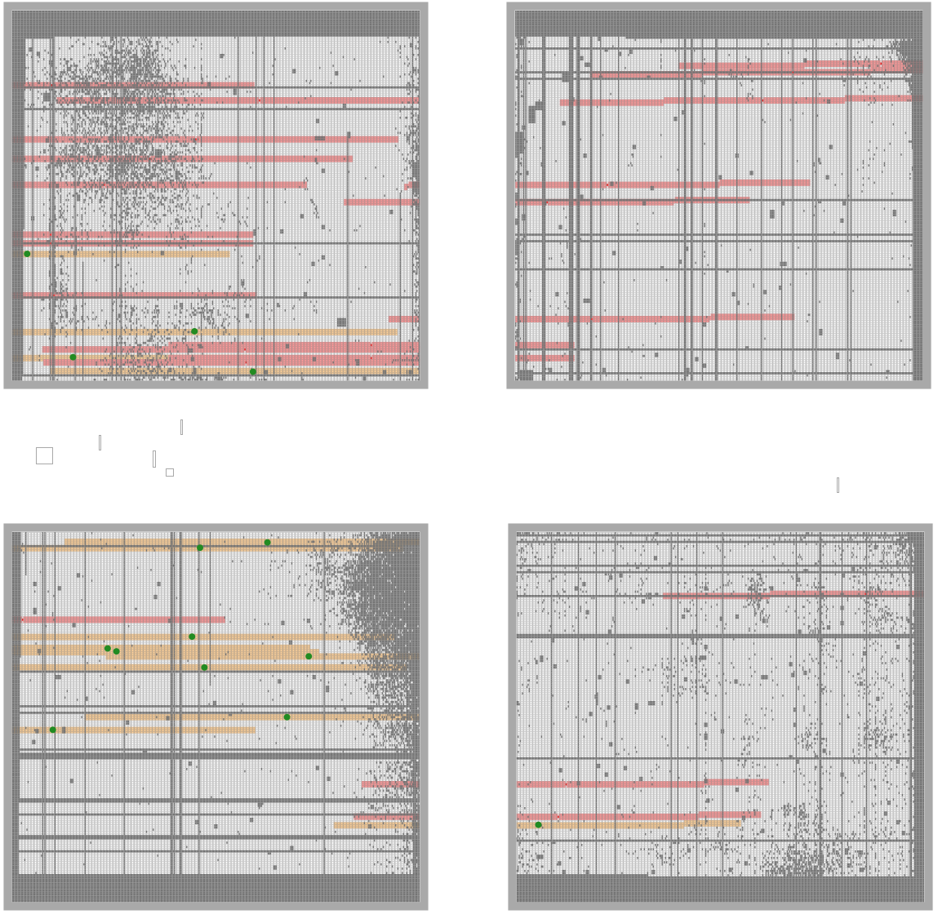
JD1c
JD2c
JD2
down left red Q4
NAILS it – JD2 and JD2c just within red edge
JD1

Slide 5
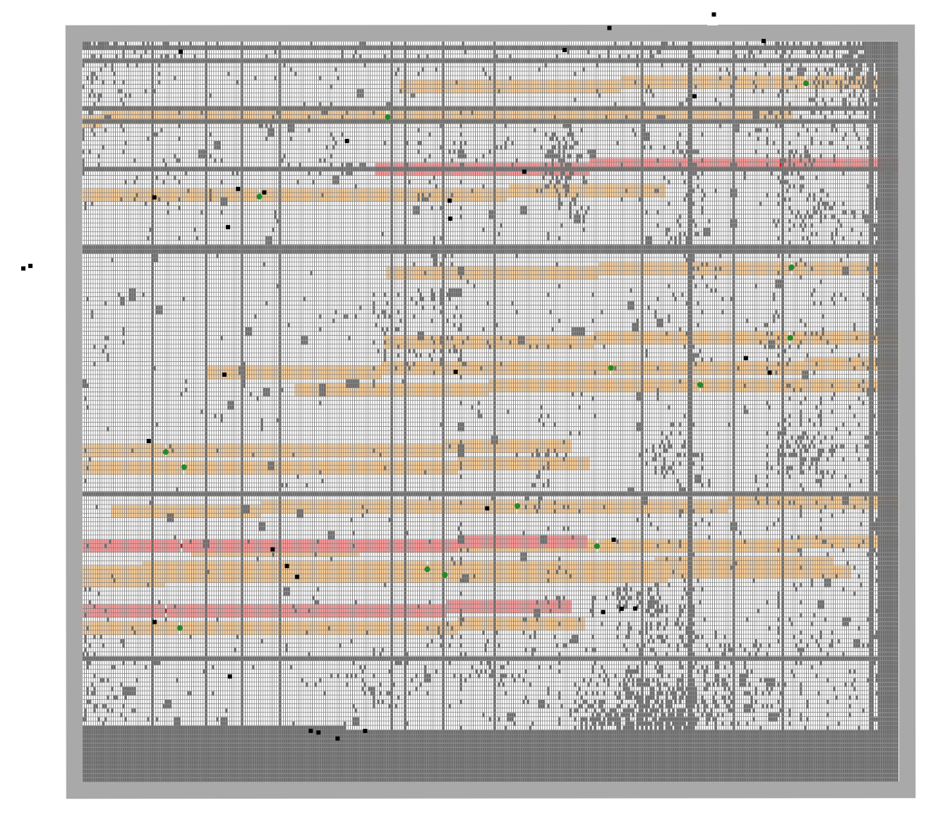
JD2
JD1c
5.3µm
JD1

Slide 6
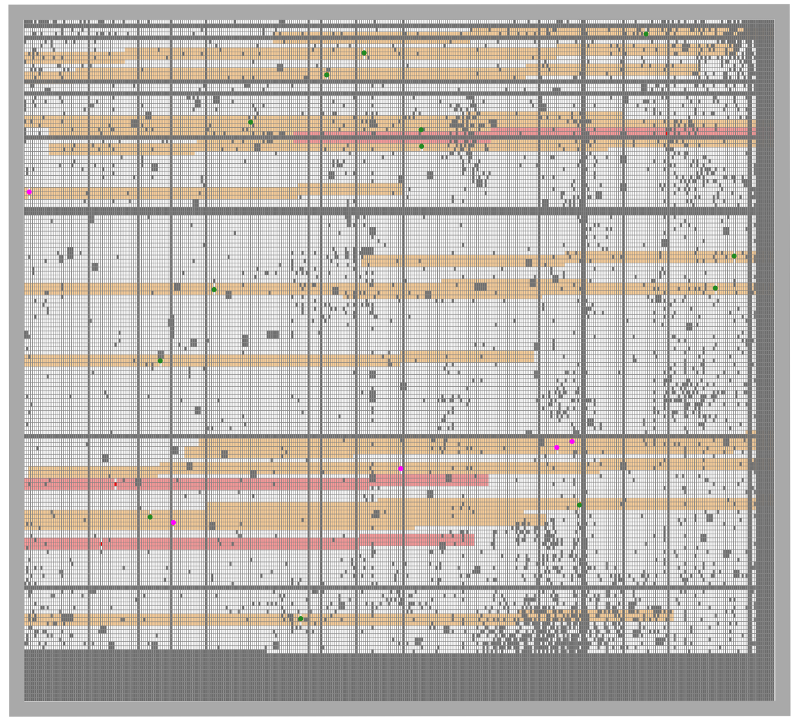
up right
This is why we can’t have nice things
actually this missed JD1
JD3
JD2c
JD1c
JD2
z=5 star

Slide 7
https://jwst-docs.stsci.edu/jwst-near-infrared-spectrograph/nirspec-observing-modes/nirspec-multi-object-spectroscopy

Slide 8
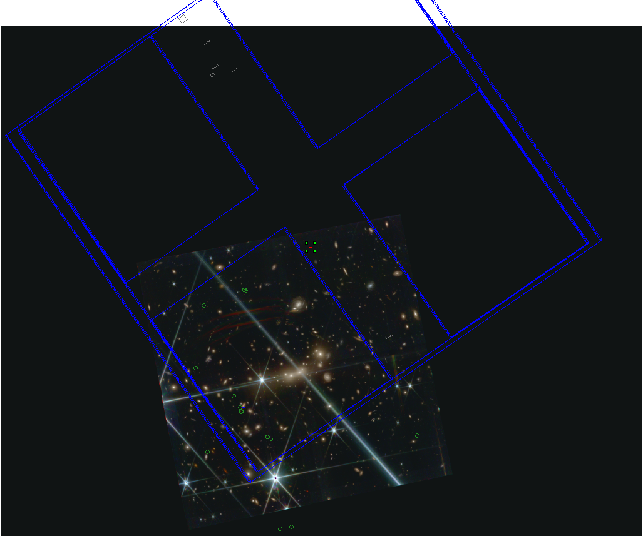

Slide 9
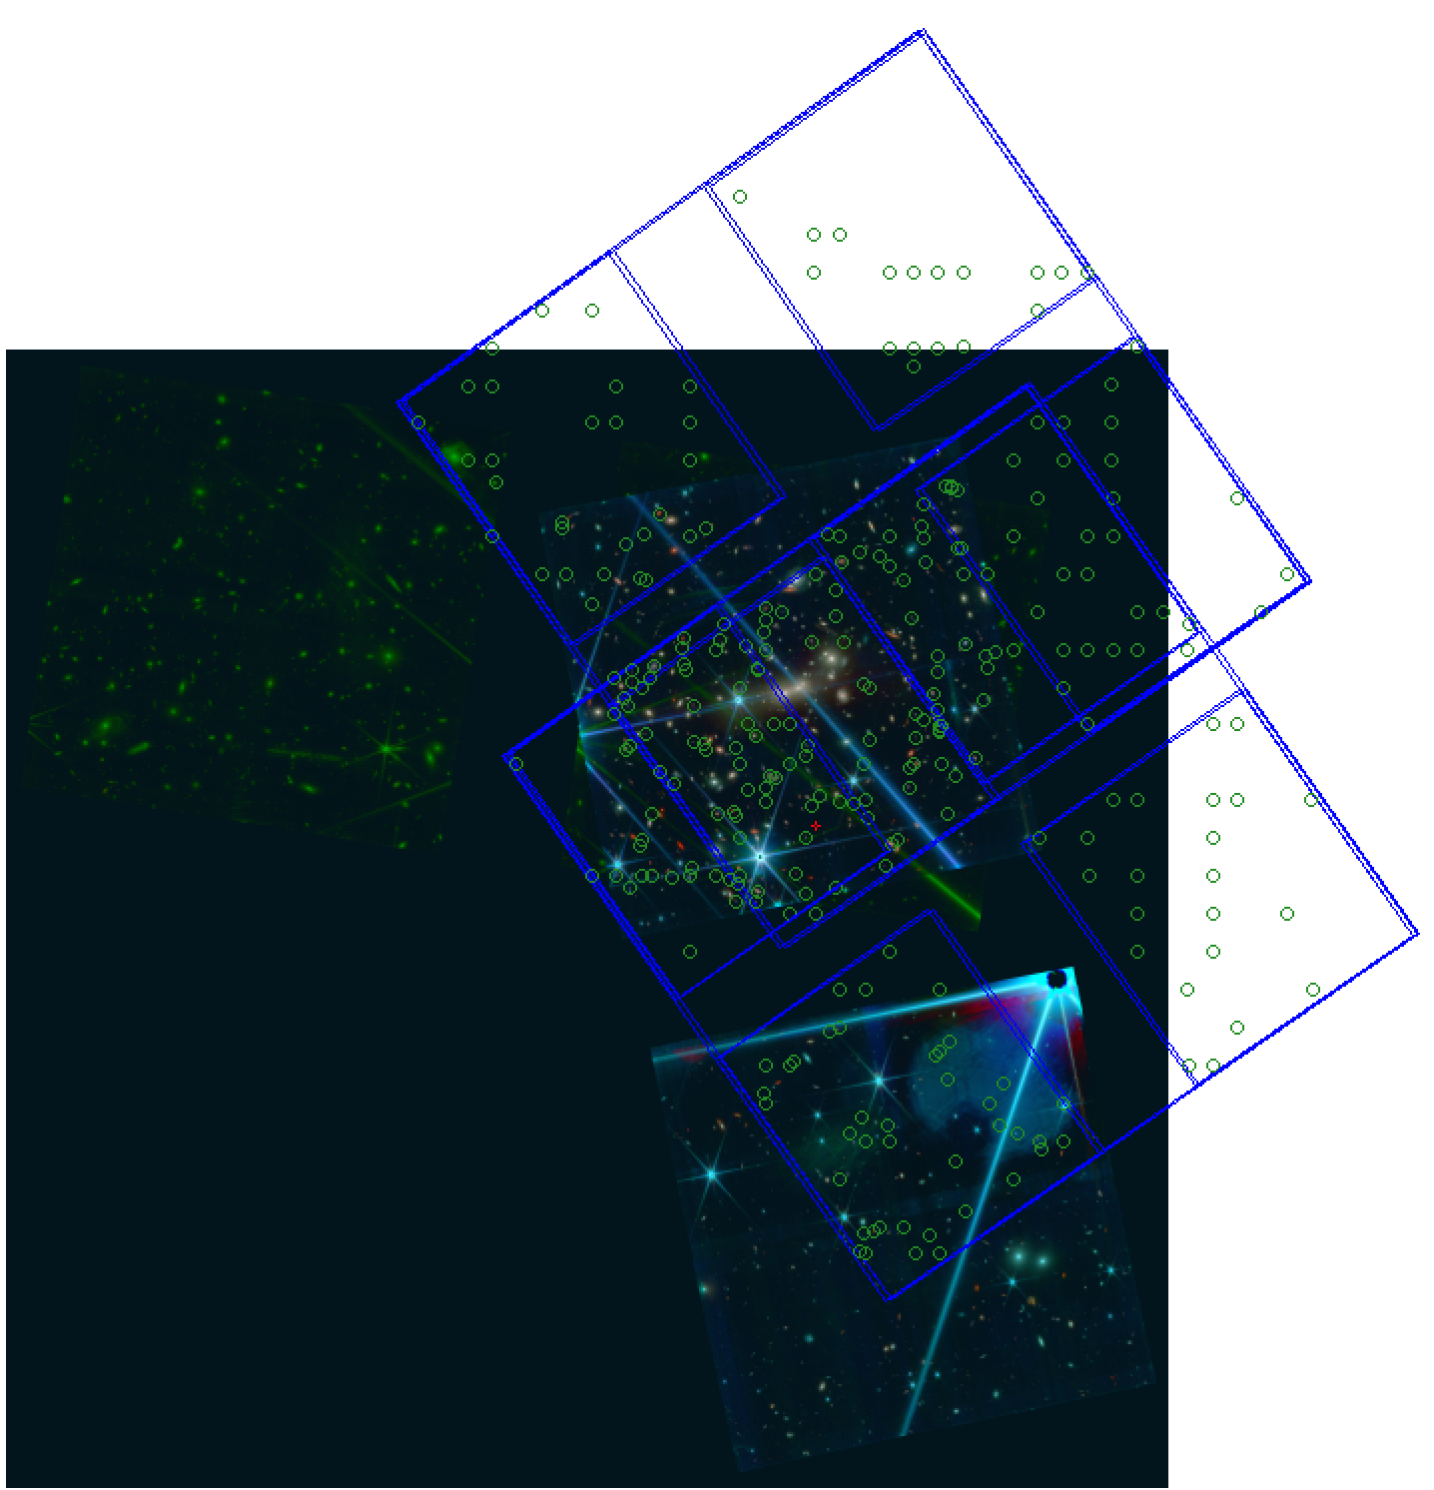
This WAS the plan…
Obs 21
Obs 22

Slide 10
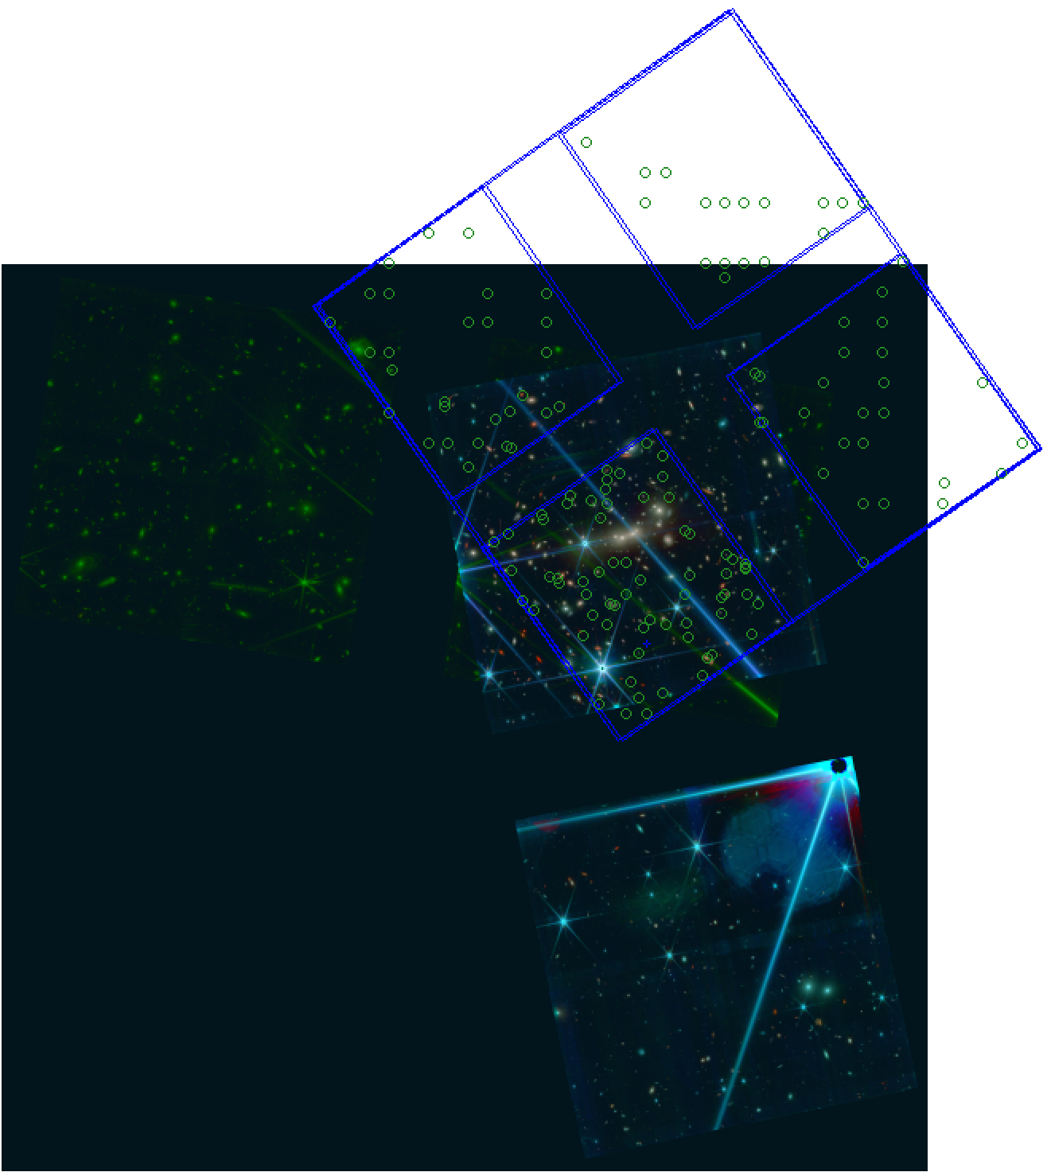
This is what we got
Obs 21
Obs 22

Slide 11
GO 1433
MACS0647
Obs 21

Slide 12
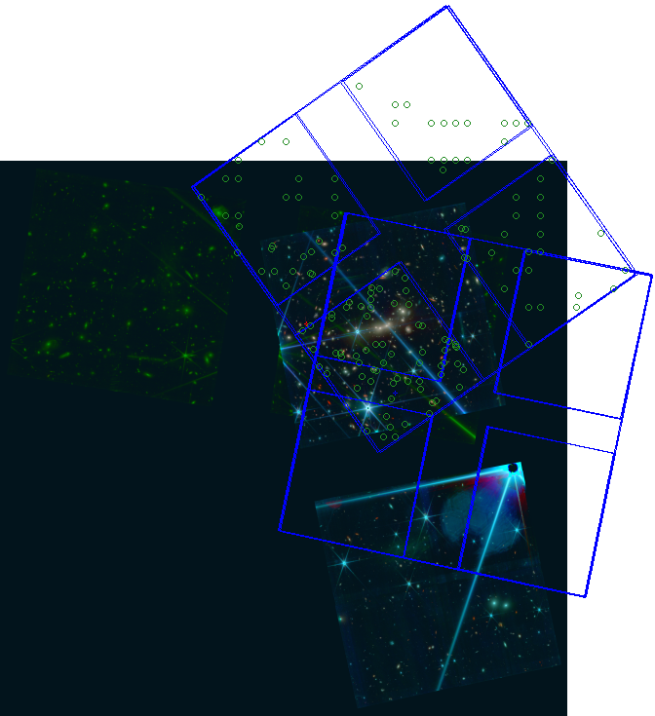
Now we’ll get something like this
APA = 305.0601197
APA = 258.1712197

Slide 13
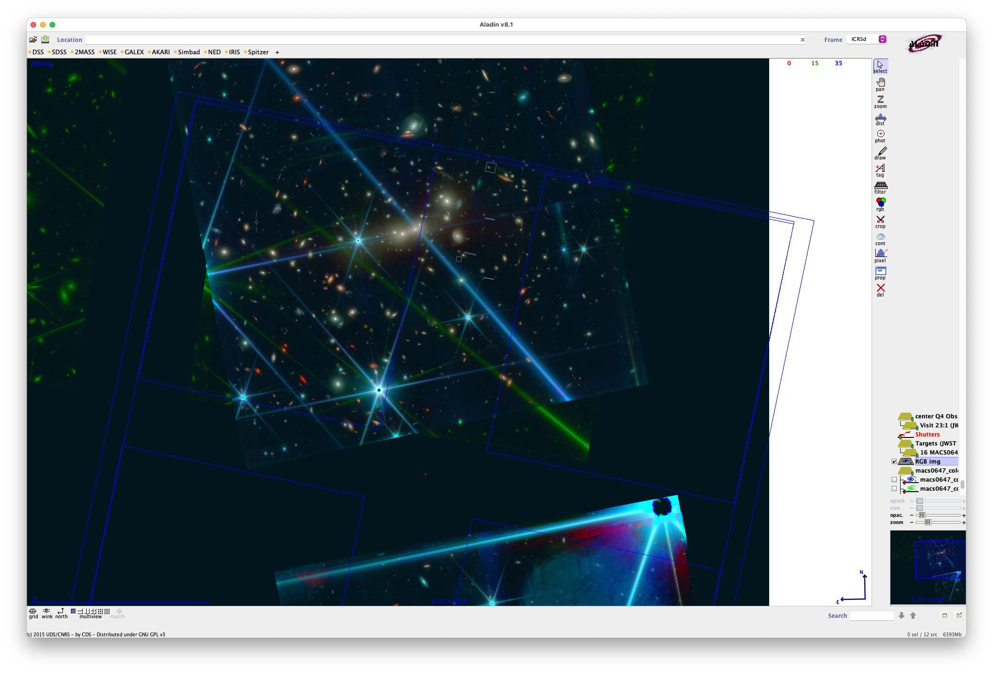
0.7µm
5.3µm

Slide 14
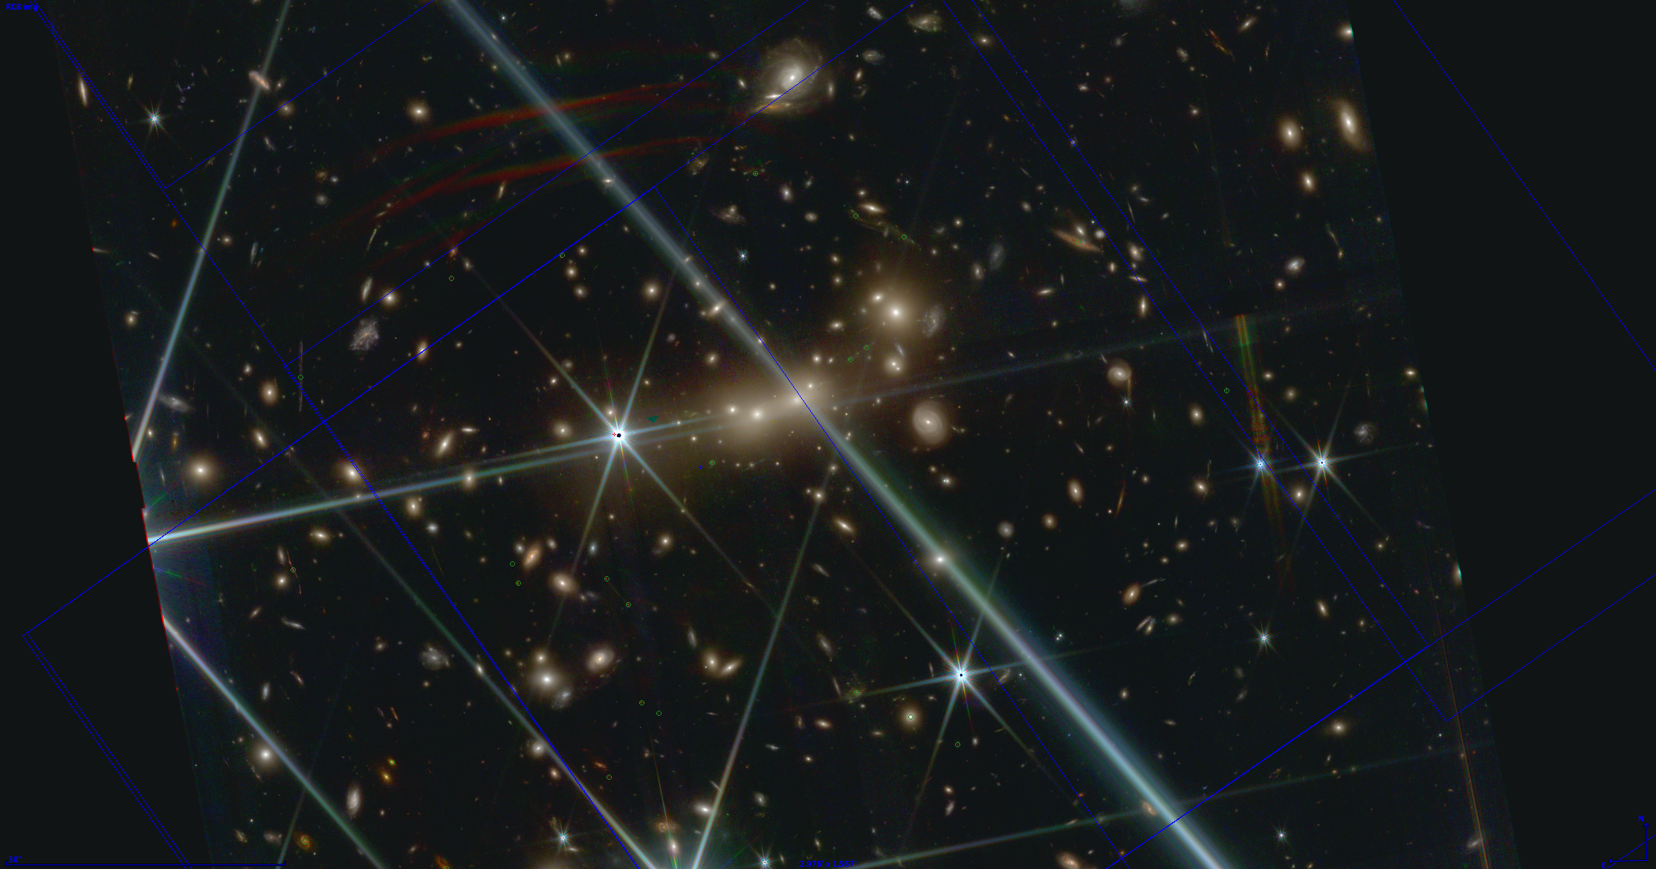
15c
z=5 clumps
z=5 star
z=5 clumps
JD1c
JD1
15a z=11.5
JD2
JD2c

Slide 15
15c
z=5 clumps
z=5 star
z=5 clumps
JD1c
JD1
15a z=11.5
JD2
JD2c

Slide 16


Slide 17
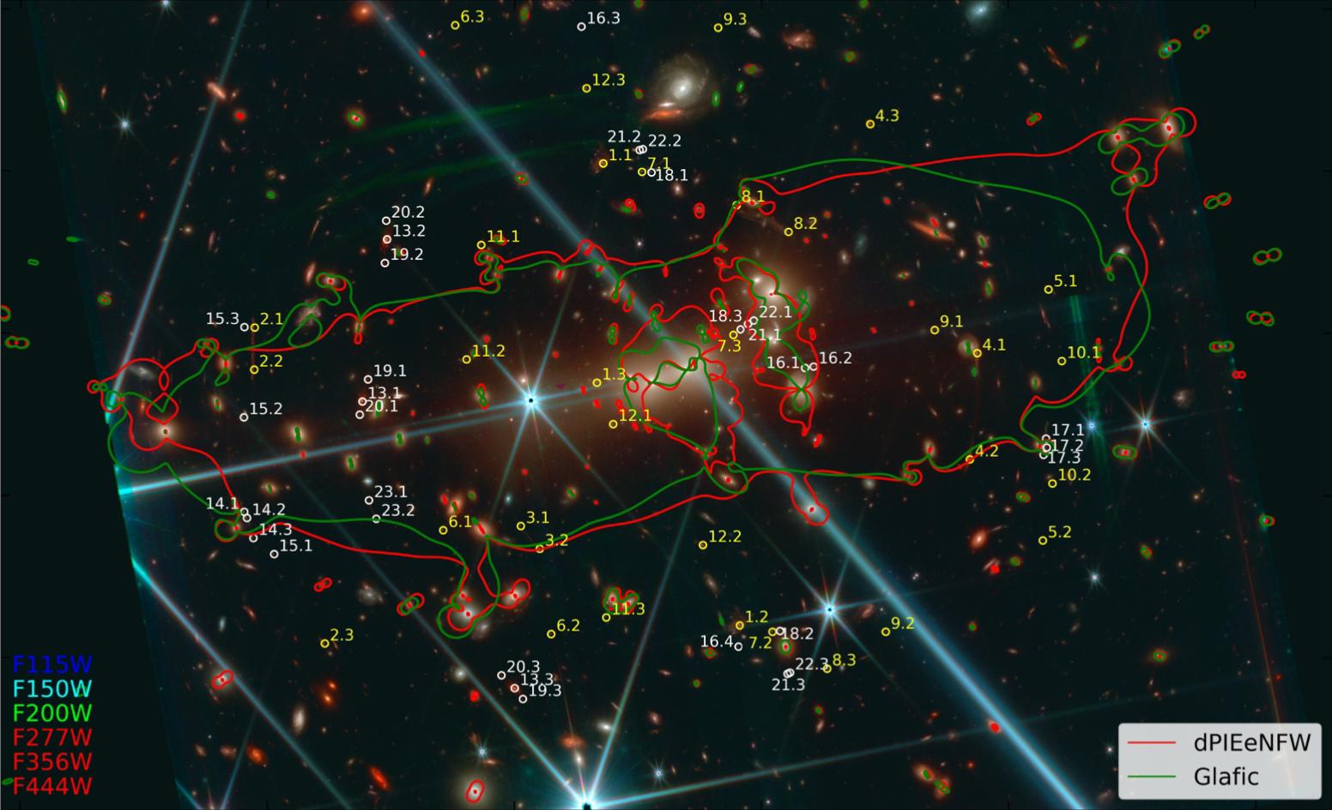
z = 6
z = 5
z = 7
z = 11
z = 11

Slide 18
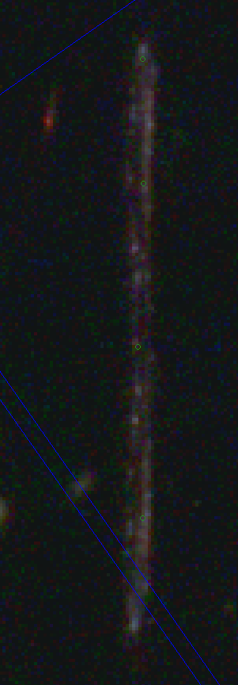
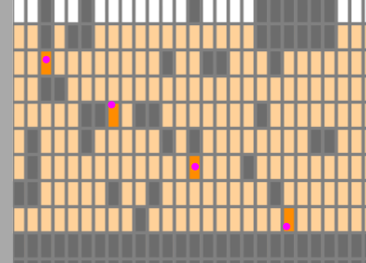
Obs 21/2: never gonna get 15c
only 1 row from z=5 star

Slide 19
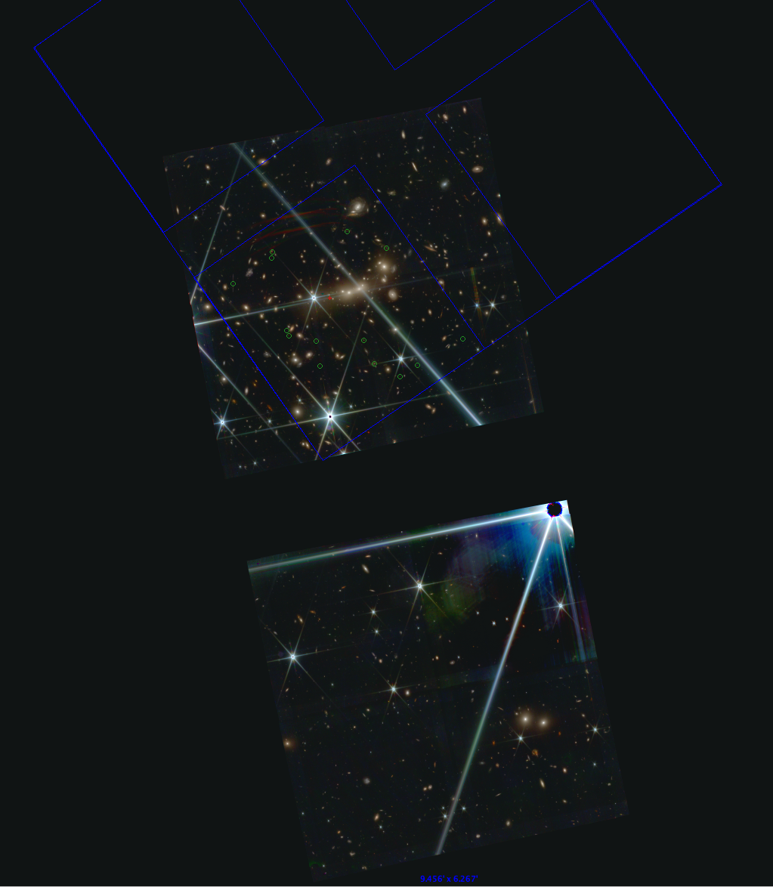
close to final placement
center Q2
down left red Q4

Slide 20
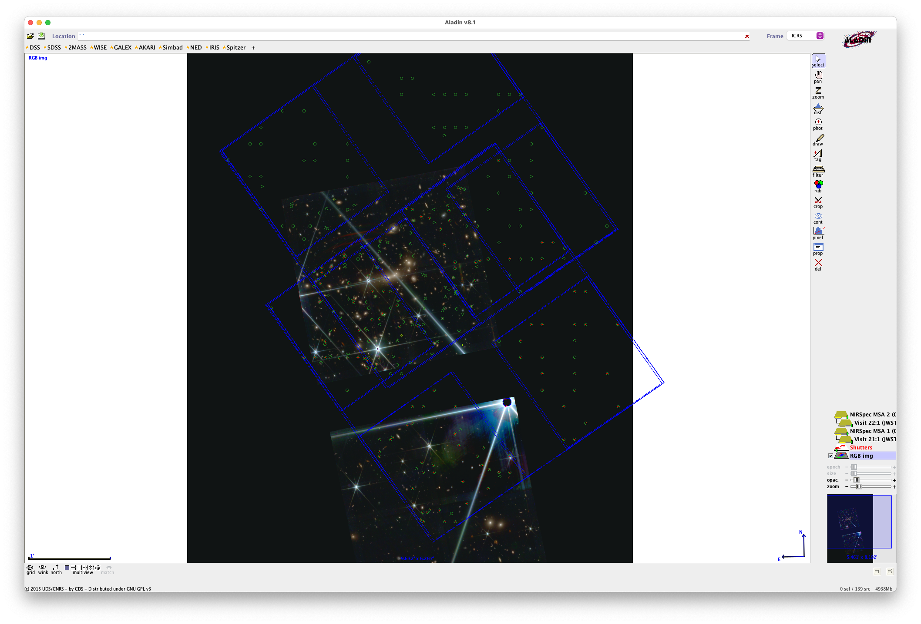

Slide 21
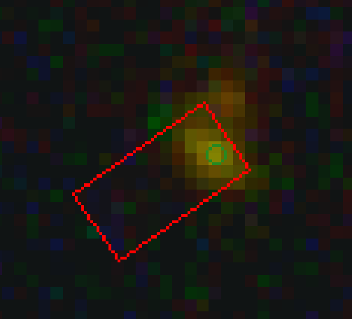
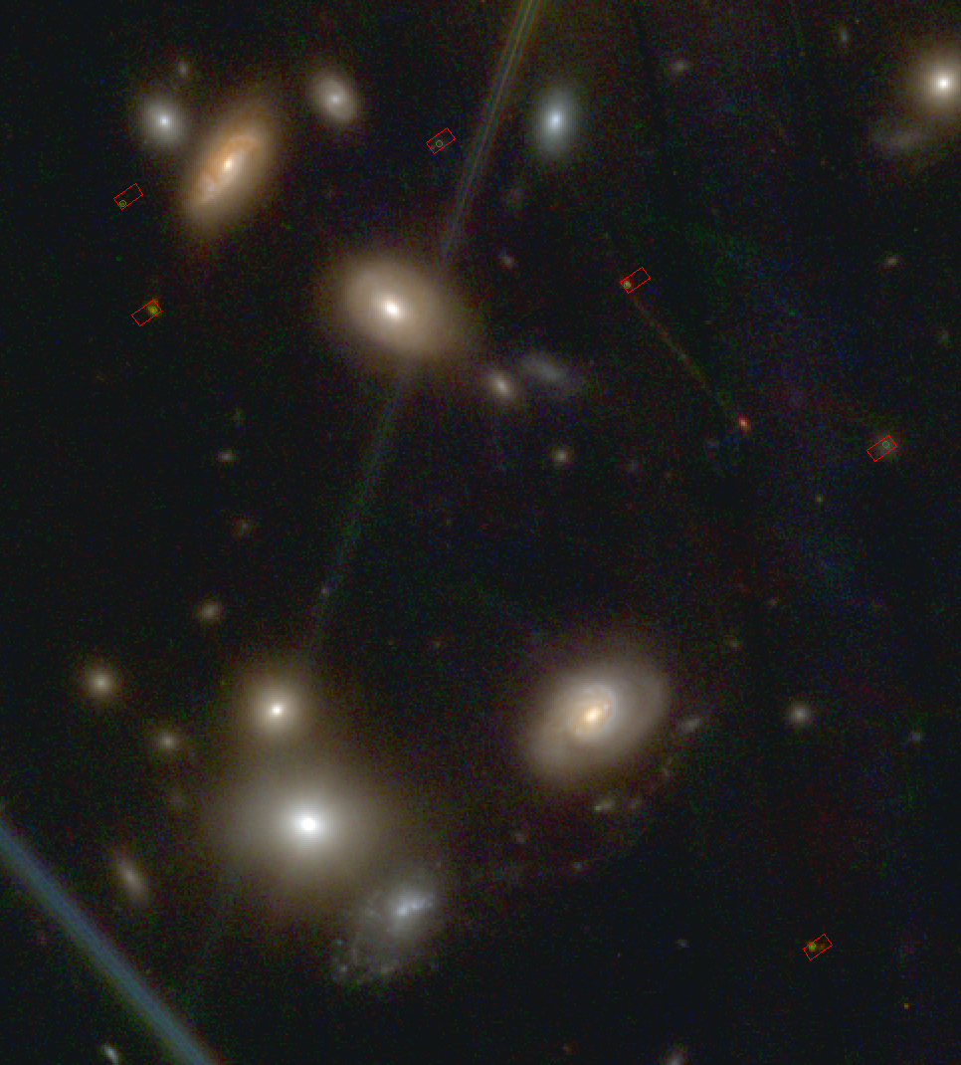
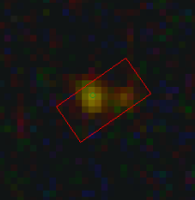
Observation 21 (?)
JD1c
JD1
JD1
JD2
JD2
JD2c

Slide 22
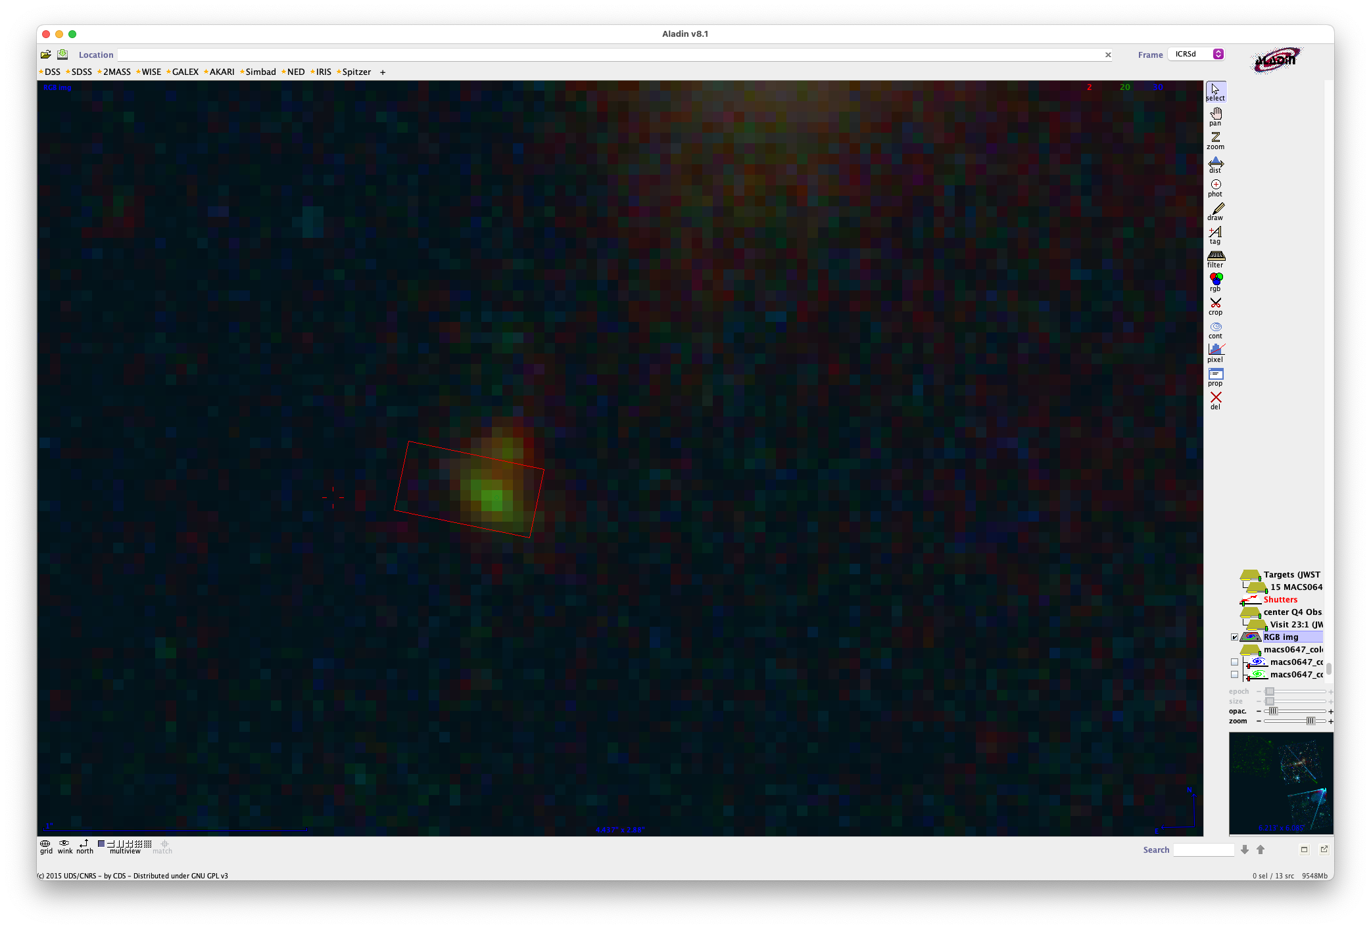
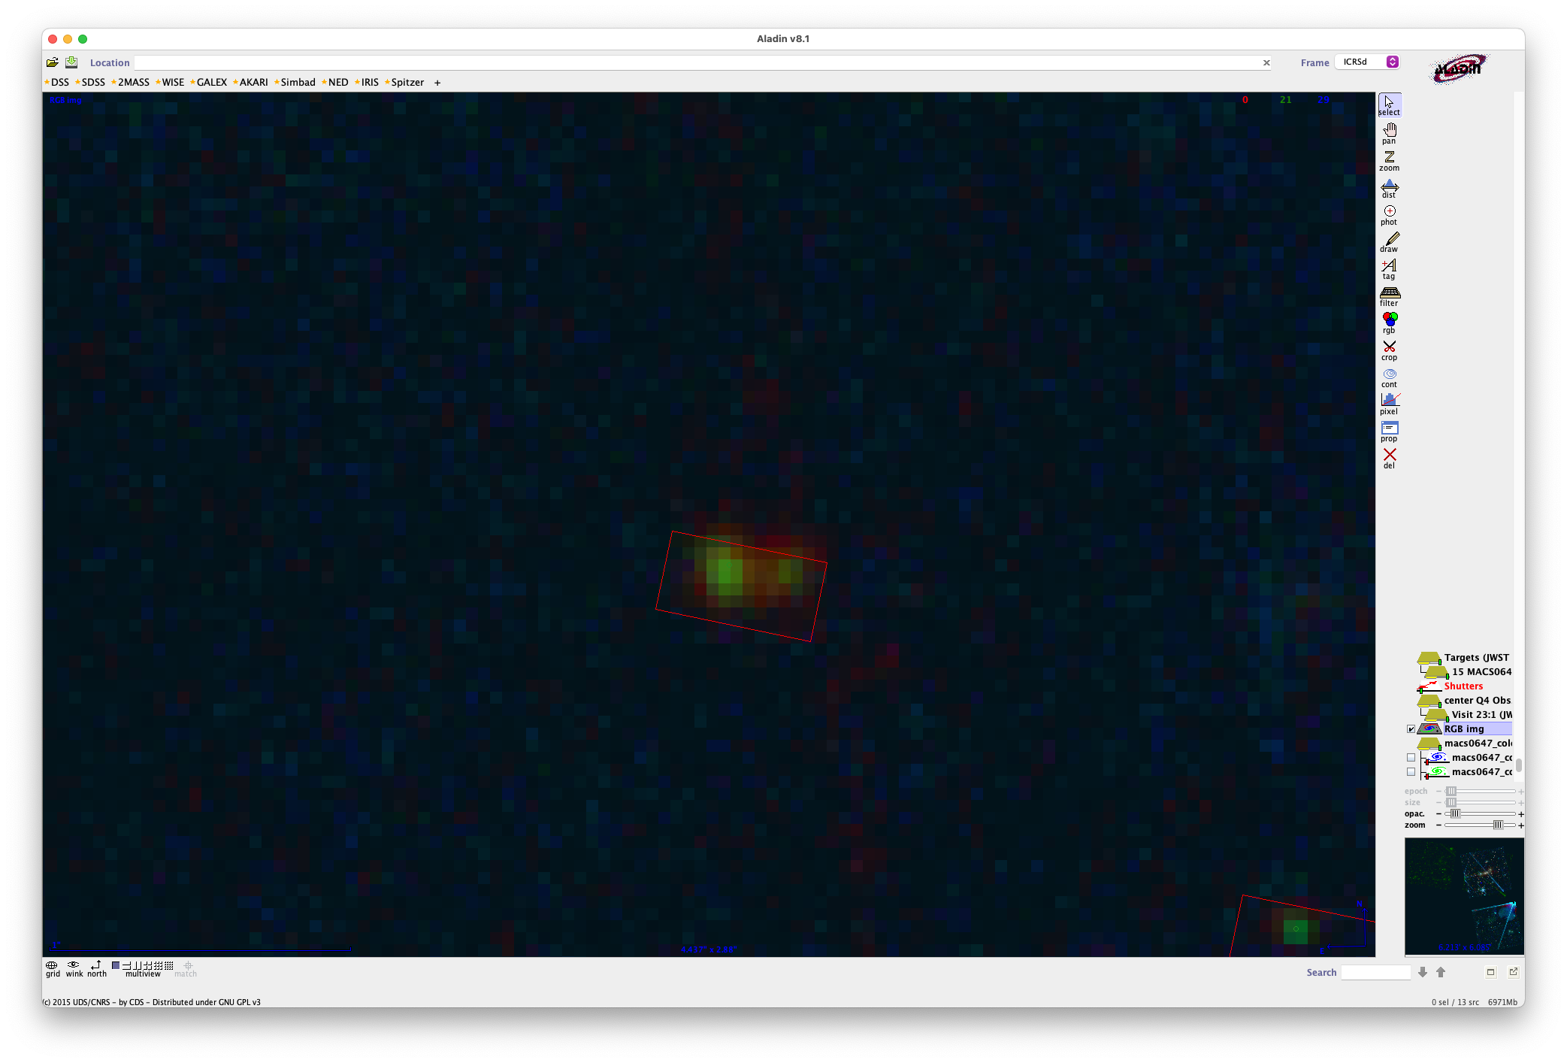
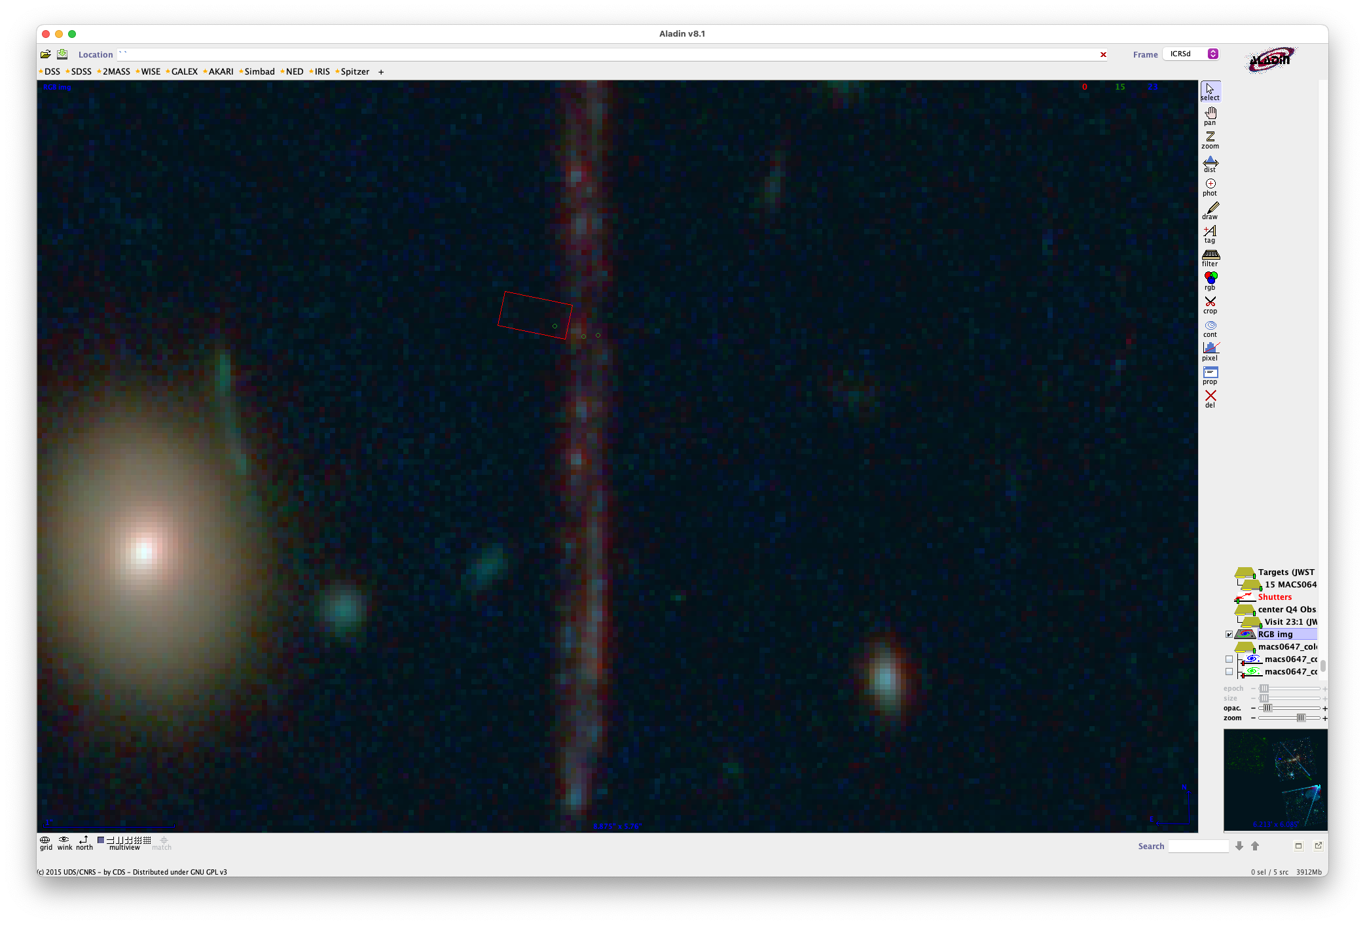

Slide 23
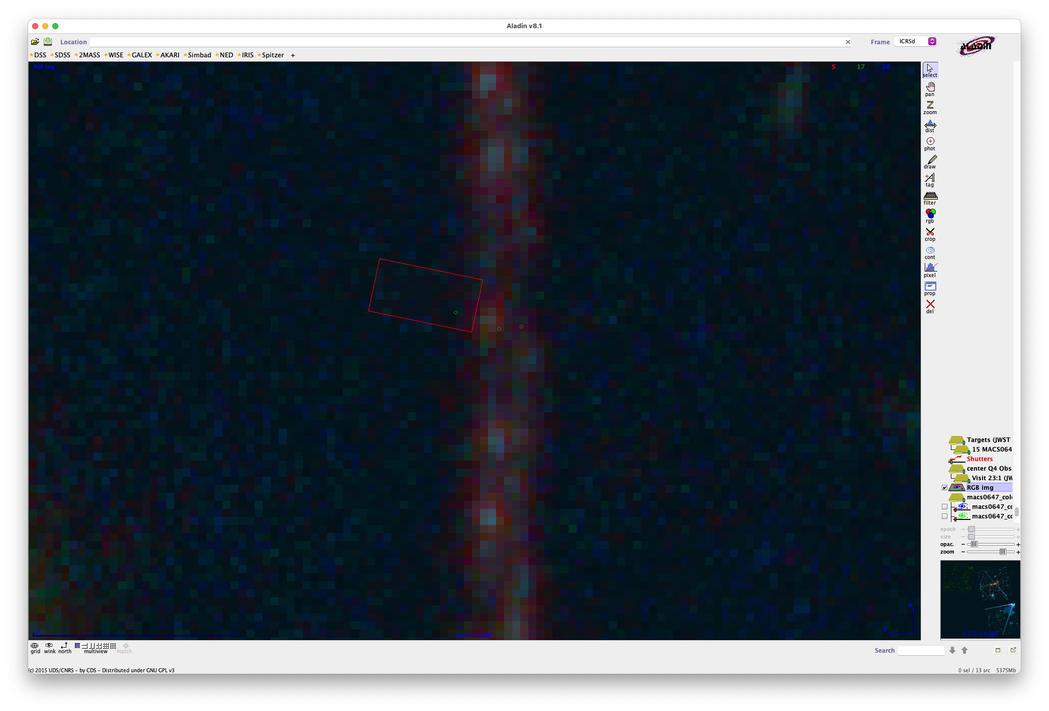

Slide 25
2
1

Slide 26
2
z = 5 star
1

Slide 27
2
z = 5 star
1

Slide 28
2
z = 5 star
1

Slide 29
2
z = 5 star
1

Slide 30
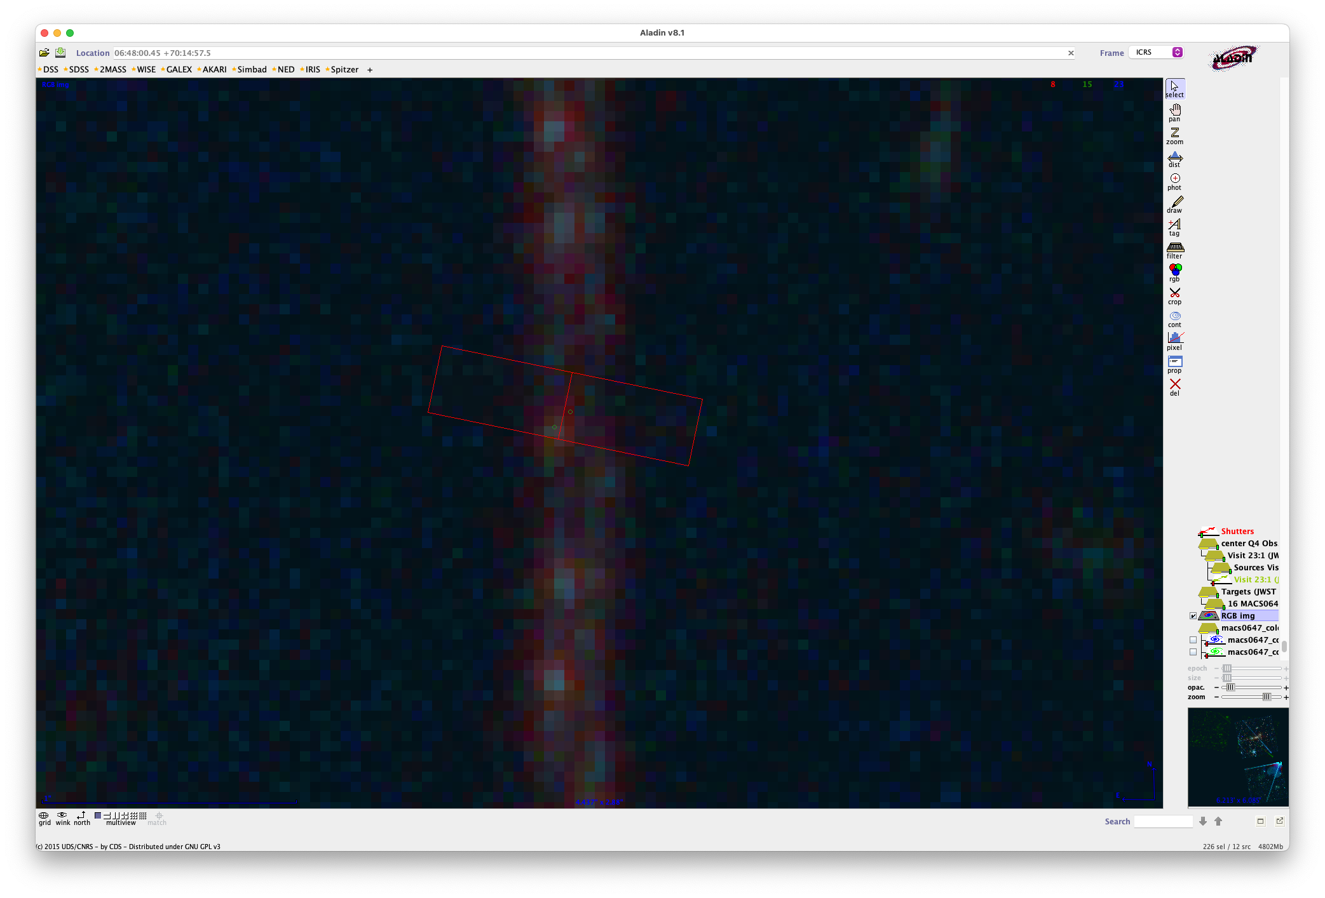
2
z = 5 star
1

Slide 31
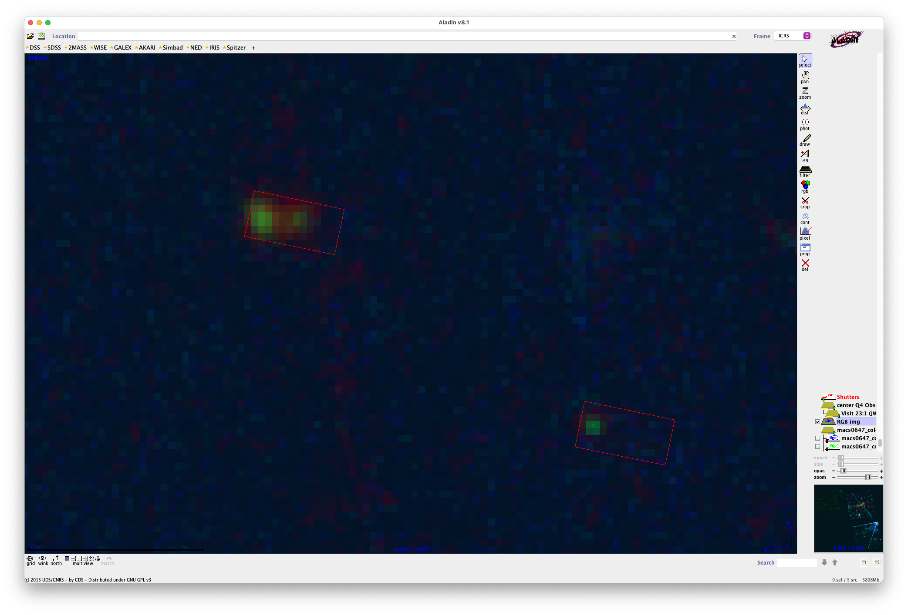
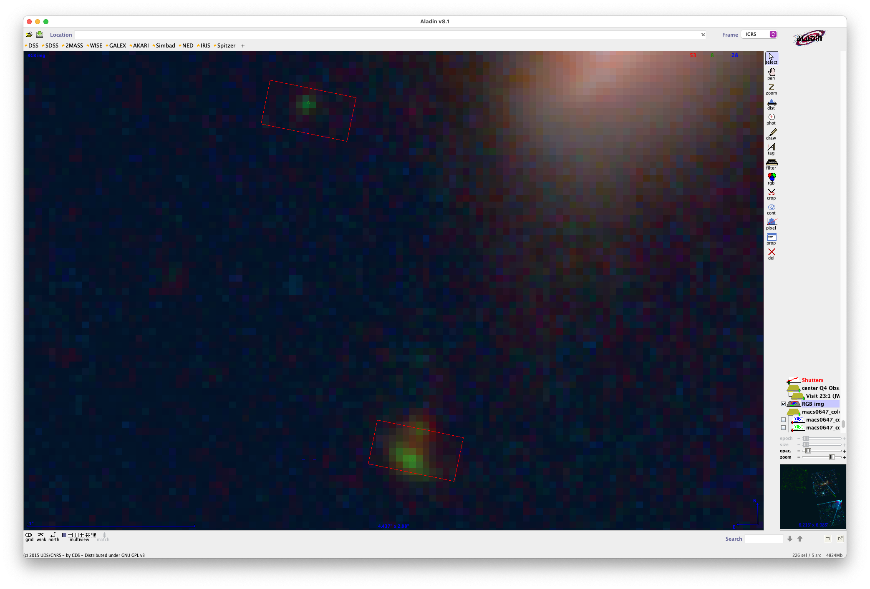
2
z = 5 star
1

Slide 32
JD2
JD2
z = 5 star
JD1
Define fake object here to get 2 exposures
(unless we’d rather look at other stuff…)
JD1

Slide 33
JD2
JD2
z = 5 star
JD1
Define fake object here to get 2 exposures
(unless we’d rather look at other stuff…)
JD1

Slide 34
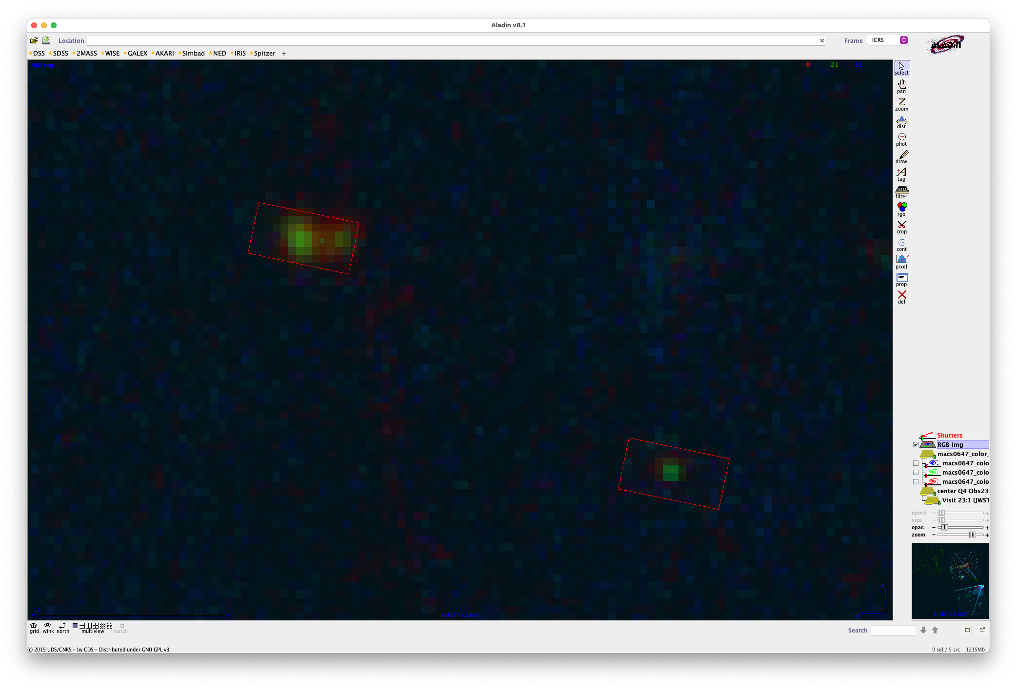
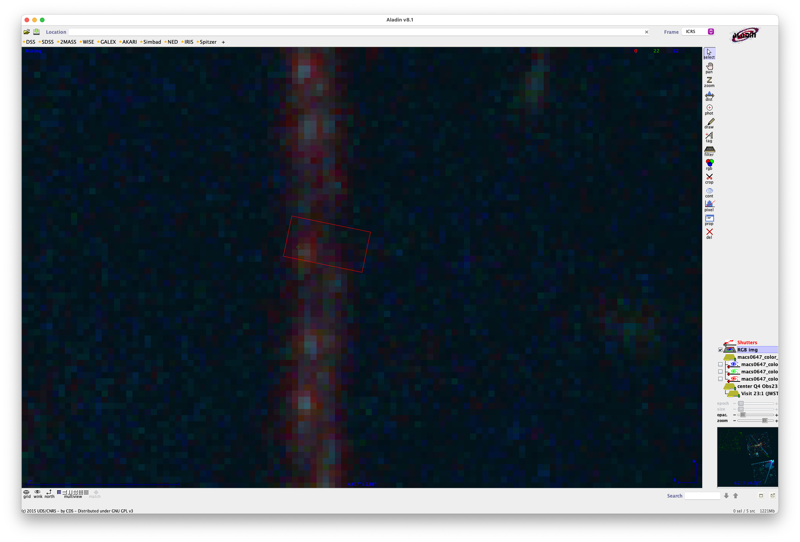
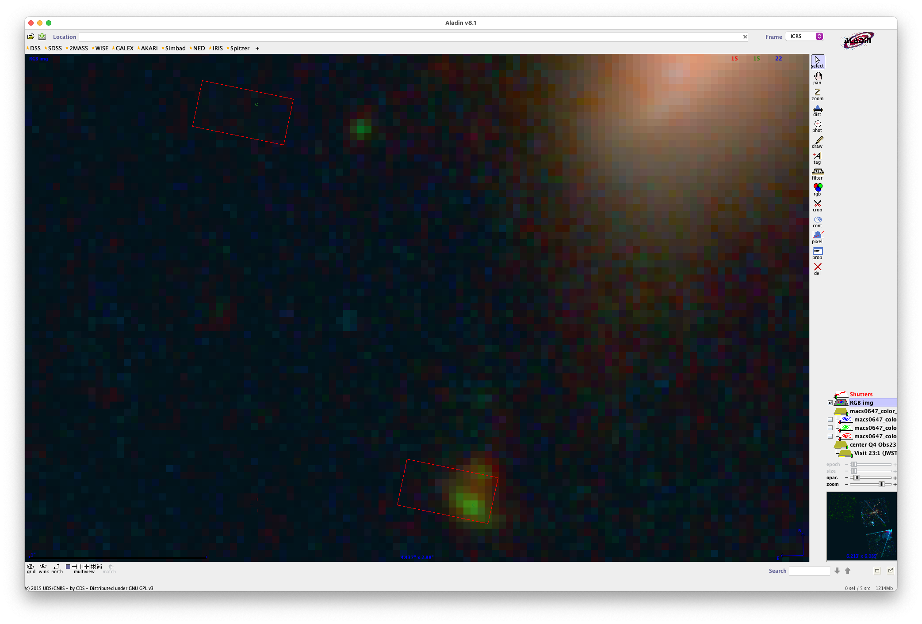
JD2
z = 5 star
JD1c
JD2c
JD1
I’m very happy with this and it works!
…I just don’t get the z = 11 arc…

Slide 35
Can’t shift detectors over to capture 5.3µm
or we’d pick up the star!
I suppose JD1 would be fine
and at z = 10.17, you only need to get out to 4.848 µm
to capture Hgamma 4340Å
But then what about 15a 3533 z ~ 11…
you could still get the other lines …
though it is fainter and Hgamma is one of the stronger lines
Too bad I guess…
It’s worth it to get more targets in the other module!
JD2c 3314
5.3µm
JD2a 33491
JD1a 35931
JD1c 3621
15a 3533 z ~ 11?
41050
41053

Slide 36
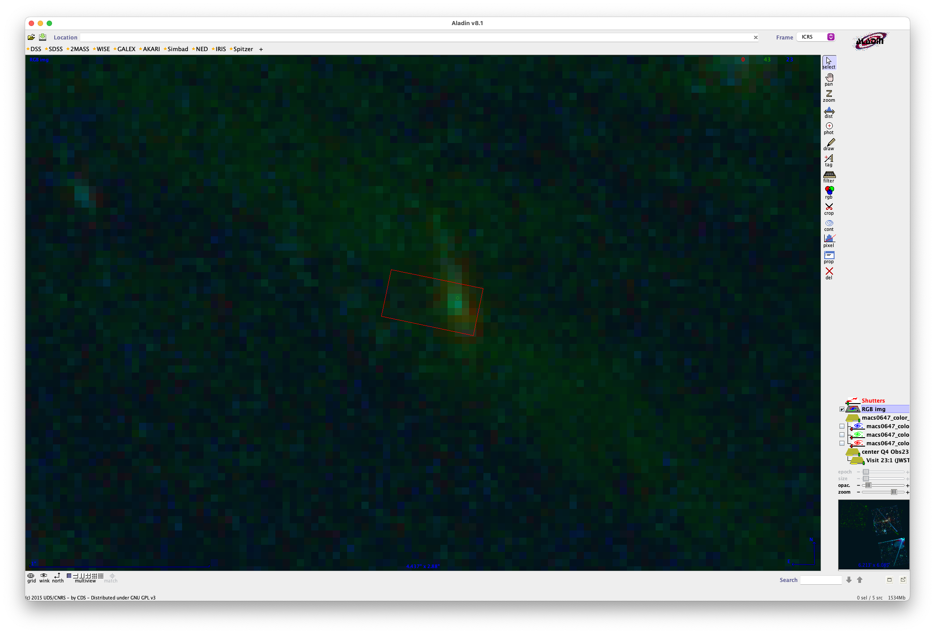
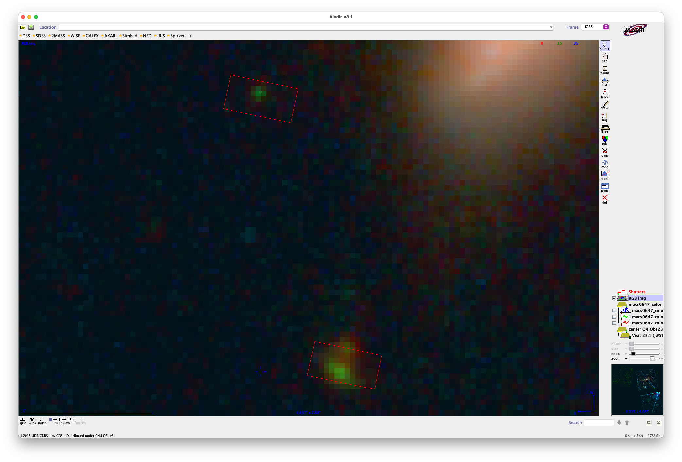

3533 15a z ~ 11 arc

Slide 37
3533 15a z ~ 11 arc
shift this one too

Slide 38
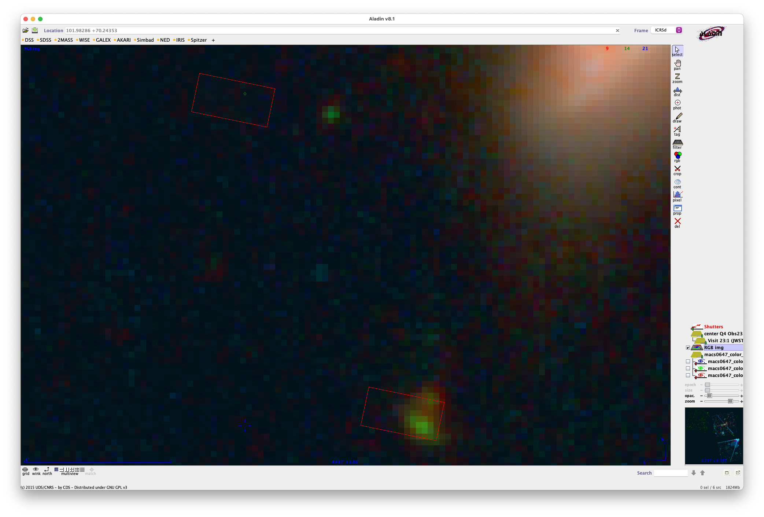
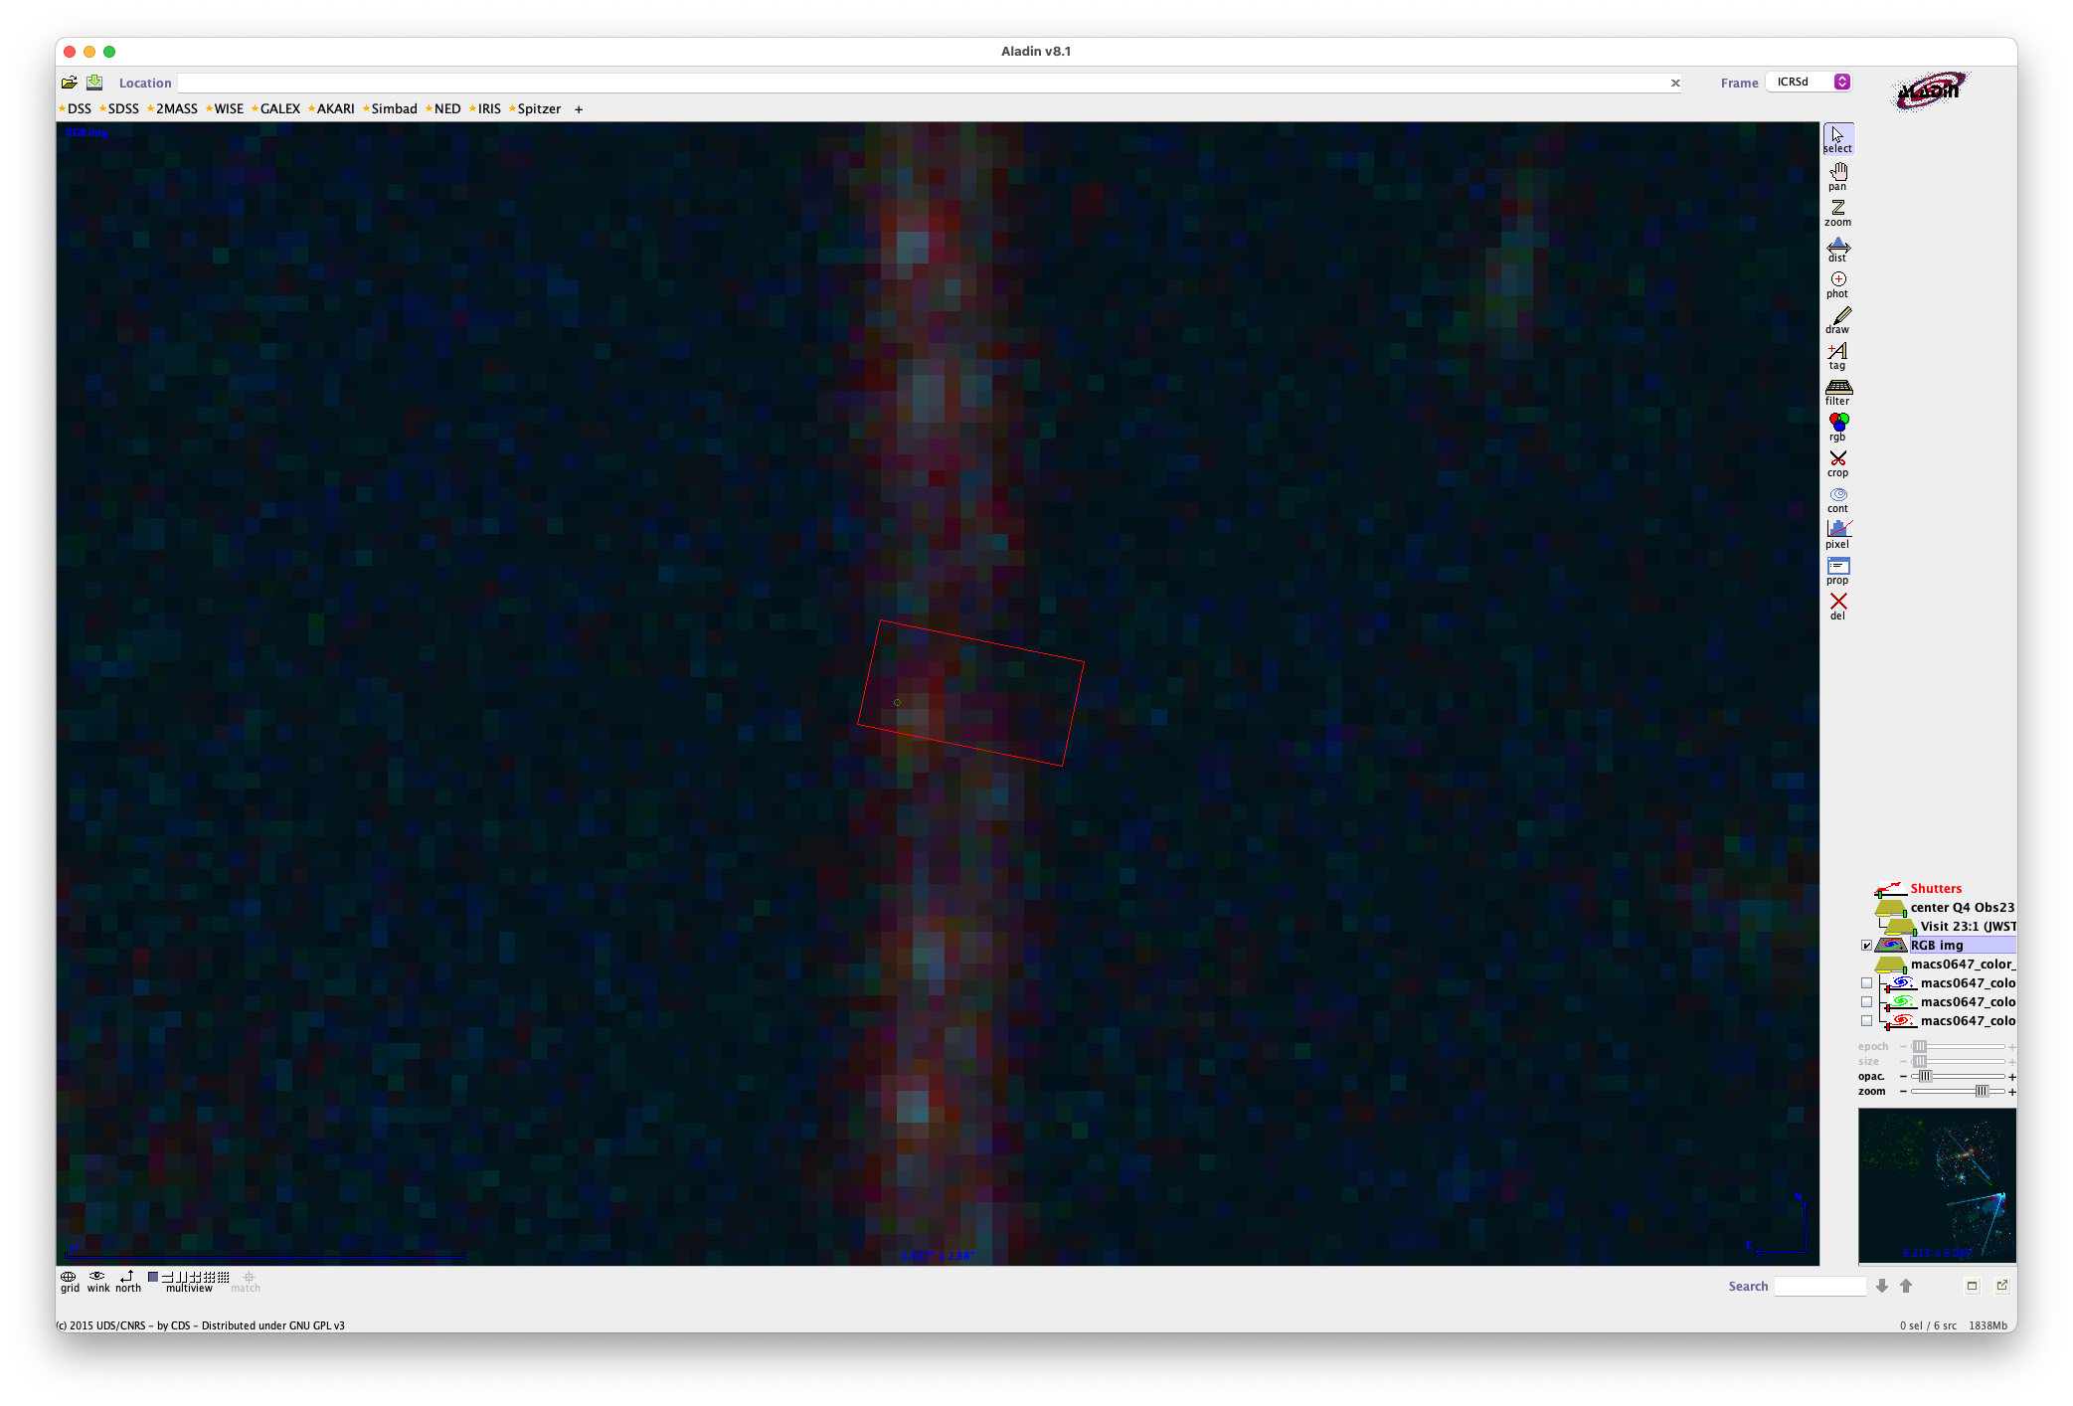
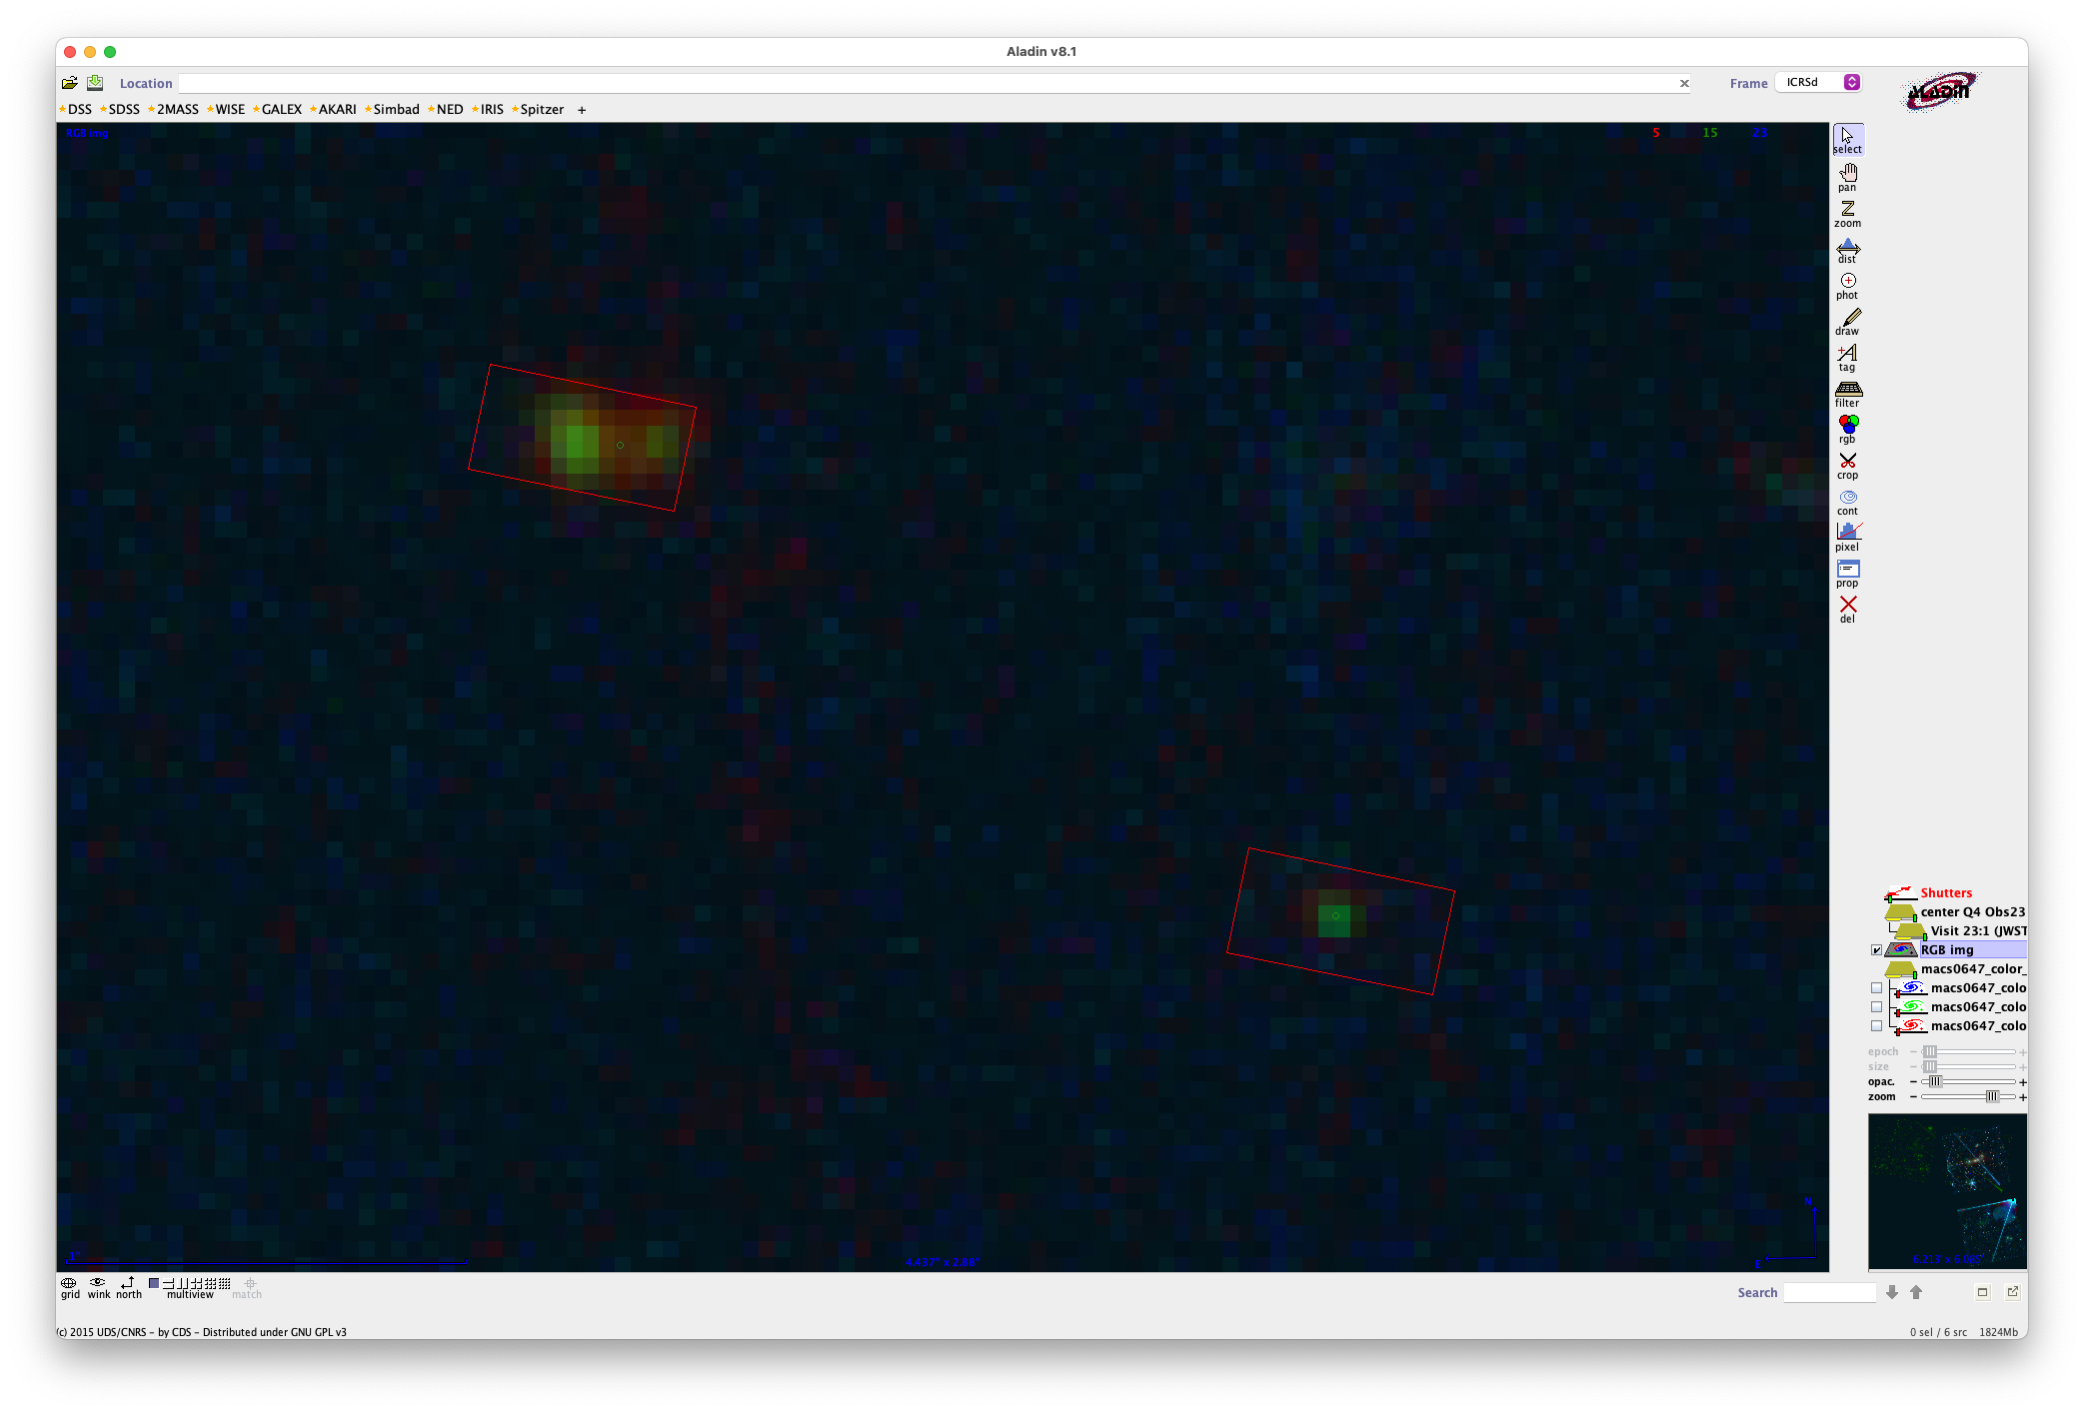

Sorry, this doesn’t work
MPT requires 5 slitlets across for each object
assuming spectra spread out a bit
This works! I get all 6

Slide 39
This works! I get all 6

Slide 40
This works! I get all 6
… actually no JD1c doesn’t work in 3 slitlets

Slide 41


Slide 42
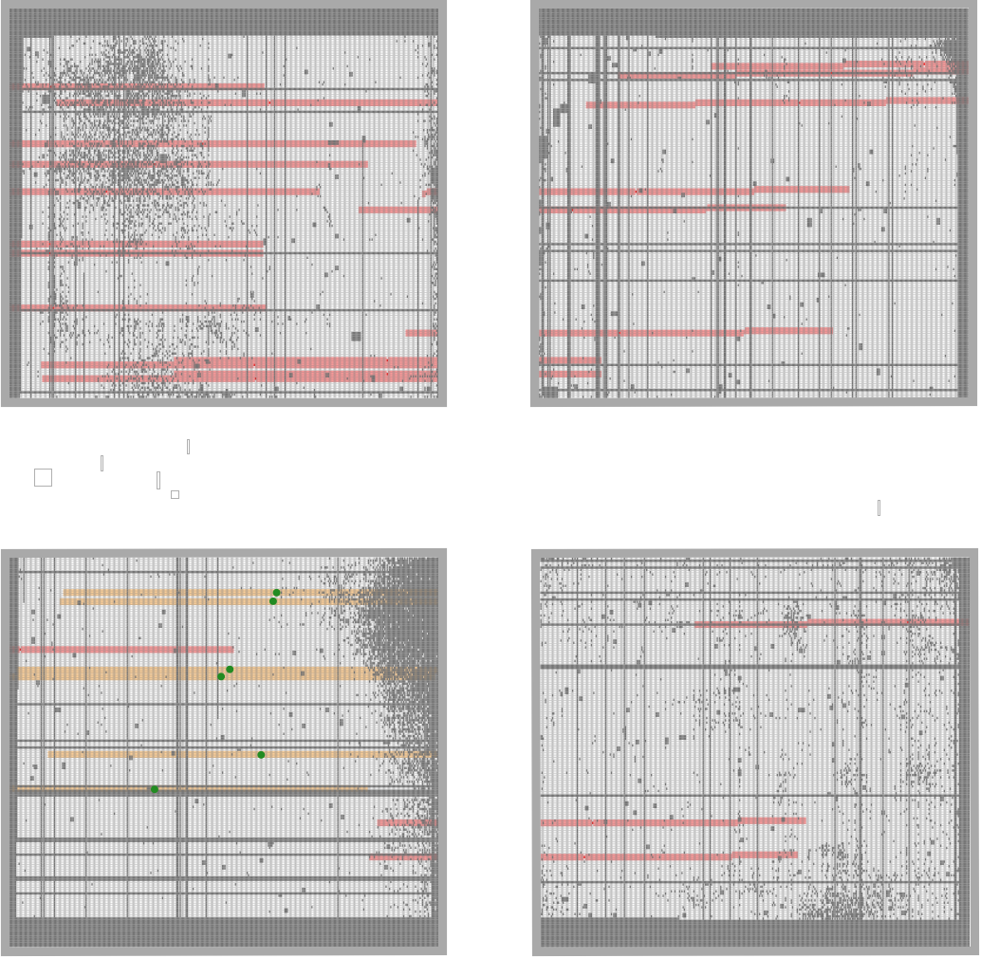

Slide 43


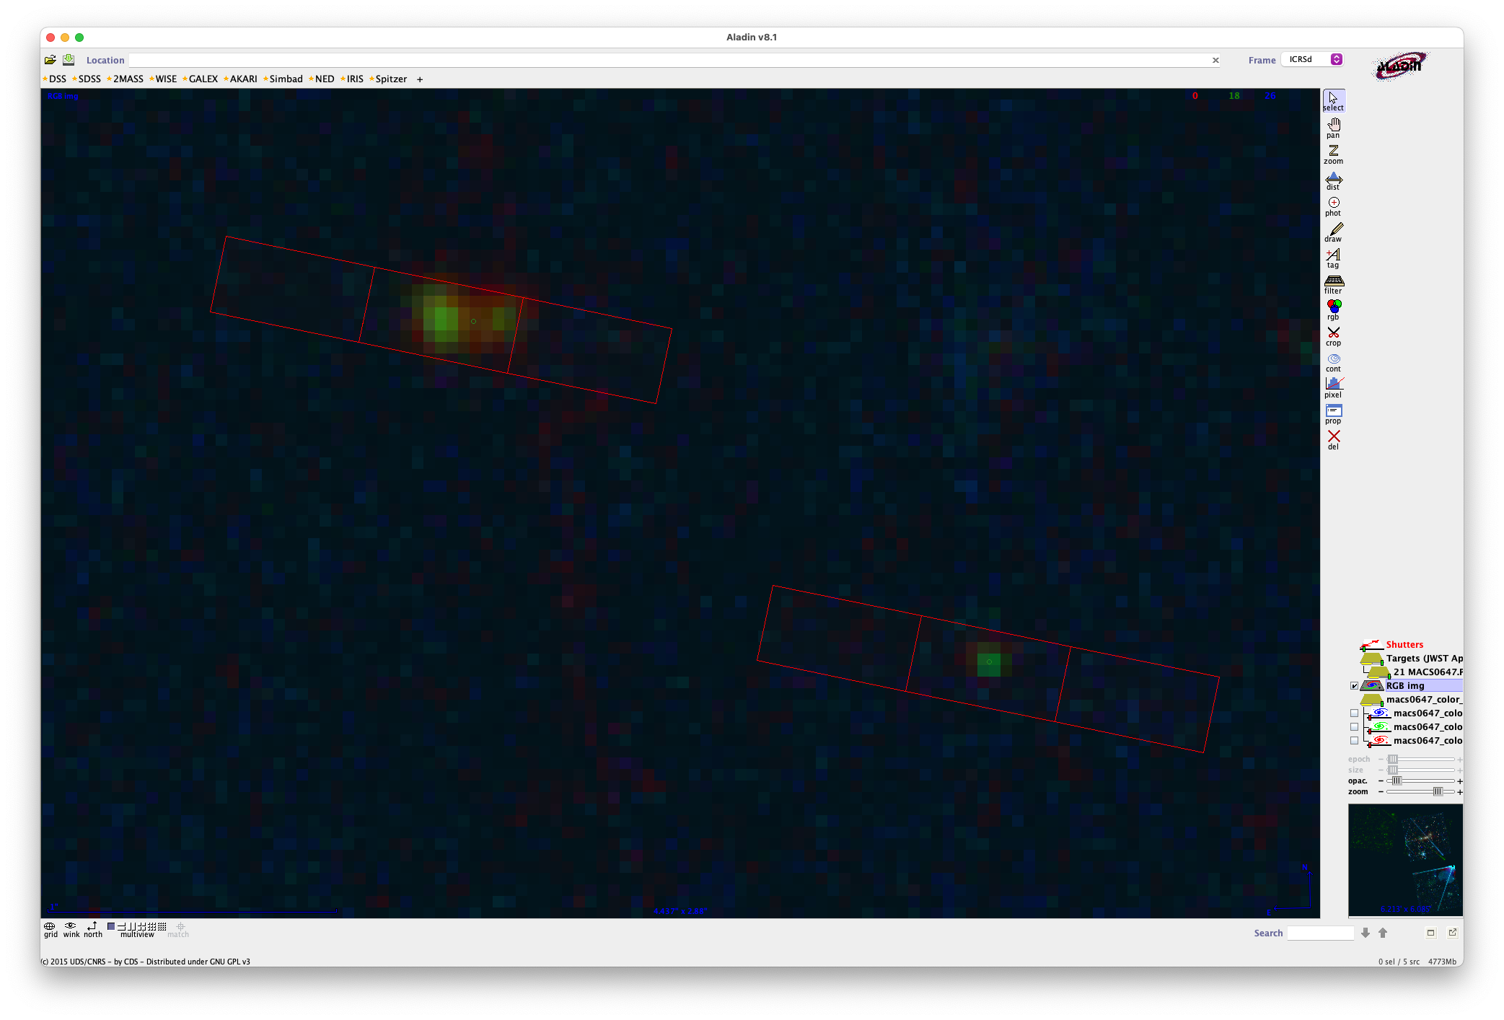
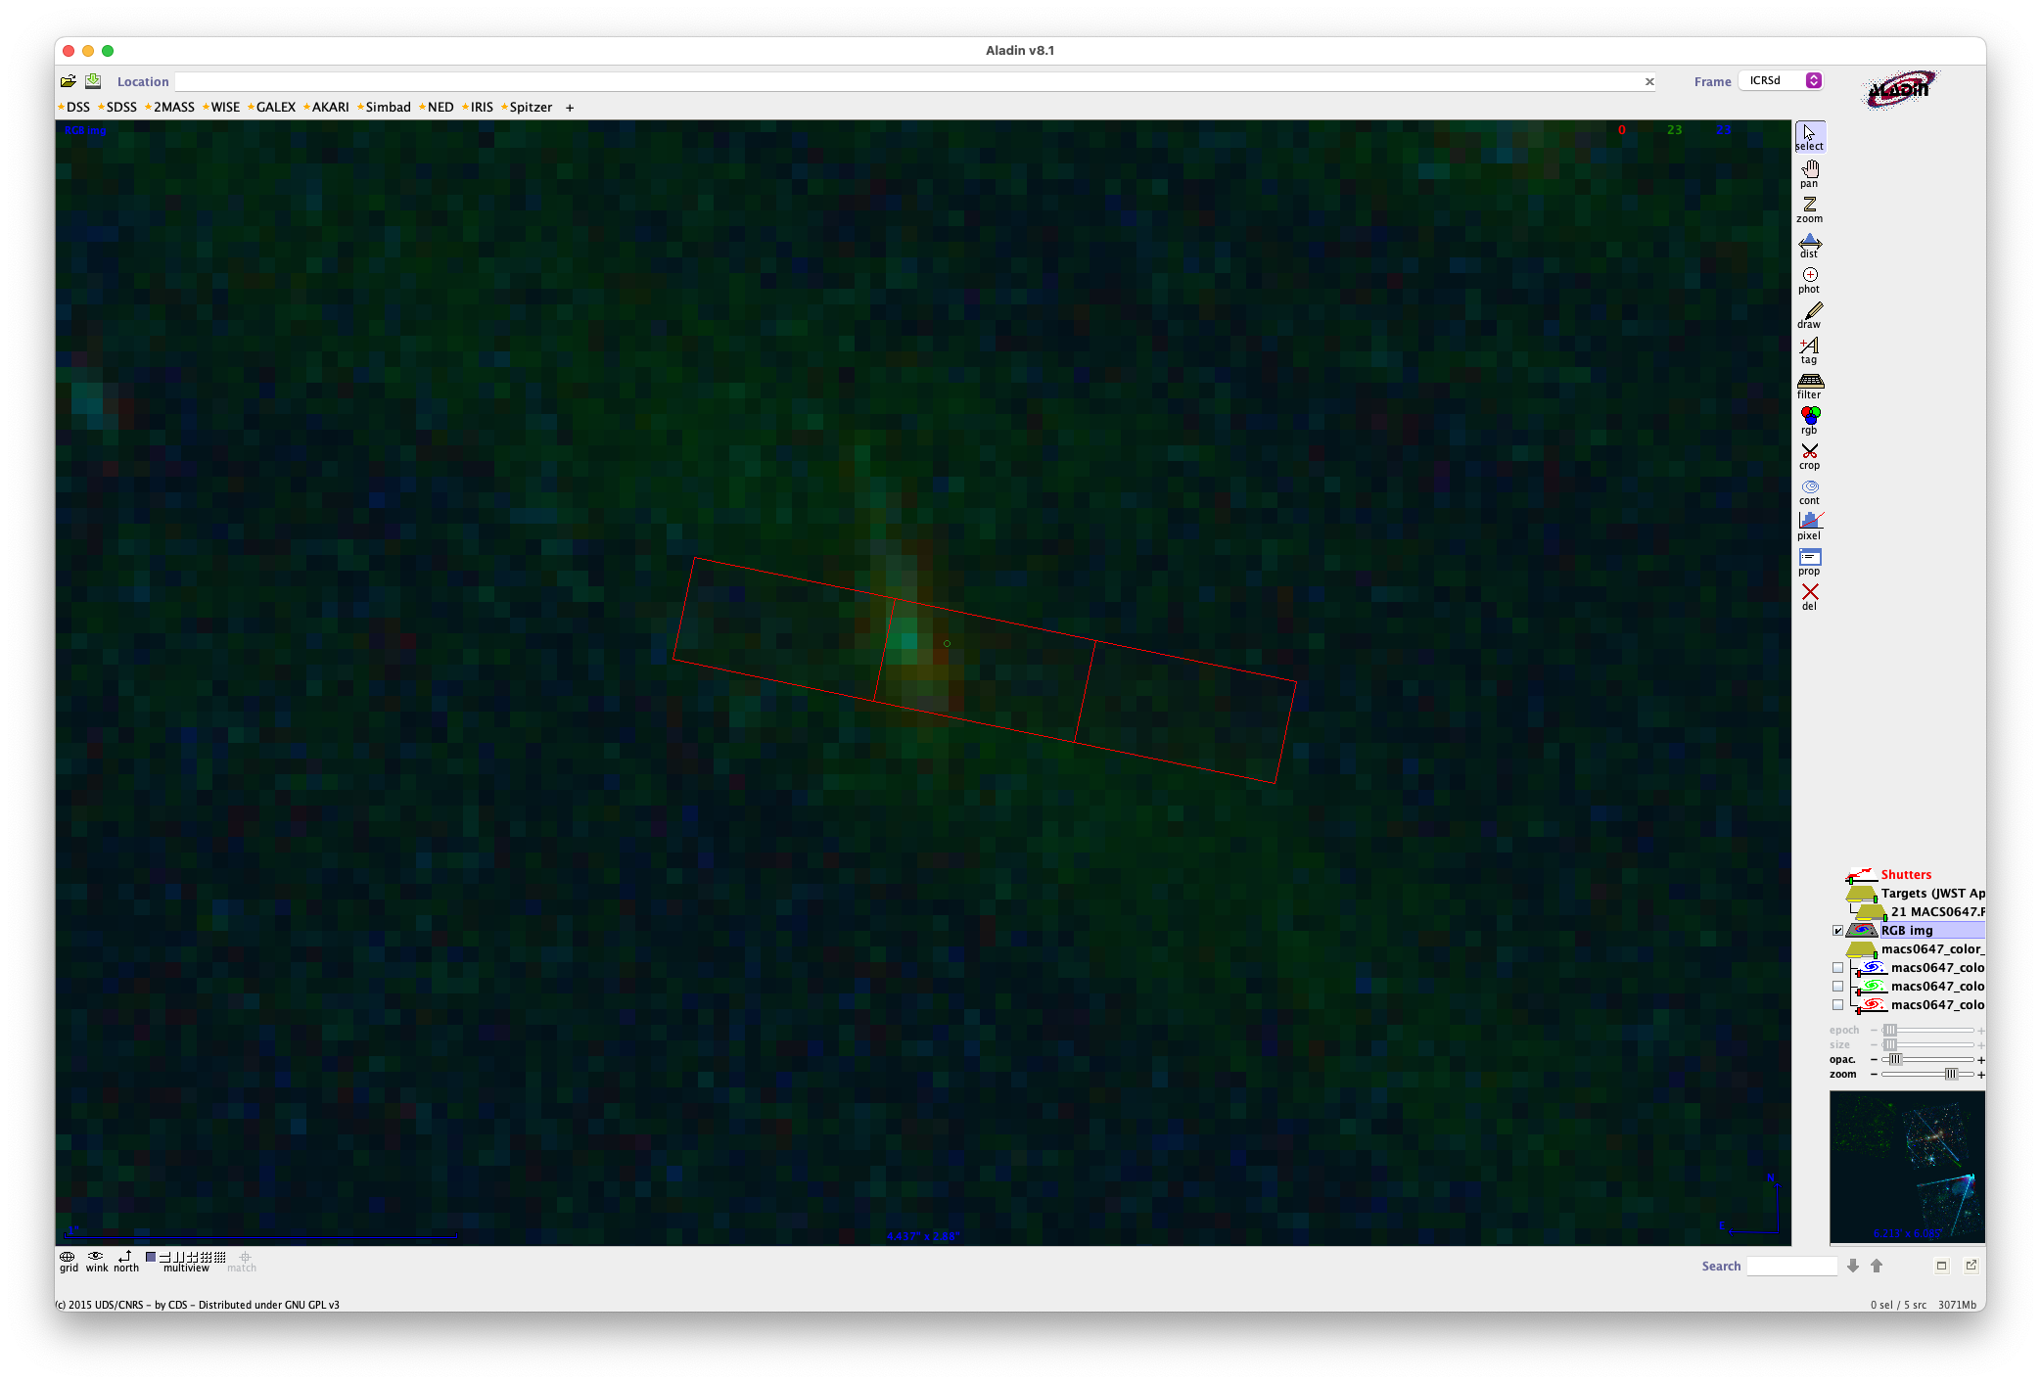
This works! Getting all 5
(JD1c just can’t)

Slide 44
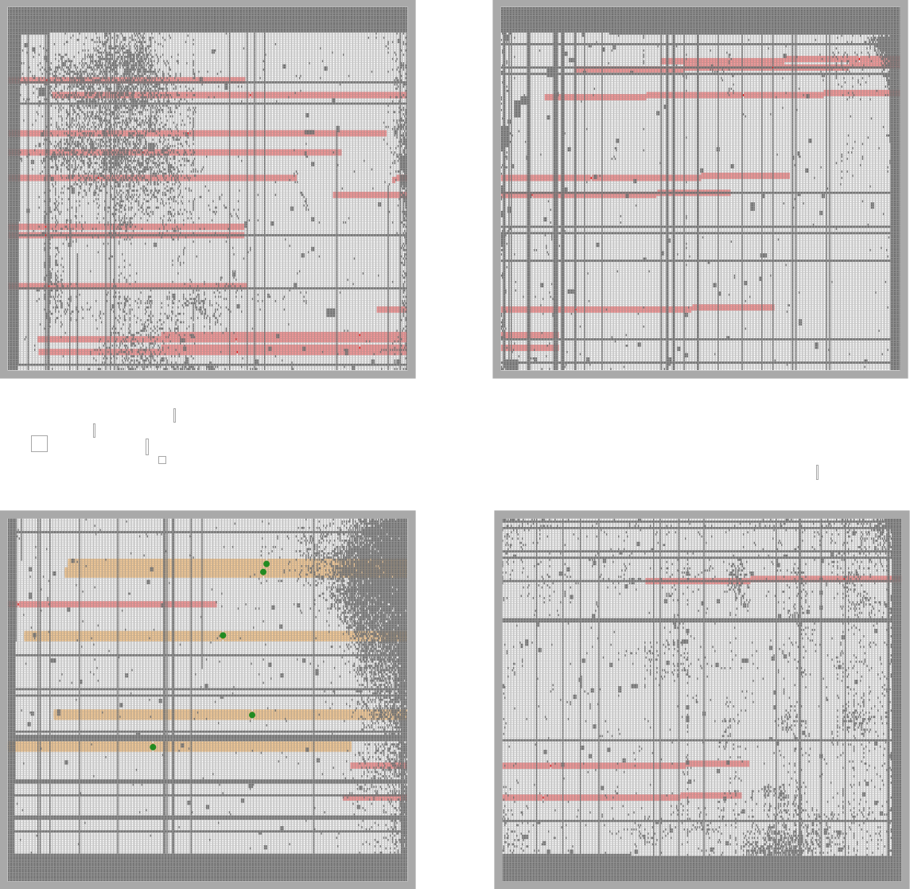
JD2c 3314
5.3µm
JD2a 33491
JD1a 35931
JD1c 3621
15a 3533 z ~ 11?
41050
41053

Slide 45
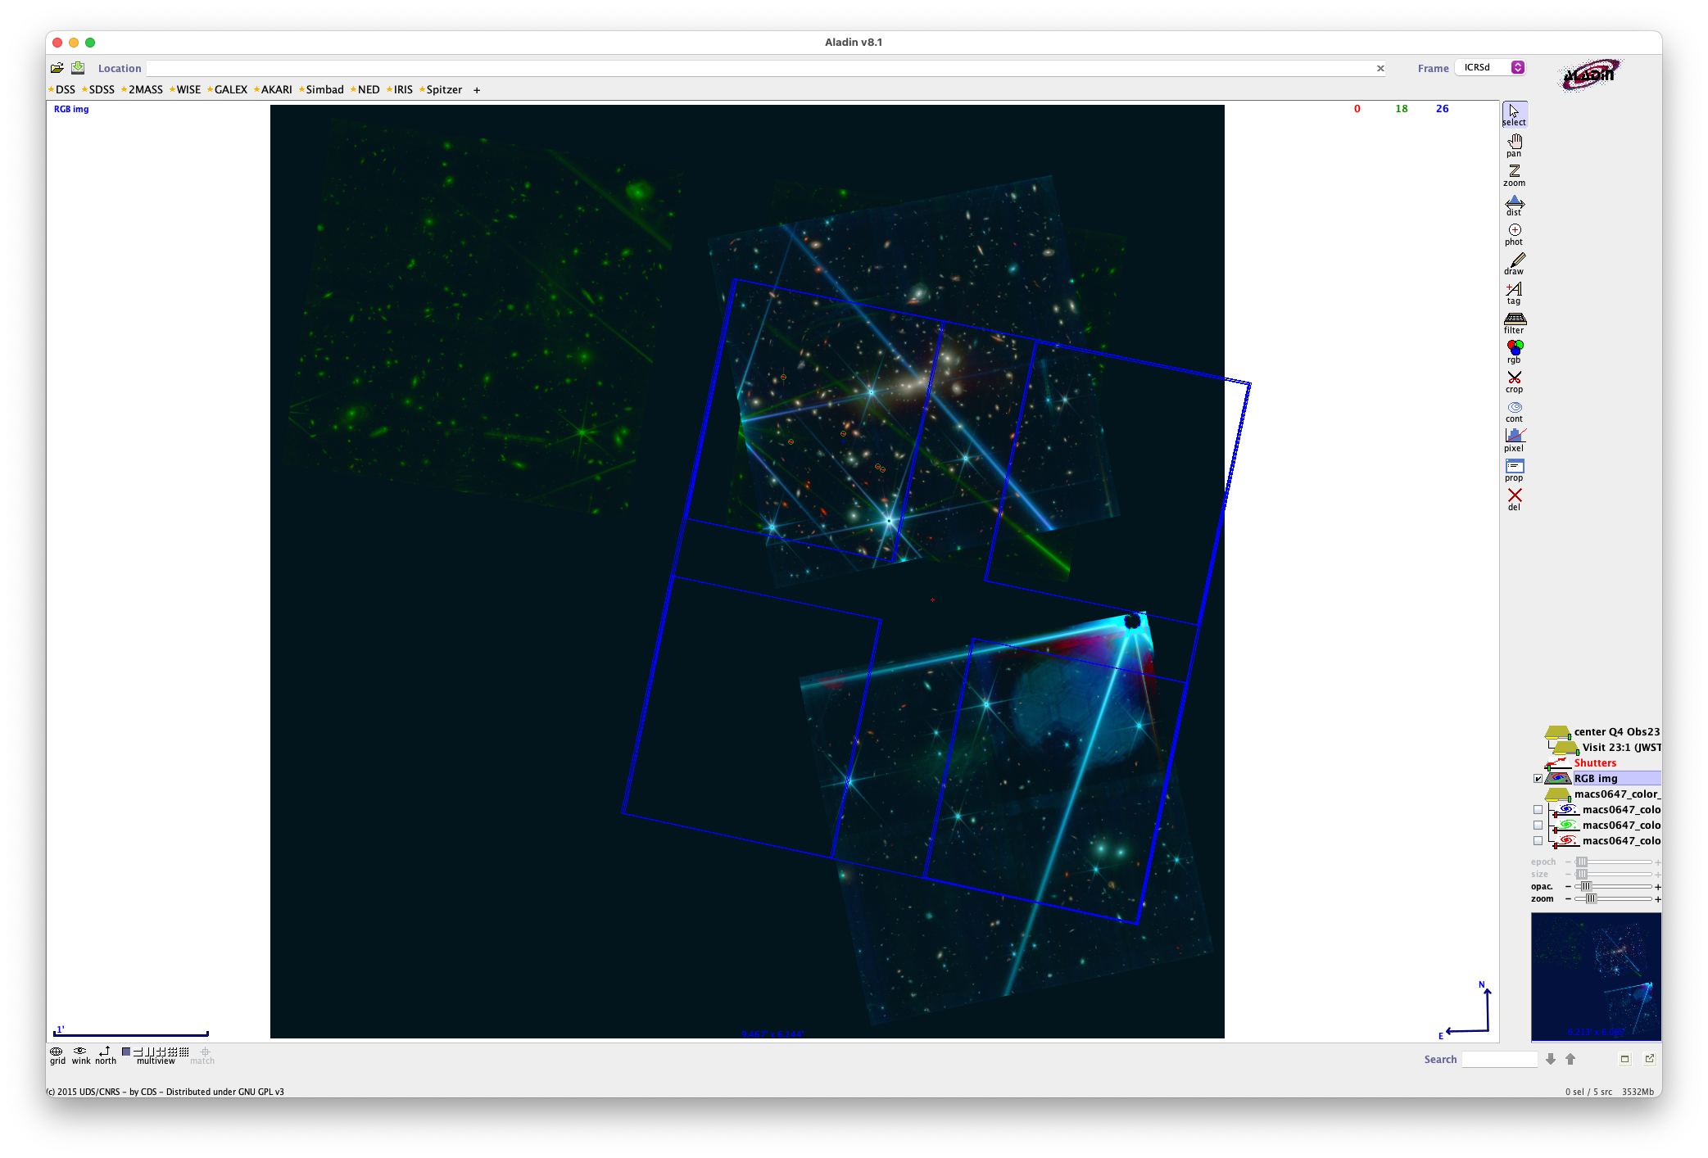

Slide 46
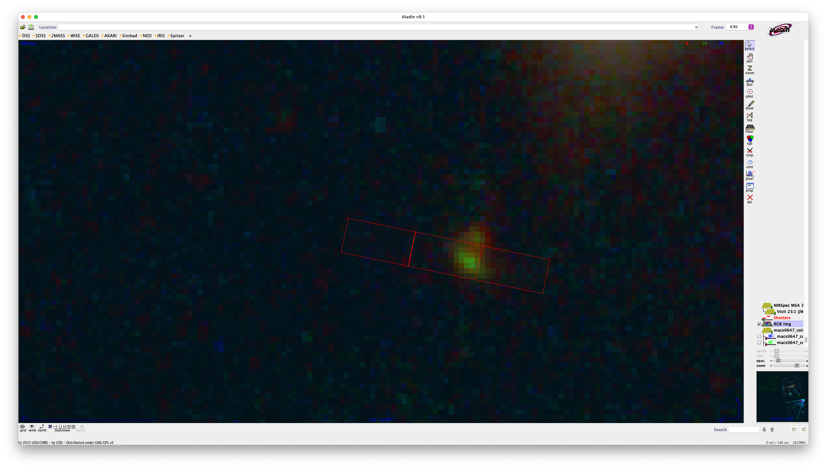
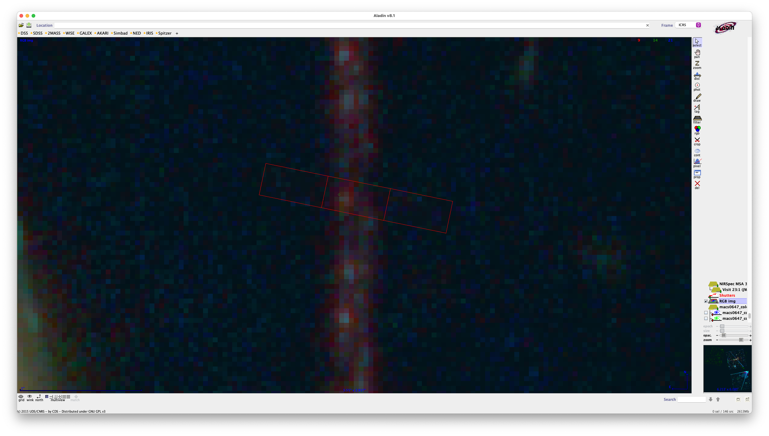
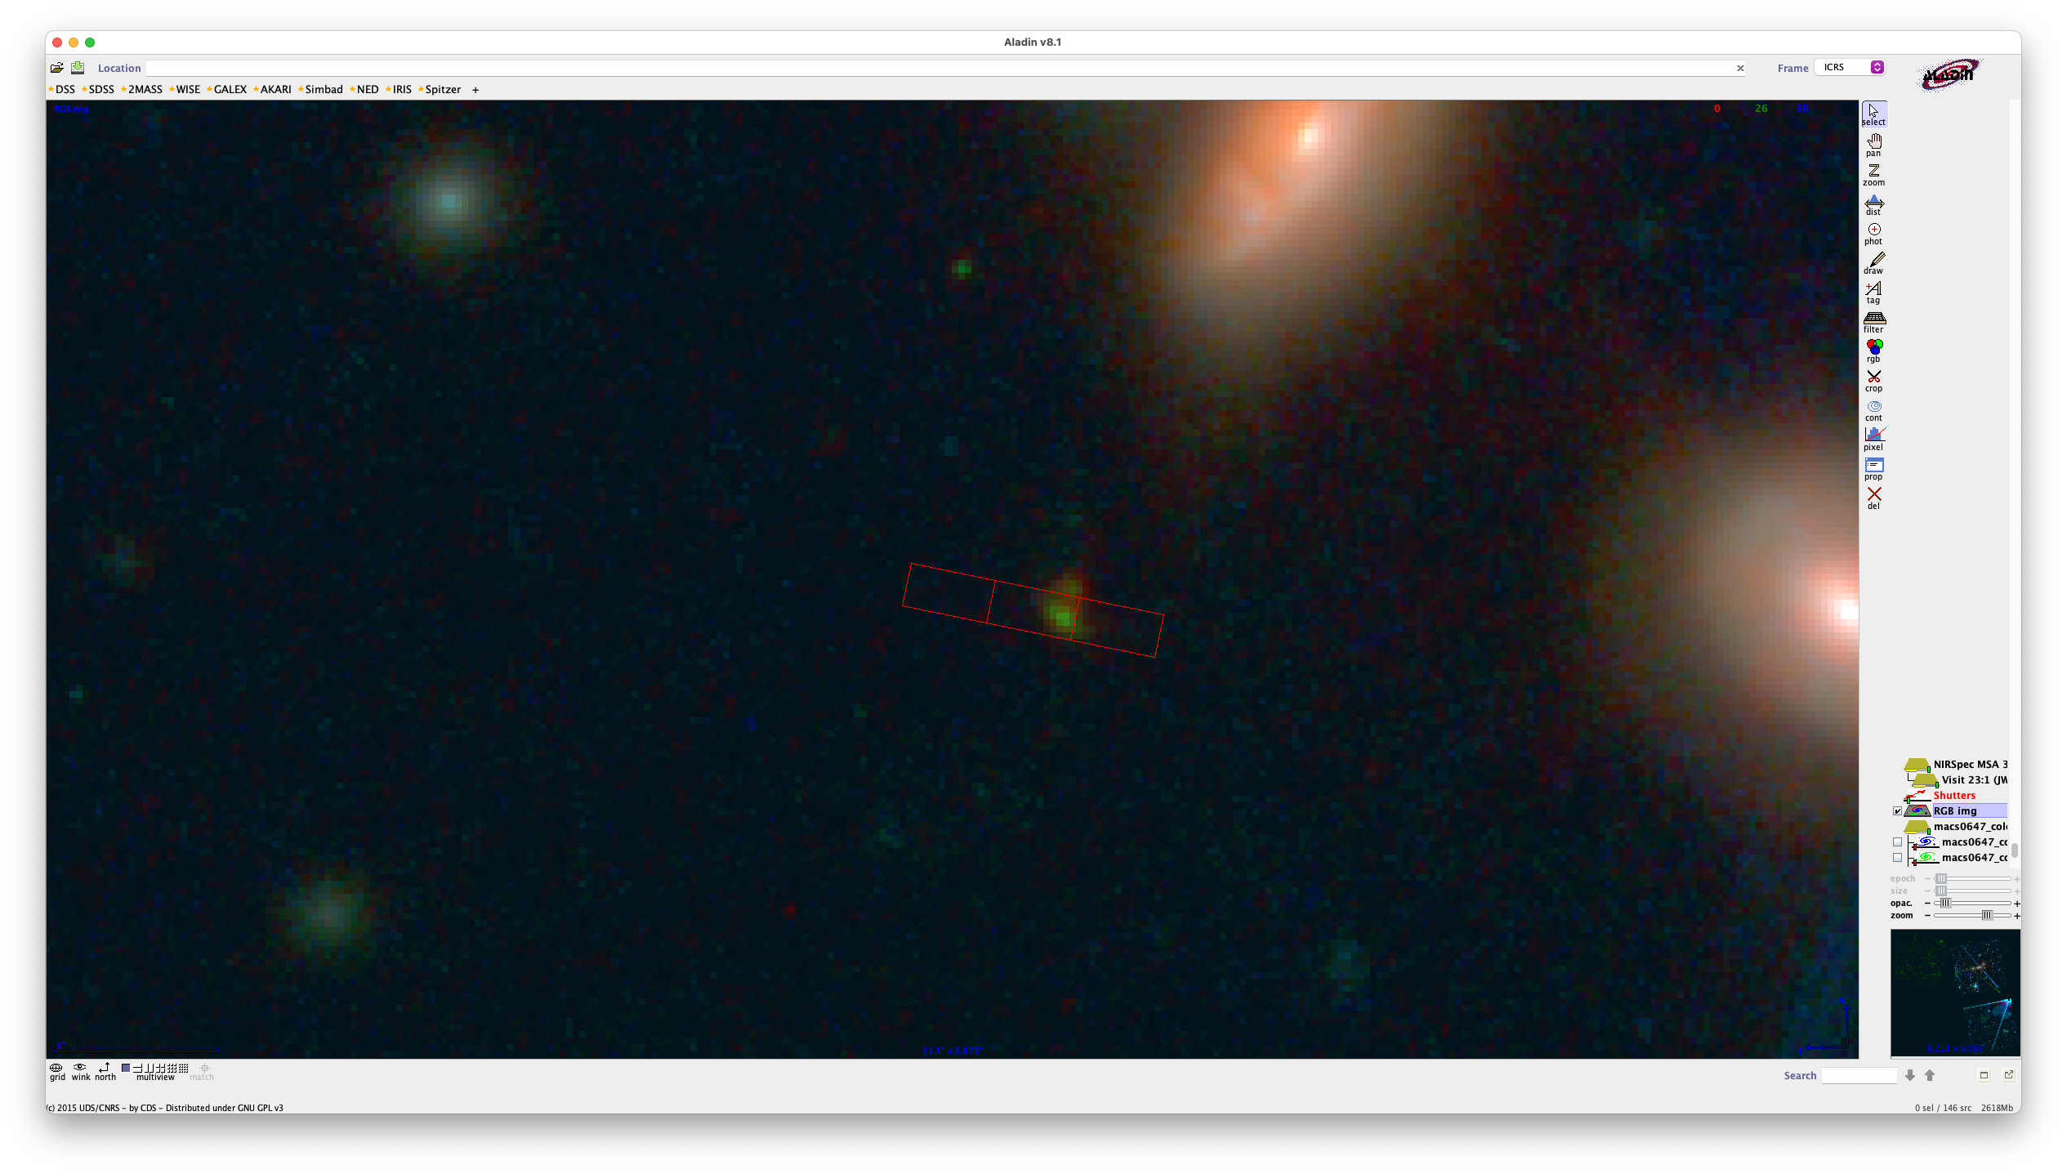
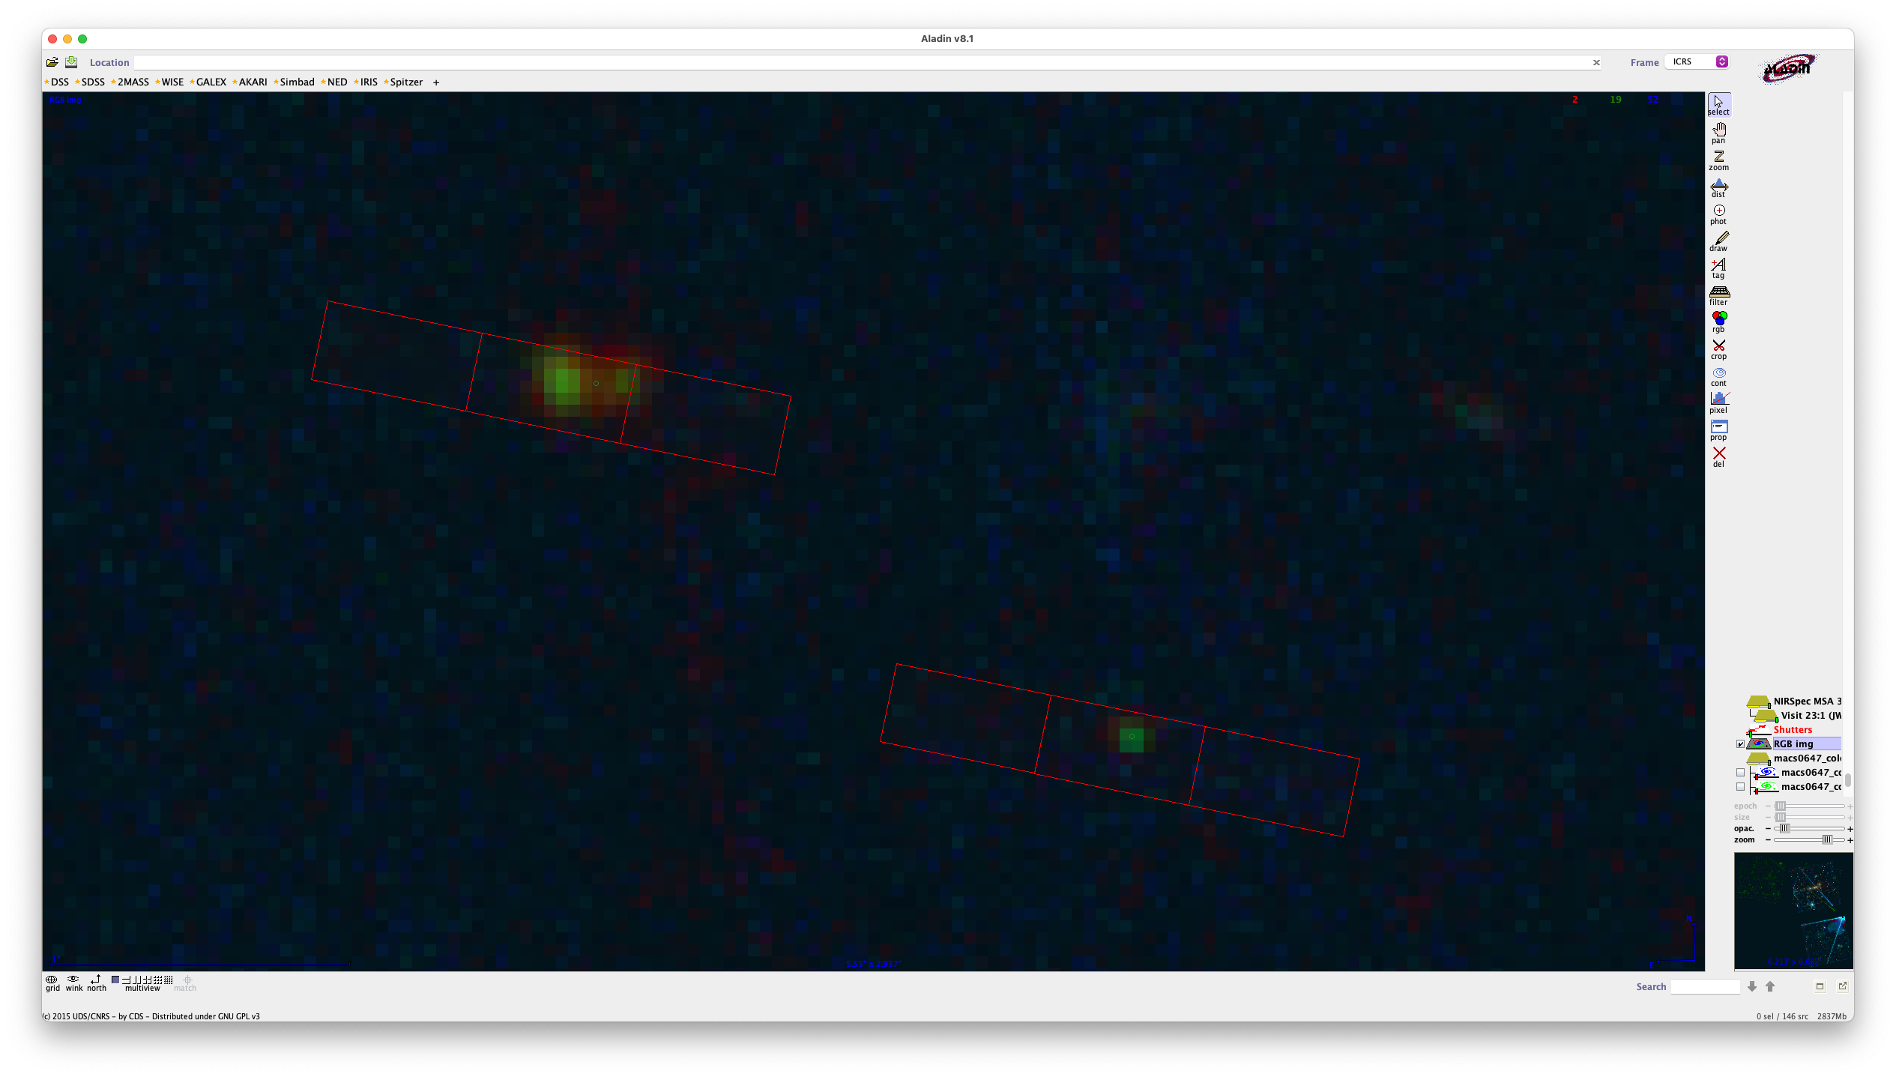
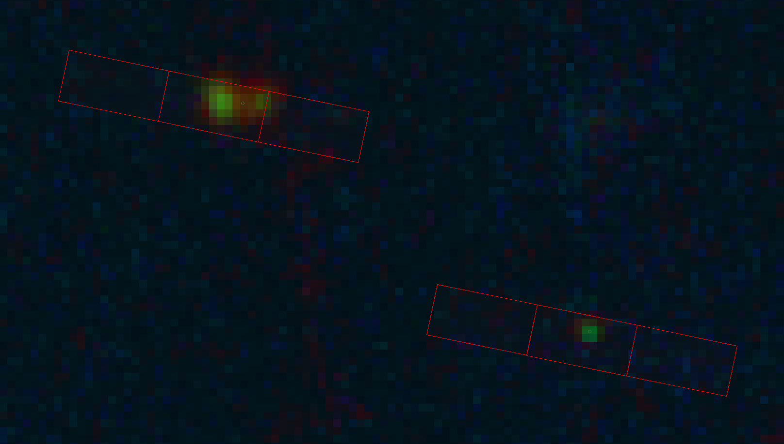
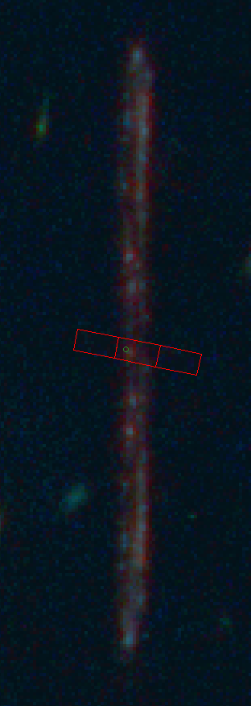
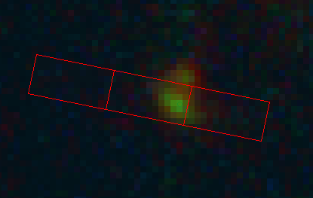
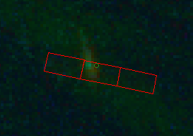
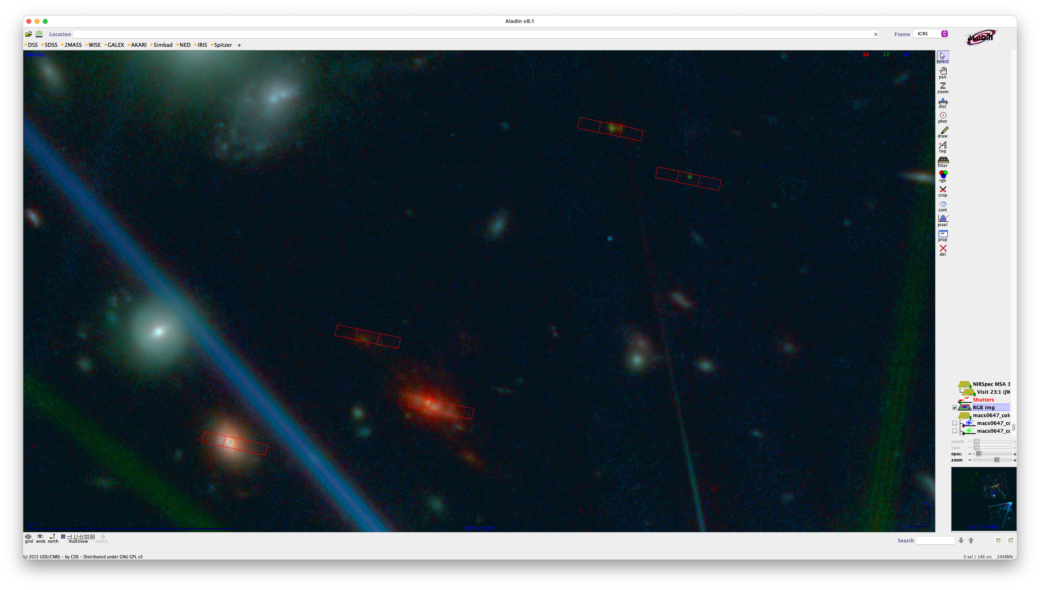


Slide 47
JD1A 3593
z ~ 11?
z=5
star
JD2 3349
JD2c

Slide 48

[NeIII]
Hγ
Lyα
CIII]
[OII]
[NeIII]
Hδ

