Slide 1
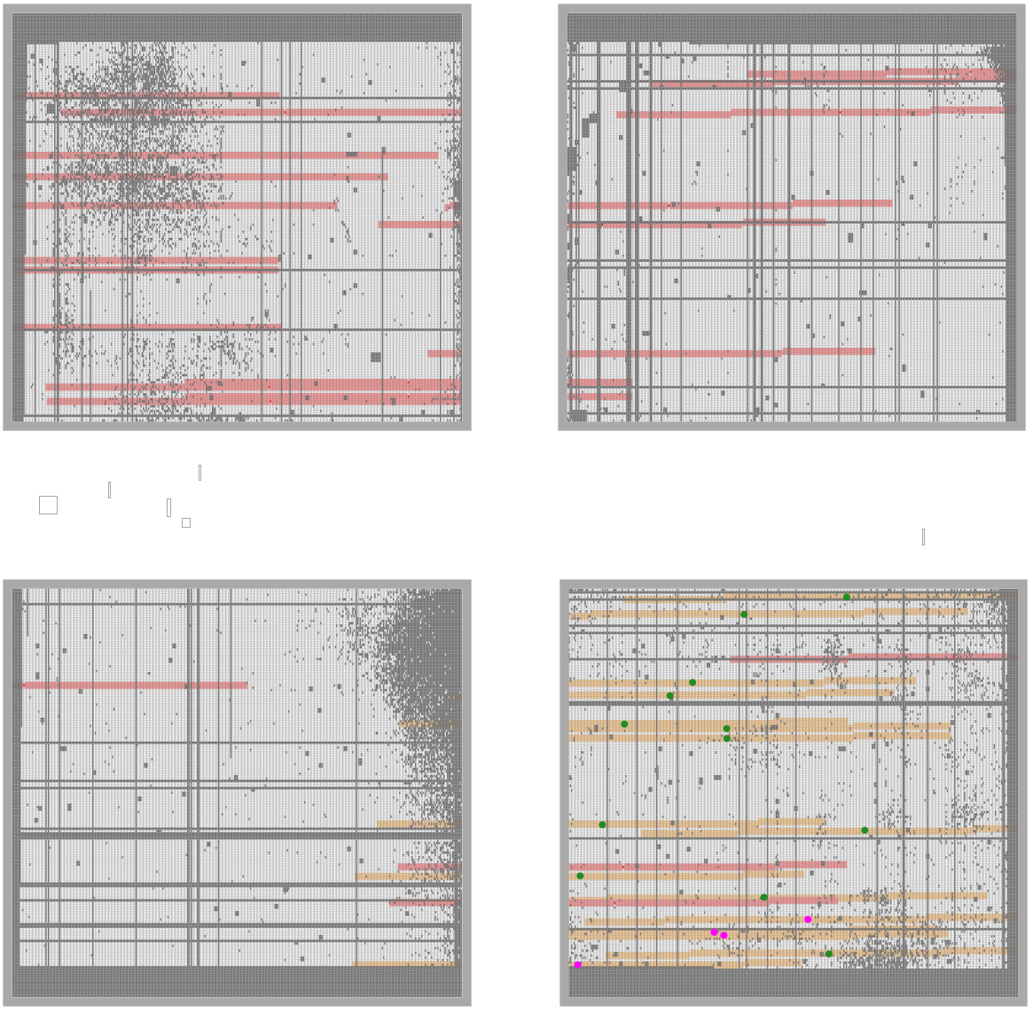
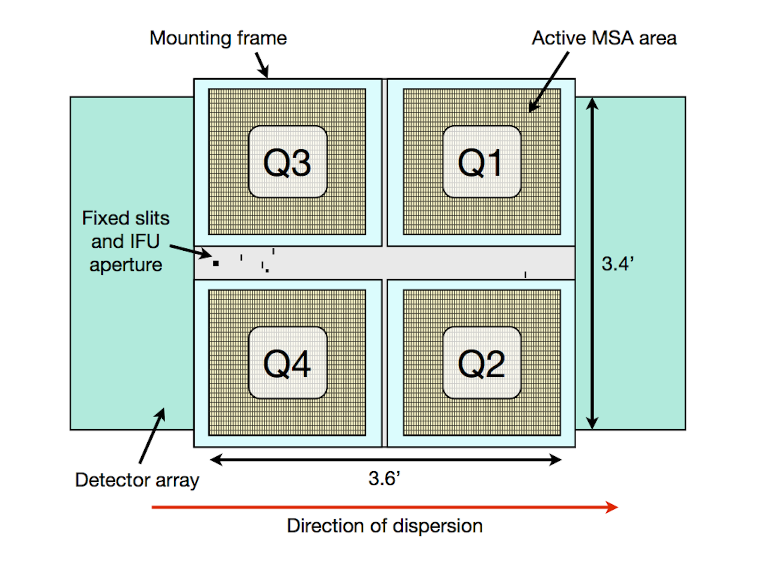
center Q2

Slide 2
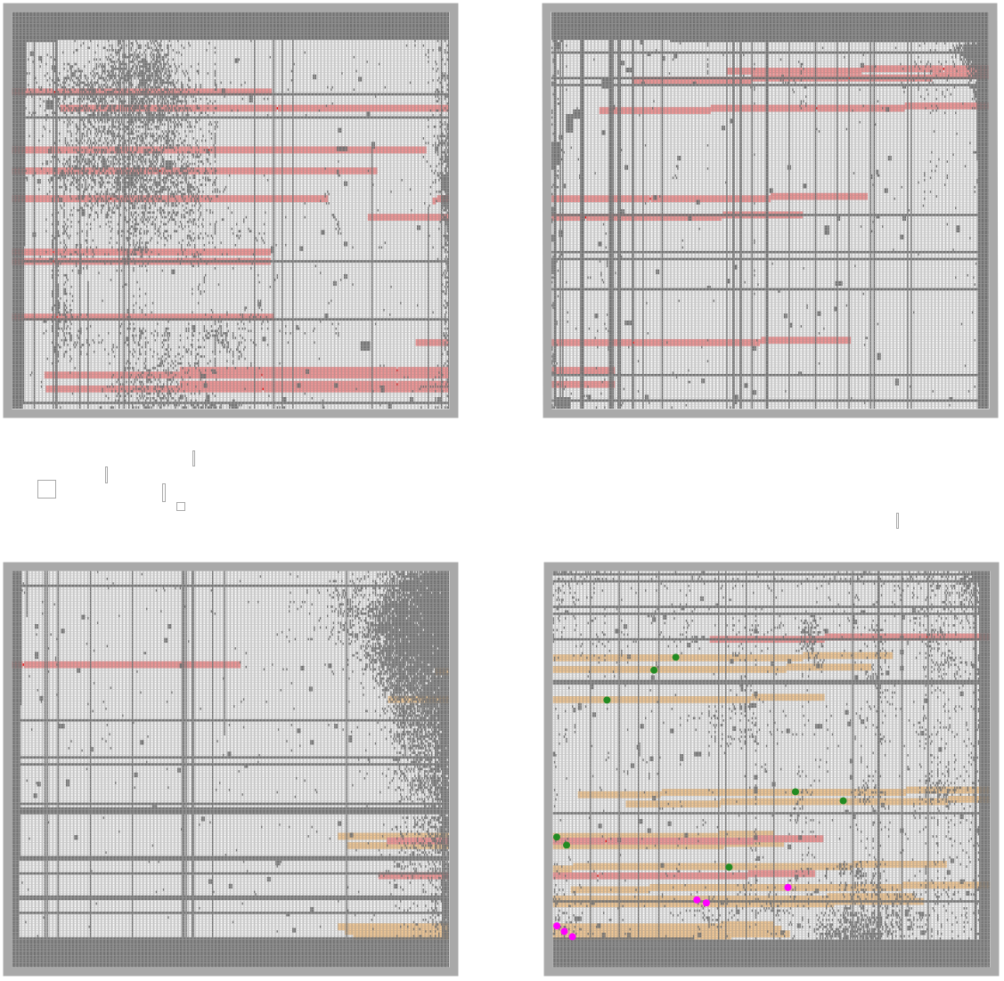
center Q2_2
JD1c
JD2c
JD1
JD2

Slide 3
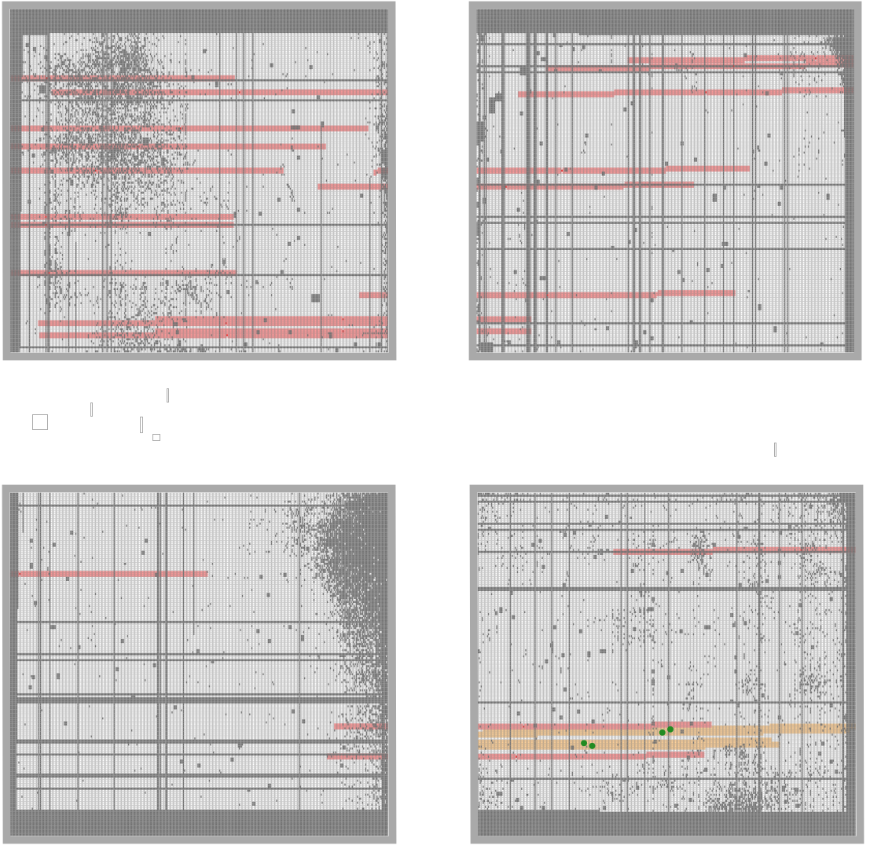
center Q2 8
JD1c
JD2c
JD1
JD2

Slide 4
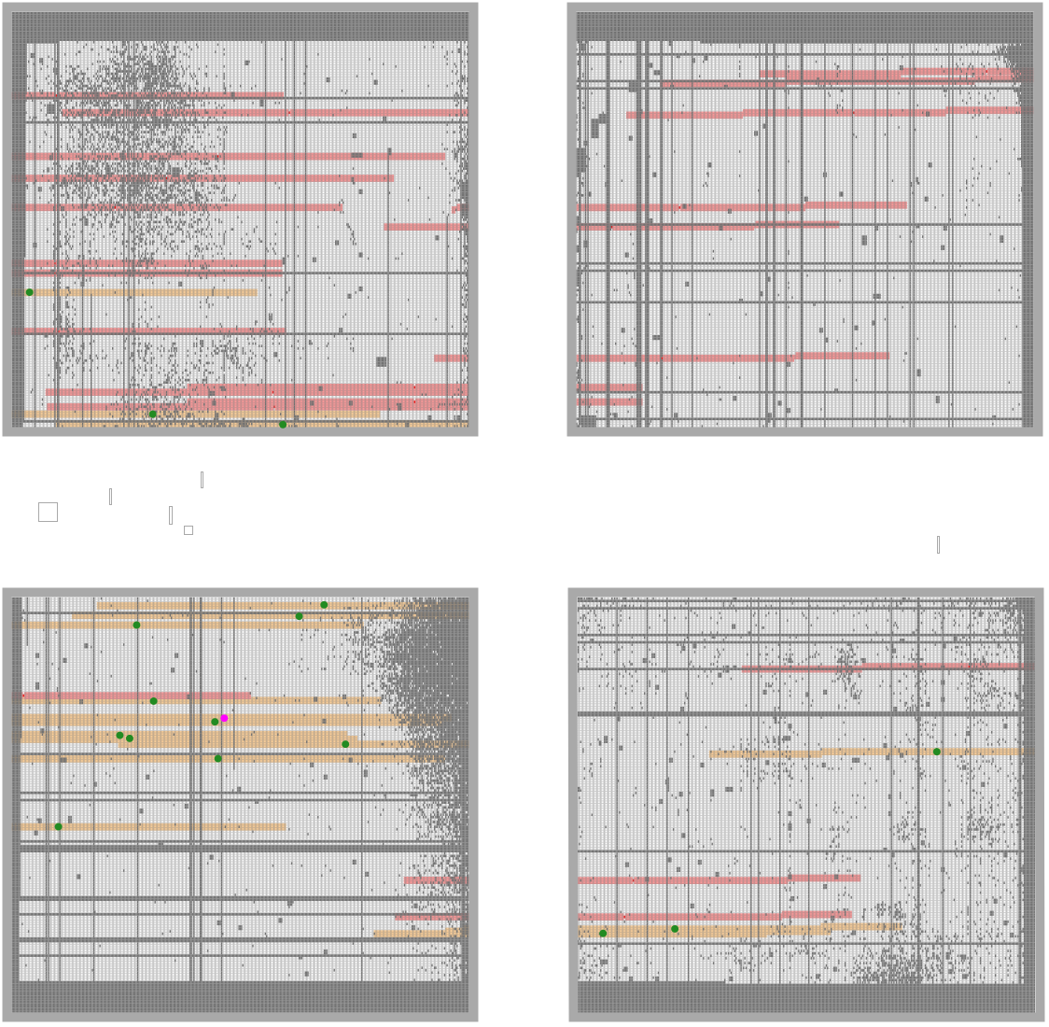
JD1c
JD2c
down left red Q4
NAILS it – JD2 and JD2c just within red edge
JD1
JD2

Slide 5
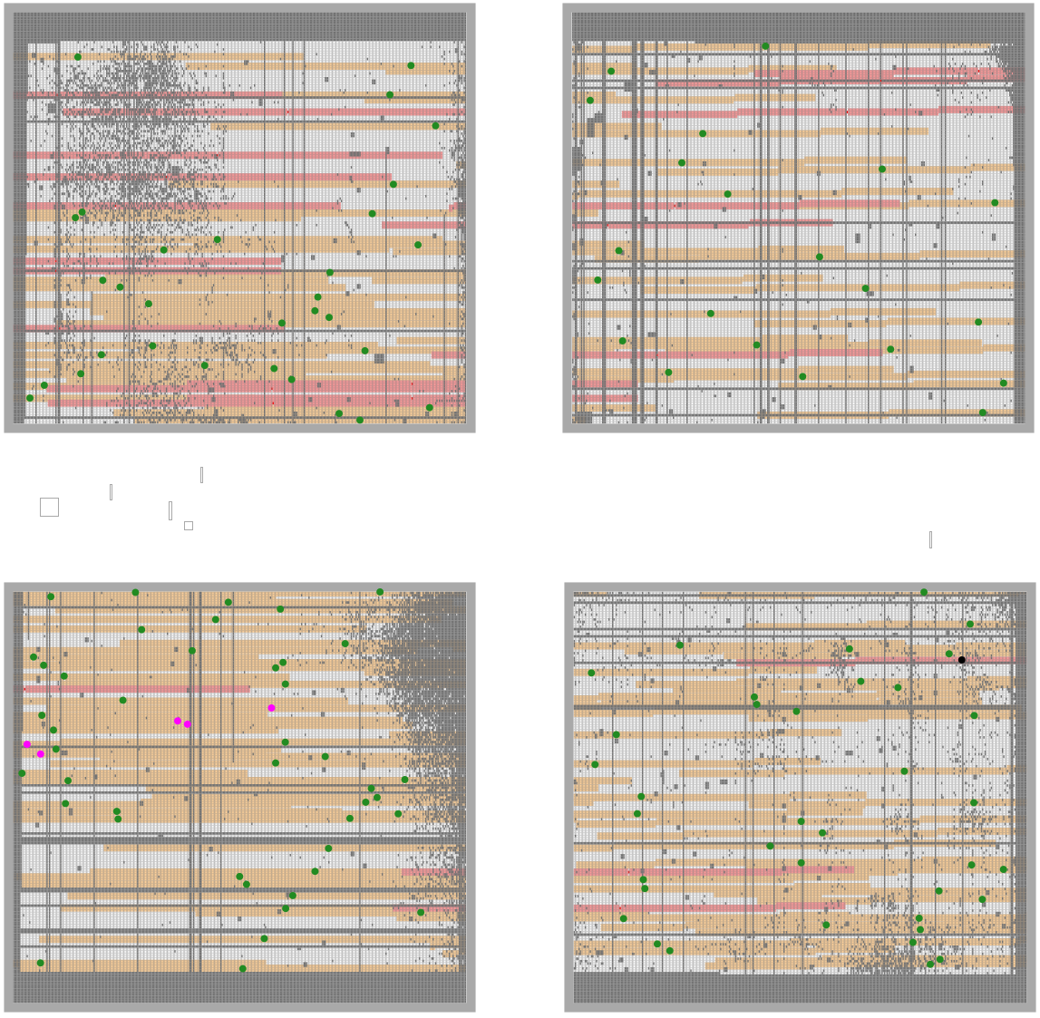
JD1c
JD2c
JD2
down left red Q4 MSA5p 4f
JD1

Slide 6
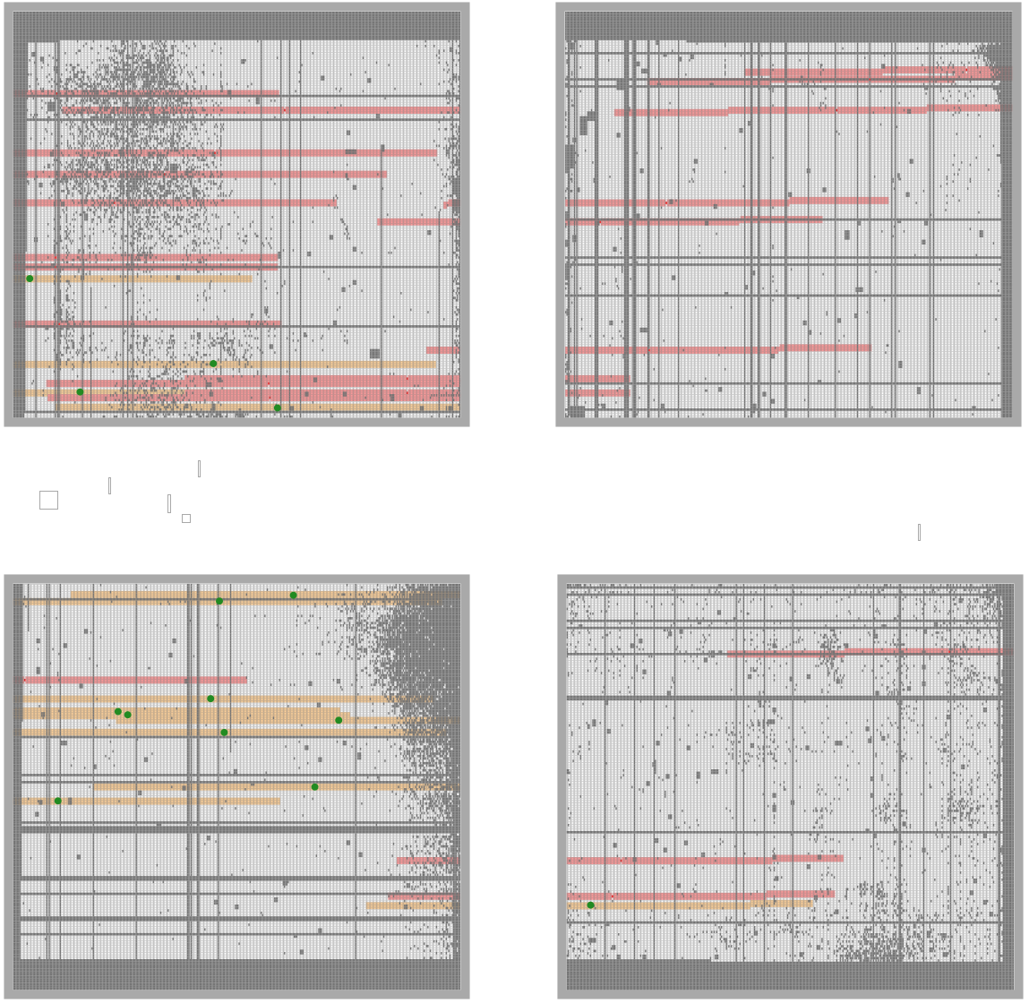
JD1c
JD2c
JD2
down left red Q4
NAILS it – JD2 and JD2c just within red edge
JD1

Slide 7
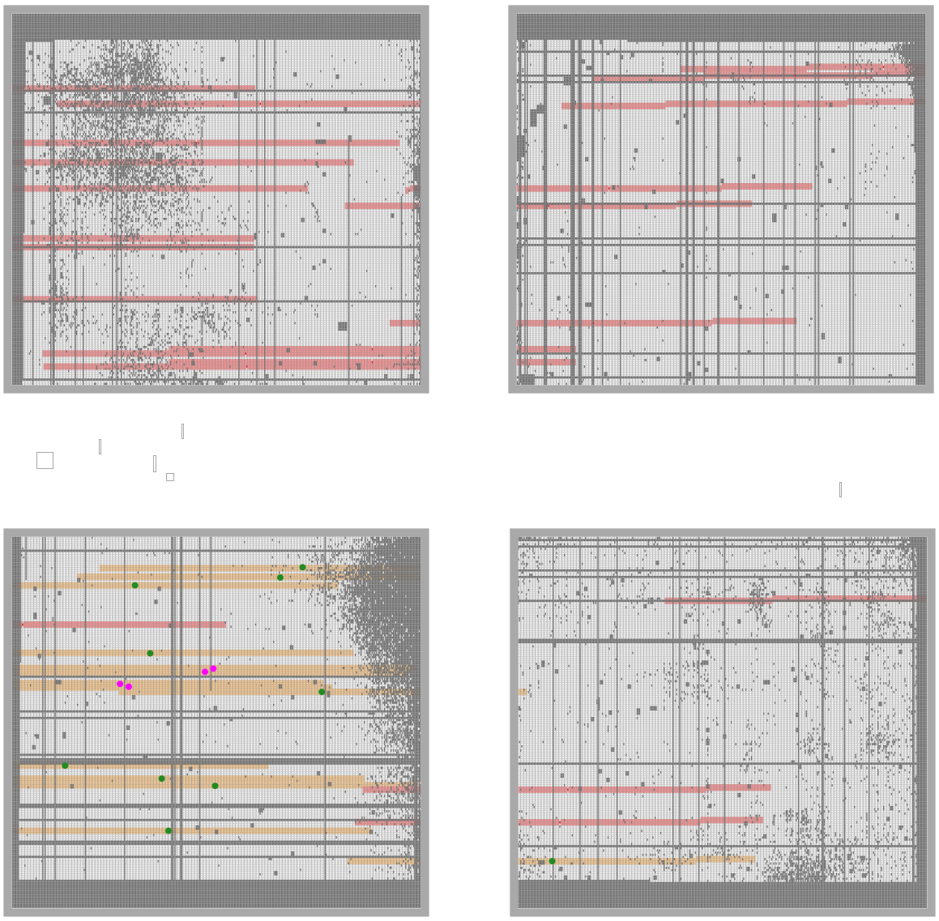
JD2c
down left red Q4
NAILS it – JD2 and JD2c just within red edge
JD1c
JD2
JD1

Slide 8
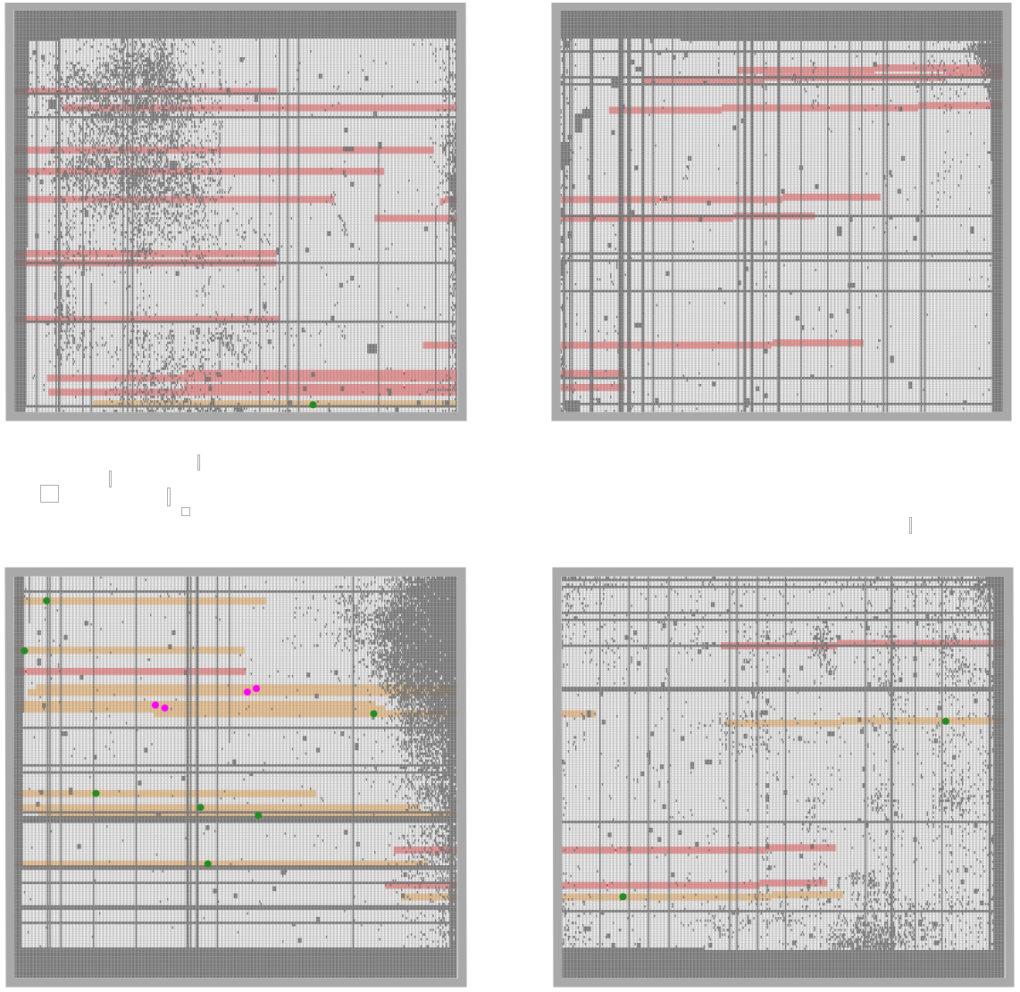
down left Q4

Slide 9
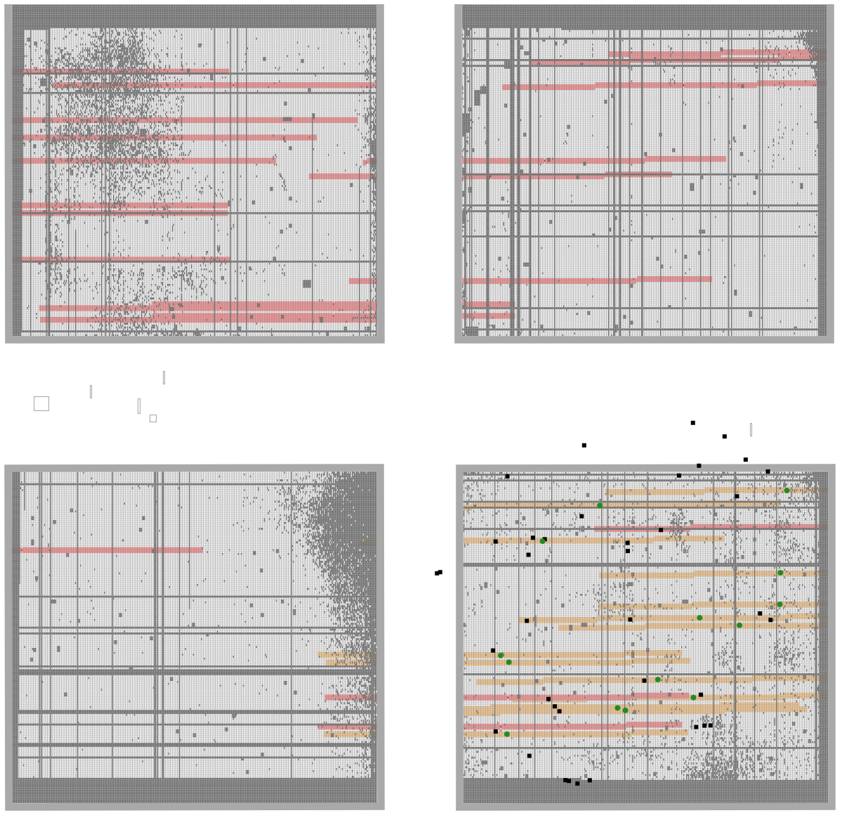
right

Slide 10
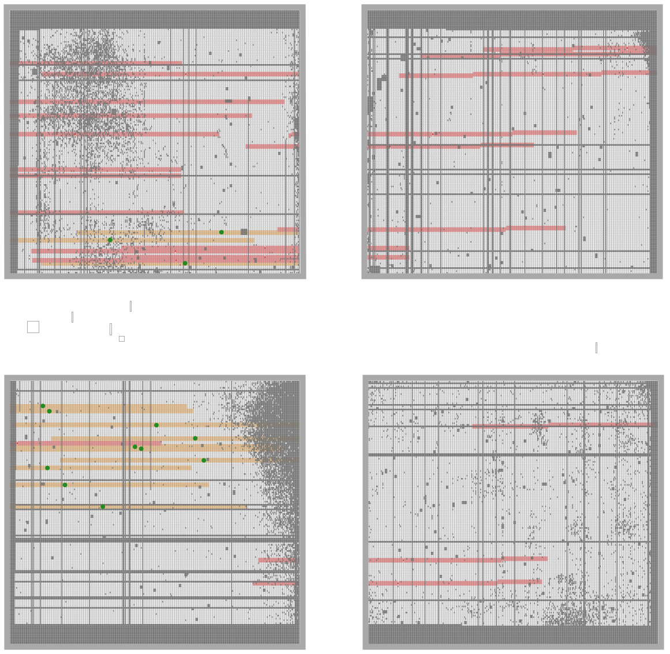
down left

Slide 11
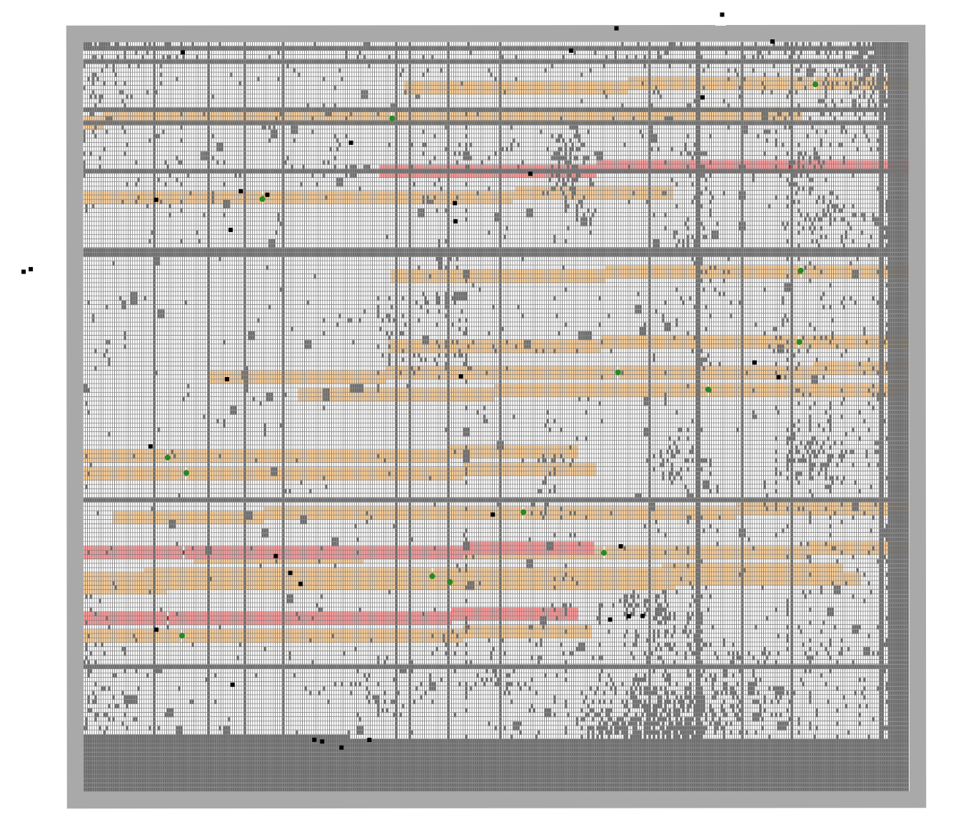
JD2
JD1c
5.3µm
JD1

Slide 12
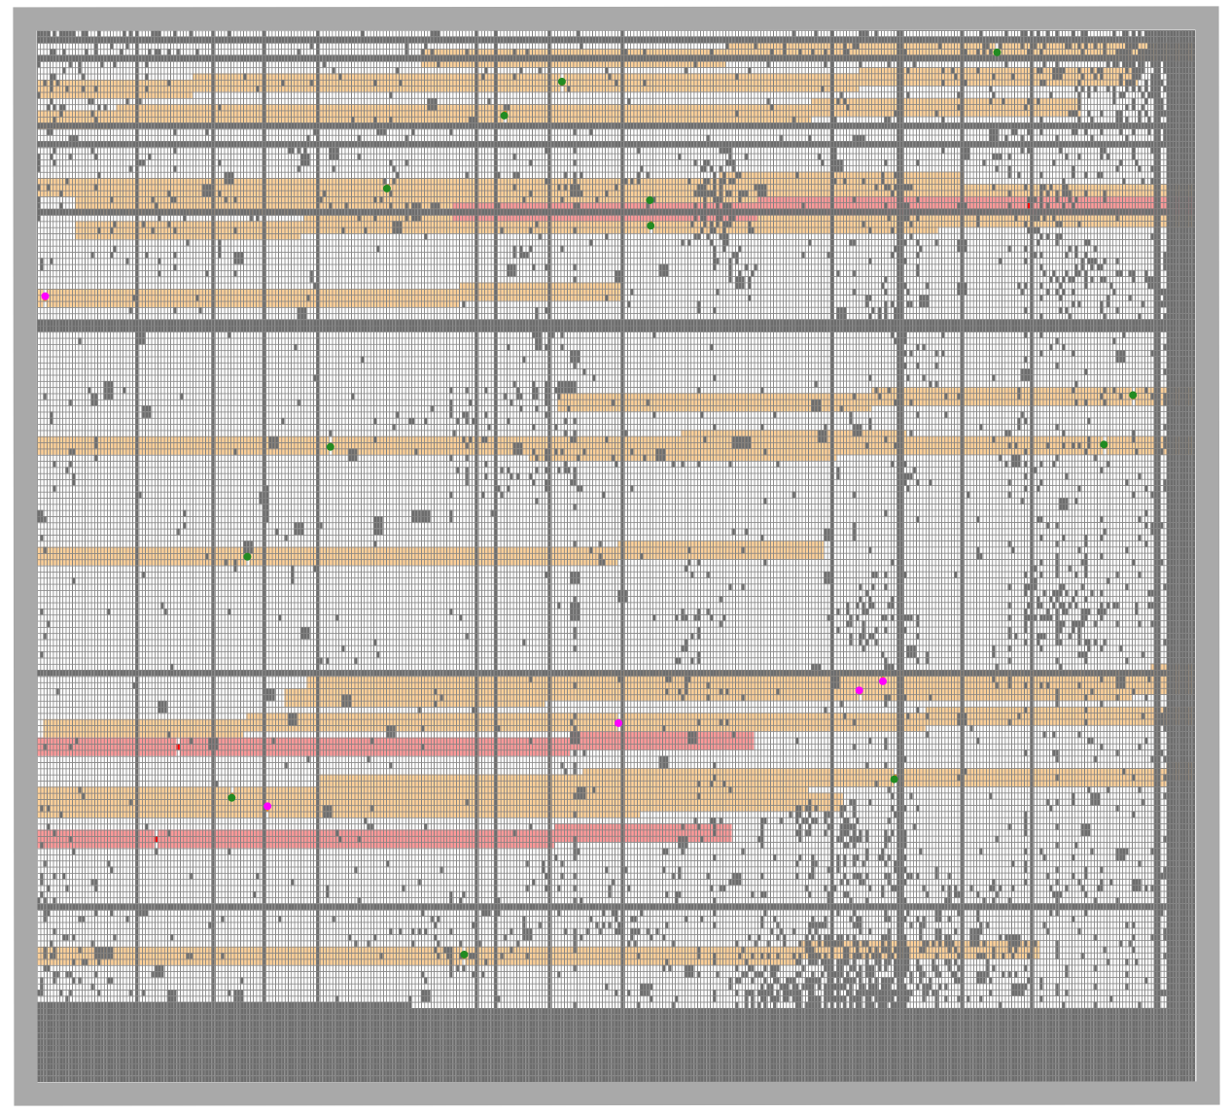
up right
This is why we can’t have nice things
actually this missed JD1
JD3
JD2c
JD1c
JD2
z=5 star

Slide 13
https://jwst-docs.stsci.edu/jwst-near-infrared-spectrograph/nirspec-observing-modes/nirspec-multi-object-spectroscopy

Slide 14
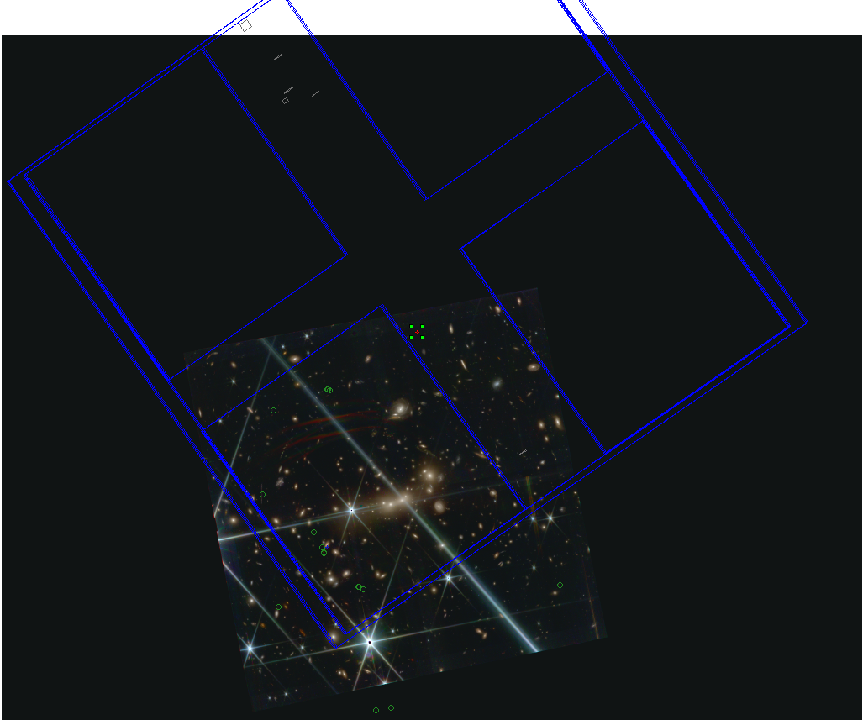

Slide 15
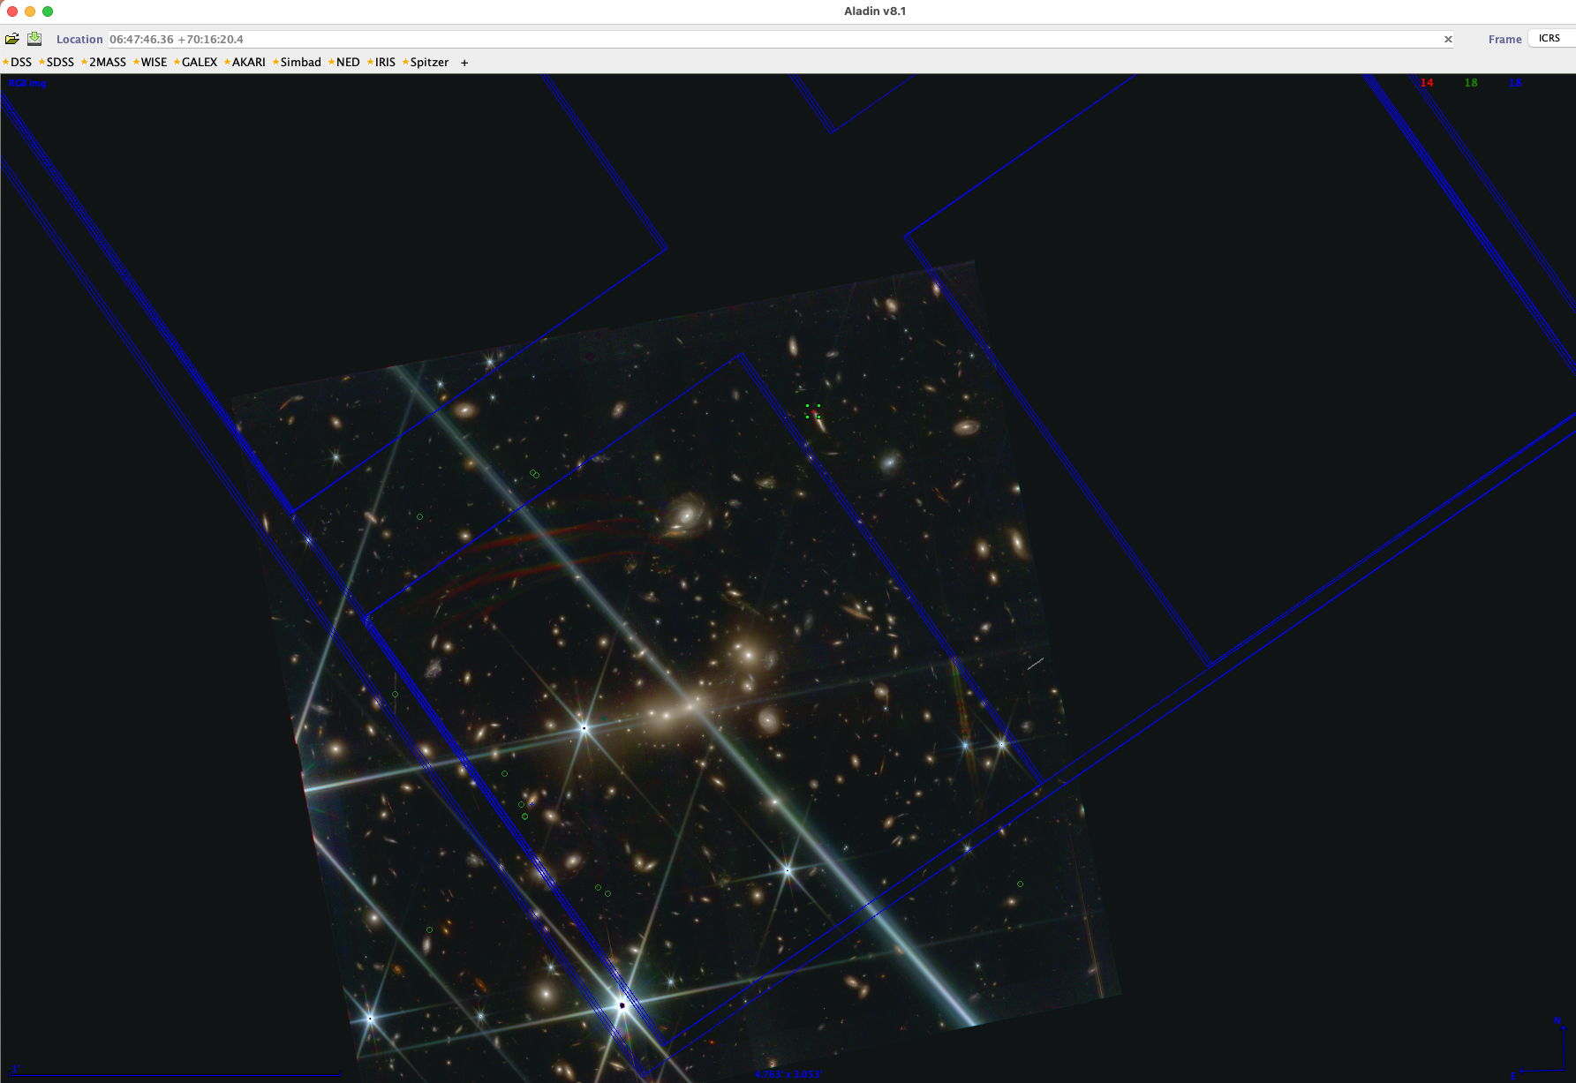

Slide 16
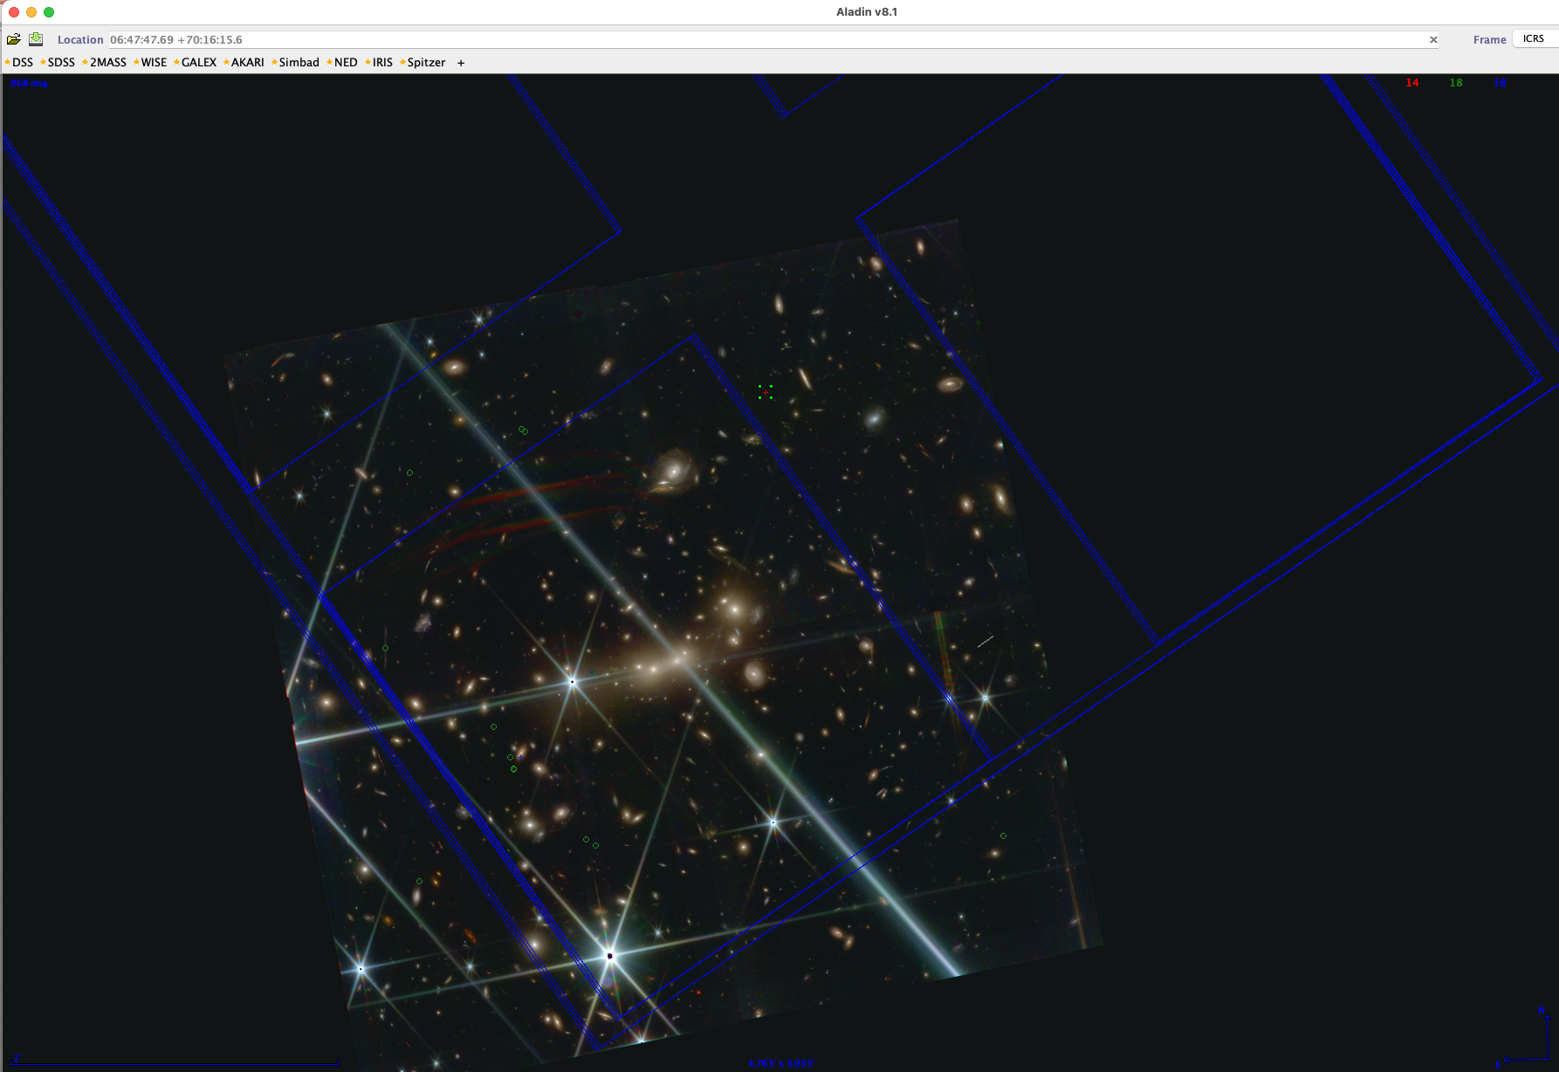

Slide 17
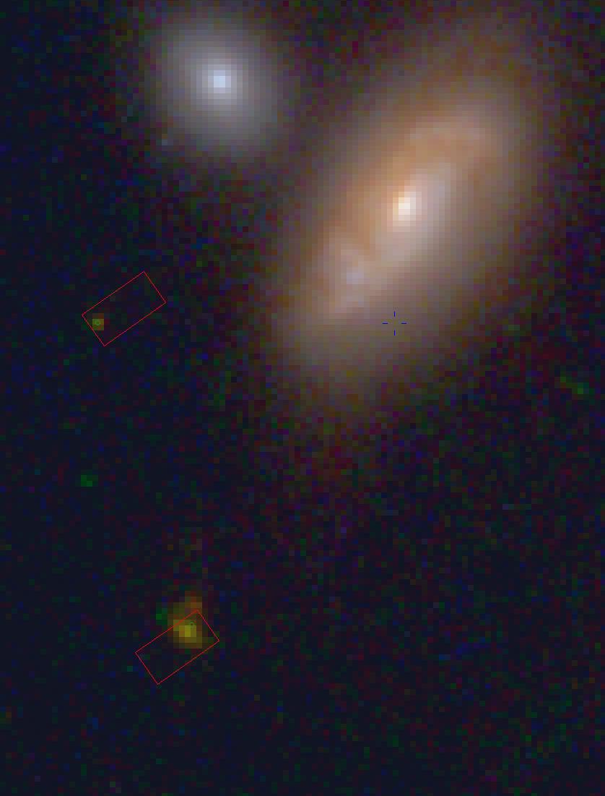
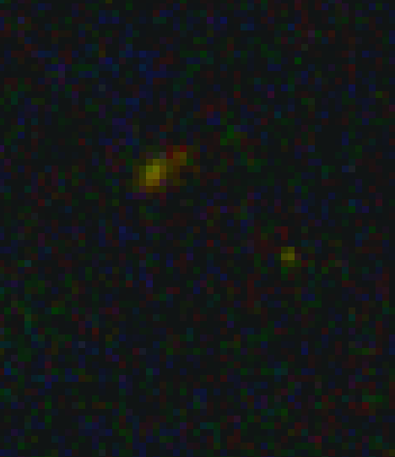
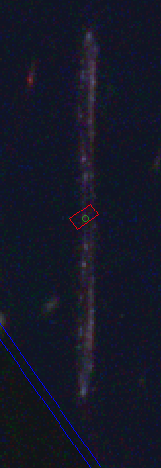
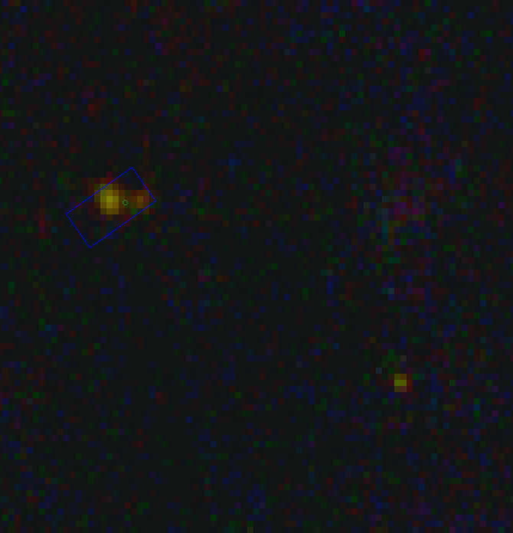
JD3
does have the best
cross dispersion spread,
but all within a pixel?
JD2
JD1

Slide 18
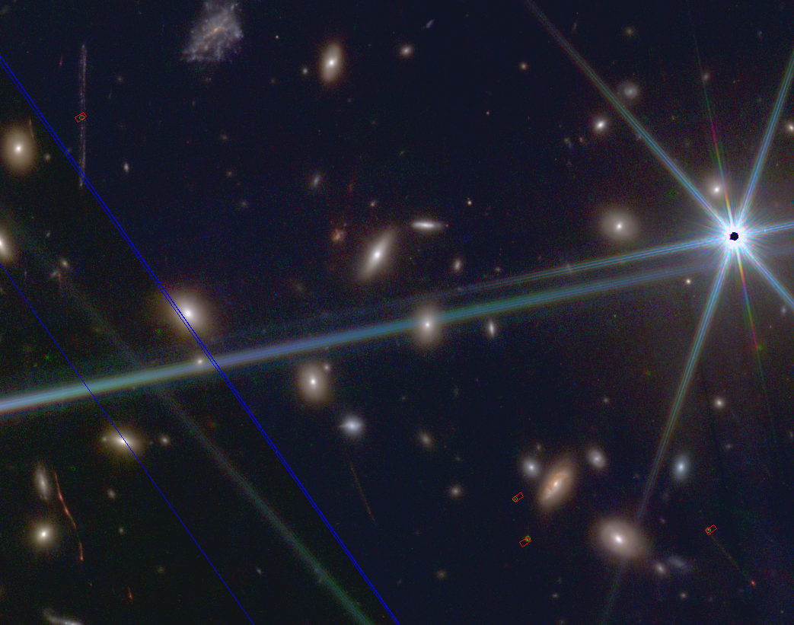

Slide 19
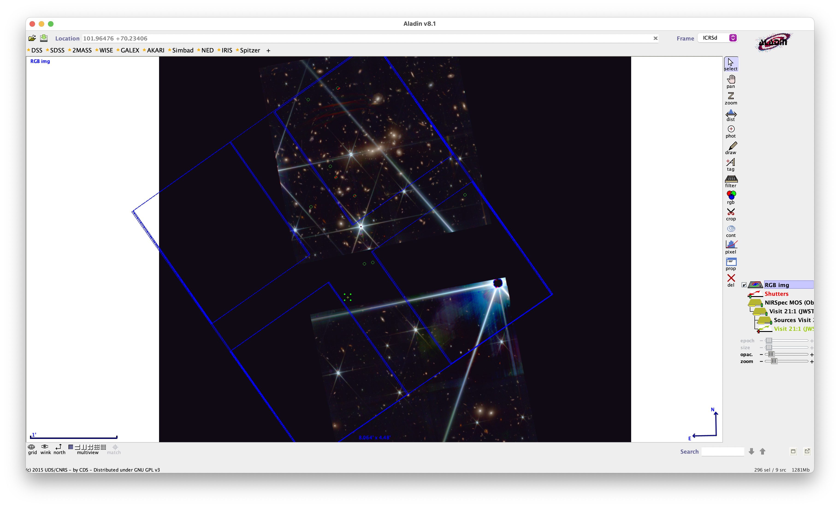
We’ll avoid putting the bright star on any detector

Slide 20
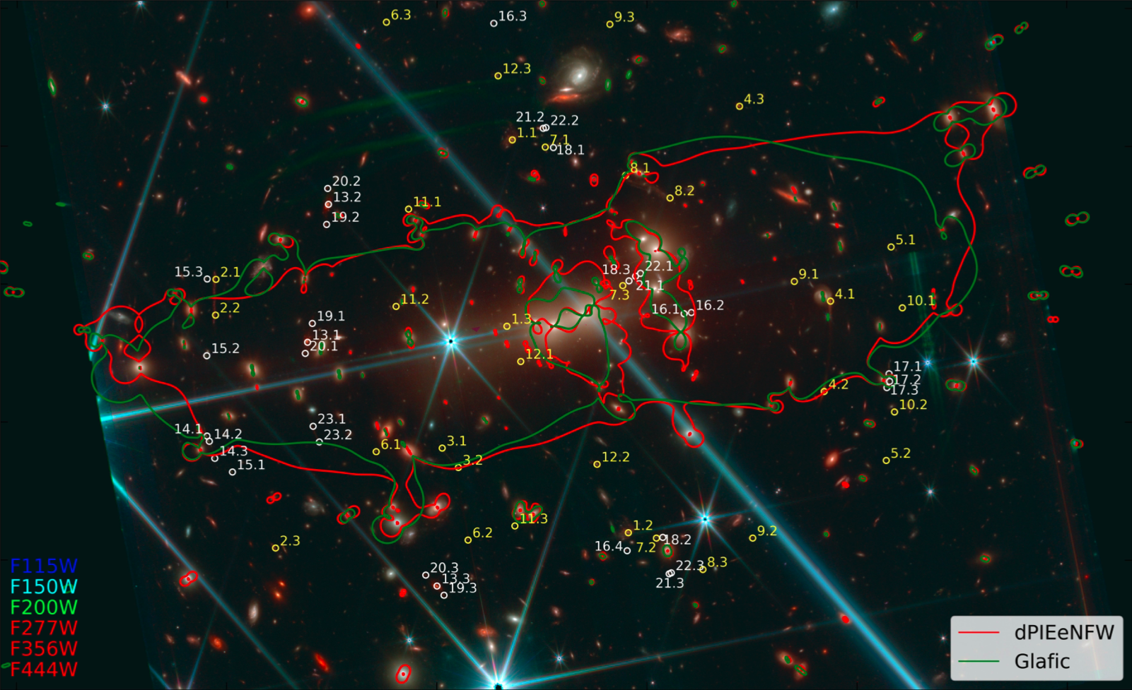

Slide 21
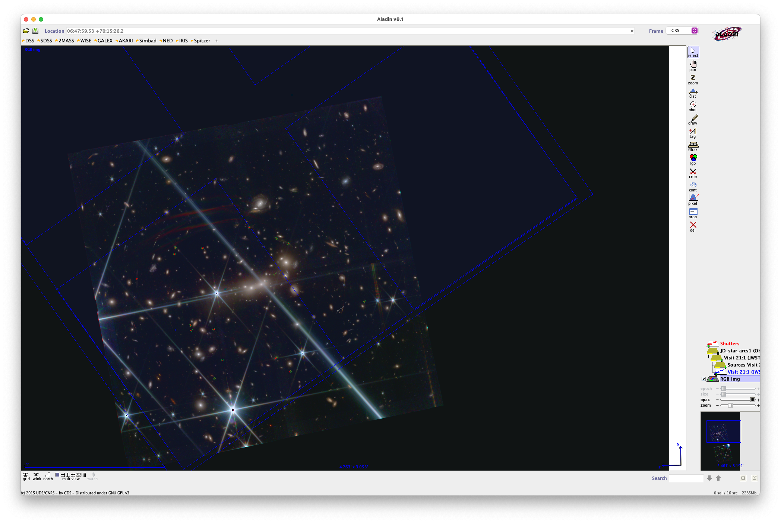
Q4
Q2
Q4
Q2
Q3
Q1
Q3
Q1

Slide 22
Q4
Q2
Q4
Q2
Q3
Q1
Q3
Q1

Slide 23
Q4
Q2
Q4
Q2
Q3
Q1
Q3
Q1

Slide 24
Q4
Q2
Q4
Q2
Q3
Q1
Q3
Q1

Slide 25
Q4
Q2
Q4
Q2
Q3
Q1
Q3
Q1

Slide 26
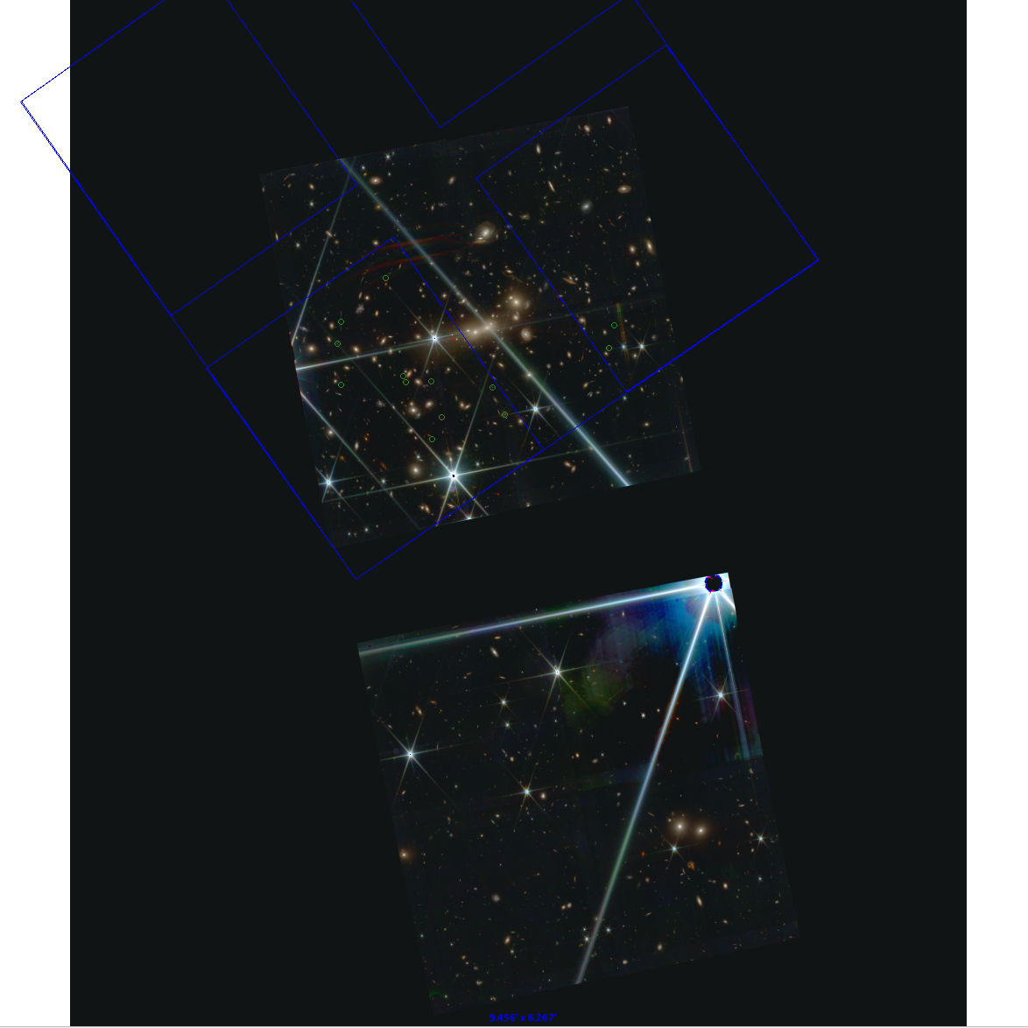

Slide 28


Slide 29
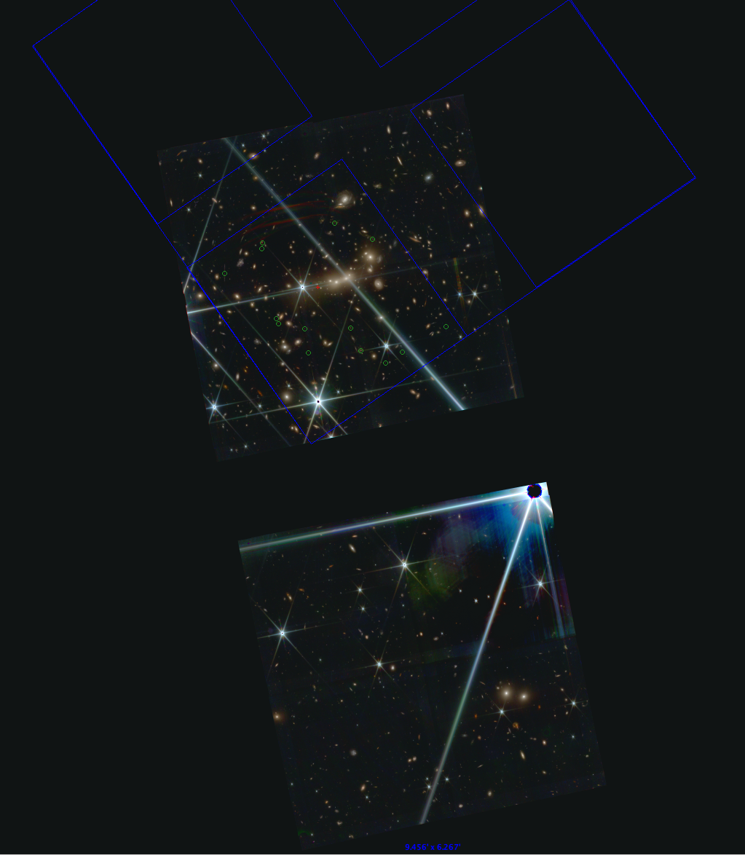

Slide 30
if I catch JD3 6.3,
then I lose the red edge
of the spectra for JD1,2

Slide 31
catch JD3 in one exposure?

Slide 32
catch JD3 in one exposure?

Slide 33
in fact you might try to center JD2 better

Slide 34
in fact you might try to center JD2 better
in both exposures

Slide 35
…
center Q2
down left red Q4
in fact you might try to center JD2 better
in 3/4 exposures

Slide 36
tweaking…
center Q2
down left red Q4
in fact you might try to center JD2 better
in 3/4 exposures

Slide 37
tweaking…
center Q2
down left red Q4
in fact you might try to center JD2 better
in 3/4 exposures

Slide 38
3 exposures?
center Q2
down left red Q4
in fact you might try to center JD2 better
in 3/4 exposures

Slide 39
tweaking…
center Q2
down left red Q4
in fact you might try to center JD2 better
in 3/4 exposures

Slide 40
center Q2
down left Q4
in fact you might try to center JD2 better
in 3/4 exposures

Slide 41
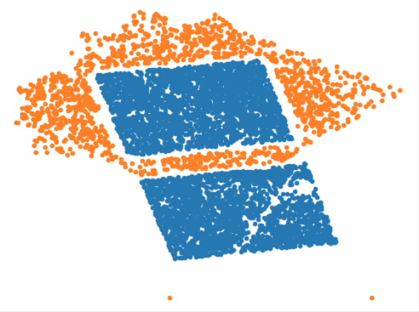
center Q2
down left Q4
in fact you might try to center JD2 better
in 3/4 exposures

Slide 42
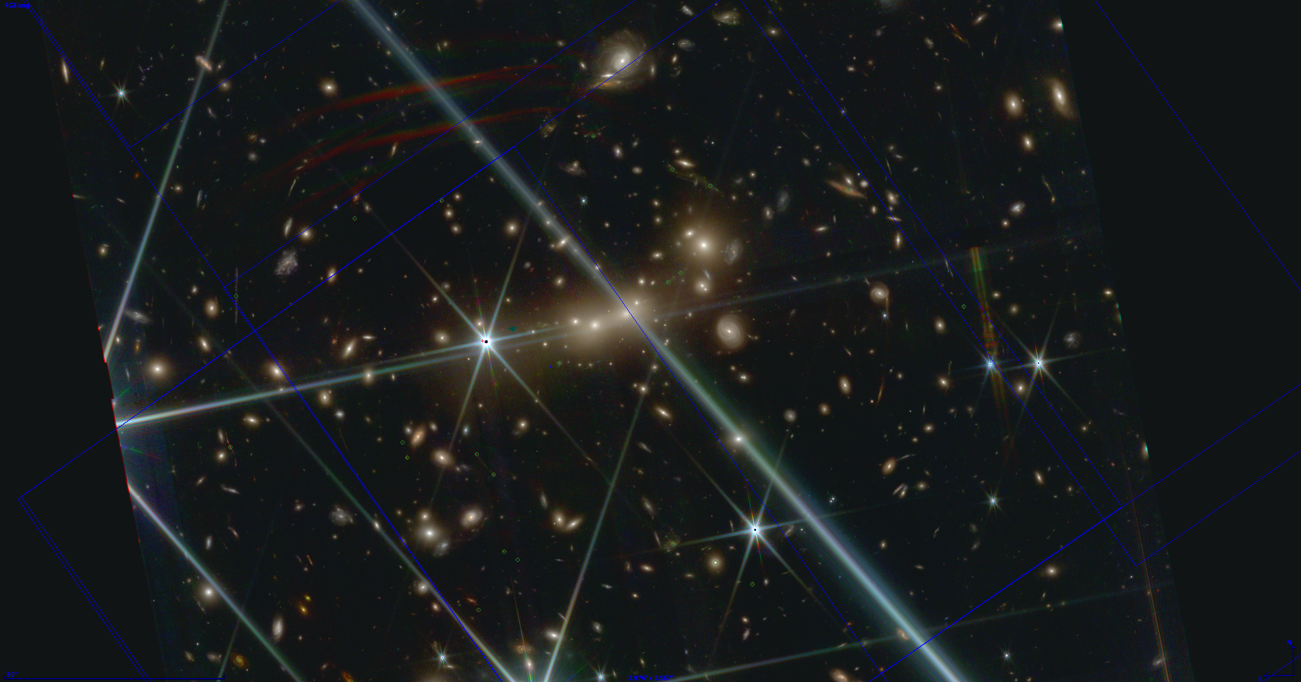
15c
z=5 clumps
z=5 star
z=5 clumps
JD1c
JD1
15a z=11.5
JD2
JD2c

Slide 43
z = 6
z = 5
z = 7
z = 11
z = 11

Slide 44
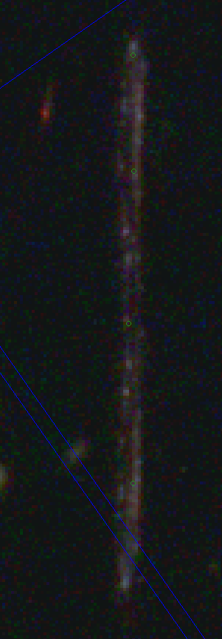
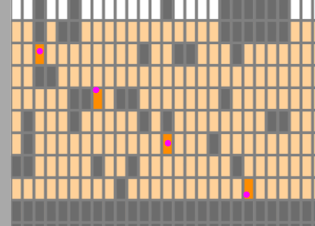
never gonna get 15c
only 1 row from z=5 star

Slide 45
close to final placement
center Q2
down left red Q4

Slide 46
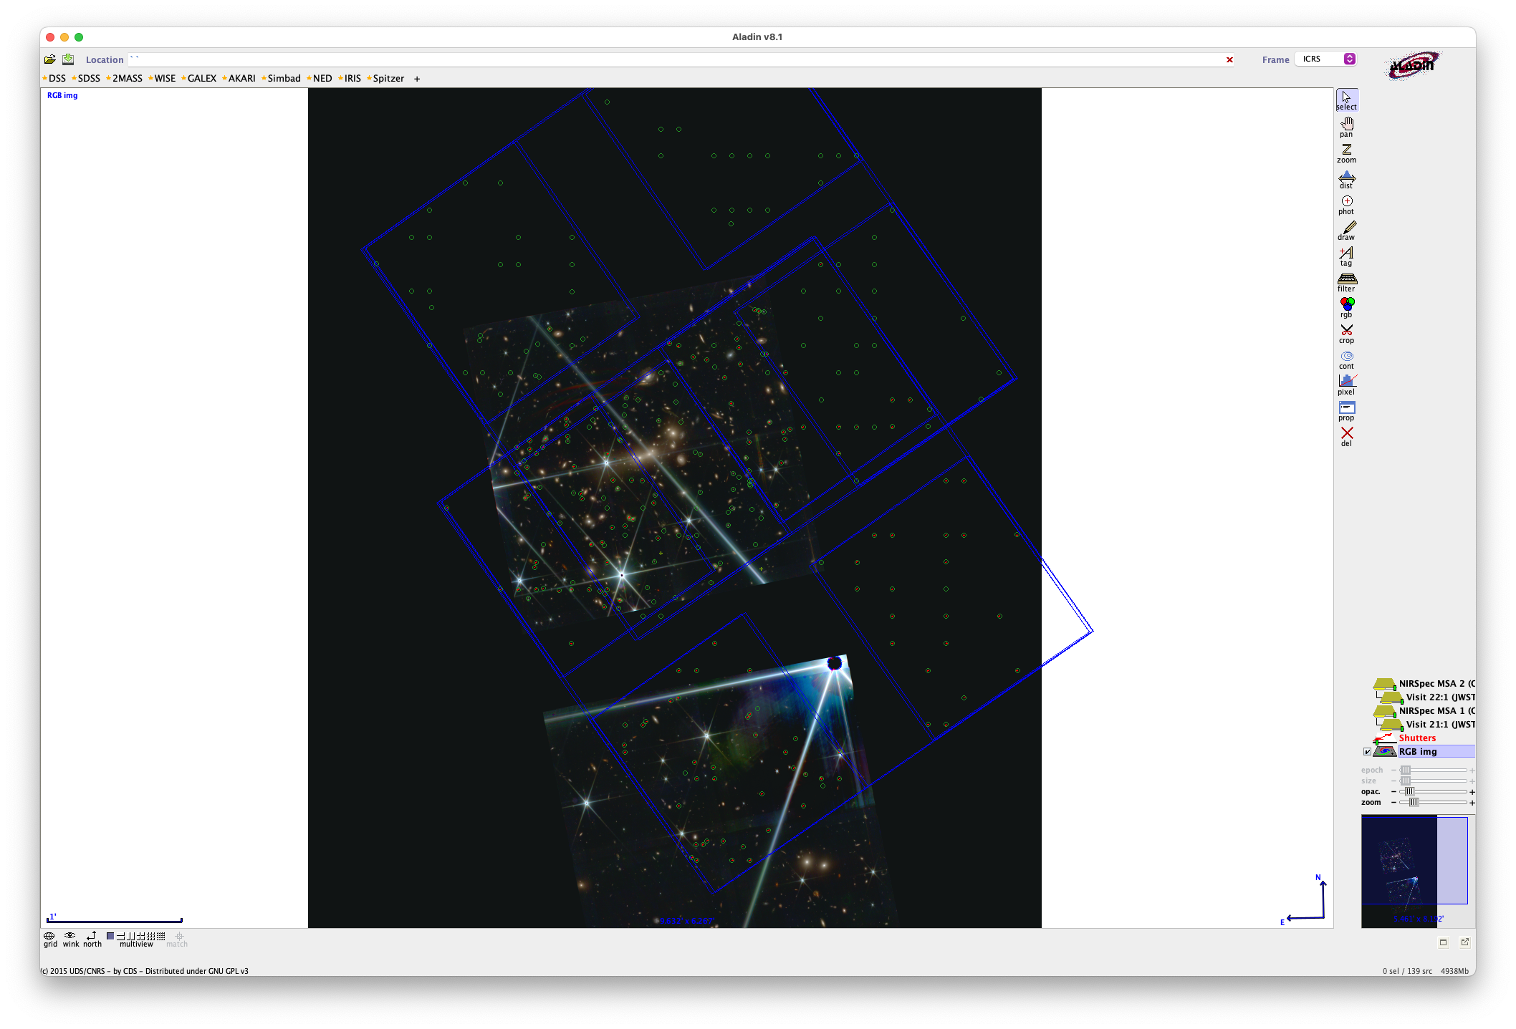


Slide 48
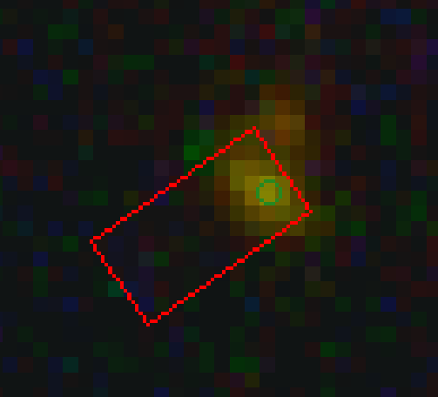
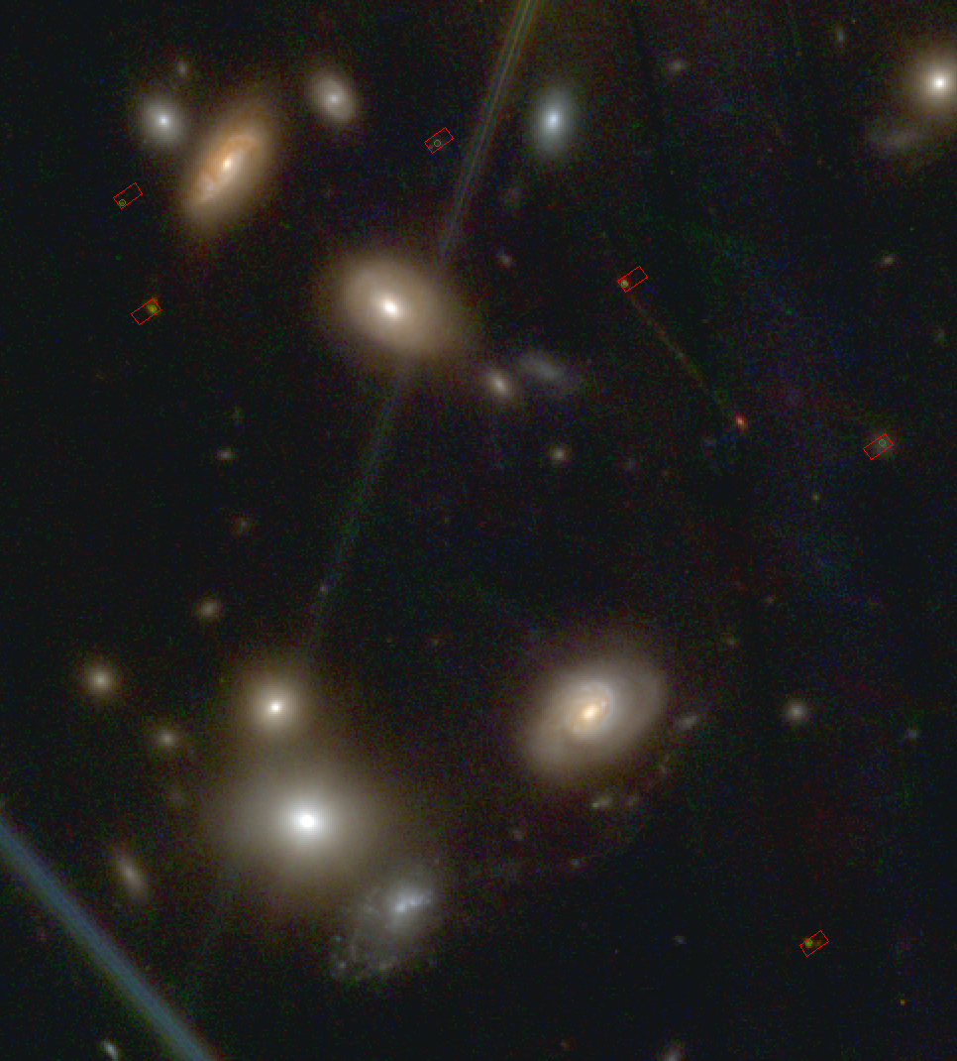
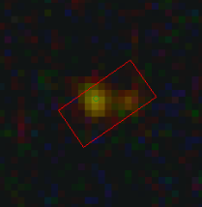
JD1c
JD1
JD1
JD2
A
B
JD2
JD2c

Slide 49
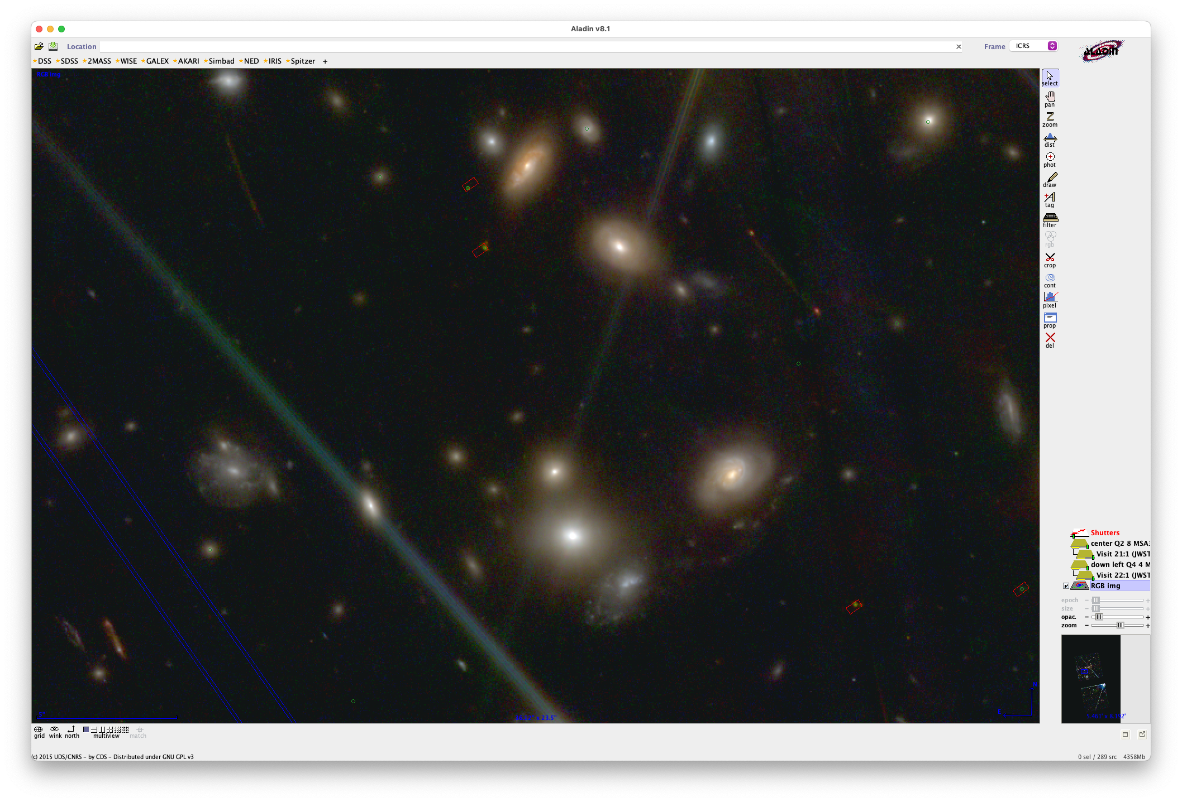

Slide 50
