Slide 1
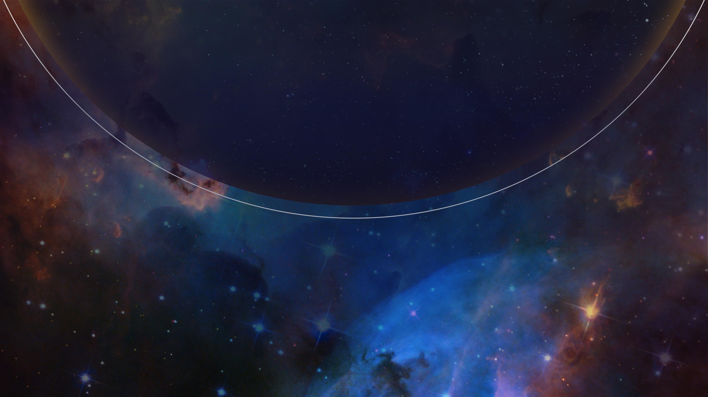

JWST NIRSpec MOS Data Reduction
EXPANDING THE FRONTIERS OF SPACE ASTRONOMY
Dan Coe & Kayli Glidic
STScI JWebbinar #33
June 27, 2024

Slide 2

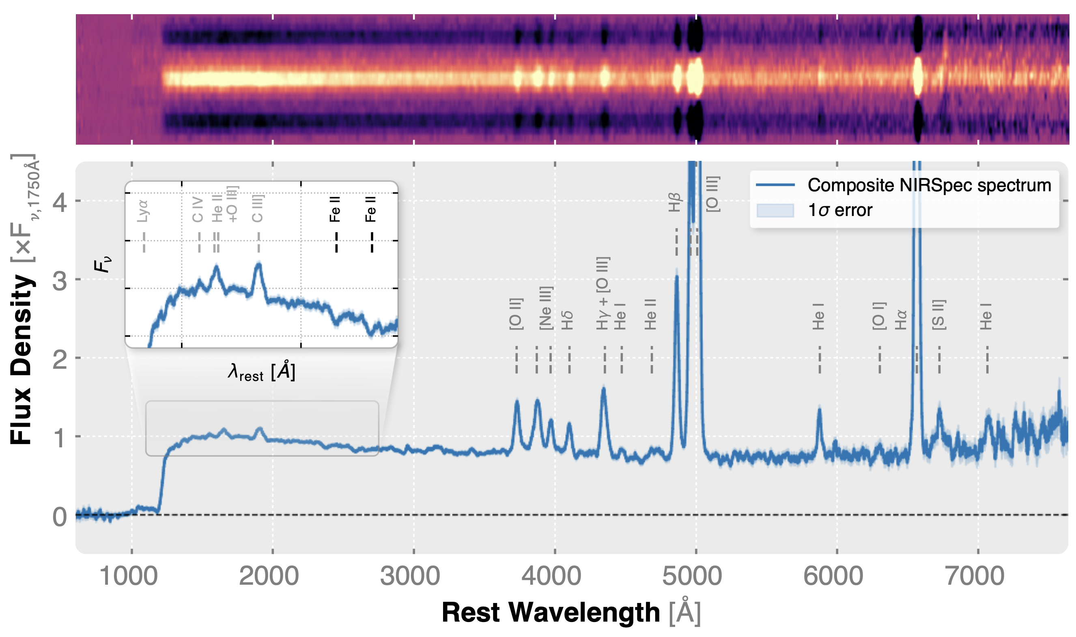
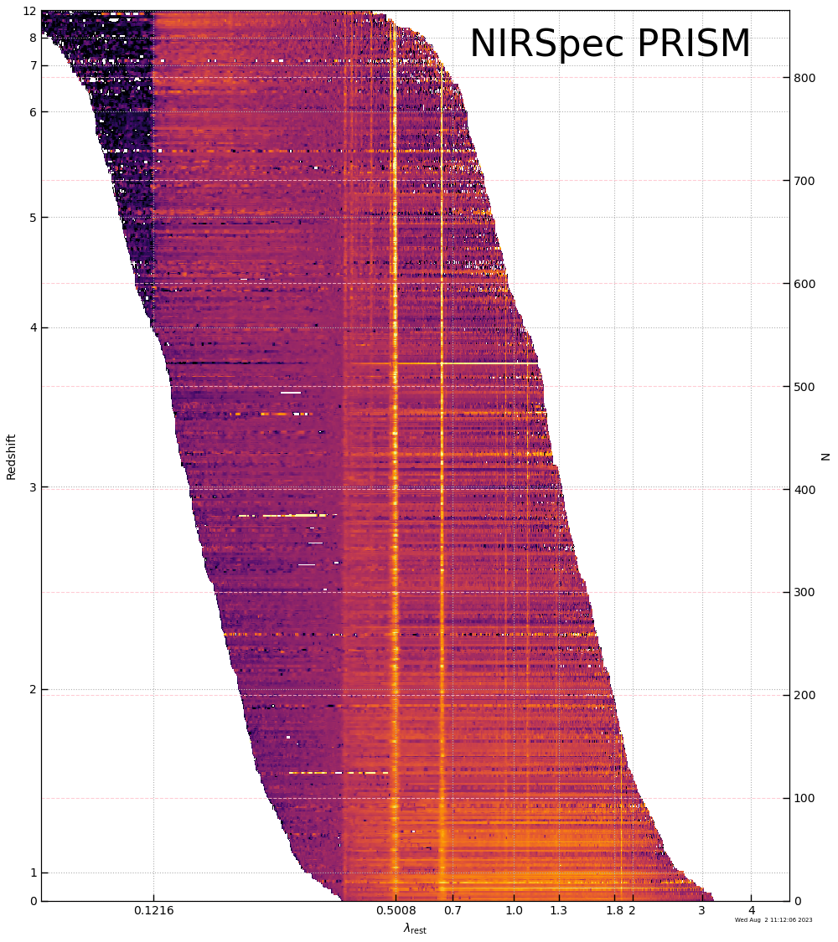

NIRSpec MOS is awesome
arXiv:2405.21054
1000 spectra

Slide 3
JWebbinar #33 session outline
This webinar will cover NIRSpec MOS (multi-object spectroscopy) data reduction by the JWST pipeline with example notebooks. We will cover recent pipeline updates that deliver improved spectra with default settings. We'll also discuss lingering caveats, workarounds, and techniques to reprocess data, including editing the MSA metafile and master background subtraction.
Overview (10 min)
Pipeline & calibration updates
Notebooks (80 min)
pipeline
MSA metafile
slits to sky
master background
NSClean
Q&A

Slide 4
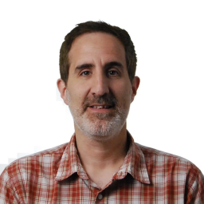
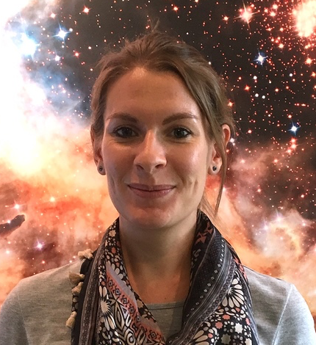
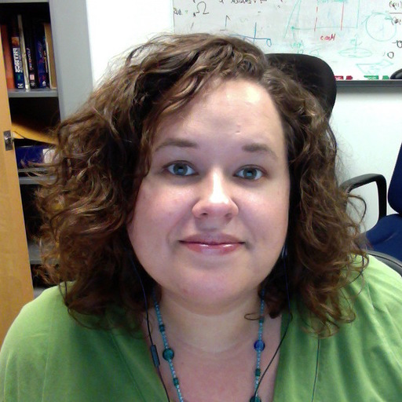
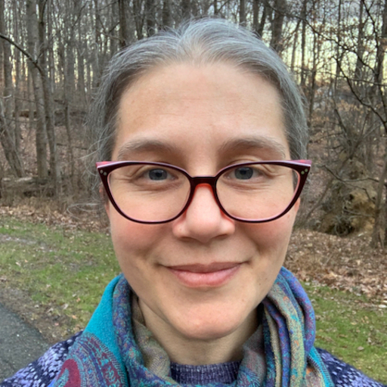

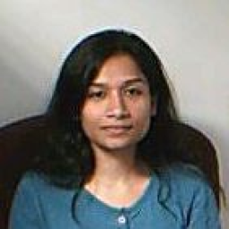
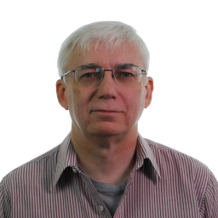

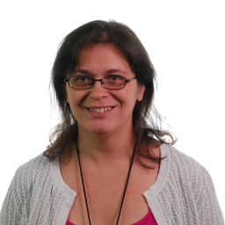
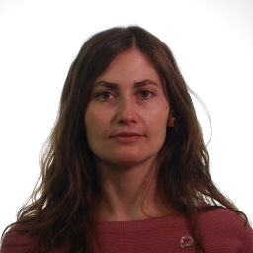
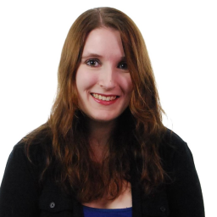
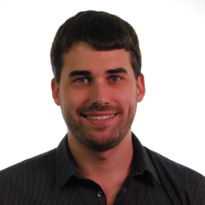
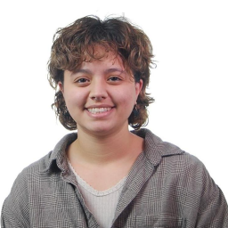
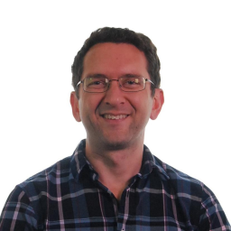
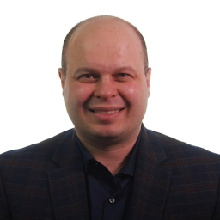
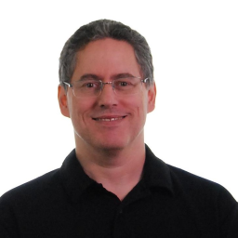

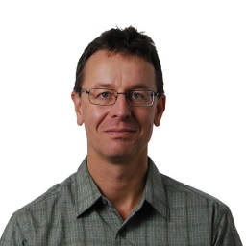

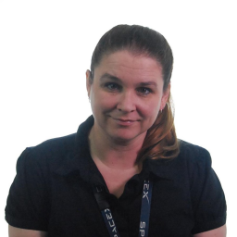

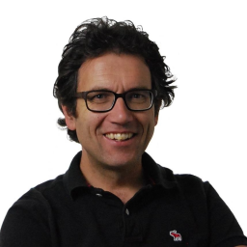

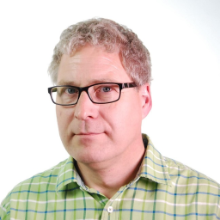
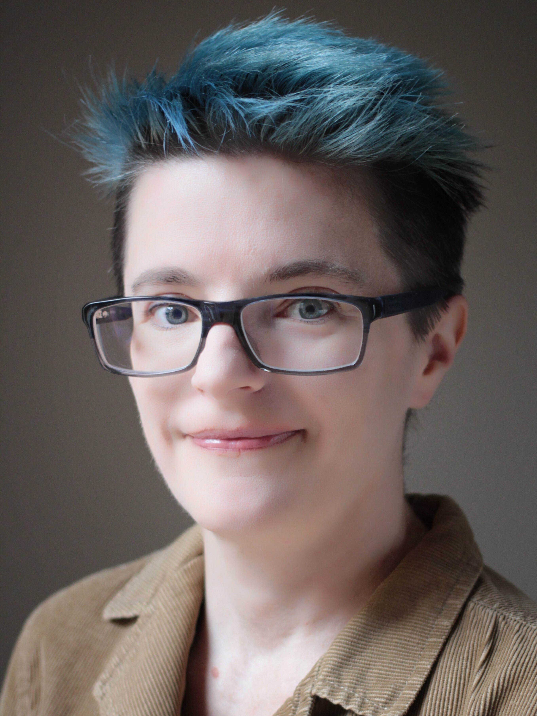
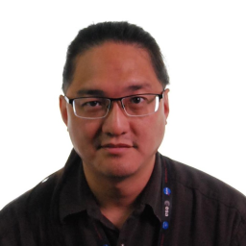
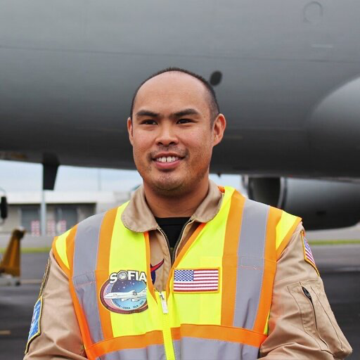
NIRSpec Team @ STScI
Leads
James Muzerolle Page
Bethan James
Alaina Henry
Melanie Clarke
Chris Hayes
Nimisha Kumari
Charles Proffitt
Leonardo Ubeda
Cheryl Pavlovsky
Elena Manjavacas
Emily Wislowski
Peter Zeidler
Kayli Glidic
Dan Coe
Nikolay Nikolov
Patrick Ogle
Diane Karakla
Torsten Böker
Tony Keyes
Tracy Beck
Glenn Wahlgren
Maurice Te Plate
Brian O’Sullivan
Alex Fullerton
Katie Bechtold
Chi Rai Wu
Chris Trinh

Slide 5
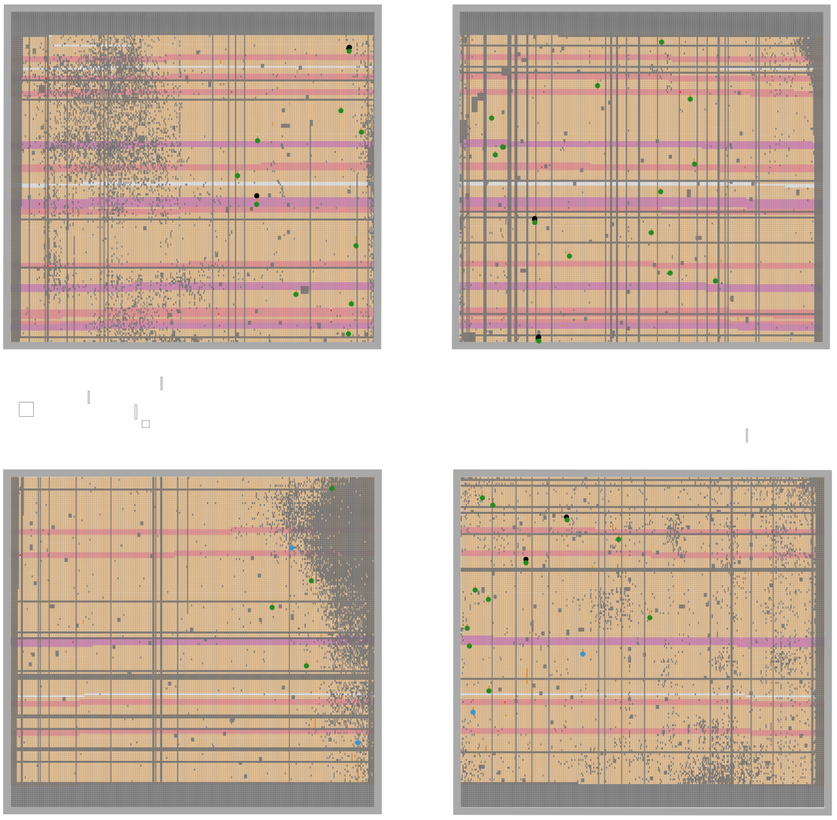
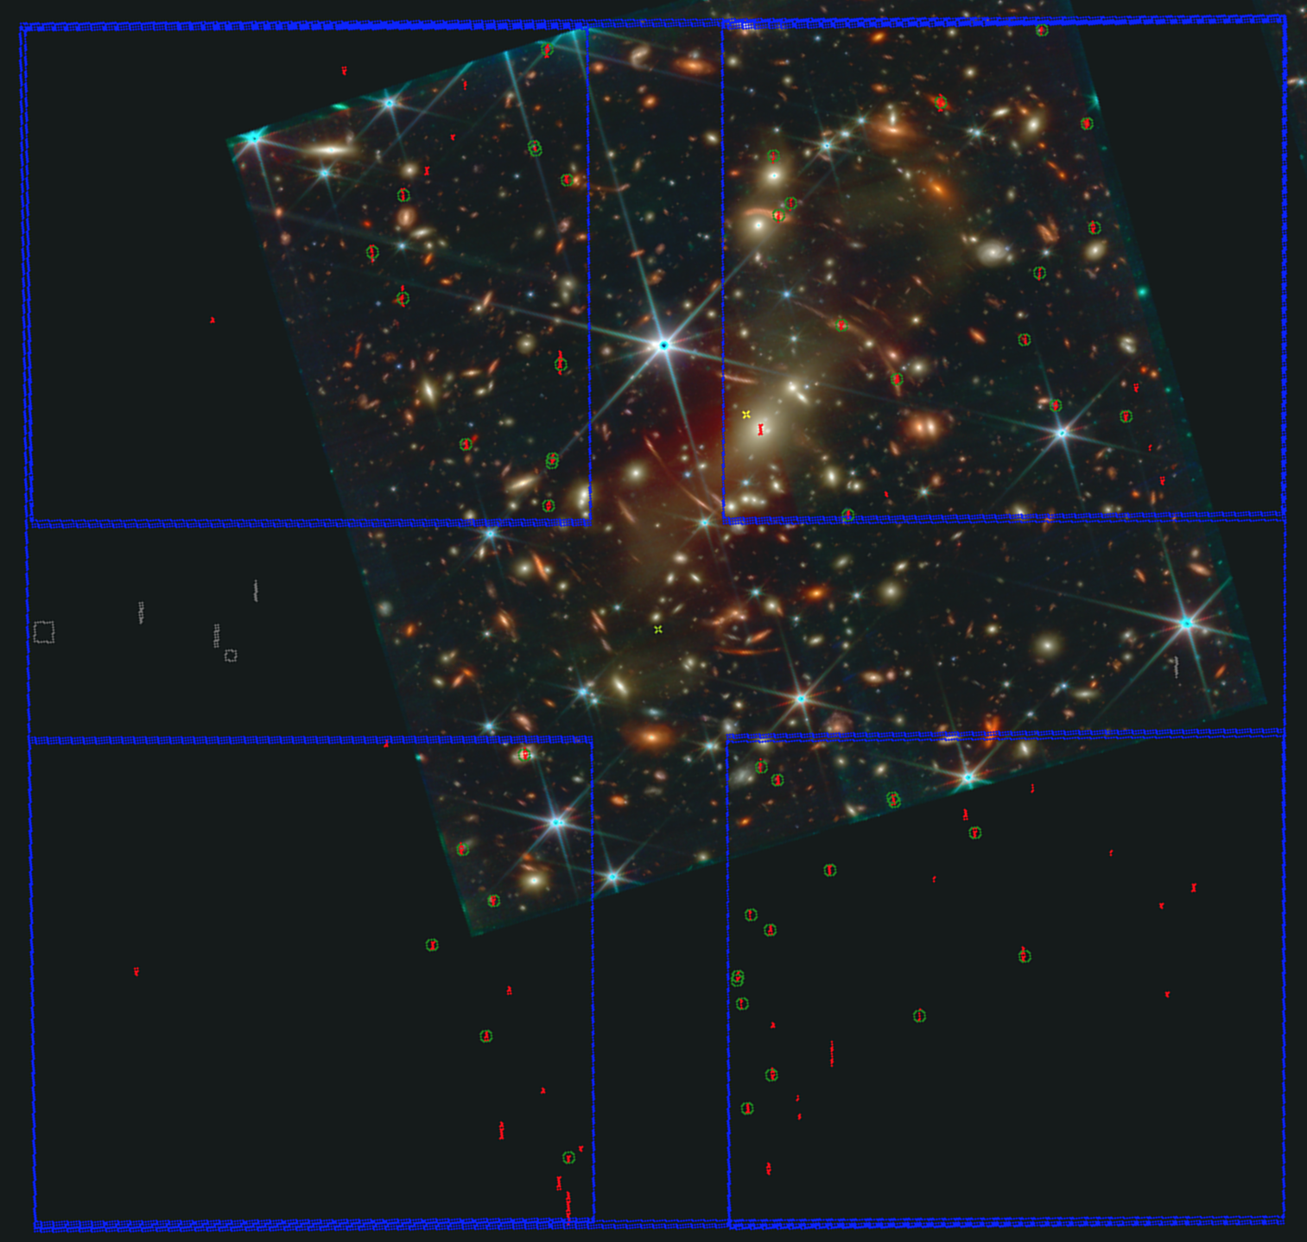
NIRSpec MOS Observation Planning in APT
JWebbinar #30
Diane Karakla
APT Aladin
MSA (micro-shutter assembly)
MPT (MSA Planning Tool)
shutter view

Slide 6
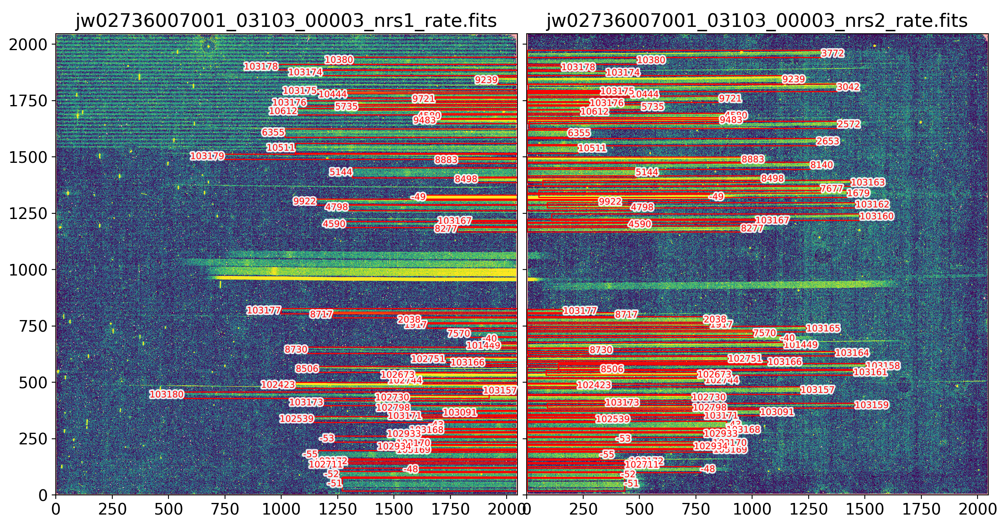
JWST pipeline Stage 1: count rates
Detector1Pipeline
bias
ramp fitting
outlier rejection
https://jwst-pipeline.readthedocs.io/en/latest/jwst/pipeline/calwebb_detector1.html
MSA (micro-shutter assembly)
MPT (MSA Planning Tool)
shutter view in APT

Slide 7
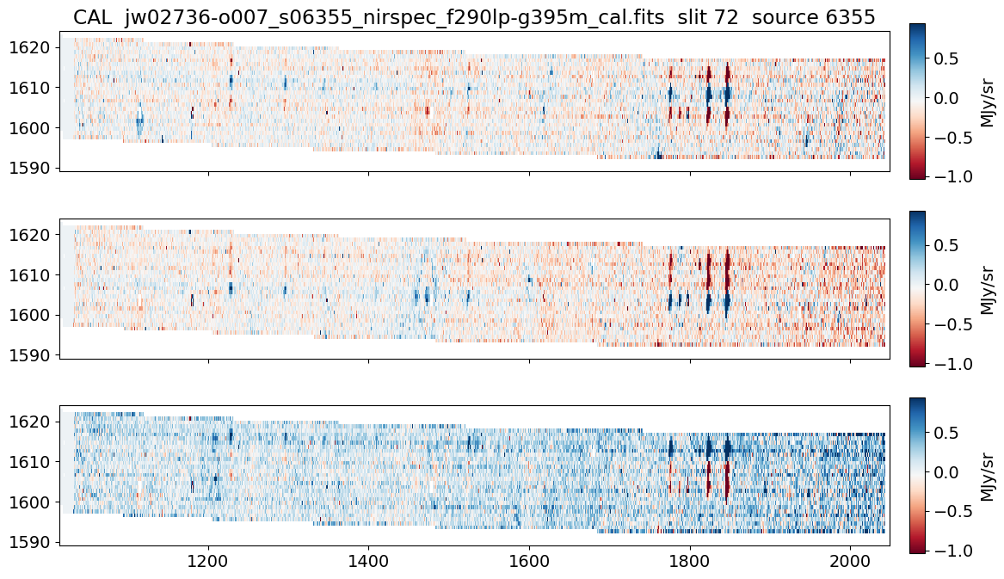
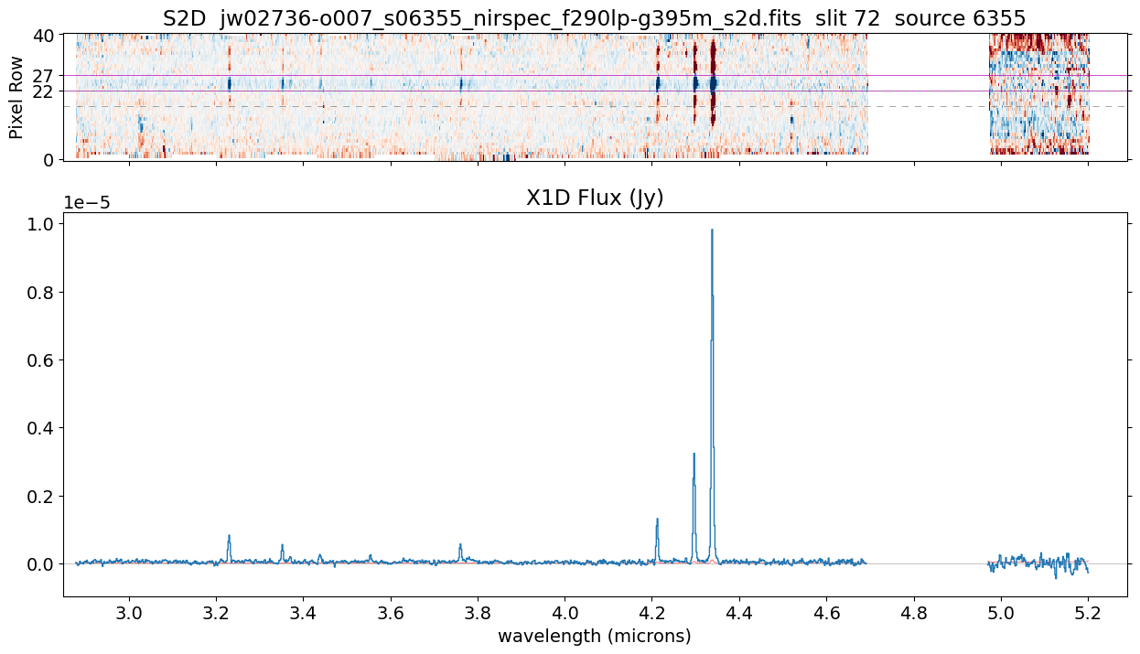
JWST pipeline Stage 2 (extraction) & Stage 3 (combining exposures)
Spec2Pipeline
WCS
NSClean (optional)
background
extract 2D
wavelength
flat field
path loss
bar shadow
resample (rectify)
extract 1D
https://jwst-pipeline.readthedocs.io/en/latest/jwst/pipeline/calwebb_spec2.html
Spec3Pipeline combine exposures
outlier detection & replace
resample
extract 1D
https://jwst-pipeline.readthedocs.io/en/latest/jwst/pipeline/calwebb_spec3.html

Slide 8
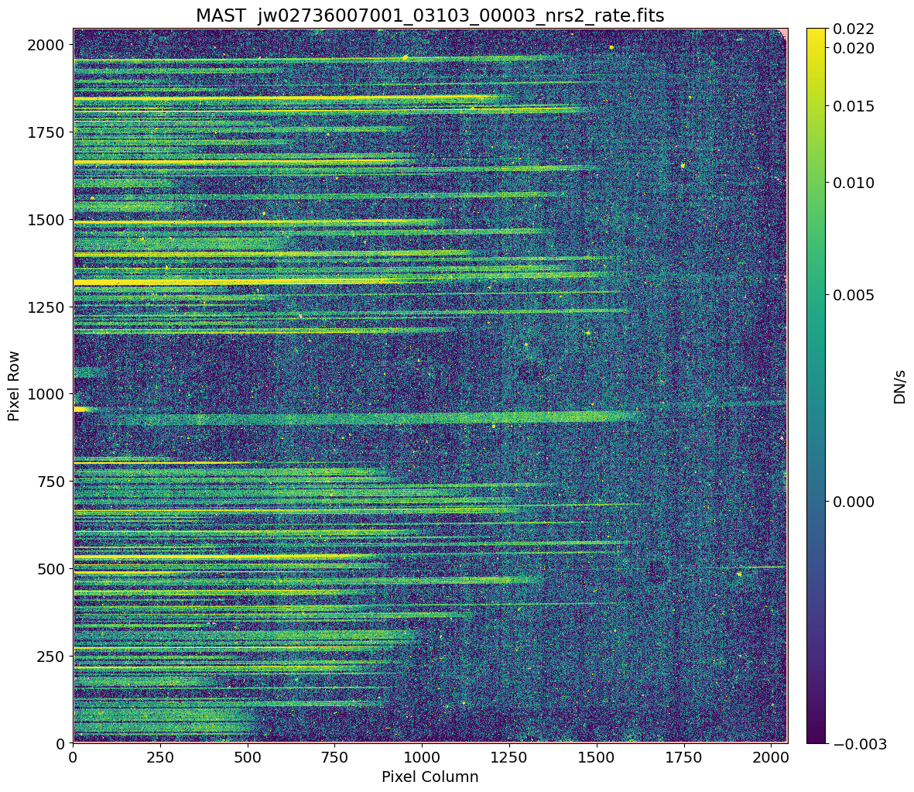

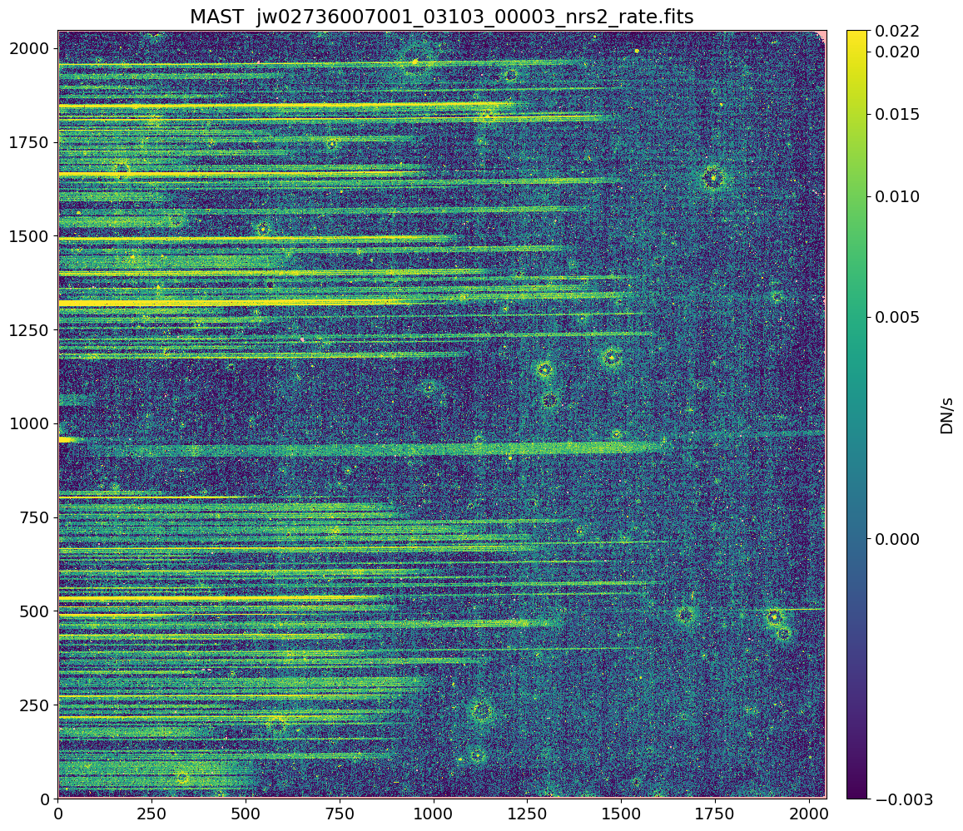
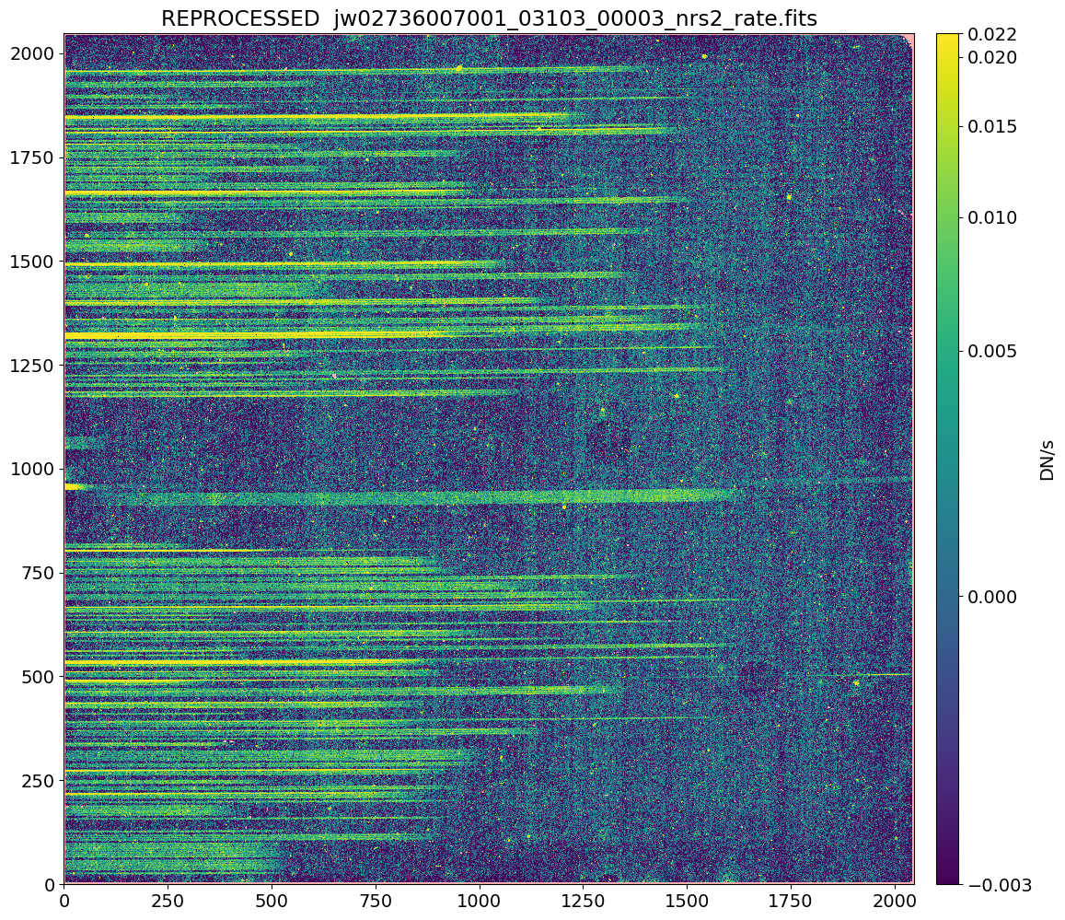
Pipeline notebook meant to show improvements in reprocessed data

Slide 9
Default pipeline processing + calibrations have improved significantly!
JWST pipeline 1.14.0
+ CRDS reference file updates

Slide 10
Improvements to pipeline and calibration
JDox: Github: CRDS: | https://jwst-docs.stsci.edu/jwst-science-calibration-pipeline/jwst-operations-pipeline-build-information https://github.com/spacetelescope/jwst/blob/master/CHANGES.rst https://jwst-crds.stsci.edu/display_all_contexts/
2D data
Snowball correction turned on by default
NSClean 1/f noise removal (optional pipeline step)
F-flats & S-flats
2D spectrum extraction
Increased 2D extraction size (reduces edge effects in resampling)
1D spectrum extraction
Improved aperture positioning based on expected source position
1D extraction size decreased to 6 pixels (previously 8 pixels)
Pathloss corrections updated
Barshadow corrections updated

Slide 11
More work to do improving pipeline and calibration
JDox: Github: CRDS: | https://jwst-docs.stsci.edu/jwst-science-calibration-pipeline/jwst-operations-pipeline-build-information https://github.com/spacetelescope/jwst/blob/master/CHANGES.rst https://jwst-crds.stsci.edu/display_all_contexts/
2D data
Outlier rejection
2D spectrum extraction
More precise flux conservation for spectral resampling
1D spectrum extraction
option to extract from unrectified data, including optimal / PSF-based
wavecorr improvements
Calibration programs
both internal and led by the community

Slide 12
JWebbinar #33 notebooks
pipeline
MSA metafile
slits to sky
master background
NSClean

Slide 13
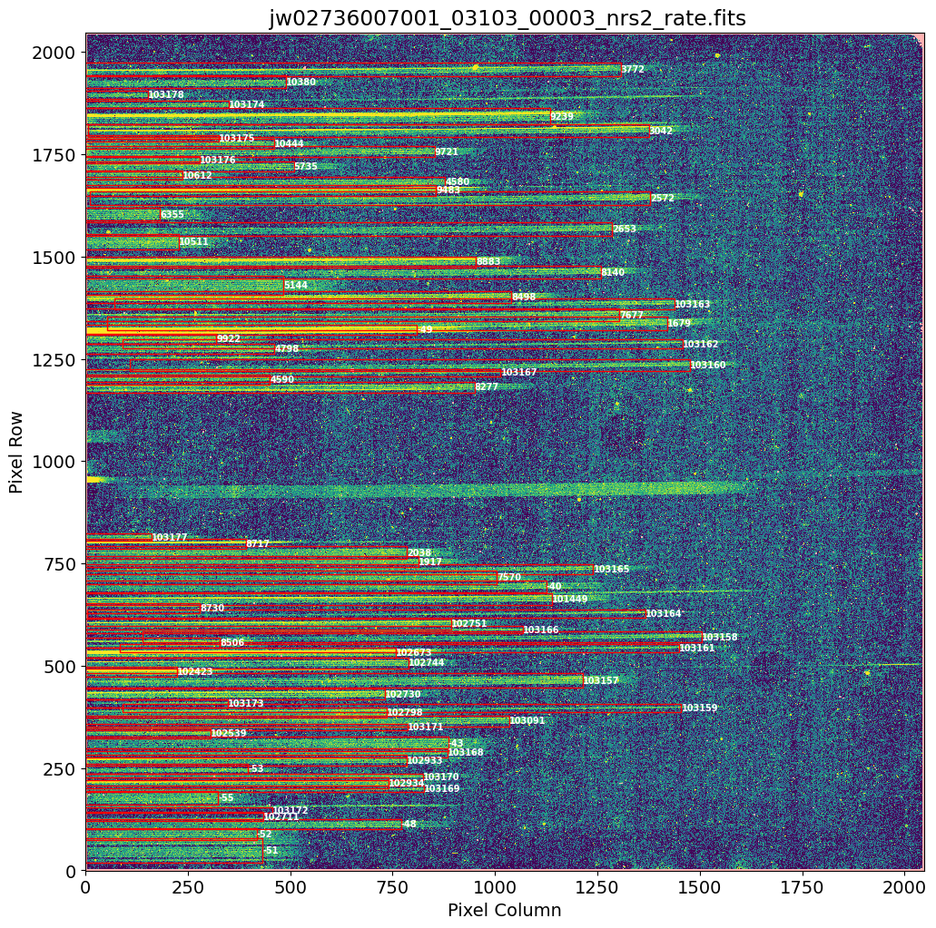
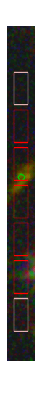
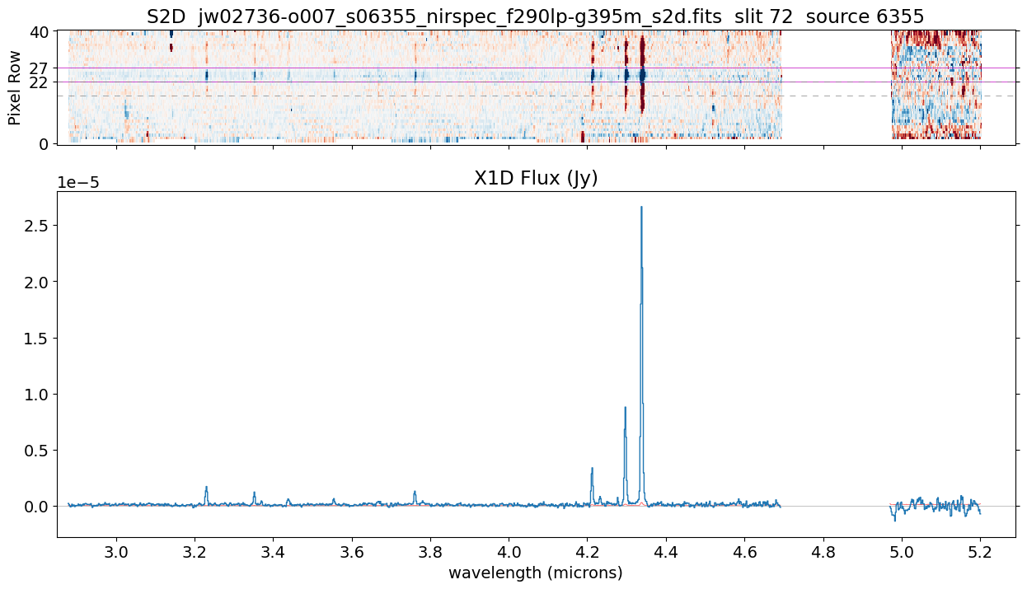
Pipeline notebook

Slide 14
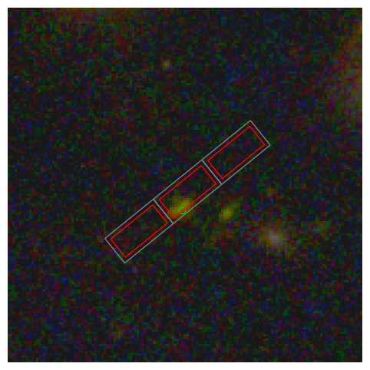
MSA
shutters
slit open area
slit full extent including bars
source position from input catalog
0.20”
0.46”
0.07”

Slide 15
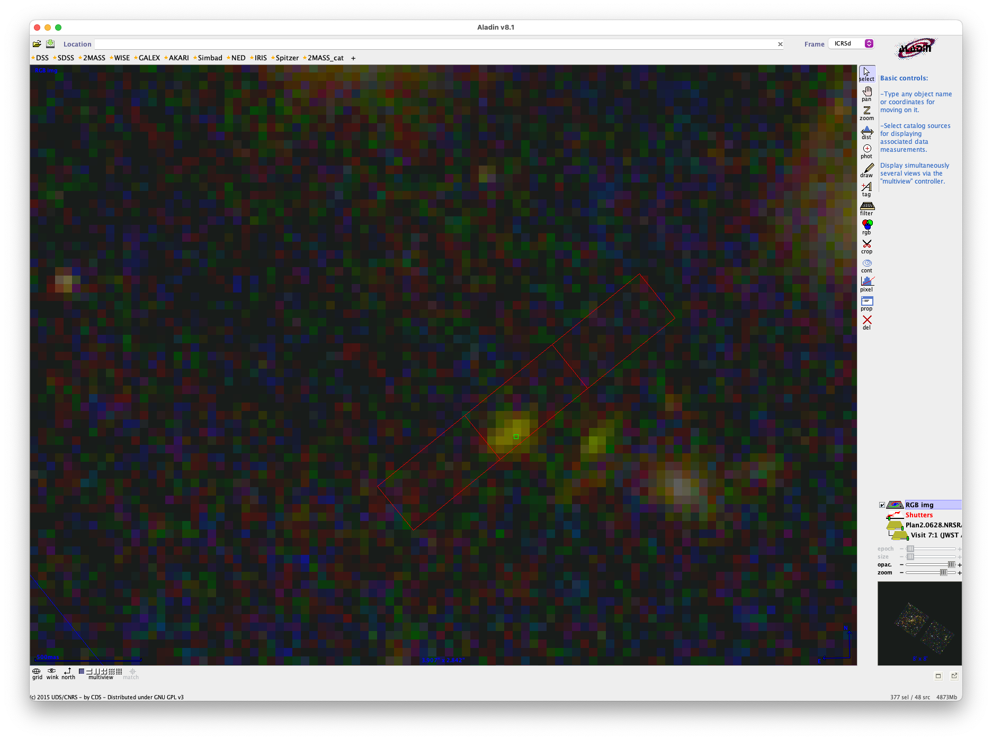
APT
Aladin
shows full slit extent including bars

Slide 16
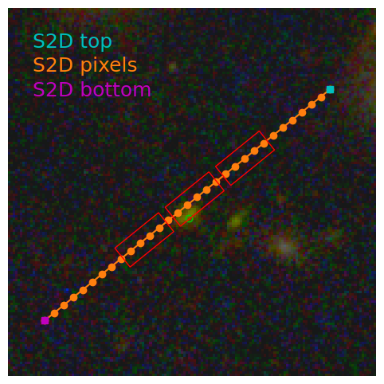
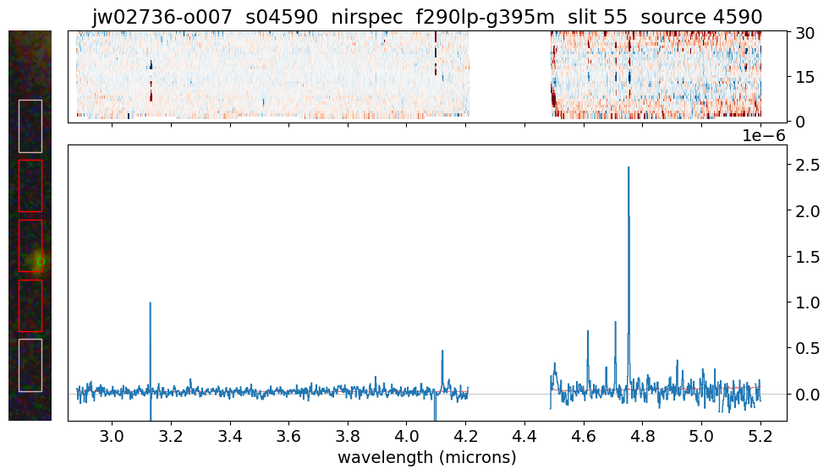
S2D datamodel
WCS transforms
MSA
shutters
world
(RA, Dec)
s2d_model.meta.wcs
1) detector
2) slit_frame
3) world
3
(1,1)
(0.5, 0.5)
MSA metafile
0.20”
S2D WCS
estimated
source
in shutter
(x,y)
slit
frame
0.46”
0.07”
1
detector (x,y)
(0.5,0.5)
(0,0)
2
(–0.5, –0.5)
(0,0)

