Slide 1
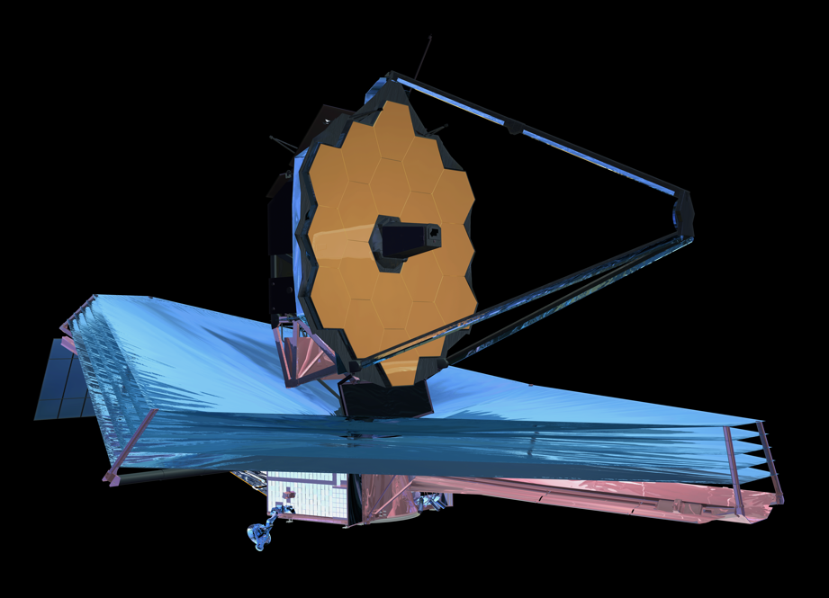
JWST Science Policies
Neill Reid, Janice Lee, Jennifer Lotz – Science Mission Office
Jason Kalirai, Rachel Osten – JWST Mission Office
AAS, January 6 2015

Slide 2
Context
Our charge at STScI is to maximise the scientific return of the missions we operate
JWST is a mission with highly complex instrumentation and a 5-year lifetime requirement, 10-year goal
JWST will offer a range of observing programs
Maximising JWST’s scientific potential requires that the community rapidly understand and uses its capabilities
Data access is key to understanding JWST’s capabilities
  An Early Release Science program, generated by the community, can play a crucial role in providing broad access to representative datasets early in Cycle 1
  Early data access increases the intellectual cycles by highlighting JWST’s capabilities and enabling more ambitious Cycle 2 GO programs

Slide 3
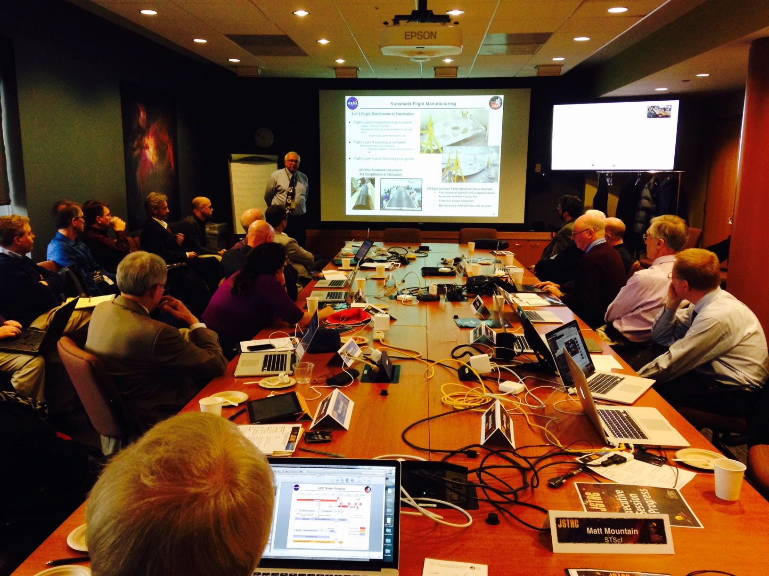
JWST Advisory Committee
Roberto Abraham (Toronto)
Neta Bahcall (Princeton)
Stefi Baum (Rochester)
Roger Brissenden (Chandra/SAO)
Hashima Hasan (NASA, ex-officio)
Tim Heckman (Johns Hopkins)
Garth Illingworth (Santa Cruz, Chair)
Malcolm Longair (Cavendish)
John Mather (NASA, ex-officio)
JSTAC: advisory to STScI Director
Represents the Scientific Community
Mark McCaughrean (ESA, ex-officio)
Chris McKee (Berkeley)
Brad Peterson (Ohio State)
Alain Ouellet (CSA, ex-officio)
Joseph Rothenberg (JHR Consulting)
Sara Seager (MIT)
Eric Smith (NASA, ex-officio)
Lisa Storrie-Lombardi (Spitzer/Caltech)
Monica Tosi (Bologna)
http://www.stsci.edu/jwst/advisory-committee

Slide 4
Talk Outline
JWST Science Planning Timeline
  What happens when?
Observing Programs
  Proposal types
An Early Release Science Program

Slide 5
JWST Science Planning Timeline

Slide 6

JWST Science Planning Timeline
(draft schedule as of January 2015)
2015
2016
2017
2018
2019
2020
2021
launch
2018Oct

Slide 7
JWST Science Planning Timeline
(draft schedule as of January 2015)
commissioning (through 4/19)
commissioning proposals
2015
2016
2017
2018
2019
2020
2021
launch
2018Oct

Slide 8
JWST Science Planning Timeline
(draft schedule as of January 2015)
commissioning (through 4/19)
commissioning proposals
2015
2016
2017
2018
2019
2020
2021
Early Release Observations (EROs)
launch
2018Oct

Slide 9
JWST Science Planning Timeline
(draft schedule as of January 2015)
commissioning (through 4/19)
commissioning proposals
GO CP
2017Nov
2015
2016
2017
2018
2019
2020
2021
Early Release Observations (EROs)
launch
2018Oct

Slide 10
JWST Science Planning Timeline
(draft schedule as of January 2015)
commissioning (through 4/19)
commissioning proposals
GO CP
2017Nov
7 mo
2015
2016
2017
2018
2019
2020
2021
GTO programs have priority on specific observations of specific targets. A full list for Cycle 1 will be available at the release of the Cycle 1 GO call.
GTO CP
2017Jan
launch
2018Oct
GTO Prop
deadline
2017Apr
2
mo
GTO Cy1
observations finalized
No later than 2017Sep

Slide 11
JWST Science Planning Timeline
(draft schedule as of January 2015)
commissioning (through 4/19)
commissioning proposals
GO CP
2017Nov
GO Cy1
deadline
2018Feb
TAC
2018May
7 mo
2015
2016
2017
2018
2019
2020
2021
GTO programs have priority on specific observations of specific targets. A full list for Cycle 1 will be available at the release of the Cycle 1 GO call.
GTO CP
2017Jan
launch
2018Oct
GTO Prop
deadline
2017Apr
2
mo
GTO Cy1
observations finalized
No later than 2017Sep

Slide 12
JWST Science Planning Timeline
(draft schedule as of January 2015)
commissioning (through 4/19)
commissioning proposals
GO CP
2017Nov
GO Cy1
deadline
2018Feb
TAC
2018May
Cycle 1 science –
April 2019
GTO & GO
7 mo
2015
2016
2017
2018
2019
2020
2021
GTO CP
2017Jan
launch
2018Oct
GTO Prop
deadline
2017Apr
2
mo
GTO Cy1
observations finalized
No later than 2017Sep

Slide 13
JWST Science Planning Timeline
(draft schedule as of January 2015)
commissioning (through 4/19)
commissioning proposals
GO CP
2017Nov
GO Cy1
deadline
2018Feb
TAC
2018May
Cycle 1 science -
April 2019
GTO & GO
7 mo
2015
2016
2017
2018
2019
2020
2021
Anticipate annual observing cycles
GTO CP
2017Jan
launch
2018Oct
GTO Prop
deadline
2017Apr
2
mo
GTO Cy1
observations finalized
No later than 2017Sep

Slide 14
JWST Science Planning Timeline
(draft schedule as of January 2015)
commissioning (through 4/19)
commissioning proposals
GO CP
2017Nov
GO Cy1
deadline
2018Feb
TAC
2018May
Cycle 1 science -
April 2019
GTO & GO
7 mo
2015
2016
2017
2018
2019
2020
2021
Cycle 2
September - CP release
December – proposal deadline
February 2020 – TAC
April 2020 – Cycle 2
GTO CP
2017Jan
launch
2018Oct
GTO Prop
deadline
2017Apr
2
mo
GTO Cy1
observations finalized
No later than 2017Sep

Slide 15
Observing Programs

Slide 16
Observations
JWST will be at L2
  Continuous observations (in principle) analogous to Spitzer rather than Hubble
Observing programs will be allocated wall-clock time
  Overheads incorporated in the allocation
  8,766 hours available per year
    5,000 to 6,000 hours on-target integration time

Slide 17
Classes of Program
Guest Observer (GO programs)
  Open access for the community
  ~80% of time in Cycles 1 through 5
Guaranteed Time Observer (GTO) programs
  4020 hours allocated over first 30 months (i.e. Cycles 1 through 3)
  NASA policy constraints on time/cycle
Director’s Discretionary Time (DD) programs
  Up to 10%/cycle i.e. ≤877 hours
  Rapid response observations & targeted science programs

Slide 18
How much GO time in Cycle 1?
8766 hours available to schedule
Up to 10% of total time as DD time
  876 hours → ~7900 hours for GO+GTO
NASA policy requires that GTO programs account for between 25% and 49% of the time available to GO and GTO programs in Cycle 1
  Assume ~2200 hours for GTO time
GO programs would constitute ~5700 hours in Cycle 1
Hubble has ~3500 science orbits/year
  ~5200 hours (with overheads)
JWST Cycle 1 will offer more GO time than a typical Hubble Cycle
GO allocation increases in Cycle 2 & 3 as GTO time decreases

Slide 19
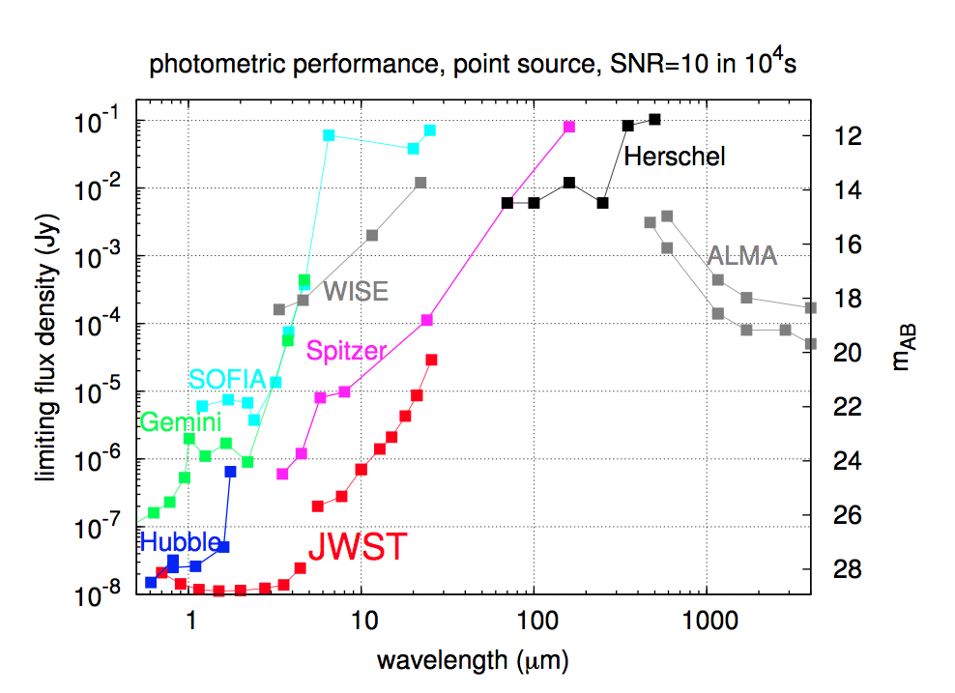
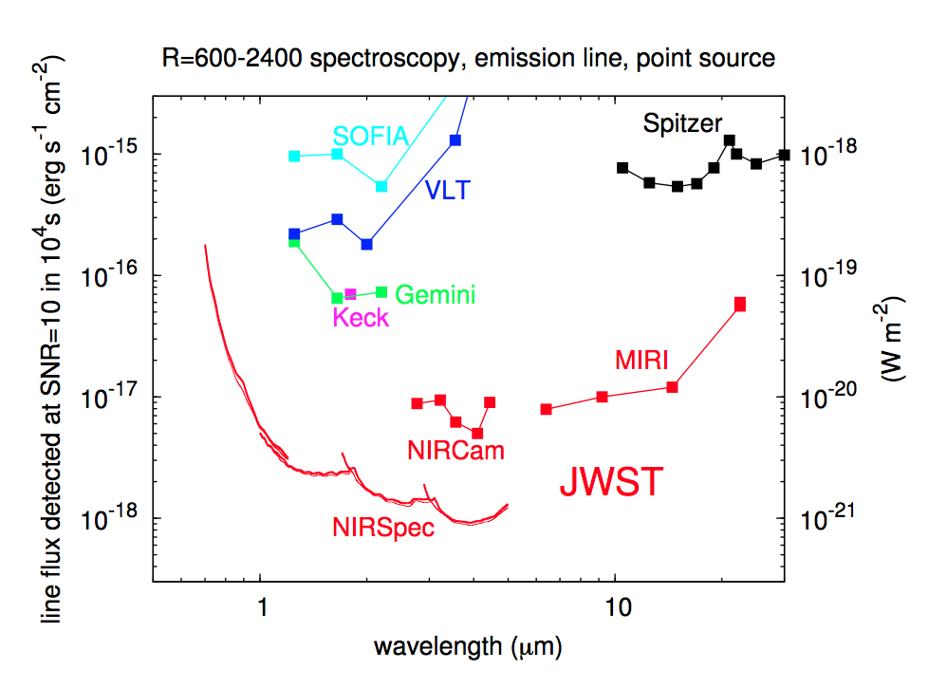
JWST Discovery Space
JWST will be an incredibly powerful machine
  10-100x sensitivity advantage over HST/Spitzer at higher resolution
  Extensive discovery space for exploratory science in relatively small time allocations

Slide 20
JWST GO Program Types
We anticipate that JWST GO size categories will include
  Small, Medium, Large, Very Large
We anticipate a balanced distribution in program sizes over all JWST cycles
  Small/Medium/Large in early cycles
  The majority of time will likely be allocated to Small programs
  Very Large programs will likely be introduced in later cycles (Cycle 3?) as more GO time becomes available and capabilities are better defined
We also anticipate specialised categories
  Long-term programs → Regular/Medium programs whose science requires observations in future cycles (astrometry, variability)
  ToO programs
  Treasury/Legacy programs → programs with broad science reach and emphasis on providing higher-level data products for the community
  Joint programs with other facilities (eg Hubble, Chandra, ALMA/NRAO, ground-based OIR facilities)
JWST will also accept proposals for archival & theory research programs
STScI is continuing to refine these concepts in consultation with the JSTAC.

Slide 21
An Early Release Science program
A science program of the community chosen by the community for the community

Slide 22
JWST & the future of astrophysics
JWST is NASA’s highest science priority and one of the largest science programs ever undertaken by the United States.
  JWST needs to be correspondingly productive

Slide 23
JWST & the future of astrophysics
JWST is NASA’s highest science priority and one of the largest science programs ever undertaken by the United States.
  We need to make JWST correspondingly productive

Slide 24
JWST & the future of astrophysics
JWST is NASA’s highest science priority and one of the largest science programs ever undertaken by the United States.
  We need to make JWST correspondingly productive
JWST is an incredibly powerful machine

Slide 25
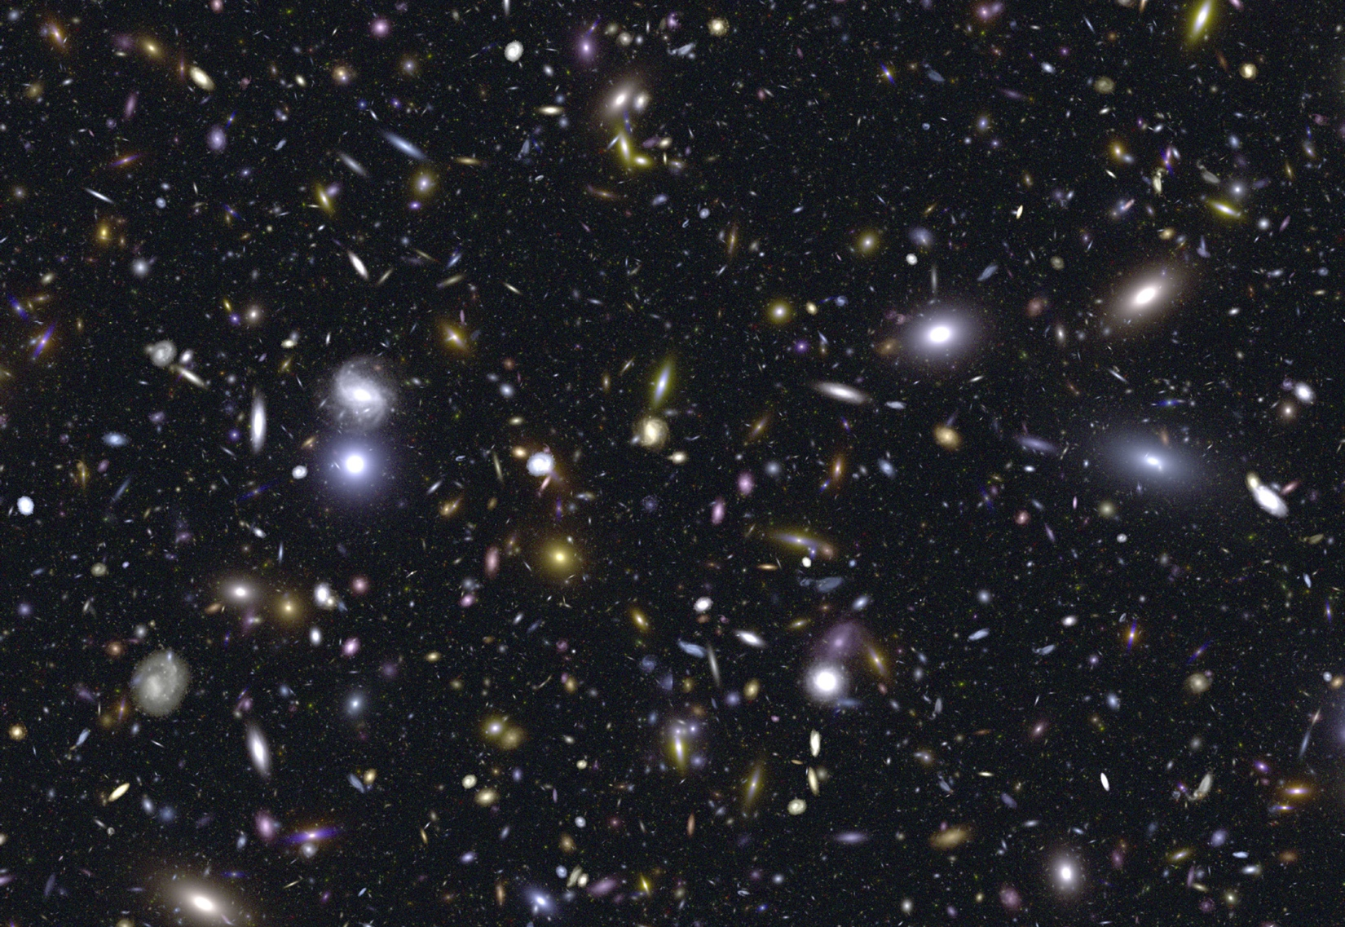
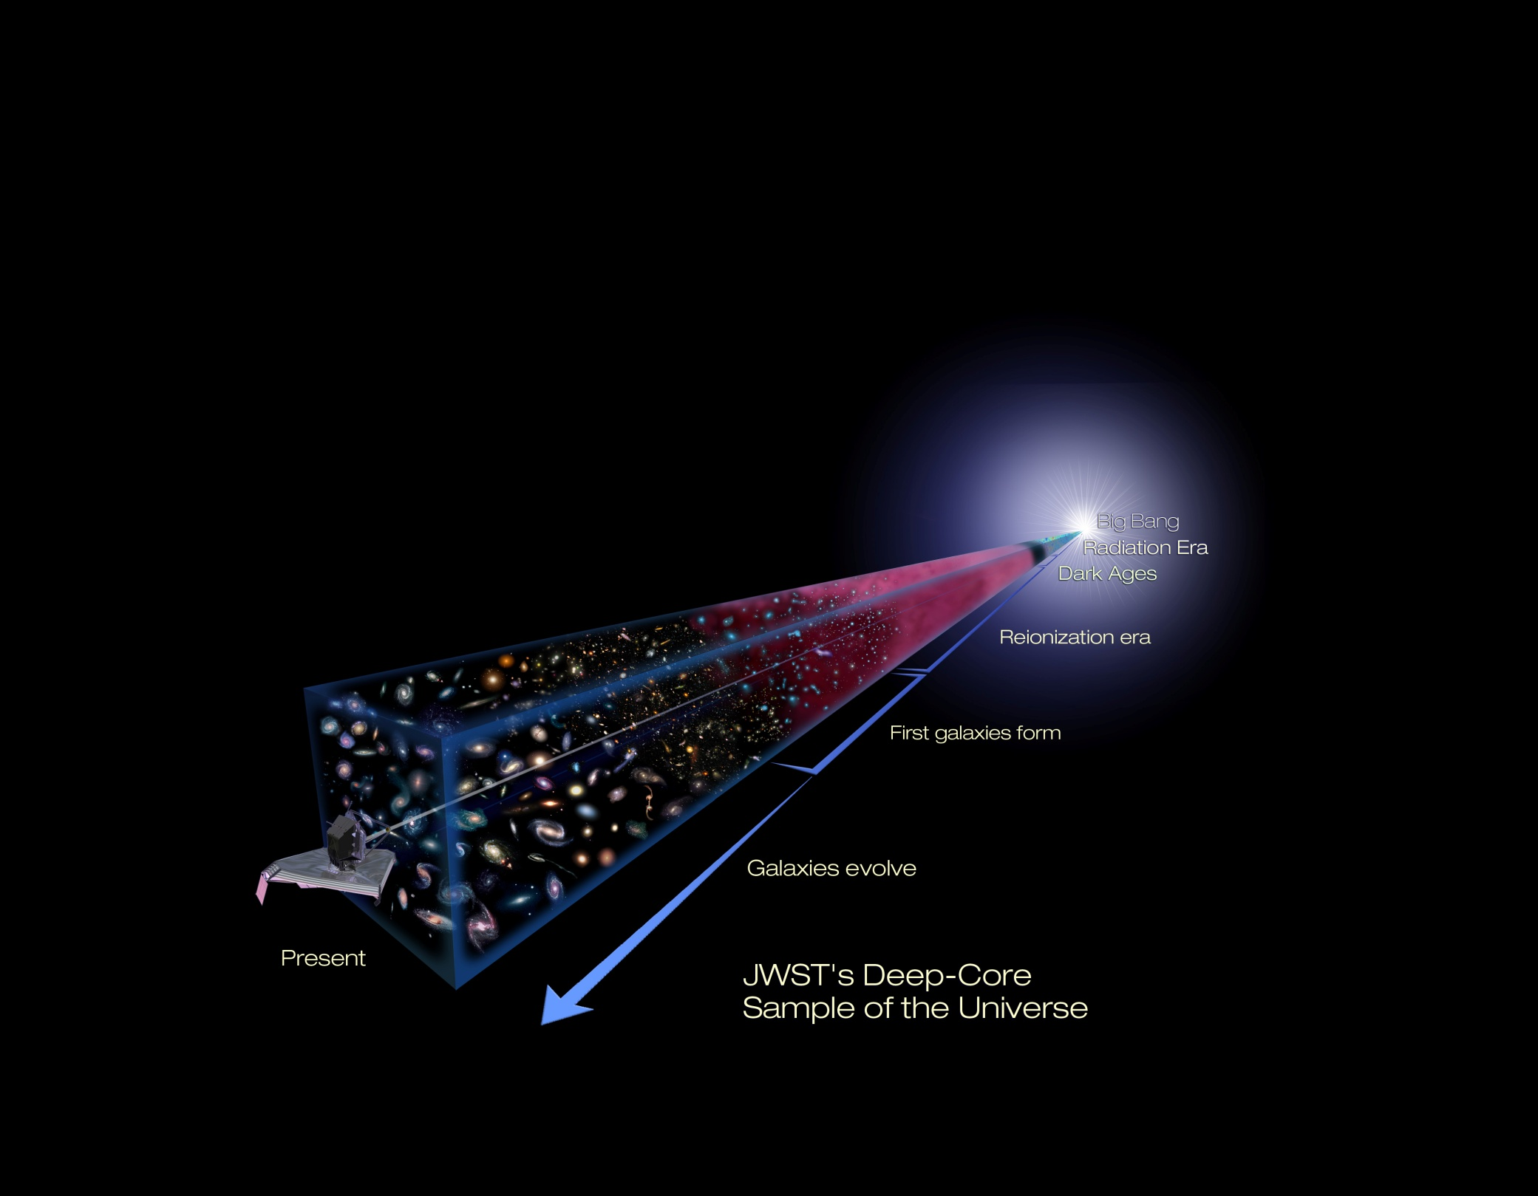
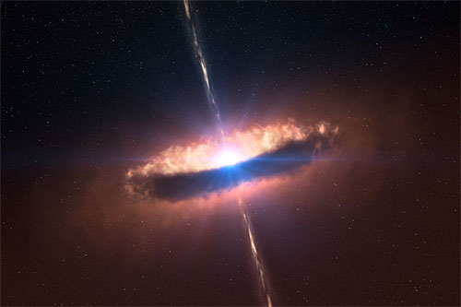
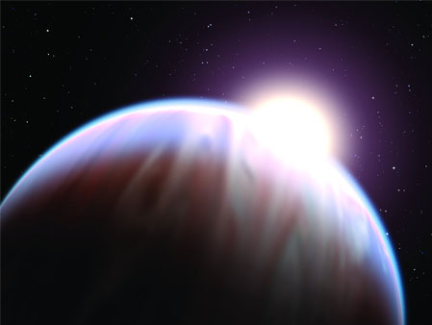
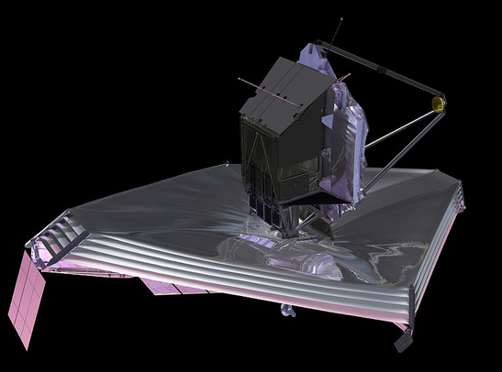
The Scientific Vision
see the Universe’s first galaxies
determine how galaxies evolve
uncover newborn stars and planets
study the origins of life
Notes:
Four science themes inform the design of the telescope. Top two have to do with redshift. Bottom two with dust and molecules.

Slide 26
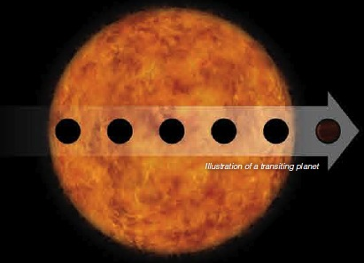
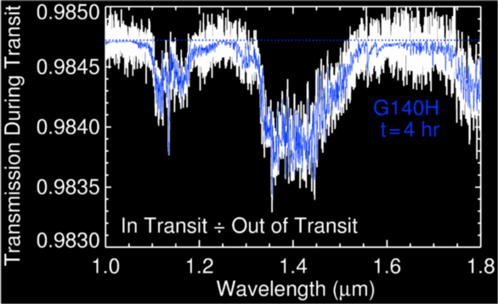
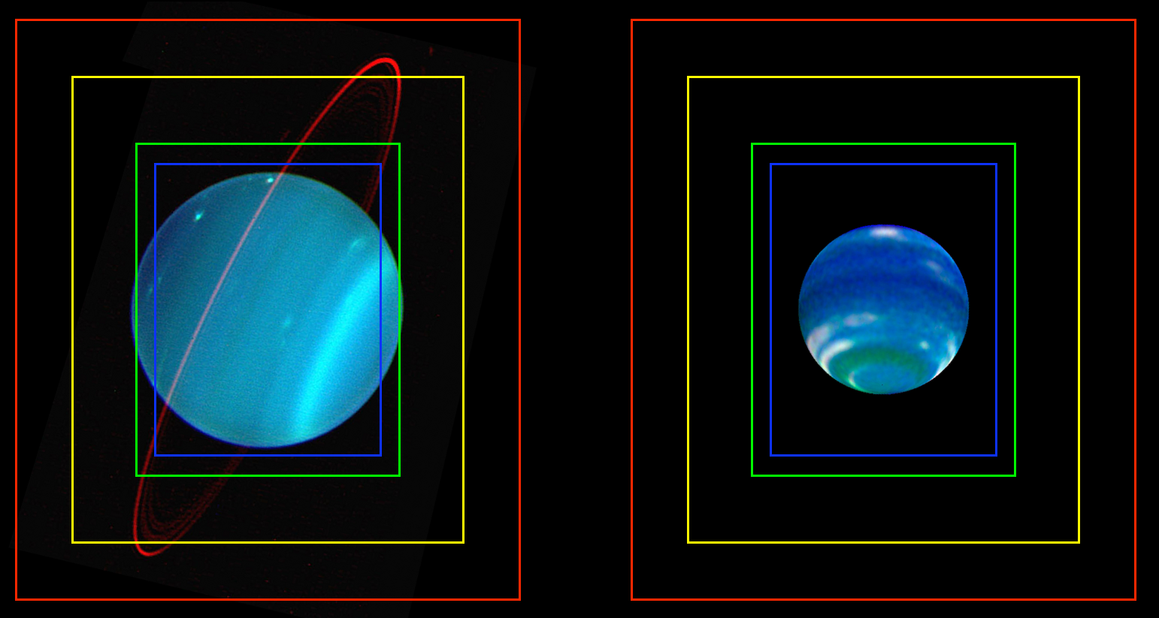
Exoplanet characterisation
Solar System observations

Slide 27
JWST & the future of astrophysics
JWST is NASA’s highest science priority and one of the largest science programs ever undertaken by the United States.
  We need to make JWST correspondingly productive
JWST is an incredibly powerful machine with complex instrumentation

Slide 28
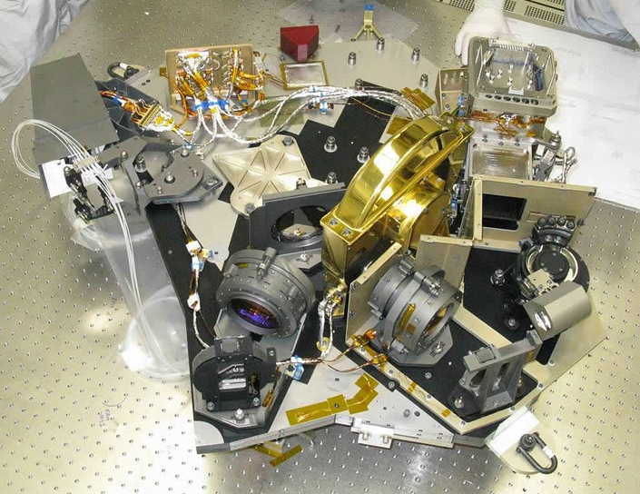

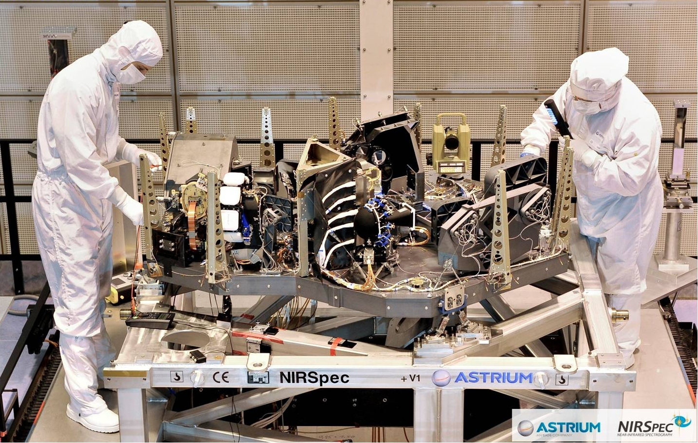
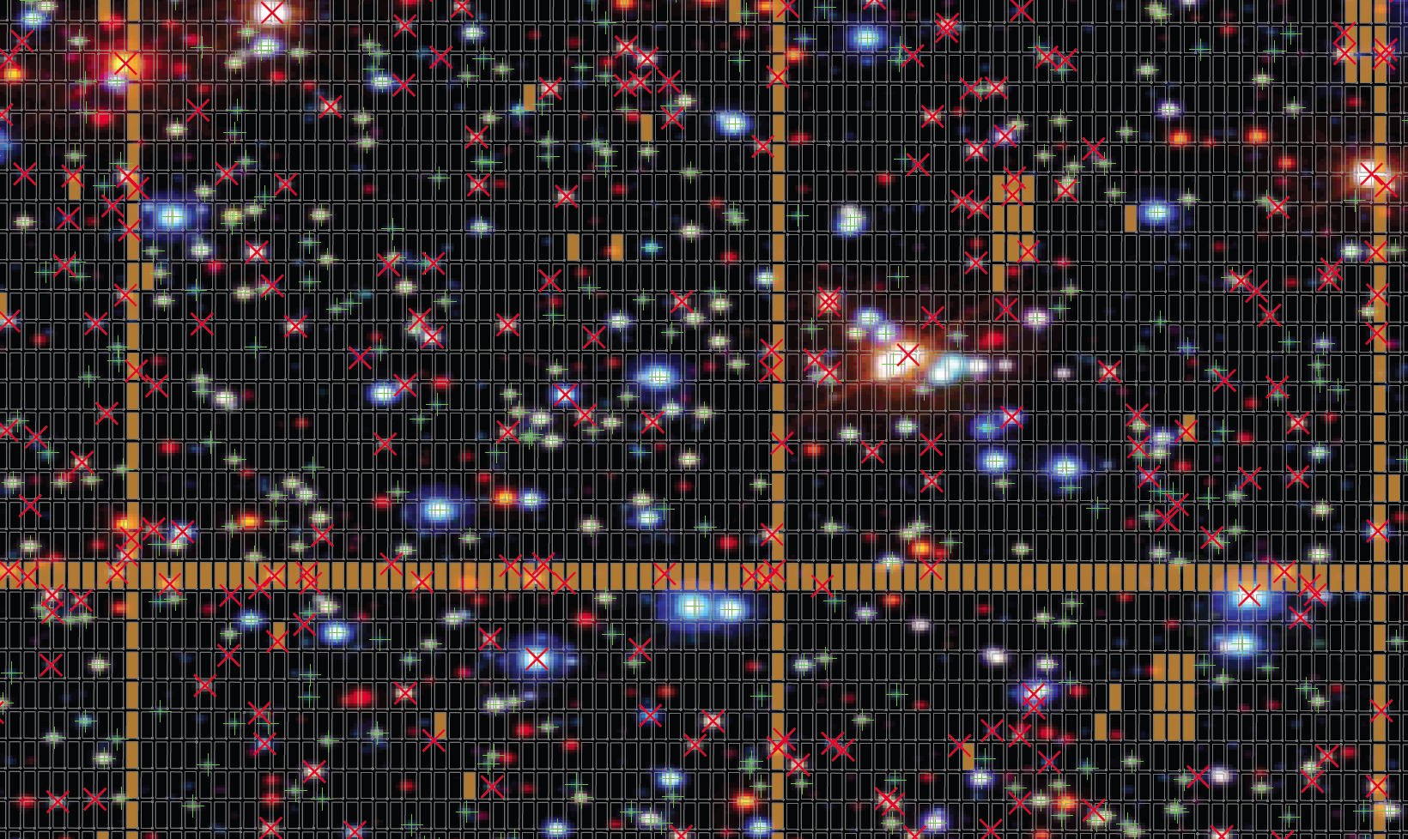
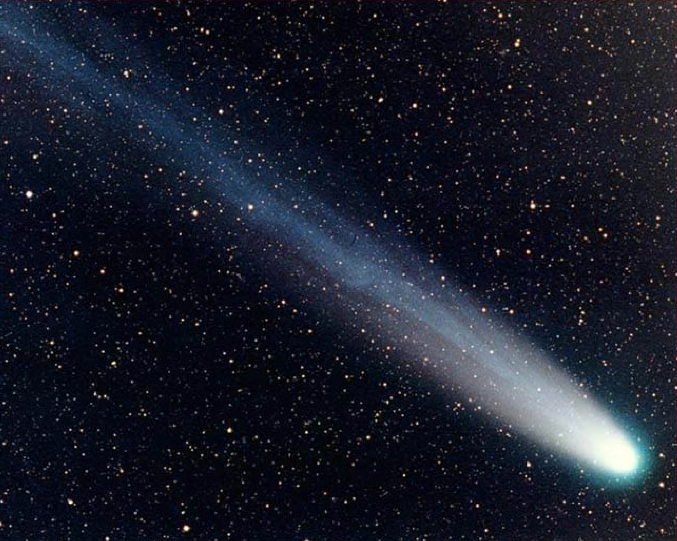
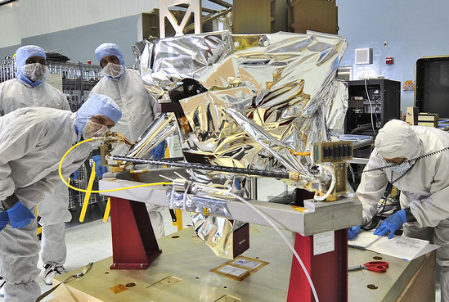
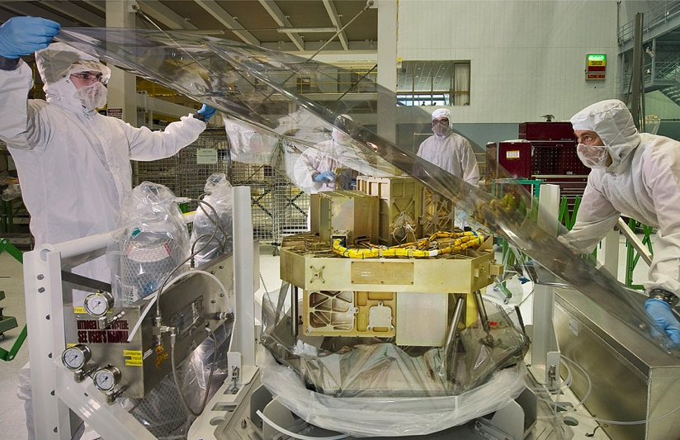
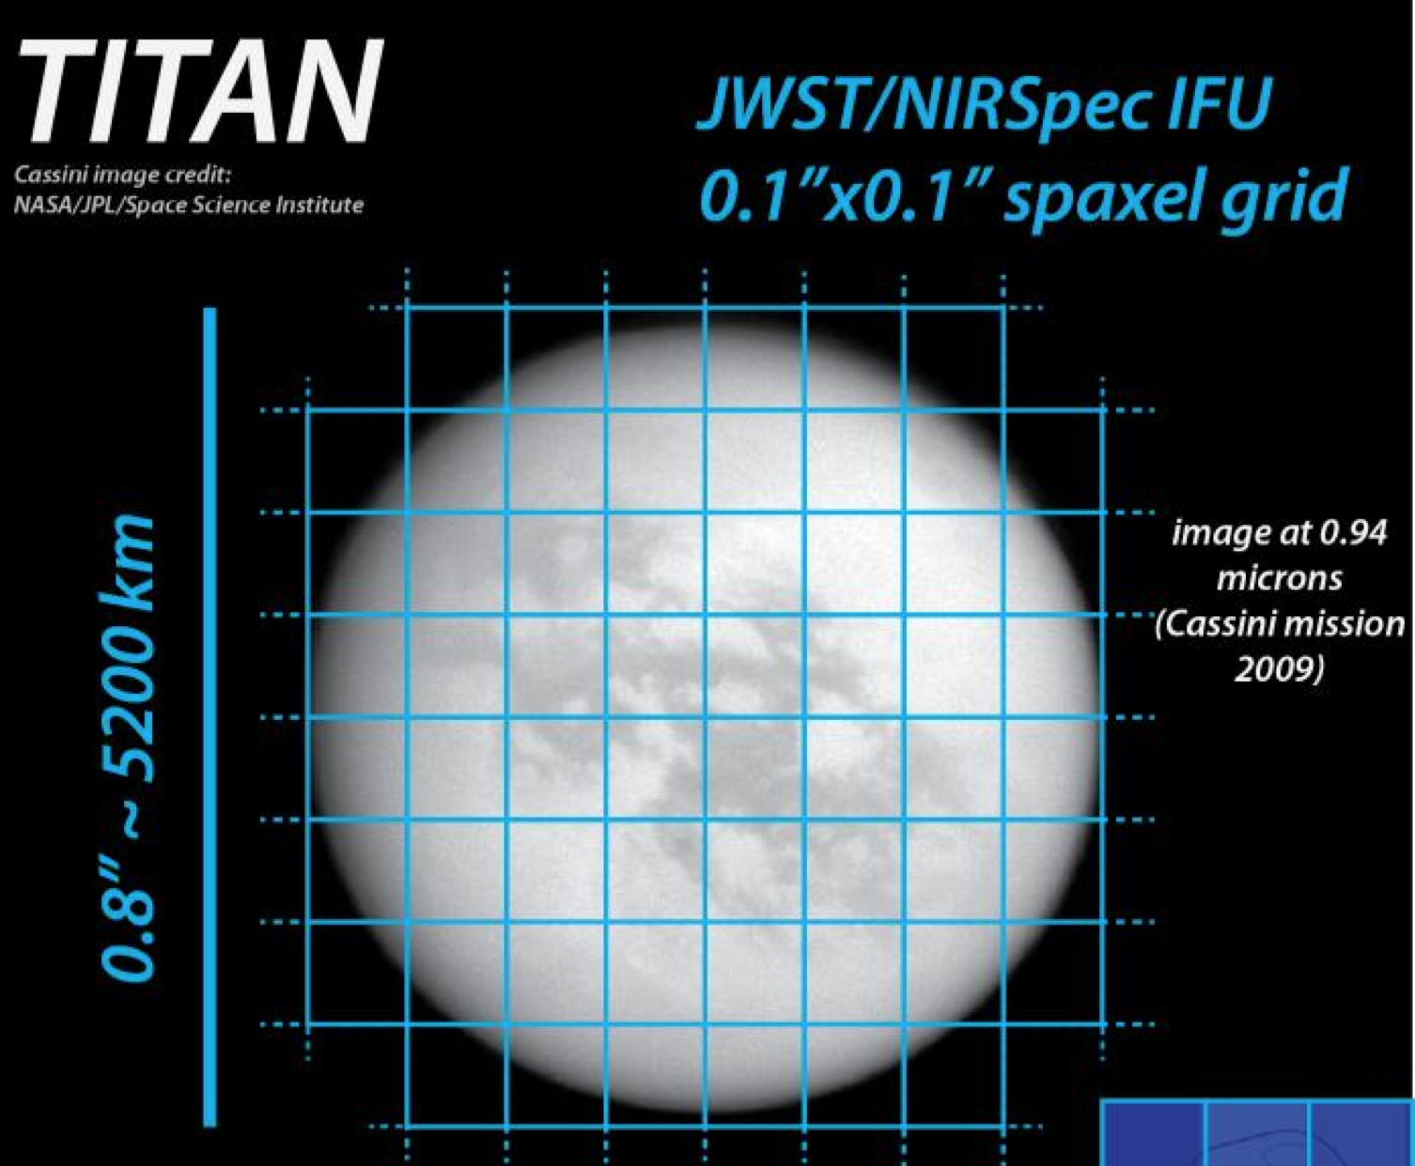
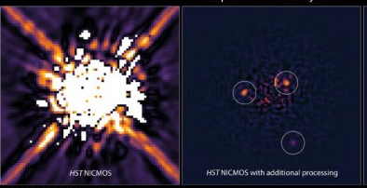
Complex Instruments
>40 imaging filters
8 spectroscopic modes
(multi-object, IFU, wide field grism, single object)
multiple coronagraphs
NIRSpec
MOS in Space
NIRCam
Moving Target
Support
MIR IFU
Spectroscopy
MIRI
Ultra Deep Fields
High Contrast Imaging
NIR IFU Spectroscopy
NIRISS
Notes:
- Highlight that talks coming up will have more info on the specifics of two of the JWST instruments.
- ISIM completed CDR during 2009 and is currently in integration and testing
- 2012 is a breakthrough year for JWST…science instruments begin delivery to GSFC for integration.
- Get back to the nature of JWST as having complex instruments, a different model from Hubble

Slide 29
JWST & the future of astrophysics
JWST is NASA’s highest science priority and one of the largest science programs ever undertaken by the United States.
  We need to make JWST correspondingly productive
JWST is an incredibly powerful machine with complex instrumentation
  Exploiting that power requires an informed community
  Providing early access to data from representative science programs is crucial to understanding JWST’s capabilities and enabling the community to maximise the science return.

Slide 30
Cycle 2 proposal schedule
JWST science observations start in April 2019
  Cycle 2 CP in September 2019, ~5 months into Cycle 1
  Cycle 2 proposal preparation starts ~October 2019, ~6 months into Cycle 1
  Cycle 2 proposal deadline in early December 2019, ~7.5 months into Cycle 1
The general community will have very limited access to non-proprietary observations to aid preparations for Cycle 2 programs
commissioning (through 4/19)
2018
2019
2020
launch
2018Oct
GO CP
2019Sep
GO Cy2
deadline
2019Dec
Cycle 2 science –
April 2020
GTO & GO
GO Cy2
TAC
2020Feb

Slide 31
An Early Release Science Program
The JWST Advisory Committee has recommended implementation of the First Look/Early Release Science Program
  “..to obtain images and spectra that would be used to demonstrate key modes of the JWST instruments. The goal of this program is to enable the community to understand the performance of JWST prior to the submission of the first post-launch Cycle 2 proposals that will be submitted just months after the end of commissioning.”
  “The data from this `First-Look’ program would complement the Early Release Observations (ERO) and the Science Verification (SV) datasets.”
  “The JSTAC recommends that the First-Look data be released both in raw form and with any initial calibrations as soon as possible; the key aspect is speed.” [JSTAC letter, 21/6/2010]
The concept was discussed with the JWST Science Working Group in July 2013

Slide 32
An Early Release Science Program
The JSTAC refined the concept in its May 2013 & November 2013 meetings.
The primary goal of the program is to maximise the science impact of JWST by
  Educating the community as to the scientific capabilities of JWST’s key instruments and modes
  Ensuring rapid data availability so that the community can generate proposals for Cycle 2 that take maximal advantage of JWST’s powerful capabilities
  Engaging the community in the planning of the ERS program
To achieve those goals, the program should
  Provide a wide range of scientifically interesting datasets
  Exercise a wide range of the expected-to-be-used modes for a range of science topics
  Be carried out very early in the first cycle
  Begin the planning process in an early, open way with proposals from community members [JSTAC letter 26/3/2014]
The JSTAC restated its support for a robust, community-led ERS program at its December 2014 meeting

Slide 33
Organising principles
Concept: A suite of science-driven observing programs, designed by the community and selected through proposal peer review
Programs will be required to address specific technical challenges
  E.g. crowded field photometry, high mid-IR background, spectral extraction, MOS observations (known targets)
The program will likely be supported by Director’s Discretionary Time
  Program scale: few hundred hours
Data will have no exclusive access period
Observations specified & proposals in place by Cycle 1 GO Call
  Provides APT templates for the GO community
  Enables AR proposals and synergistic GO proposals for supplementary and/or complementary observations
  ERS programs cannot duplicate GTO observations
  GO programs cannot duplicate ERS observations
Calibrated data products will be made available on a rapid basis
  STScI will provide assistance in their production

Slide 34
JWST ERS Science Planning Timeline
(draft schedule as of January 2015)
Cycle 1
2019Apr
GTO & GO
Cycle 2
2020Apr
GTO & GO
GO Cycle 1 CP
2017Nov
GO Cycle 1
deadline
2018Feb
Community discussion of ERS Program;
Define ERS science & technical priorities
ERS proposal submission & review
Finalise ERS
GO Cycle 1
TAC May 18
ERS Observations
2015
2016
2017
2018
2019
2020
GTO CP
Jan2017
You are here
launch
2018Oct
GO Cycle 2
deadline
2019Dec
GTO Prop
deadline
Apr2017
2
mo
GO Cycle 2 CP
2019 Sep
GTO Cy1
targets finalized
No later than Sep2017

Slide 35
Next steps
Refine the program concept
  Identify appropriate range of technical challenges to be addressed by ERS programs
  Develop more detailed definition of program specifications, e.g.
    Size constraints, target distribution (α, δ), target flexibility, etc.
  Develop a more detailed implementation timeline
  Explore options for funding
The overall program will be shaped based on community input. We will shortly circulate a poll to determine
  overall community interest,
  instrument preferences,
  science topics, etc.

Slide 36
Summary
The JWST science planning timeline
  Cycle 1 deadline currently set for February 2018
JWST will offer a balanced range of GO programs
We propose to implement a community-selected Early Release Science program that will provide representative datasets for key instrument modes through a suite of science-driven observing proposals
  We invite your active participation in defining and implementing that program
In the meantime,
  Contact us at the STScI booth, or
  E-mail suggestions (to jwst_ers @ stsci.edu)

Slide 37
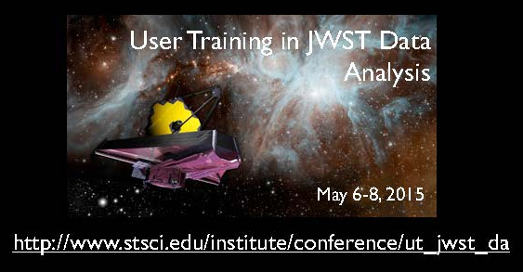
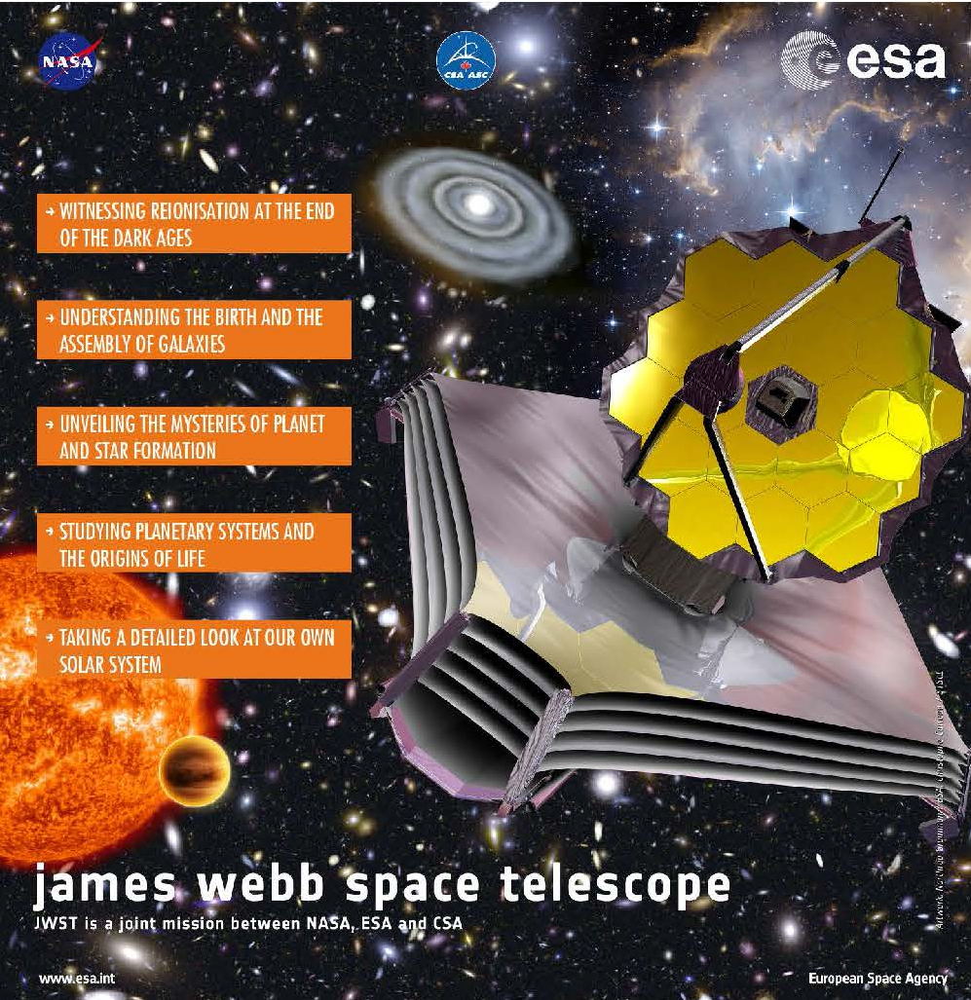
Upcoming events
Exploring the Universe with JWST
October 12-16, 2015:
ESA/ESTEC – Netherlands
http://congrexprojects.com/2015-events/15a02/introduction

