Slide 1
Astrometry and Photometry with Under-Sampled Detectors in Space
Jay Anderson, STScI
Aug 12, 2025
Earth 2.0 Science Conference
Shanghai, China
(remote from Virginia, USA)

Slide 2
Astrometry and Photometry with Under-sampled Detectors in Space
Goals
  Convince you it's possible, but not easy
  Different world of analysis
Why under-sampling?
  Pixels expensive: detectors, circuits, storage, downlink
  Trade off between sampling and real estate... real estate wins
  Similar trade-off with distortion and # of reflections
Before HST...
  "Under-sampling made astrometry impossible" – many people said
  Not true... It’s just challenging
  Ideal PSF for astrometry: top-hat, width of 1 pixel (even slosh)
Goldilocks…

Slide 3

Astrometry and Photometry with Under-sampled Detectors in Space
Goals
  Convince you it's possible, but not easy
  Diffferent world of analysis
Why under-sampling?
  Pixels expensive: detectors, circuits, storage, downlink
  Trade off between sampling and real estate... real estate wins
  Similar trade-off with distortion and # of reflections
Before HST...
  "Under-sampling made astrometry impossible" – many people said
  Not true... It’s just challenging
  Ideal PSF for astrometry: top-hat, width of 1 pixel (even slosh)
Goldilocks…

Slide 4
Astrometry and Photometry with Under-sampled Detectors in Space
Goals
  Convince you it's possible, but not easy
  Different world of analysis
Why under-sampling?
  Pixels expensive: detectors, circuits, storage, downlink
  Trade off between sampling and real estate... real estate wins
  Similar trade-off with distortion and # of reflections
Before HST...
  "Under-sampling made astrometry impossible" – many people said
  Not true... It’s just challenging
  Ideal PSF for astrometry: top-hat, width of 1 pixel (even slosh)
Goldilocks…
too
narrow
too
wide
just
right!

Slide 5
Under-Sampling? % Flux in central pixel
Marginally-sampled Gaussian: 13%
HST
  WFPC2: PC 20%, WF 45%
  ACS/WFC gets 23% (ACS/HRC got 9%)
  WFC3/UVIS gets 18%
  WFC3/IR gets over 50%
JWST
  NIRCam 60% → 15%
ROMAN
  ~30% +

Slide 6
This talk...
How to deal with under-sampling
  Benefits of space-based observations
  Different approach to PSF modeling
Current Space-Based observations
  HST
  Webb
Plans for the Roman pipeline and PIT

Slide 7
Space-Based Observing
Benefits
No atmosphere, no seeing
No day-night cycle: esp at L2
High Strehl ratios
Optics quite well known
Long-term stable observing platform

Slide 8
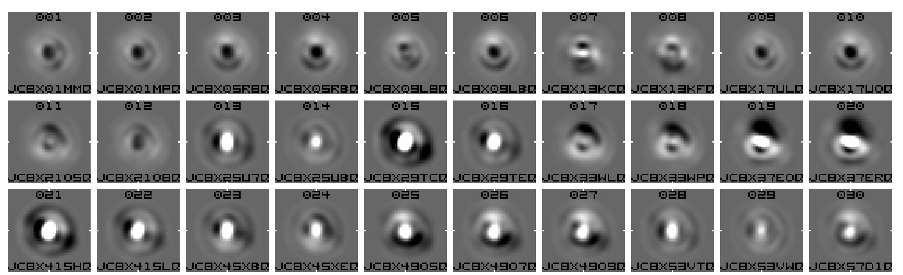
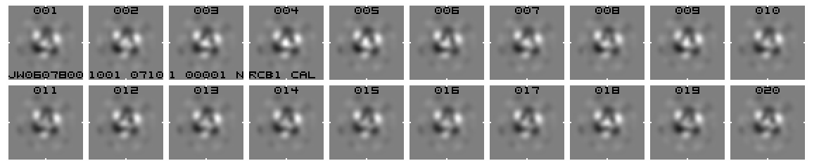
Space-Based Observing
Benefits
No atmosphere, no seeing
No day-night cycle: esp at L2
High Strehl ratios
Optics quite well known
Long-term stable observing platform
Challenges
Under-sampling
Sharp PSF features, even in halo/outskirts
Variations
  HST has “breathing” and “jitter”
    PSF core shape constant: core/halo ±10%
    PSF photometry varies by ~2%
    Outskirts more variable
  JWST has mirror adjustments
    Long term ~0.5%
    Short term ~0.1%
  Roman?
    Jitter?
    Slow breathing?
HST PSF PERTURBATION
JWST PSF PERTURBATION

Slide 9

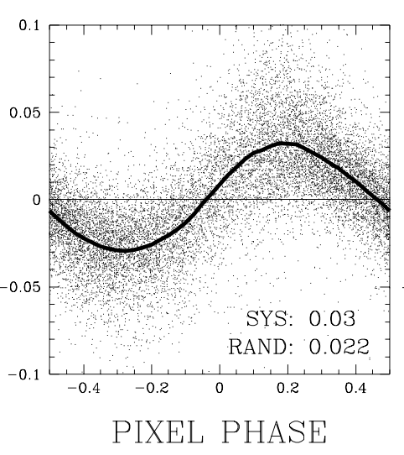
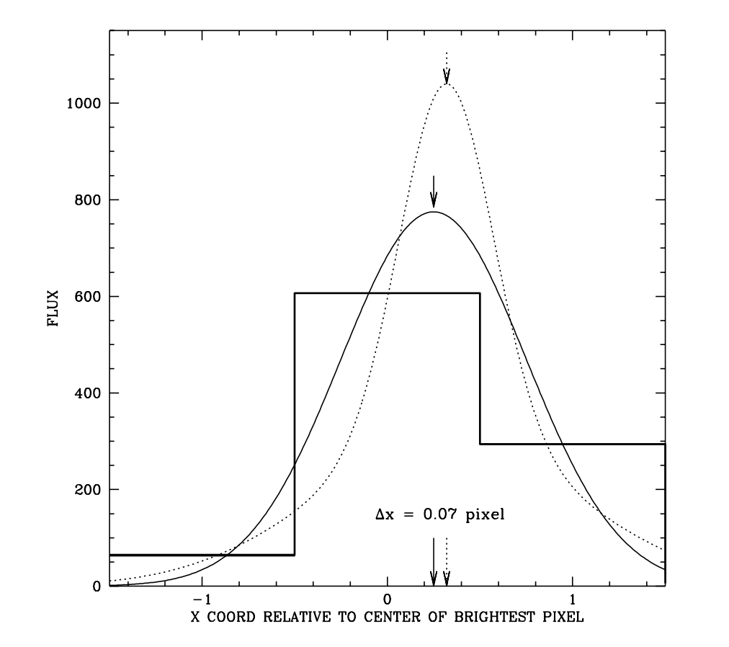
Space-Based
PSF MODELS
2000
Initial work with WFPC2
  Advisor Ivan King had HST GTO time on globular clusters
  Got images: residuals show clear bias
Need for careful PSF modeling
  Uncharted territory: DAOPHOT for ground
  Benefit: I don't know much optics
  How to know true underlying shape?
x position residuals
When you fit stars,
you always deal with
pixel-integrated PSF
Epiphany:
We never need
underlying shape
When you solve for
the PSF, you start with
pixel-integrated values

Slide 11
1/2%
2%
4%
2%
1%
1%
3%
7%
4%
3%
2%
8%
8%
4%
30%
1%
2%
7%
3%
2%
1/2%
1%
3%
2%
1%

Slide 12
1%
3%
3%
2%
½ %
3%
4%
4%
3%
2%
2%
5%
4%
20%
20%
2%
4%
4%
2%
2%
1%
2%
2%
1%
½ %

Slide 13
2%
4%
4%
3%
½ %
4%
15%
15%
5%
3%
4%
15%
15%
5%
3%
1%
4%
4%
2%
1%
½ %
1%
1%
1%
½ %

Slide 14
1/2%
2%
4%
2%
1%
1%
3%
7%
4%
3%
2%
8%
8%
4%
30%
1%
2%
7%
3%
2%
1/2%
1%
3%
2%
1%

Slide 15
∆x
1/2%
2%
4%
2%
1%
1%
3%
7%
4%
3%
∆y
2%
8%
8%
4%
30%
1%
2%
7%
3%
2%
1/2%
1%
3%
2%
1%

Slide 16
∆x
1/2%
2%
4%
2%
1%
Every pixel in a star’s image samples the PSF at one location
1%
3%
7%
4%
3%
∆y
2%
8%
8%
4%
30%
⋏
P_{ij} – sky*
𝛙(∆x, ∆y) =
1%
2%
7%
3%
2%
Z*
1/2%
1%
3%
2%
1%
Fraction of the star’s light that lands in this pixel

Slide 17
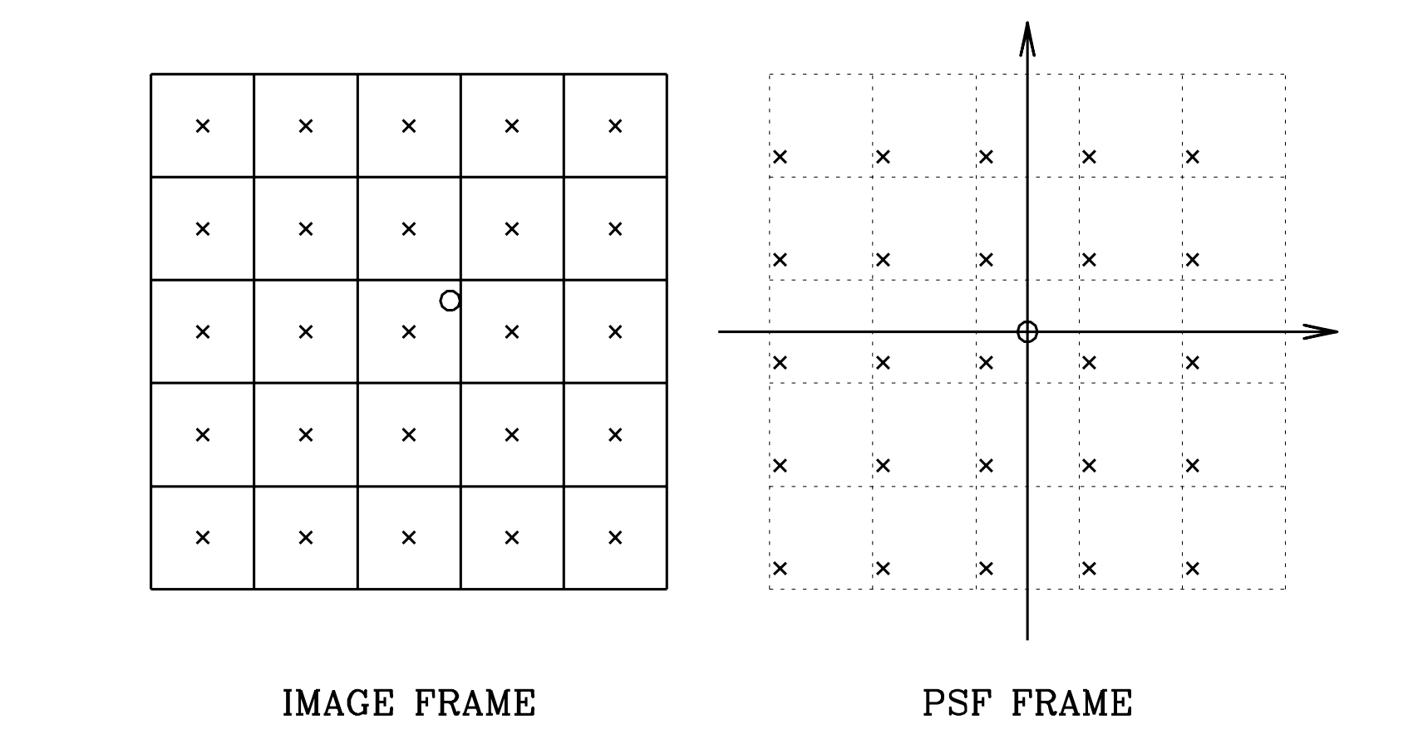
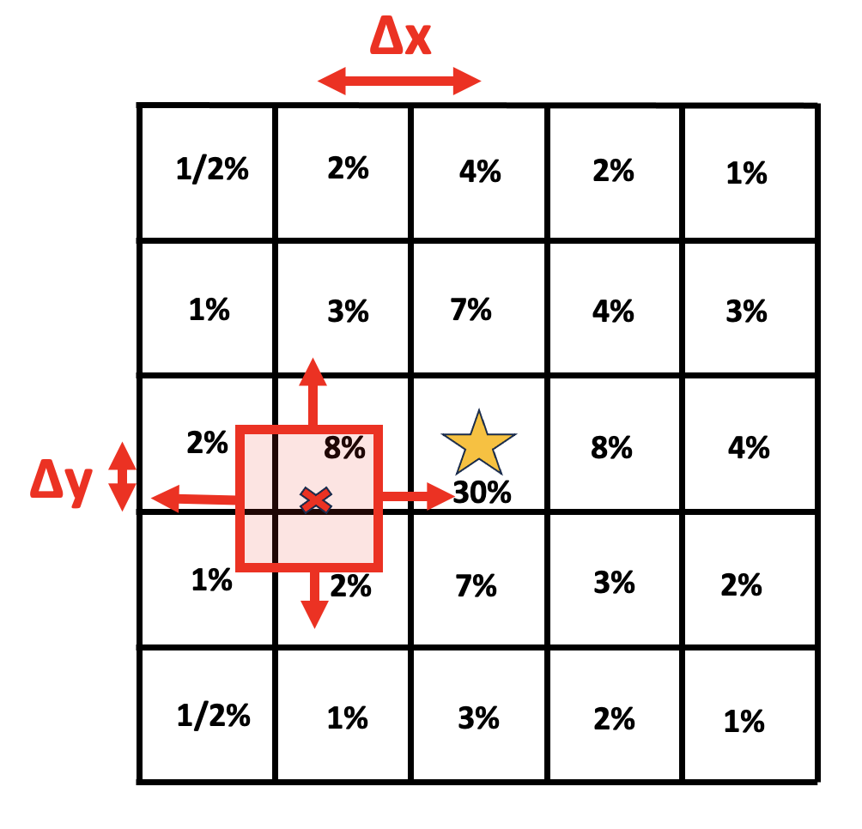
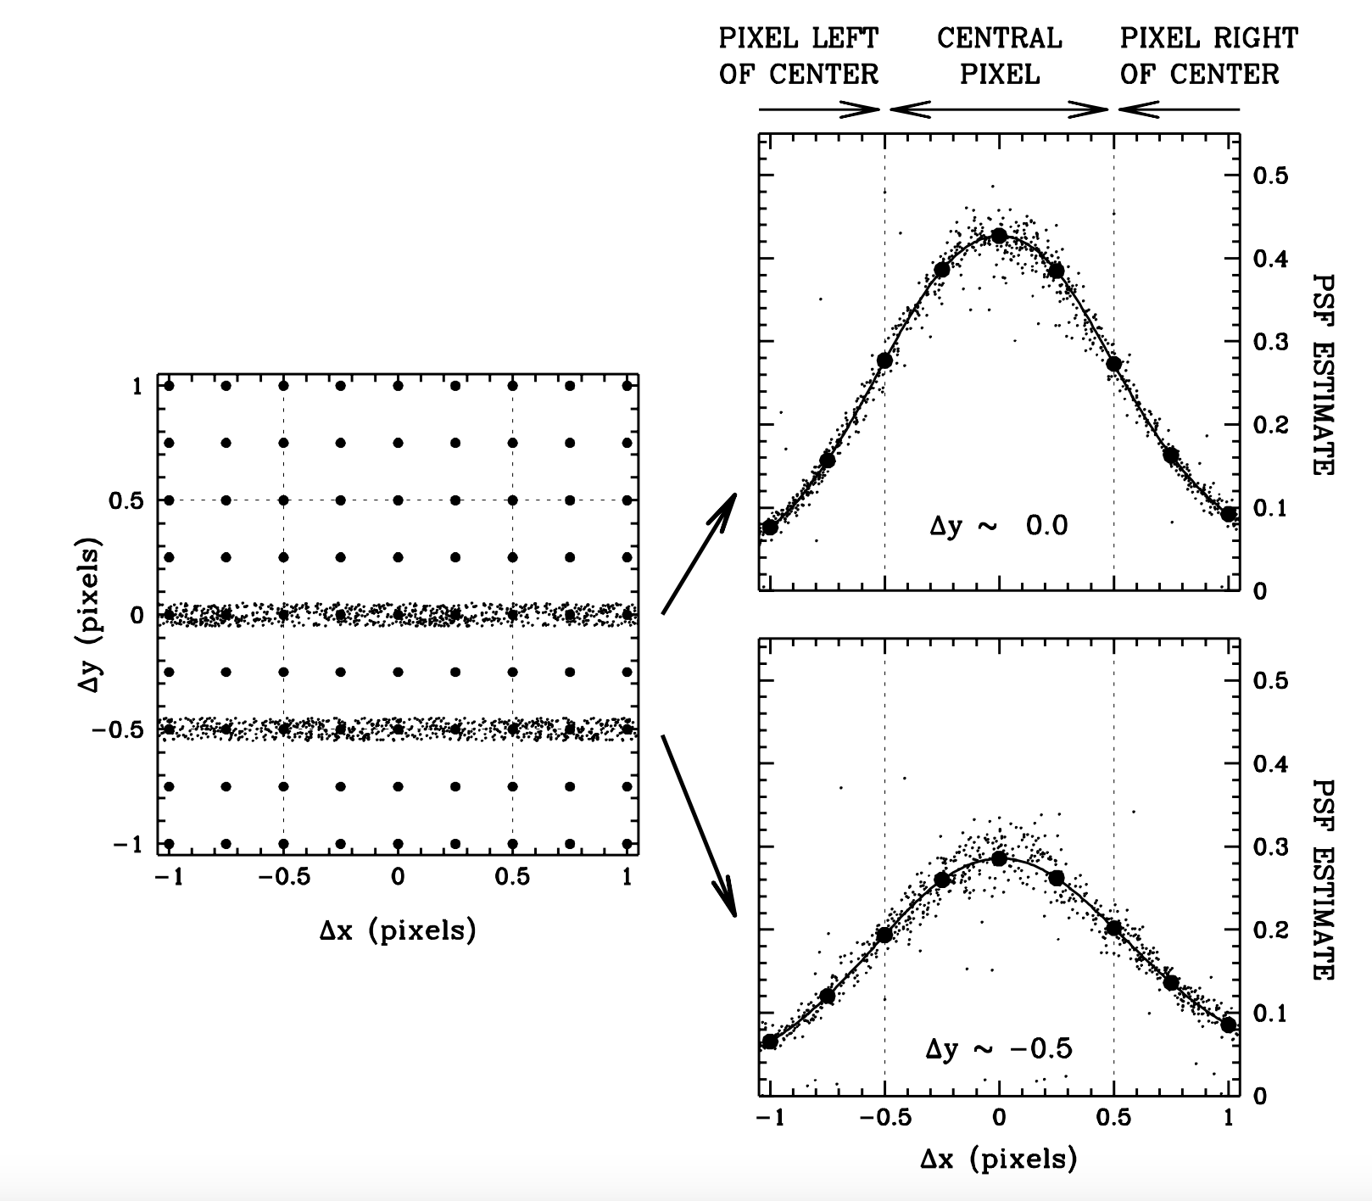
(1) The inner 5x5 pixels of a star, sample PSF at 25 places
(2) Many star images provide a multitude of PSF samplings
(3) Can “see” the ePSF directly in samplings

Slide 18
Modeling 𝛙eff
Grid has a lot of degrees of freedom
  Spacing ~0.25 pixel
  Smoothness constraints (an art)
  Normalization constraints Σ_{(r<5)} ѱ = 1
  Sub-pixel normalization constraints
Visible PSF goes out to r ~ 10 pixels
  Unsaturated stars have little signal beyond this
  May need farther for saturated stars, but constructing is more complicated.

Slide 19
Quick Examples of Science
HST -- LAWD-37: He atmosphere WD
HST -- OB462: Recent isolated BH
JWST – Preliminary work
ROMAN – pipeline effort

Slide 20
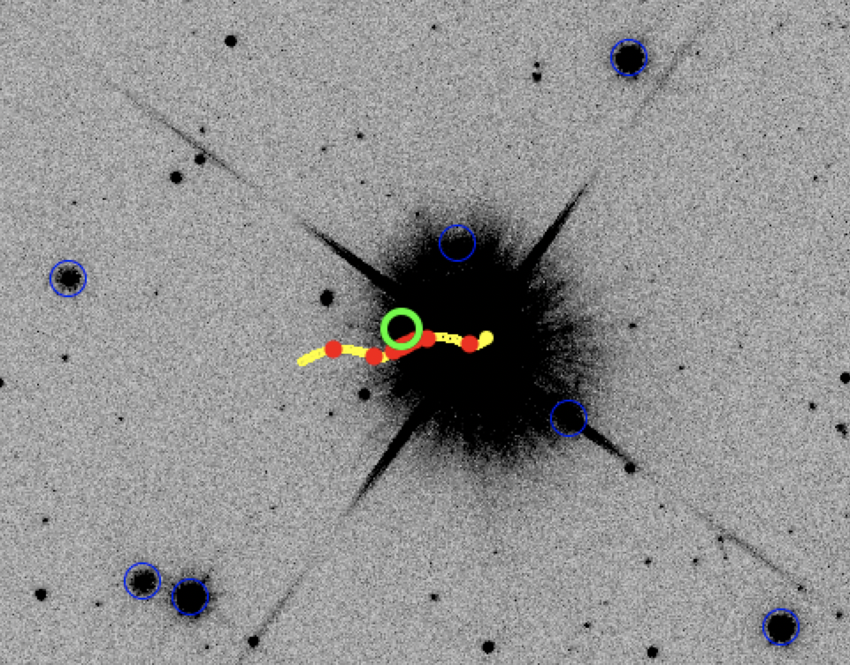
Ex#1:LAWD-37
Isolated DQ-Type WD
Peter McGill predicted event from GAIA DR1 Catalog
PI-Sahu observed 9 epochs with HST’s WFC3/UVIS.
Measure mass
From deflection of background star

Slide 21
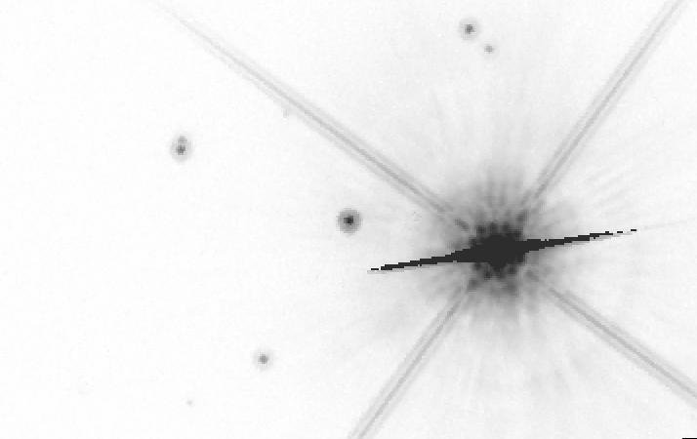
E1_2019.331

Slide 22
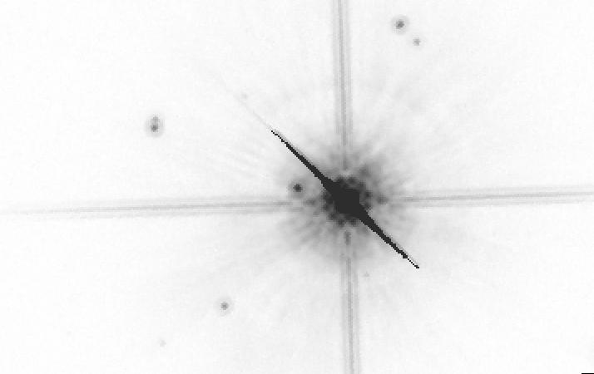
E3_2019.715

Slide 23
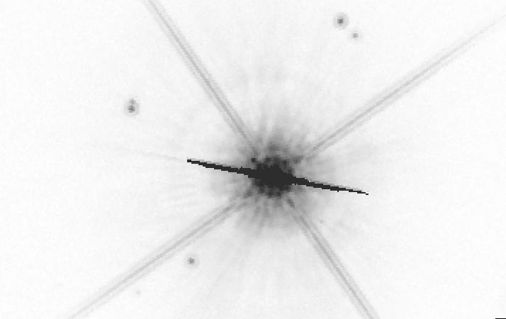
E3_2019.817

Slide 24
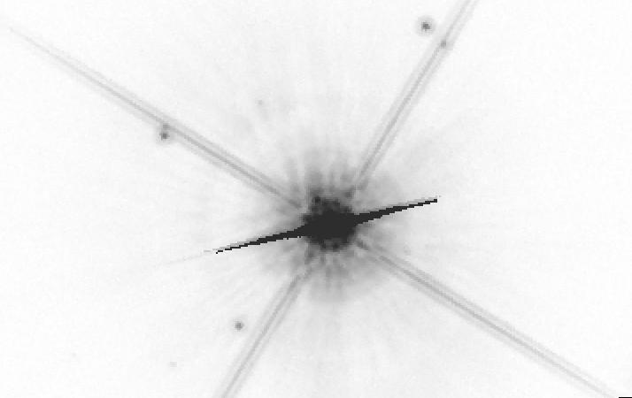
E4_2019.863

Slide 25
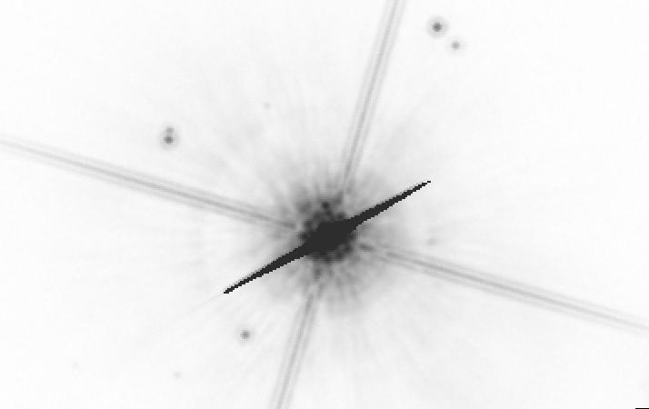
E5_19.907

Slide 26
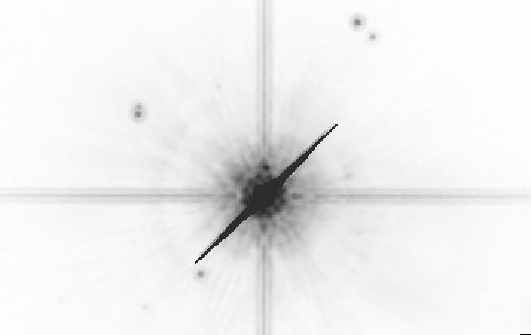
E6_19.931

Slide 27
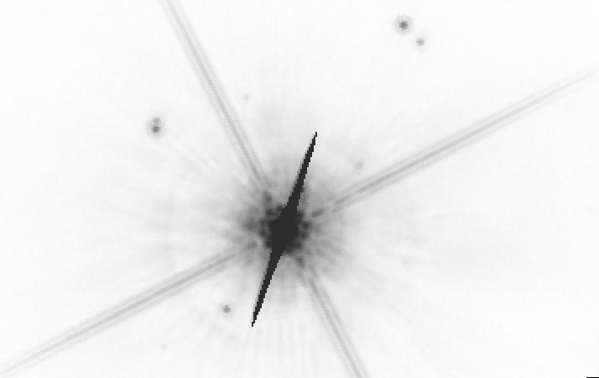
E7_20.008

Slide 28
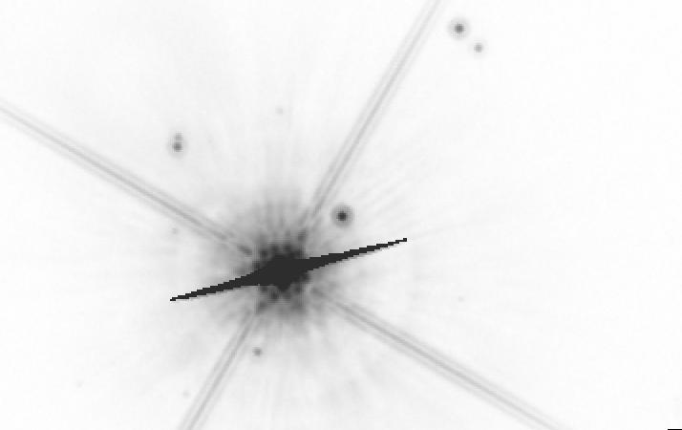
E8_20.339

Slide 29
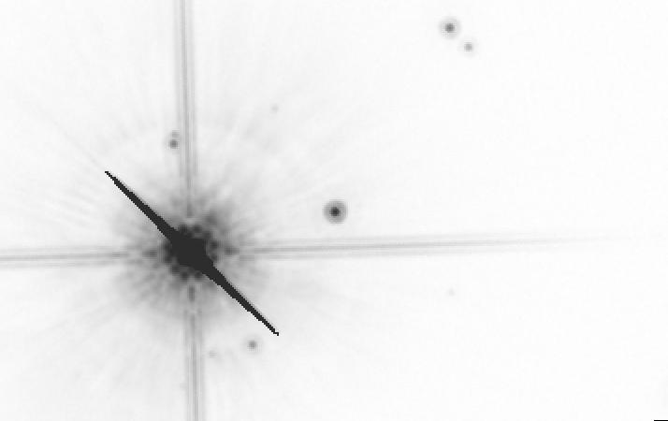
E9_20.711

Slide 30
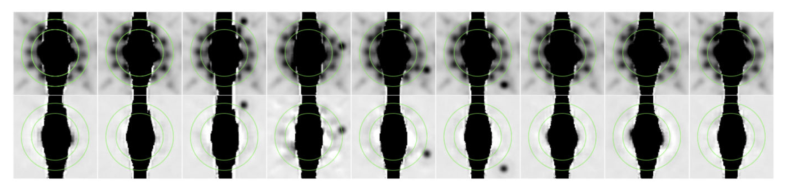
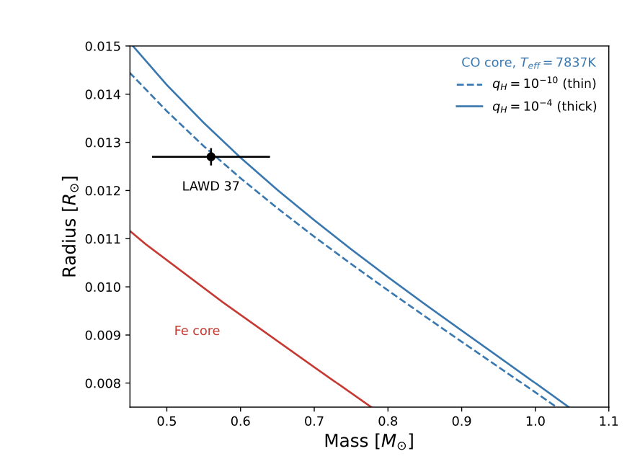
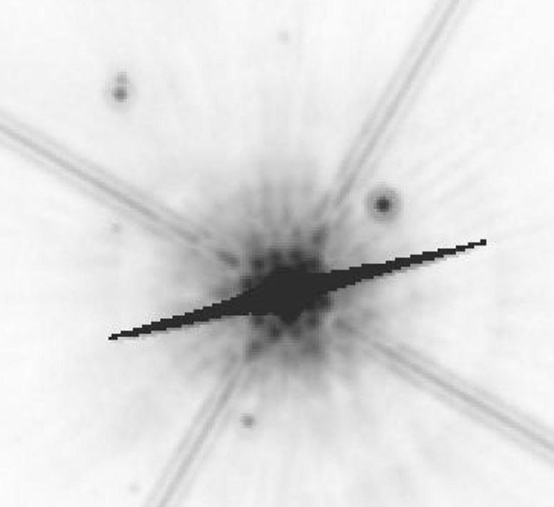
Must do careful subtraction of WD’s PSF halo -- no available reference stars that blue!
Also, need for very careful reference-frame treatment!

Slide 31
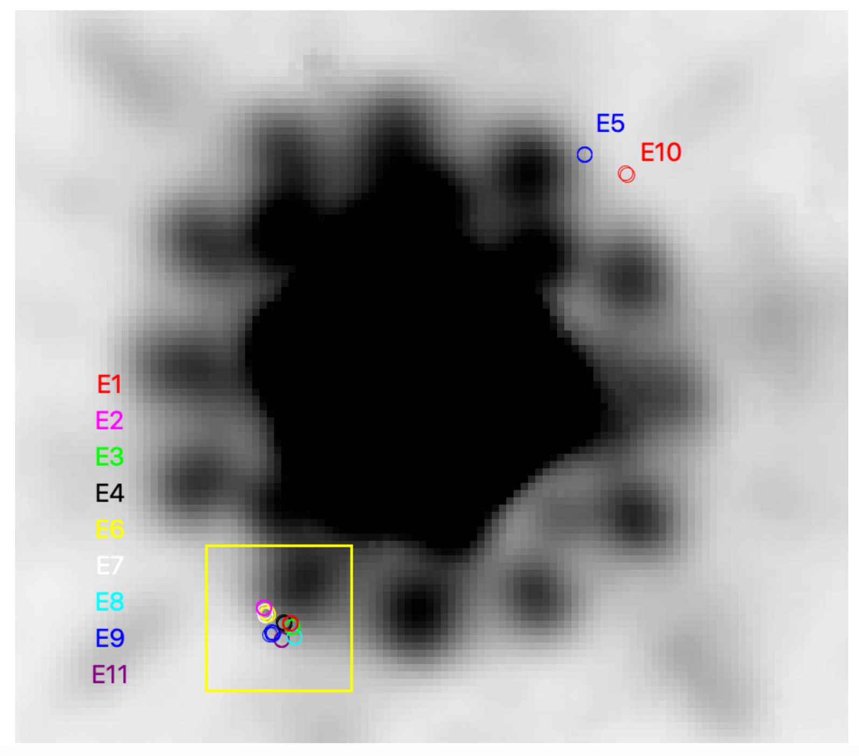
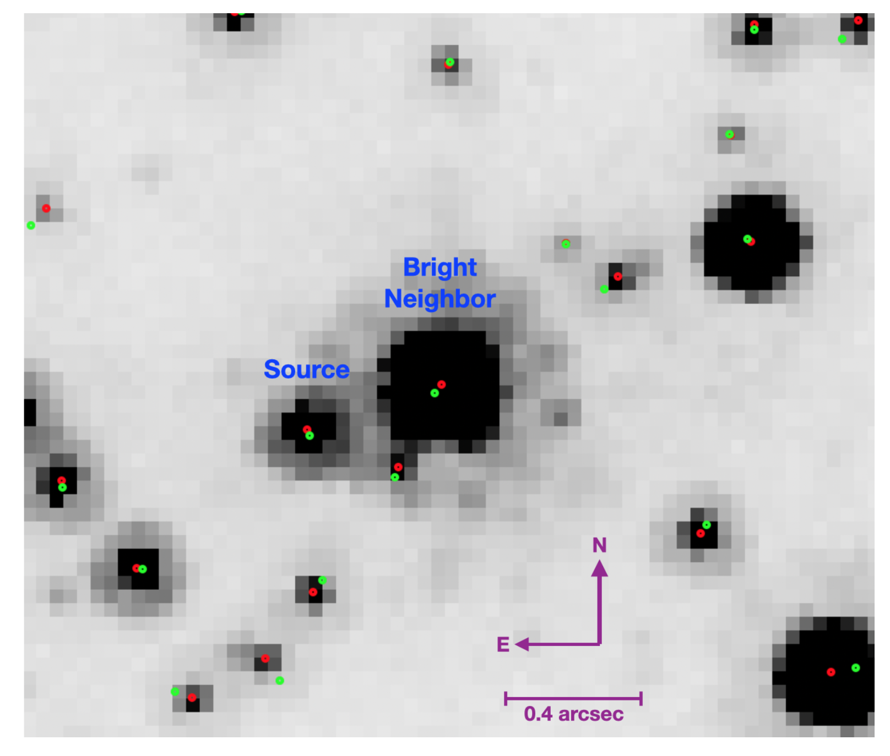
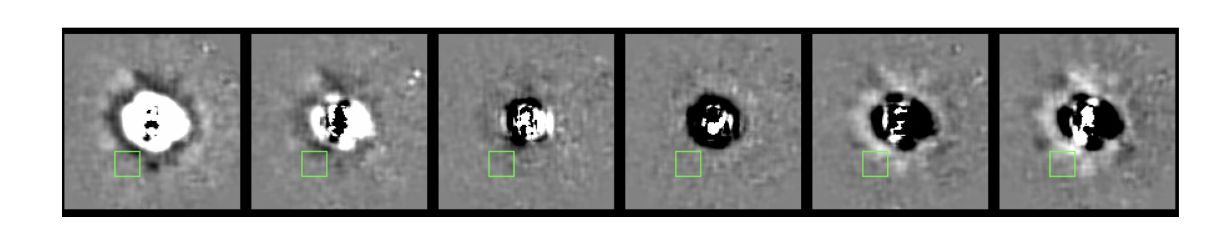
Ex#2Recent Isolated Black Hole
(OB462)
Multi-year brightening
long duration event
Astrometric signature
Analyzed in
Sahu, Lam
papers
Bright star’s “breathing” during an orbit…

Slide 32
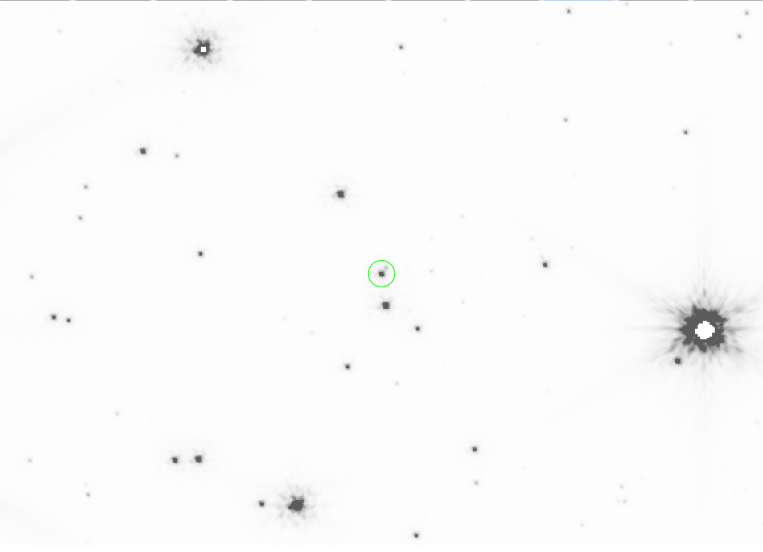
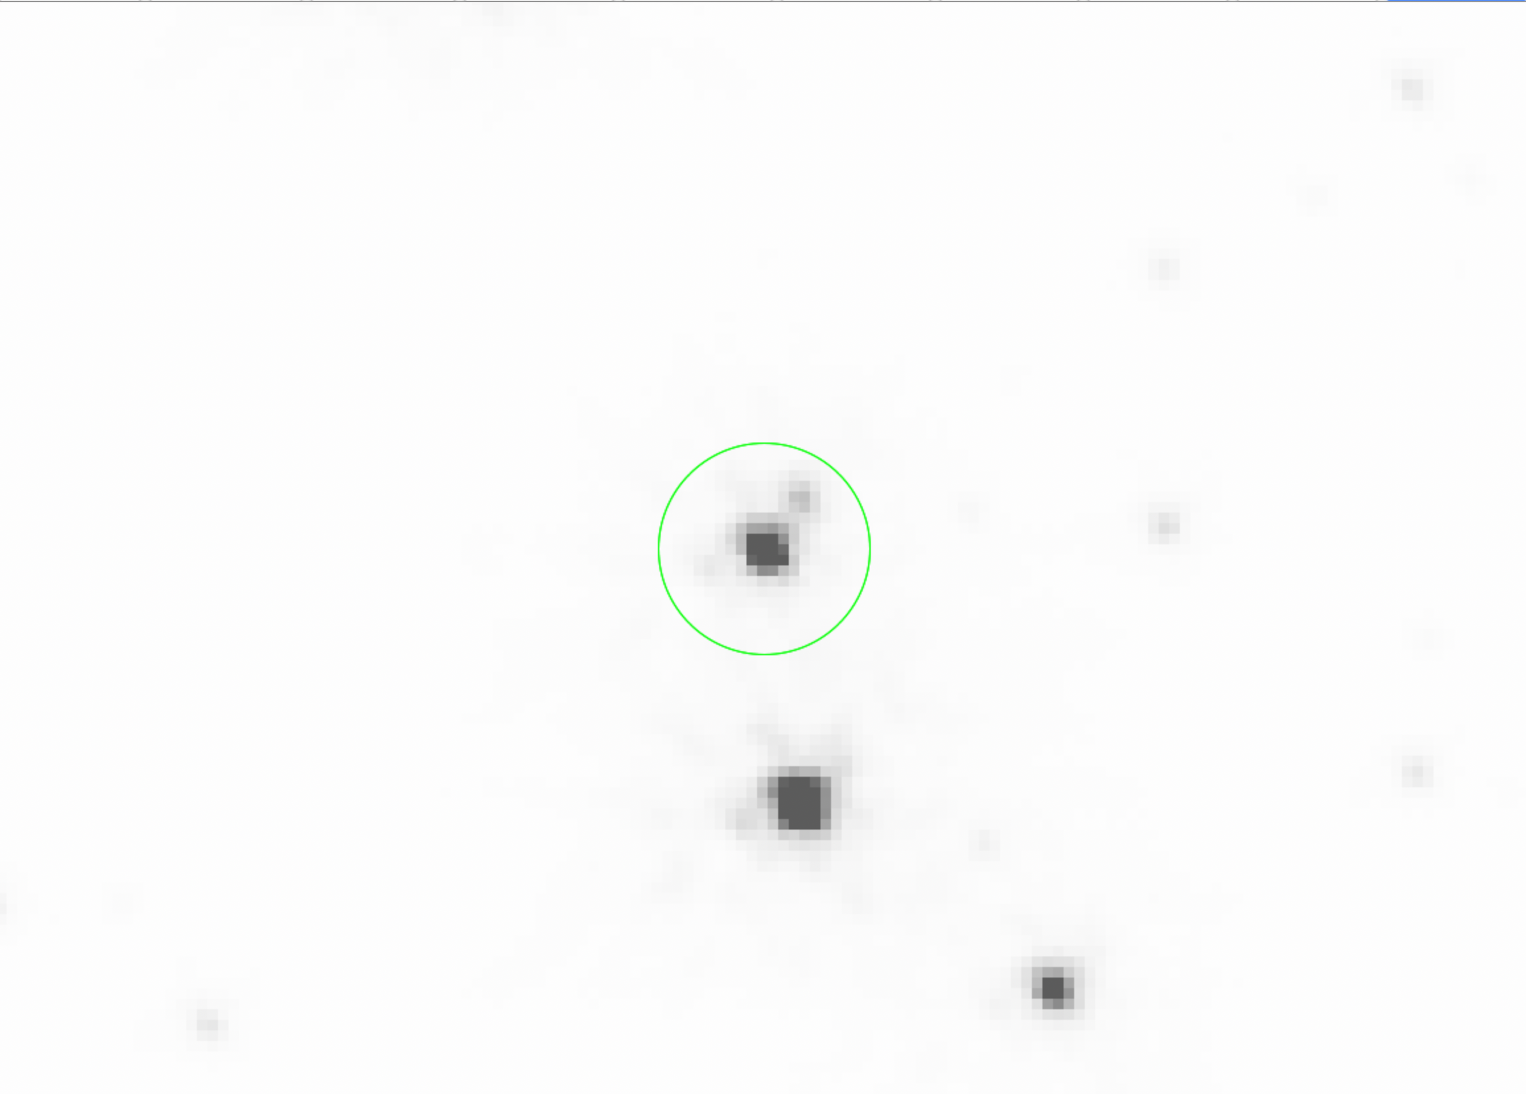
ma n
F070W
Ex#3 JWST: PI-Blackman
Exquisite dither!!
MOA 2010-BLG-477: searching for lens

Slide 33

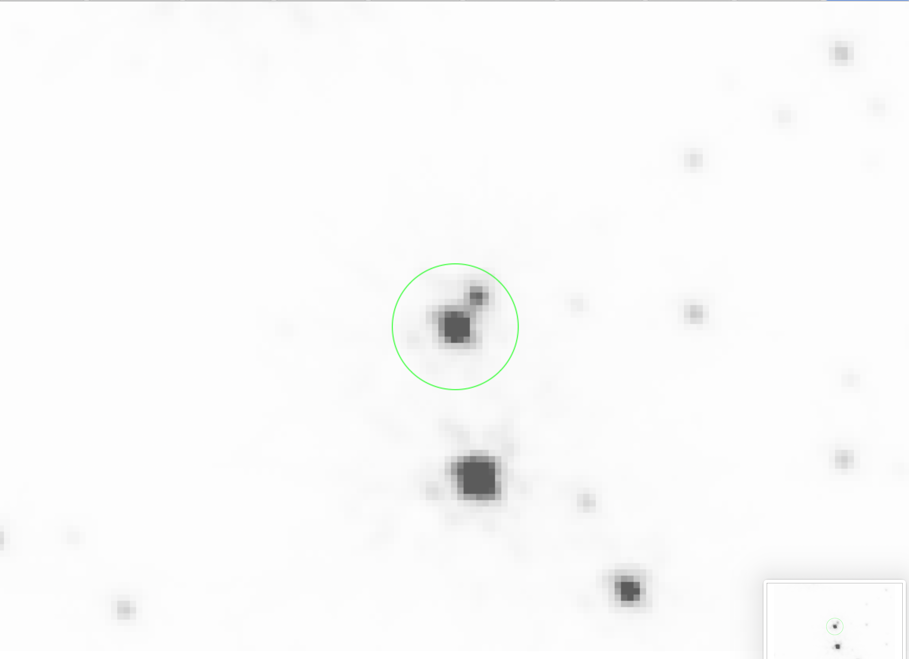
Blackma n
F090W
JWST: PI-Blackman
MOA 2010-BLG-477: searching for lens

Slide 34
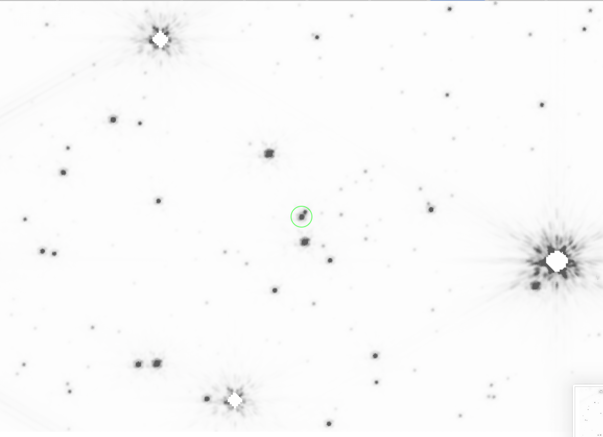
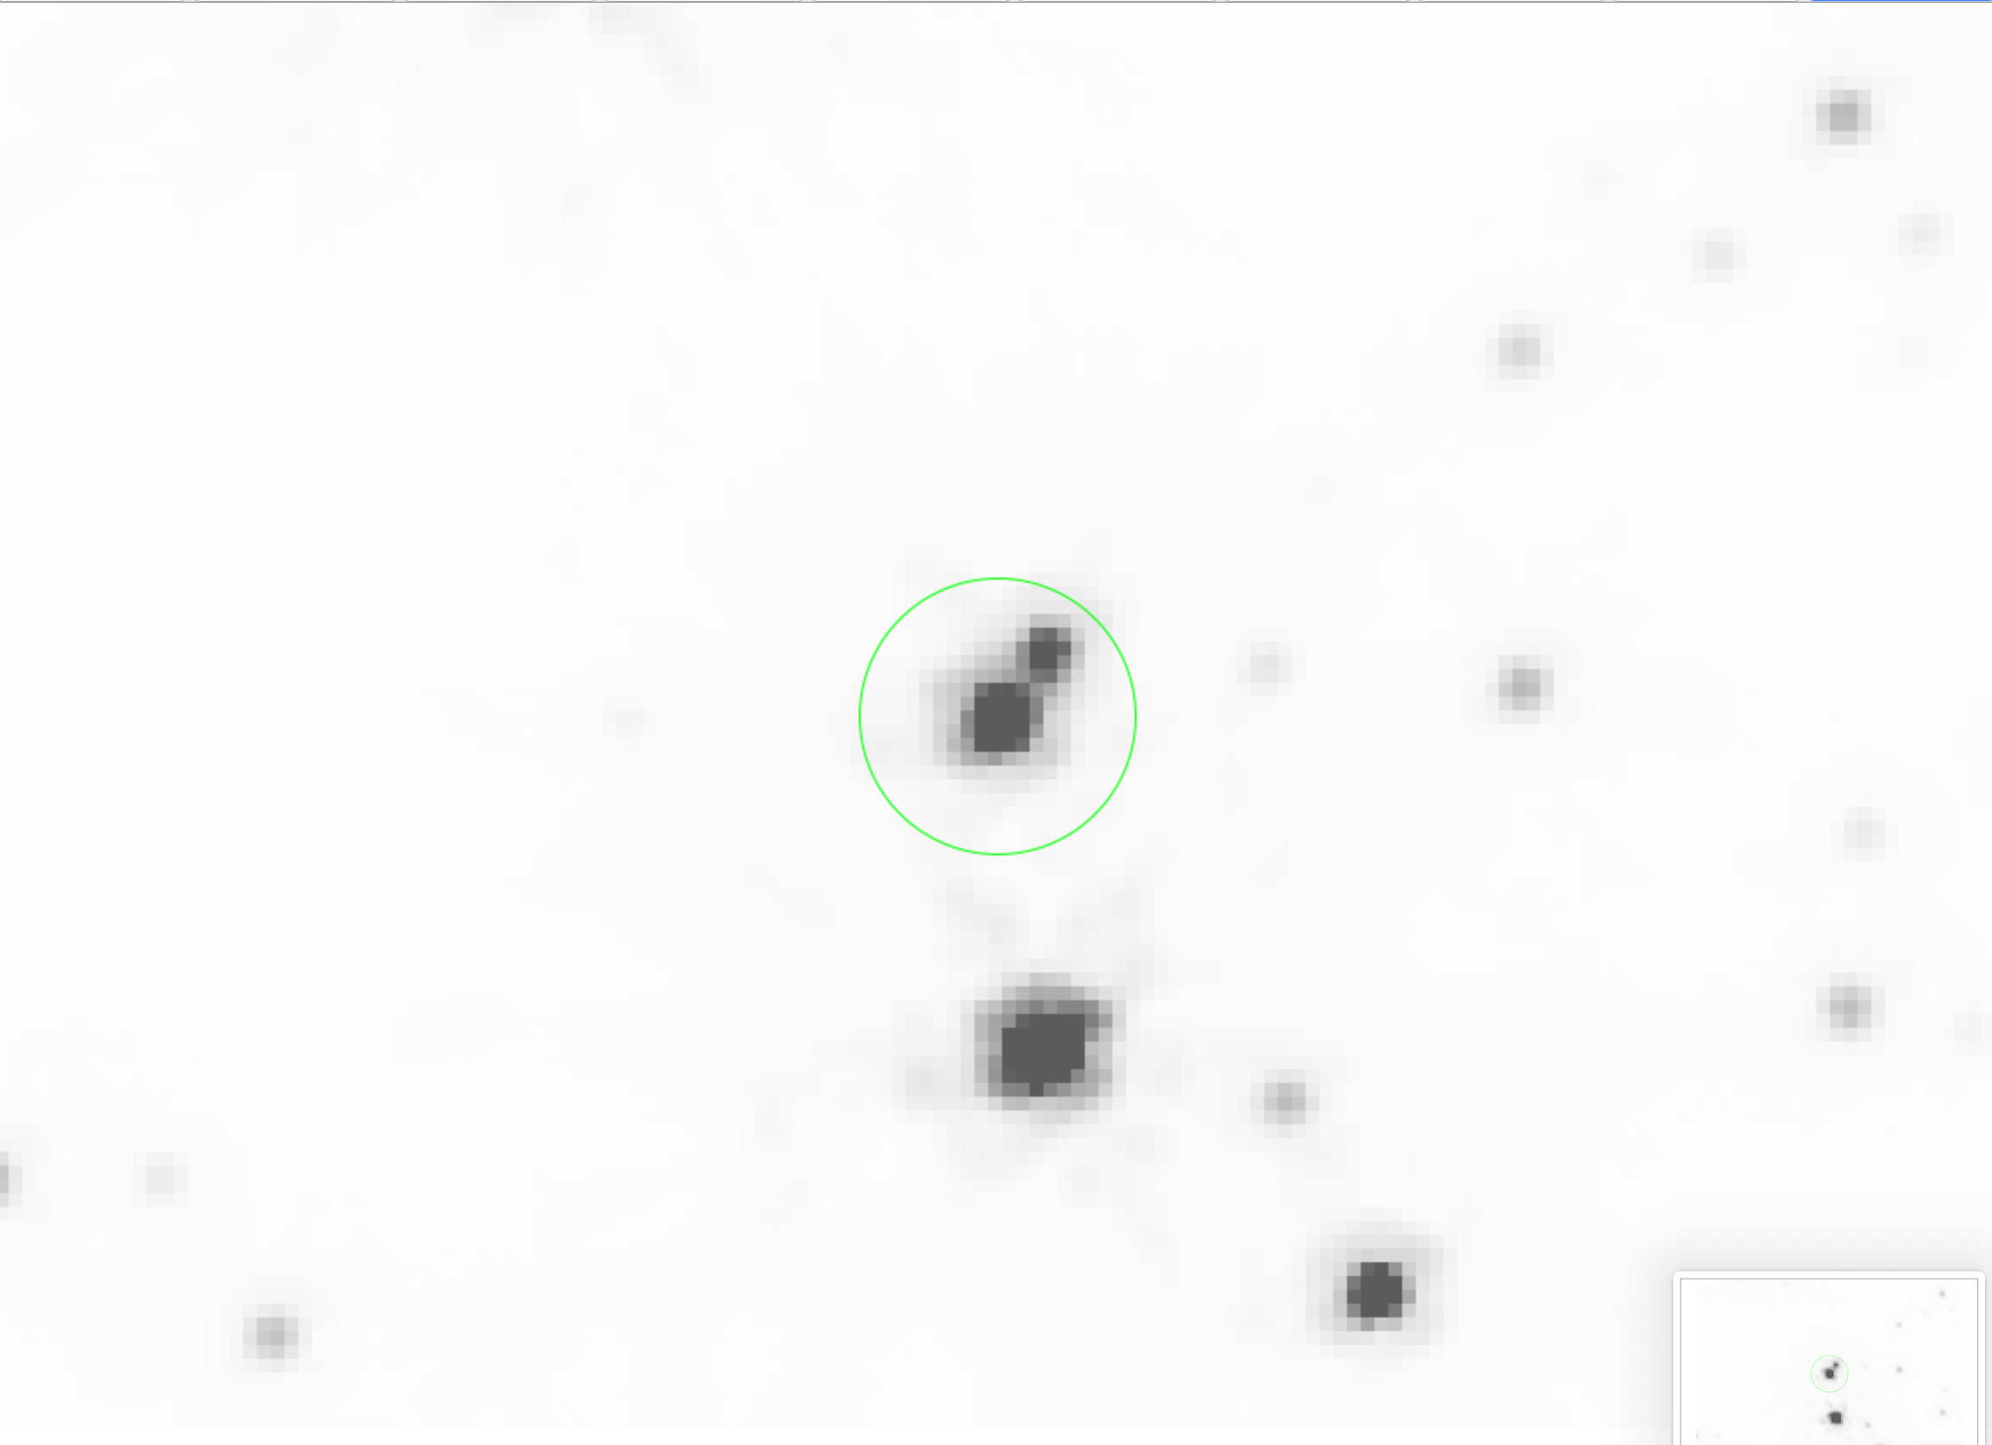
Blackma n
F115W
JWST: PI-Blackman
MOA 2010-BLG-477: searching for lens

Slide 35
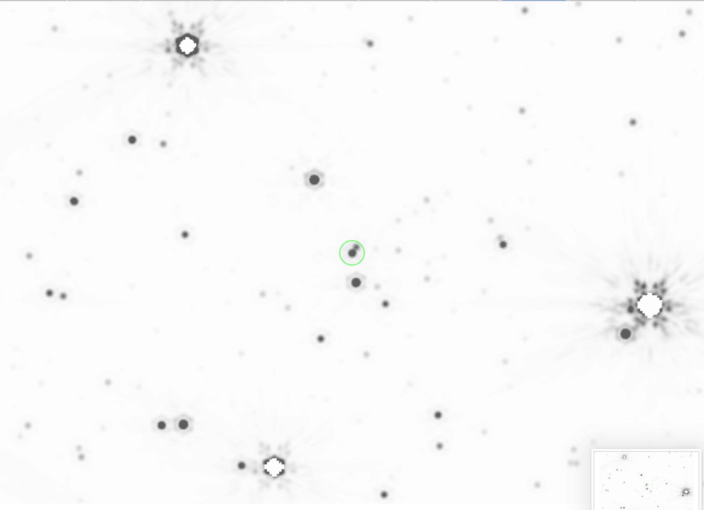
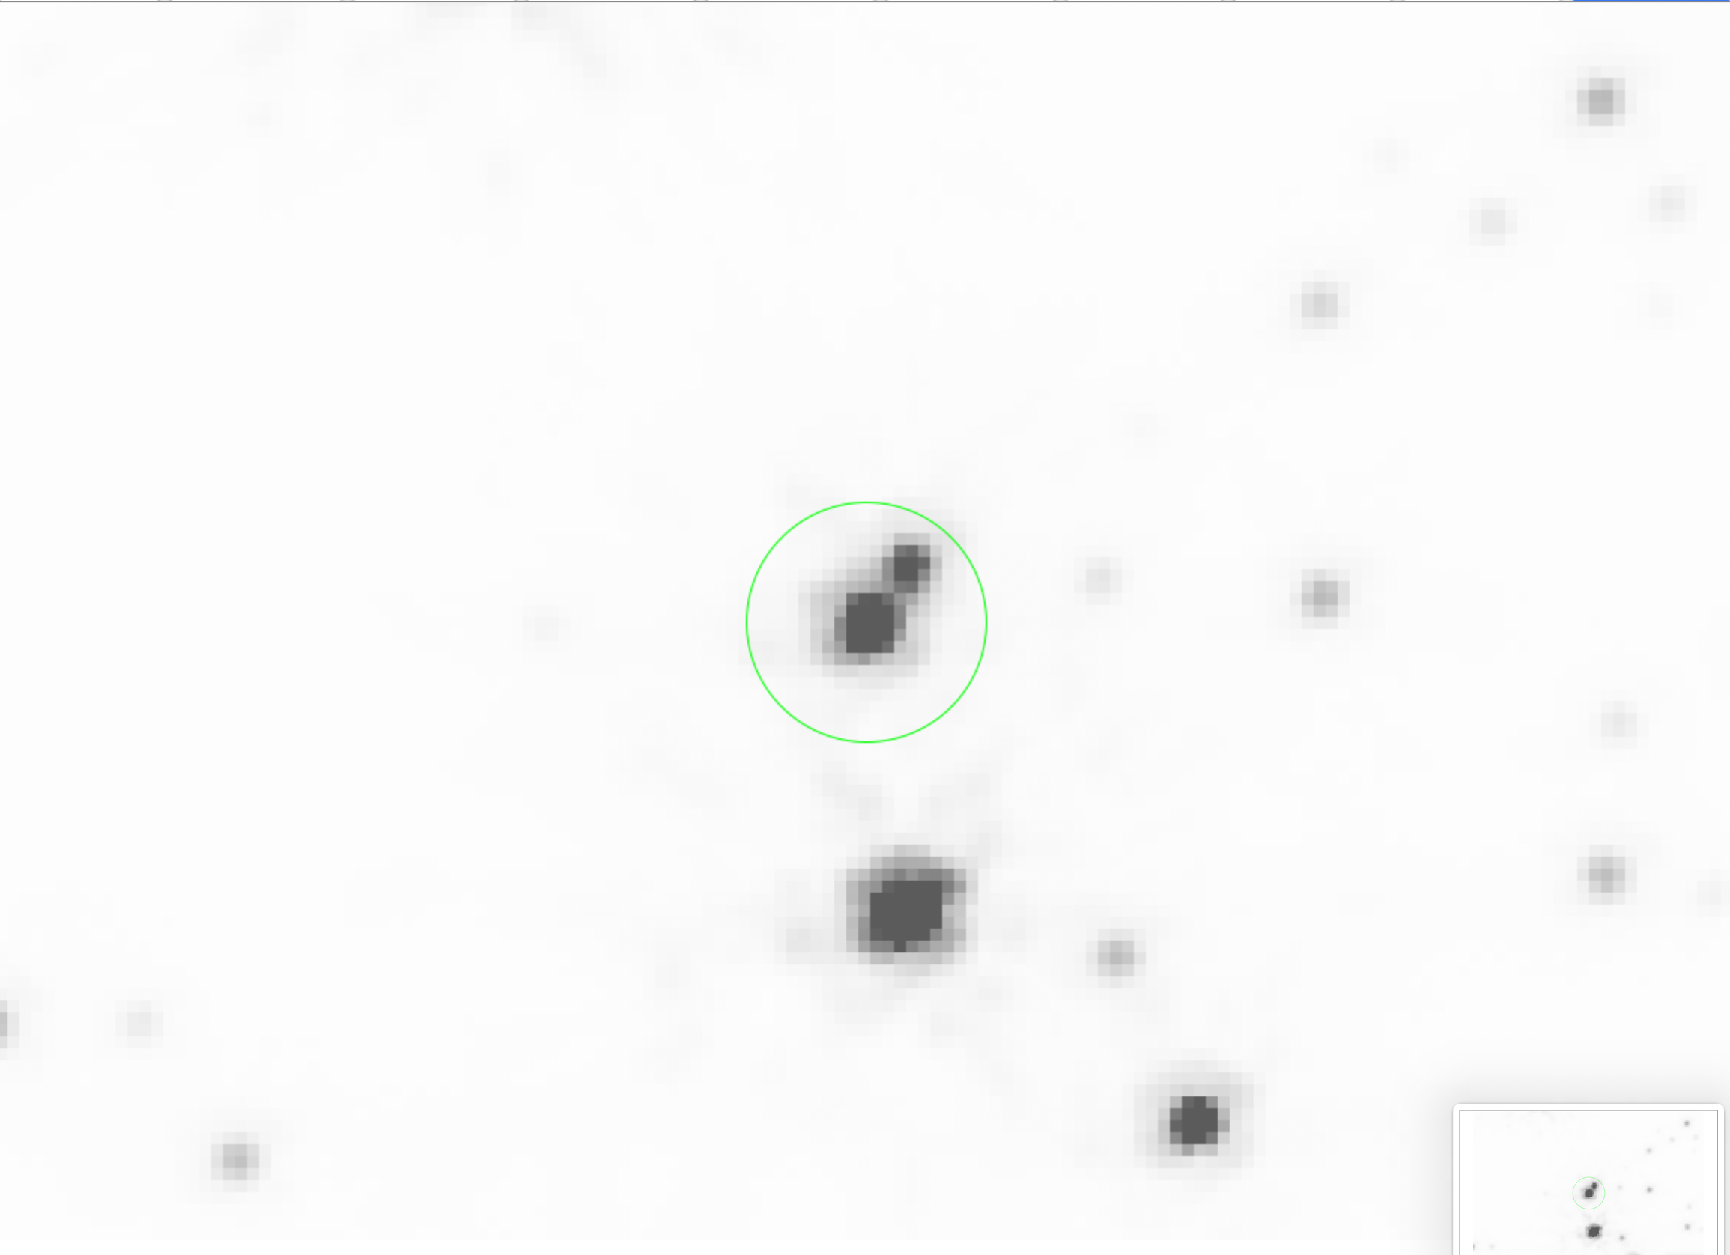
Blackma n
F200W
JWST: PI-Blackman
MOA 2010-BLG-477: searching for lens

Slide 36
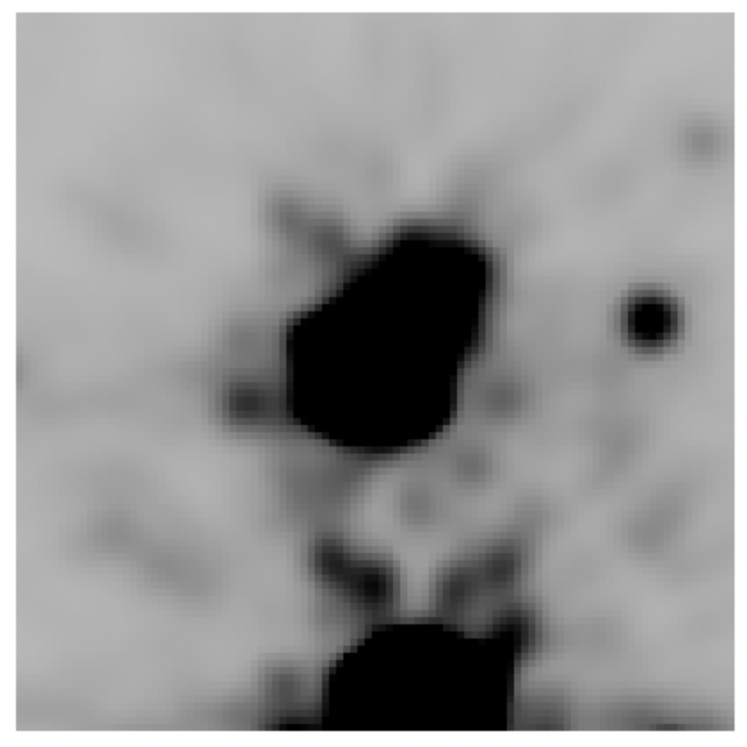
F115W: CLOSE UP OF TARGET
TWO STARS

Slide 37
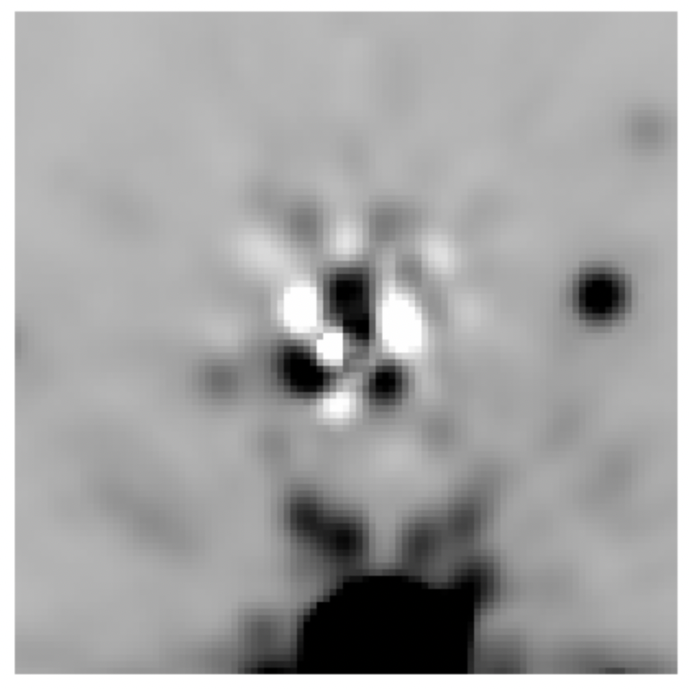
F115W: SUBTRACT MODEL “LIBRARY” PSF

Slide 38
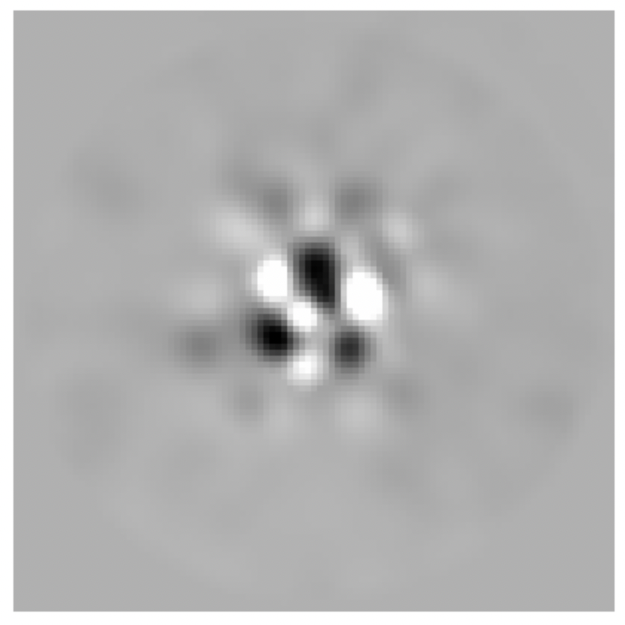
F115W: FIND DETAILED PERTURBATION

Slide 39
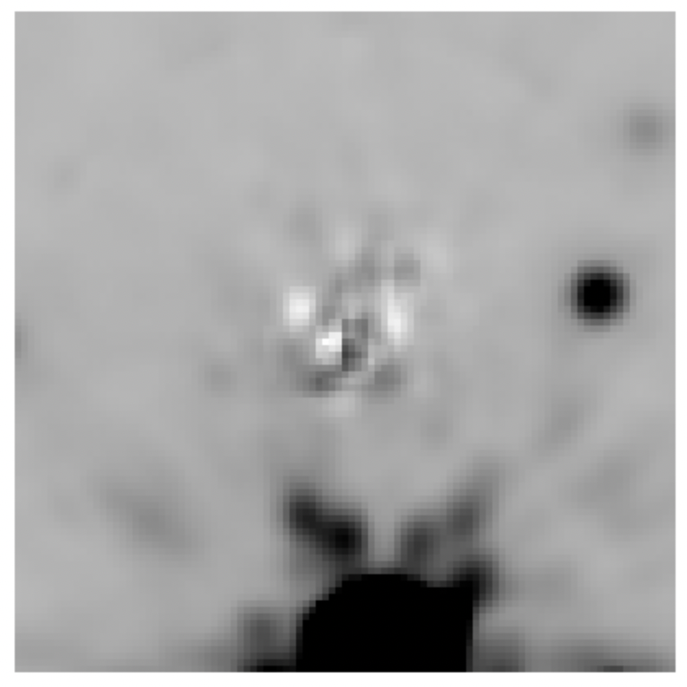
F115W: TWO-SOURCE SUBTRACTION
More work to do, with this and
other filters

Slide 40
Lessons learned from HST + JWST...
No event is simple
  Especially true for the interesting ones
Everything must be measured relative to a reference
Always annoying neighboring stars around
Telescopes stable, but...
  Jitter, breathing, color dependence are perturbations
Use uninvolved stars to "regularize" observations
Time is precious: 1950's game show:

Slide 41
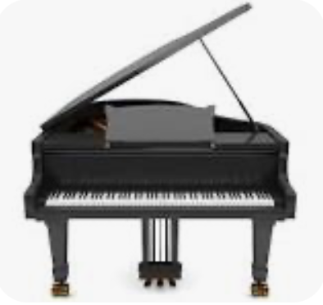

Lessons learned from HST + JWST...
No event is simple
  Especially true for the interesting ones
Everything must be measured relative to a reference
Always annoying neighboring stars around
Telescopes stable, but...
  Jitter, breathing, color dependence are perturbations
Use uninvolved stars to "regularize" observations
Time is precious: 1950's game show:
  Take minimum possible data
  "Hey, TAC, I can find that black hole in 5 visits!"

Slide 42
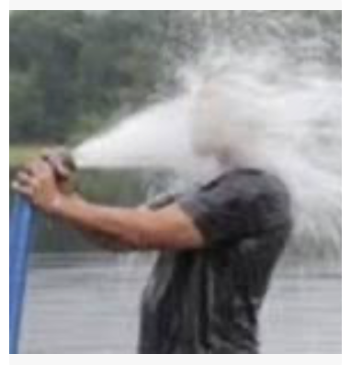
Lessons learned from HST + JWST...
No event is simple
  Especially true for the interesting ones
Everything must be measured relative to a reference
Always annoying neighboring stars around
Telescopes stable, but...
  Jitter, breathing, color dependence are perturbations
Use uninvolved stars to "regularize" observations
Time is precious: 1950's game show:
  Take minimum possible data
  "Hey, TAC, I can find that black hole in 5 visits!"
NOT FOR ROMAN!!!
    MOVIES!
Drinking from a
firehose.

Slide 43
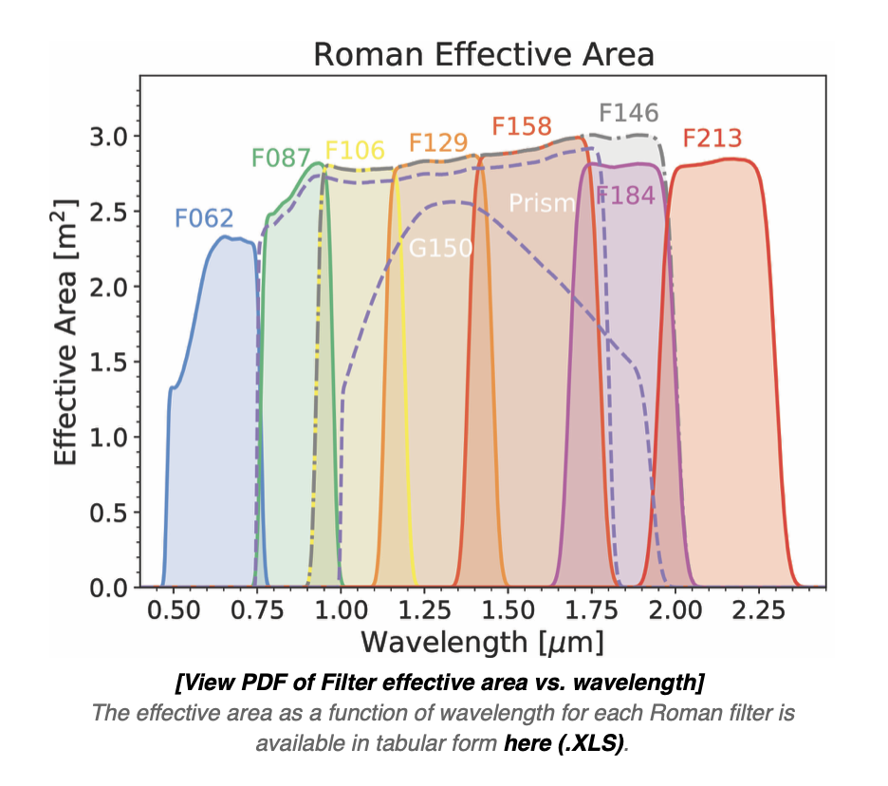
ROMAN Galactic Bulge Time Domain Survey
HST/JWST:
  Special Cases!
  Roman can’t afford special cases!
Build on what we have for HST/JWST
  ROMAN more stable than HST or JWST
  Under-sampling similar
Advantages over ground
  Resolution ~0.1 arcsec, 100x more pixels/star
  Less crowding, but non-trivial
  Dramatically less blending for events than gd
    Observing full event from space: big change
    Should be able to get brightness/colors of both
    Less degeneracy for PM fitting
Challenges:
  W149 → Color-dependent PSF

Slide 44

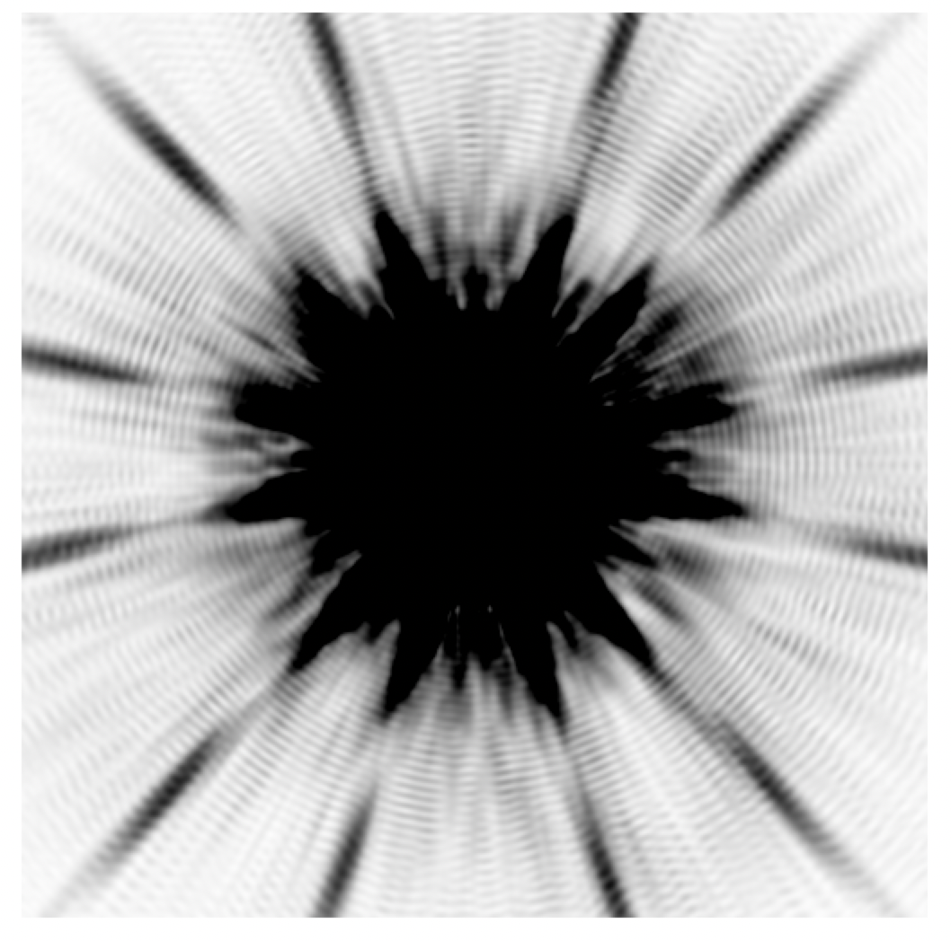
PSF variation with color
F087

Slide 45

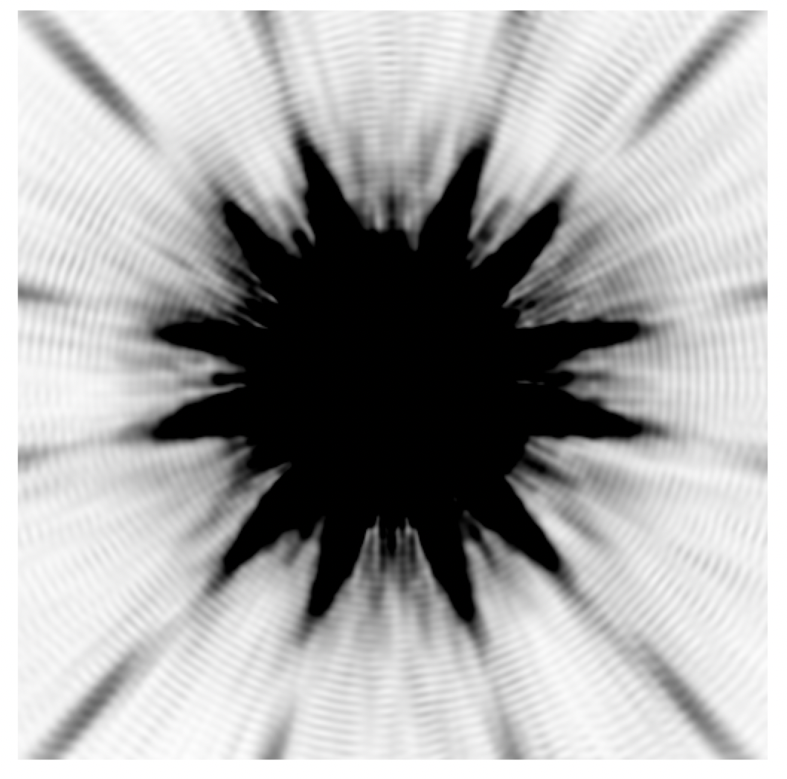
PSF variation with color
F106

Slide 46

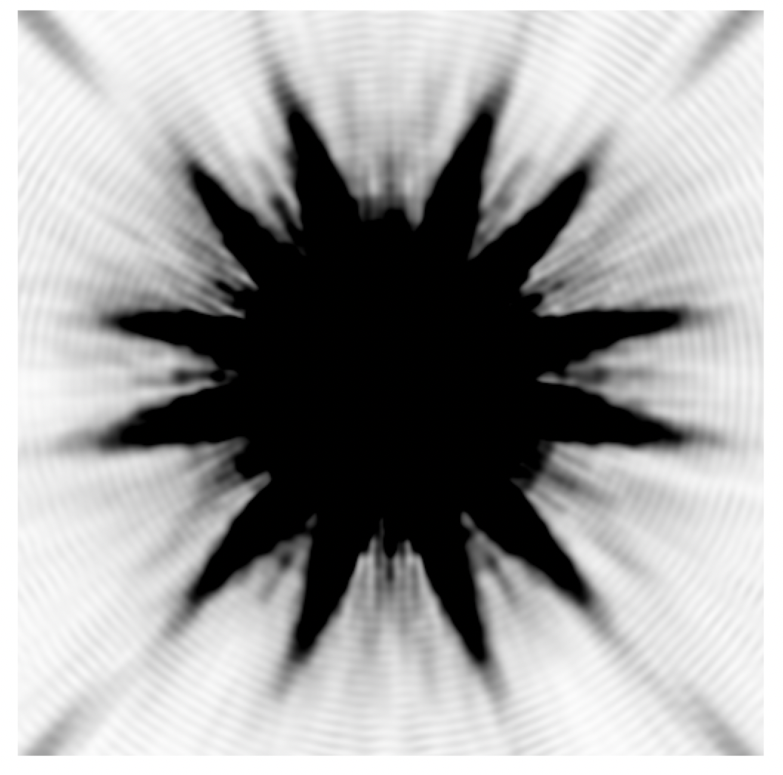
PSF variation with color
F128

Slide 47

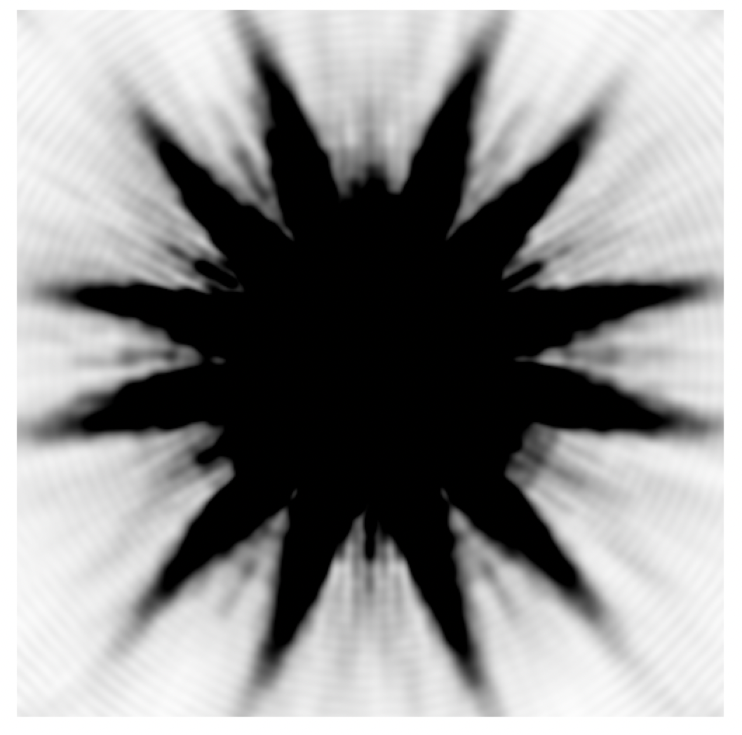
PSF variation with color
F158

Slide 48

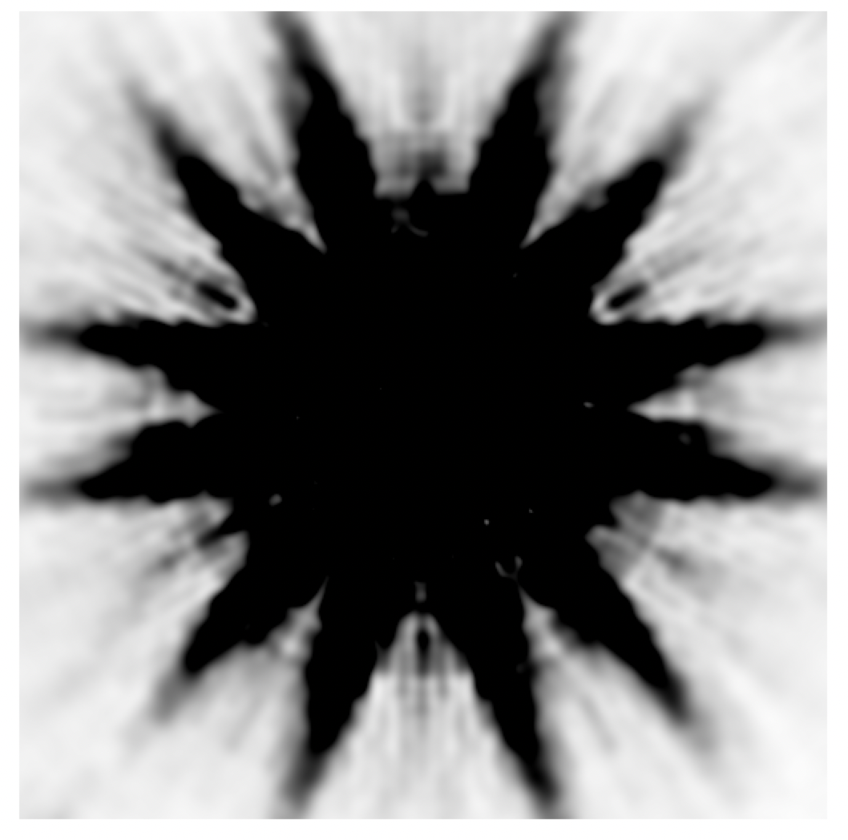
PSF variation with color
F184

Slide 49
5x wide filter
F184
BLUE
STAR
RED
STAR

Slide 50
ROMAN GBTDS
Challenges:
  W149 → Color-dependent PSF
Need pipeline, no one-off reductions
  1) Pipeline should automatically reduce most events
    Per requirements documents
    MSOS/IPAC is implementing PIT’s design
  2) But... some events too complicated for one-size-fits-all analysis
    Need access to pixels for community
    PIT will develop tools for complicated "bonus" cases
MSOS pipeline
1) Stacks: weekly, seasonally stacks
      ~625 images in W146 ; 14–28 images in Z087 + K213
  2) Catalog construction / maintenance
  3) Difference images intermediate product
  4) Starting PSF from calibration fields
to meet requirements

Slide 51
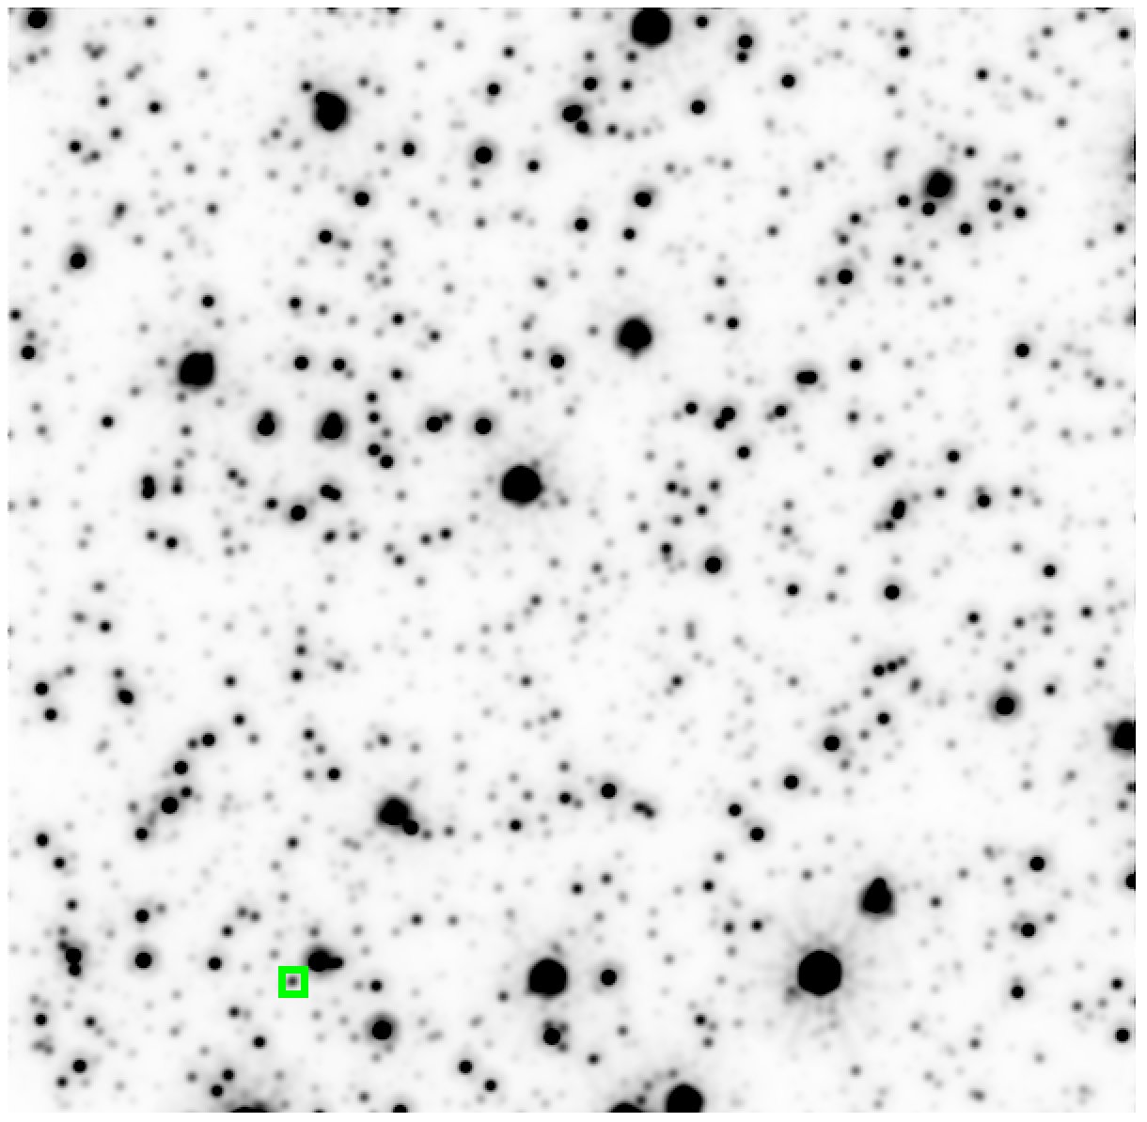
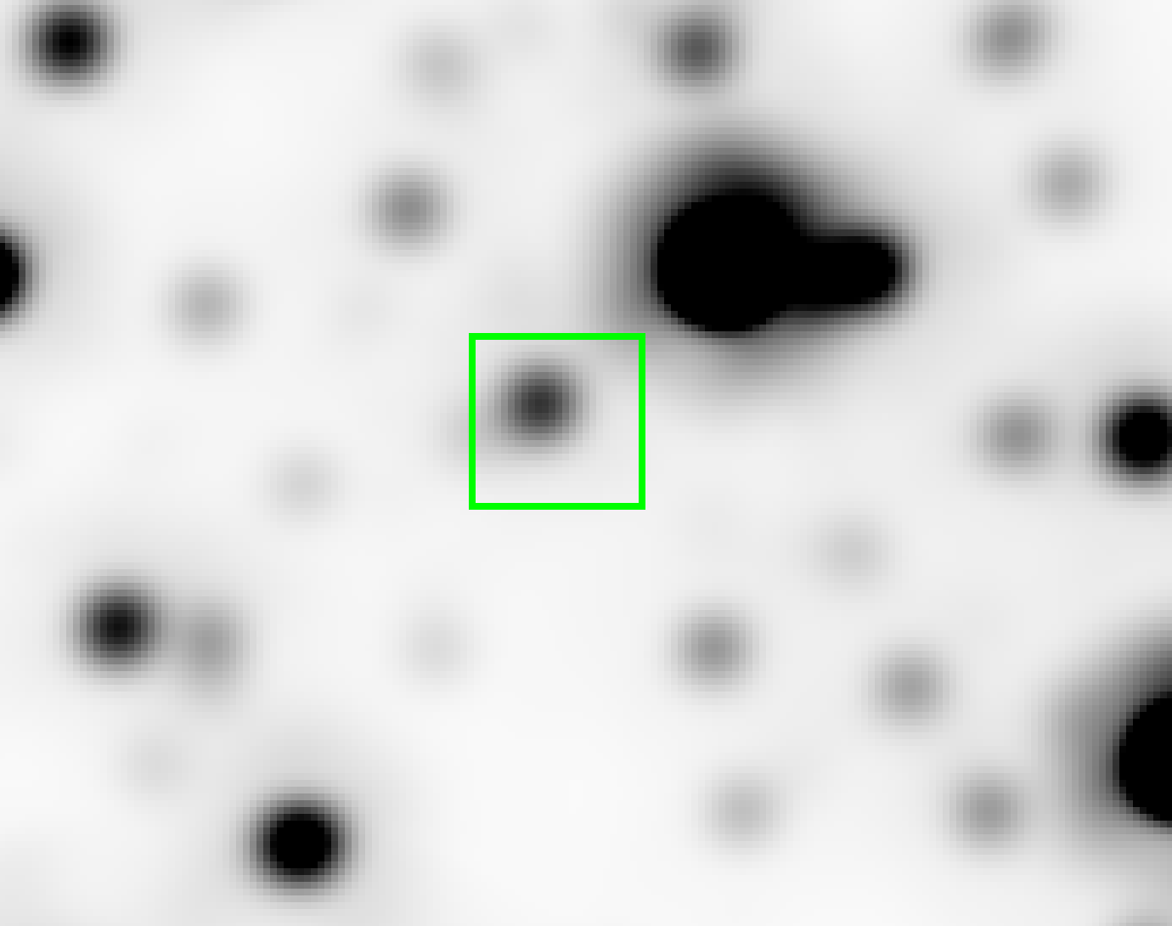
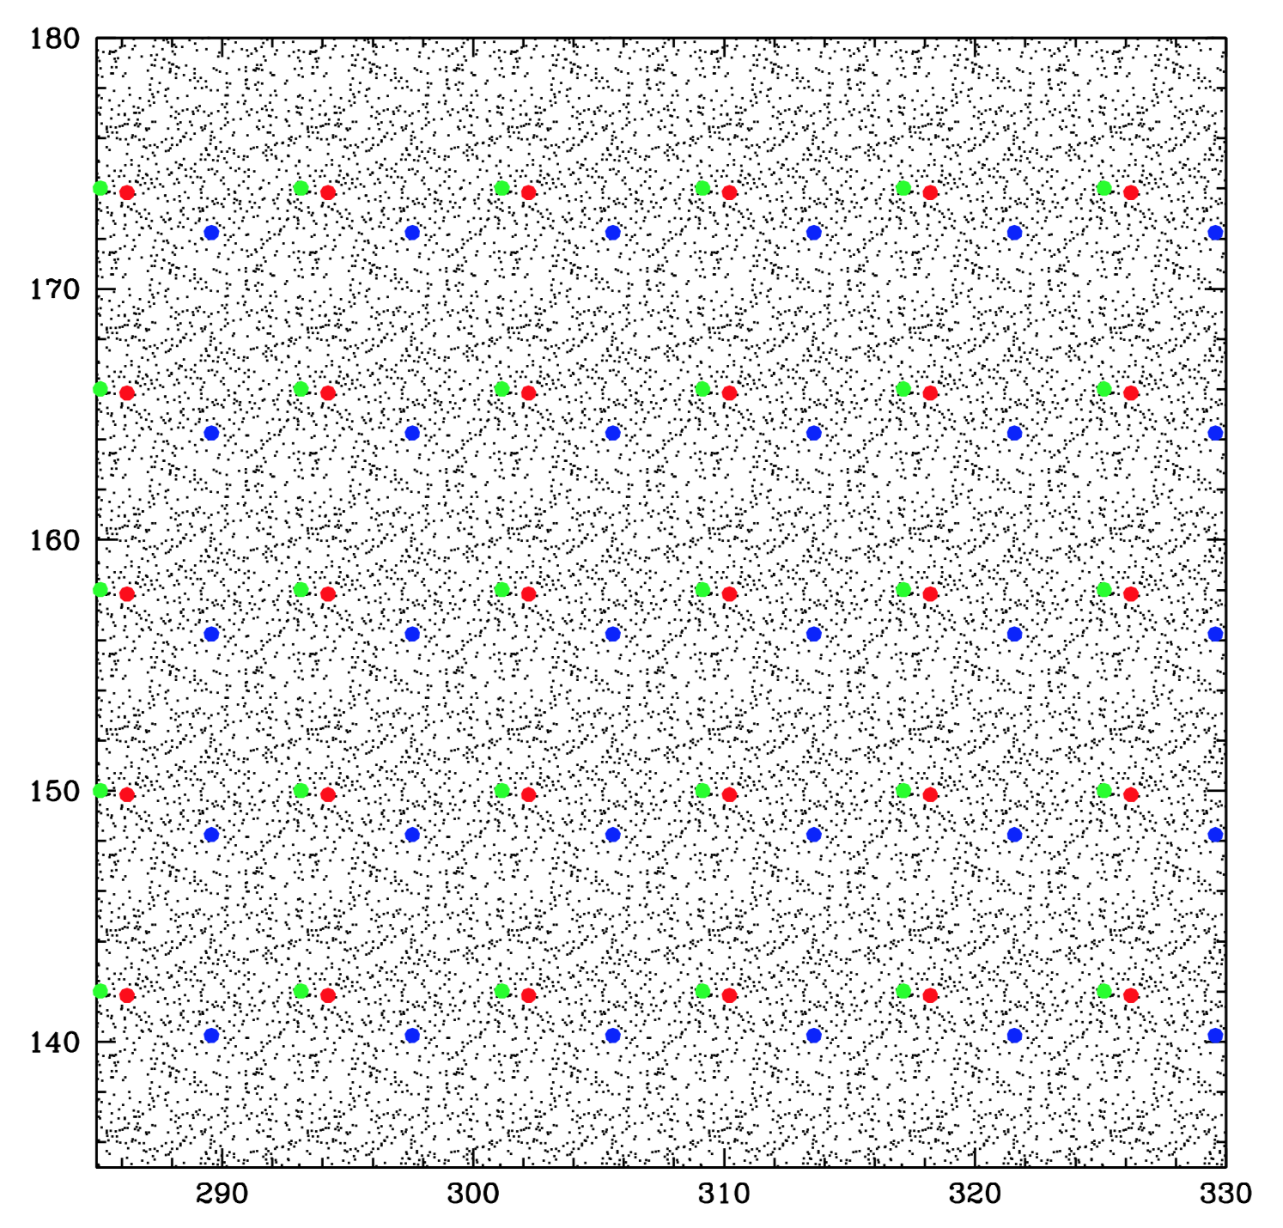
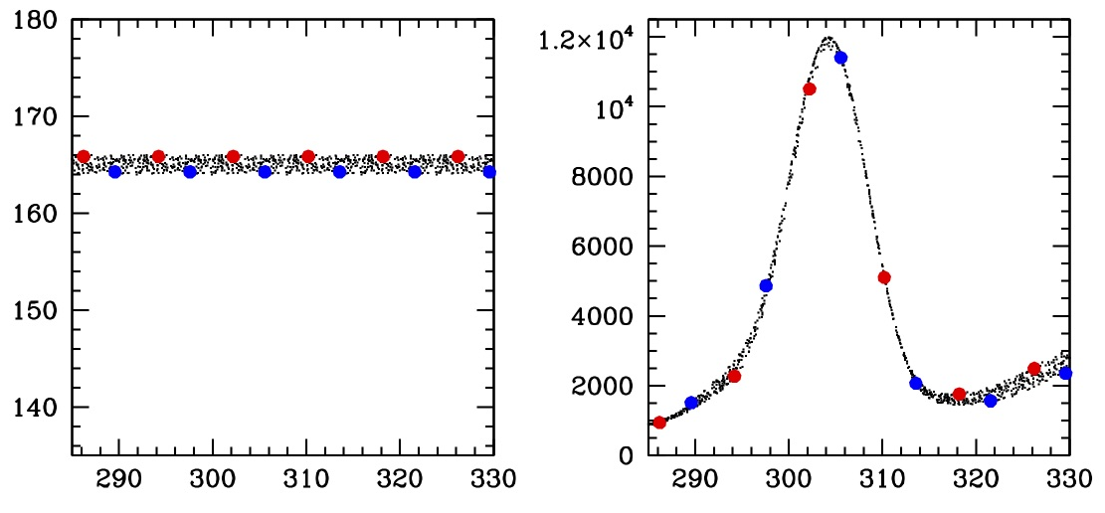
1) Stacked Reference Frame
Goal: catalogs and basis for DIA
1 week of exposures (~625); 50s each
Realistic PSF, realistic densities: 10-mas jitter
x8 super-sampled stack (not DrizzledTM !)
  Constructed iteratively, respecting the sampling
  Like building a PSF, but for a whole image
  This is now working
  Stacks can be analyzed like ground-based images!

Slide 52
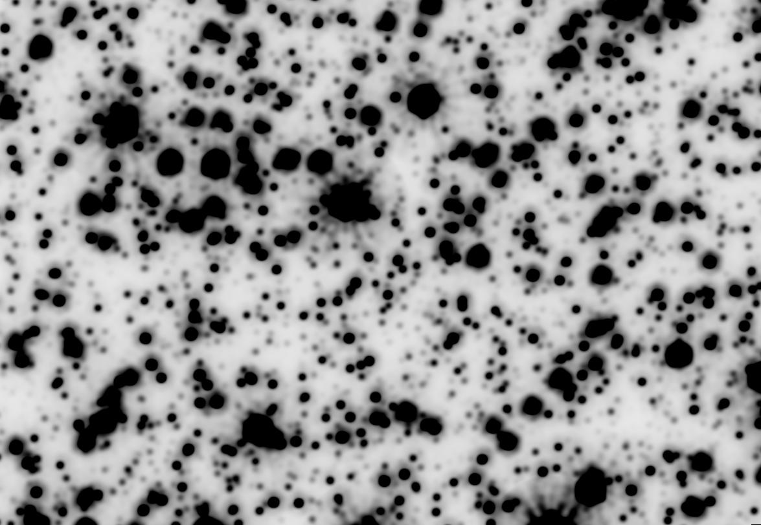
Stack

Slide 53
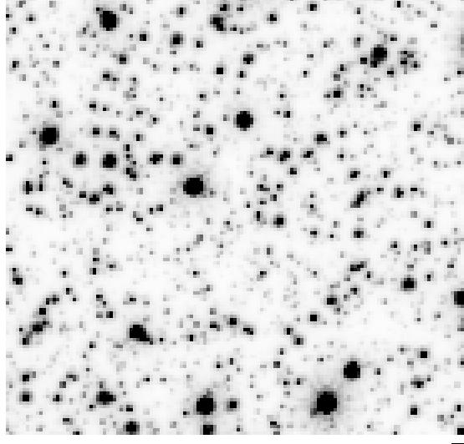
First exposure

Slide 54

First model
(blotted)

Slide 55

Residual
0.1% diff
In central
pixel
Model — Individual
Typically, about 0.1% max
~Numerical Noise
Could improve
sampling/smoothing

Slide 56
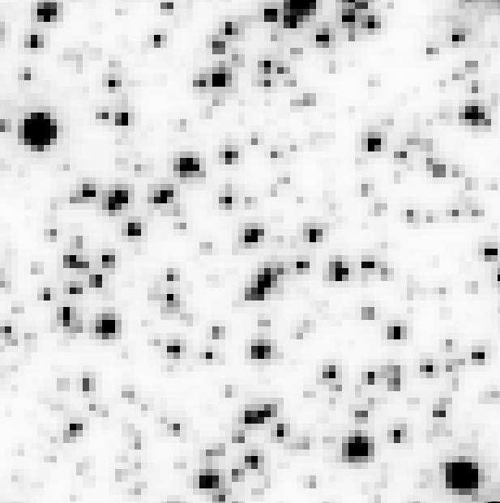
Jitter
Explore varying the PSF
  Default jitter is (10,10, -)
  Exposure with jitter (12,10,30)
ORIGINAL EXPOSURE#1

Slide 57

Jitter
Explore varying the PSF
  Default jitter is (10,10, -)
  Exposure with jitter (12,10,30)
BROADER EXPOSURE#1

Slide 58
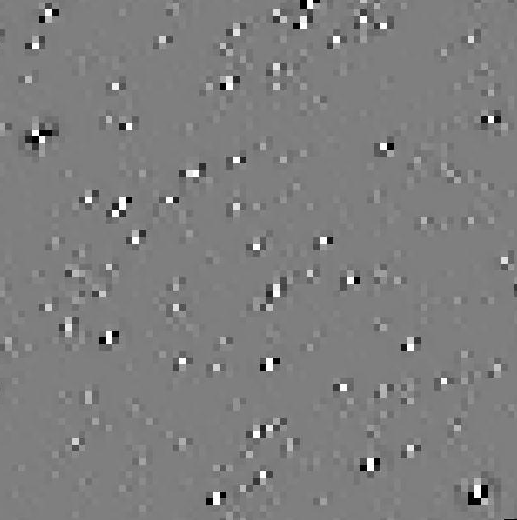
1% diff
In central
pixel
Jitter
Explore varying the PSF
  Default jitter is (10,10, -)
  Exposure with jitter (12,10,30)
  Difference… less than 1% flux
  in central pixel
  Need to “regularize” the images
    Better stacking
    Better Difference Image Analysis
RESIDUAL EXPOSURE#1

Slide 59

Jitter variation
Re-made exposure#1 with jitter (12,10, 30˚) instead of (10,10,-)
STACKED IMAGES OF STARS
Perturb each exposure at locations of stars to “regularize” them
for combination
ACTUAL PSF DIFFERENCE
EXTRACTED PSF DIFFERENCE

Slide 60
1) Stack
2) Catalog Construction
Easy on regularized stack
Need to start with PSF — see (4)
  Too dense to construct locally
  Extended wings
  Very extended diffraction spikes
  Will need to fold in color variation

Slide 61


Slide 63


Slide 64


Slide 65

BRIGHT
STAR

Slide 66

BRIGHT
STAR

Slide 67

DOUBLE
STAR

Slide 68

DOUBLE
STAR

Slide 69
ONLY ONE FOUND!
NOT REAL!
ONLY
ONE
DOUBLE
STAR

Slide 70
DOUBLE
STAR

Slide 71
1) Stack
2) Catalog Construction
Easy on regularized stack
Need to start with PSF — see (3)
  Too dense to construct locally
  Extended wings
  Very extended diffraction spikes
  Will need to fold in color variation
Basic catalog algorithm implemented
  Like DAOPHOT or DoPHOT or ROMAPHOT
  Can be improved
  Will need to be tweaked with real data

Slide 72
1) Stacks
2) Catalog
3) Difference Images
0.1% diff
In central
pixel
Less critical than for ground, since most events stand out as separate stars.
Sophisticated analyses possible on DIs
In un-resampled pixels (not stack)
Test for PSF shape (false positives)
Events not in catalog
Confirm location for lensing
Significance (windowing)
Solar System objects
Fast-moving stars
Astrometry of extreme lensing!!!

Slide 73


1) Stacks
2) Catalog
3) Difference Images
4) Starting PSF
LMC Commissioning / Calibration field simulation
16 dithered exposures

Slide 74

PSF goes out to 30 pixels.

Slide 75

PSF goes out to 30 pixels.

Slide 76

PSF goes out to 30 pixels.

Slide 77

PSF goes out to 30 pixels.

Slide 78


Slide 79


Slide 83


Slide 84
So… pipeline in progress
Stacks
Catalogs
Difference Images
Starting PSFs
Still things to do
  Color dependence of PSF
  Blue / Red procedure
  Exactly how to analyze difference images
Pipeline’s goal is to meet requirements
Leaves PIT to follow up for complicated events
  Difference Images to public?
  Pixel “cores” for event detailed analysis
    Tools for mapping, analysis

Slide 85
The End

