Slide 1
Lecciones en Ingles para la Familia Vasquez-Araoz
Jay Anderson

Slide 2
Entender la lengua Inglés
Quiero décir: Entender lo que es la
lengua Inglés
¿De dónde es?
¿Cómo fonciona?
¿Cómo se compara a otros lenguas?
¿Es fácil o dificil?

Slide 3
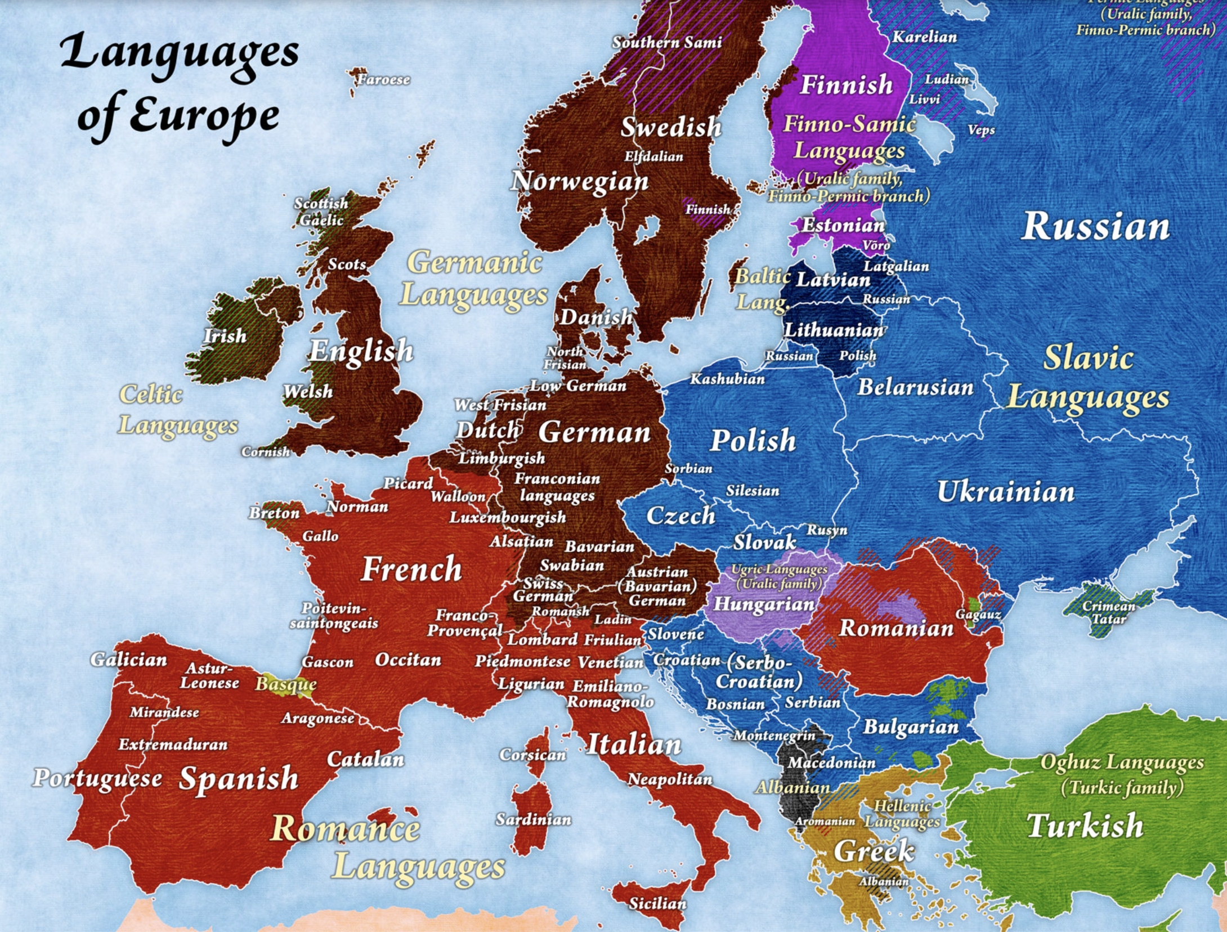
Los Idiomas
Européos
Sueca
Géografica
Ruso
Ingles
Alemán
Las 6 Familias:
Frances
Finlandés
Céltica
Rusa
Portugues
Alemán
Latin
(Ingles)
Italiano
Griega
Español
Español

Slide 4
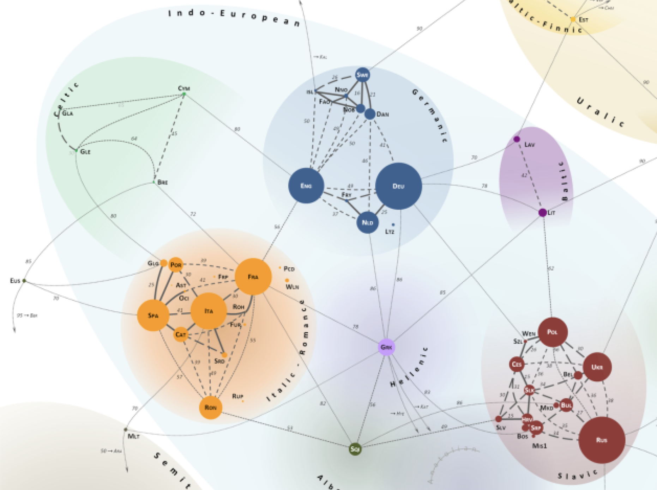
Las Idiomas
de Europa
Finlandés
Sueca
Céltica
La Proximidad
entre dos idiomas
significa
mas palabras
similares
Ingles
Germ
Portugues
No es broma:
Un Finlandés y
un Español se
encuentran en
una taverna.
¿Como se
communican?
¡En Inglés!
Francés
Español
Grieca
Italiano/
Latin
Ruso

Slide 5
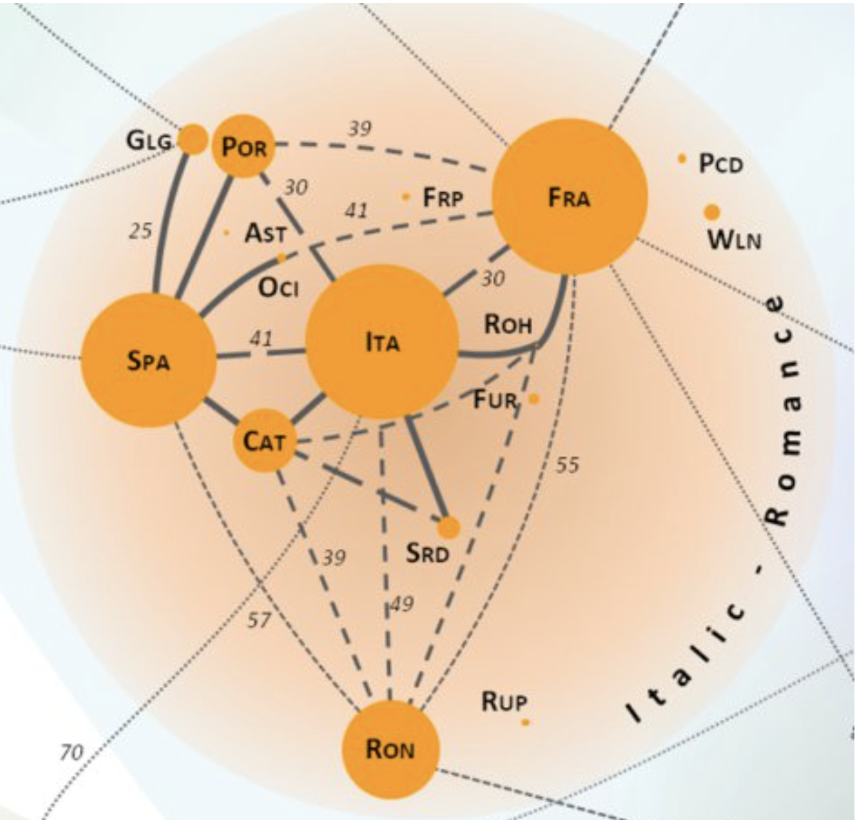
Inglés
Portugues
El Inglés es
>2x mas lejos
del español
que el francés!
Frances
Italiano
(Latino)
Español

Slide 6
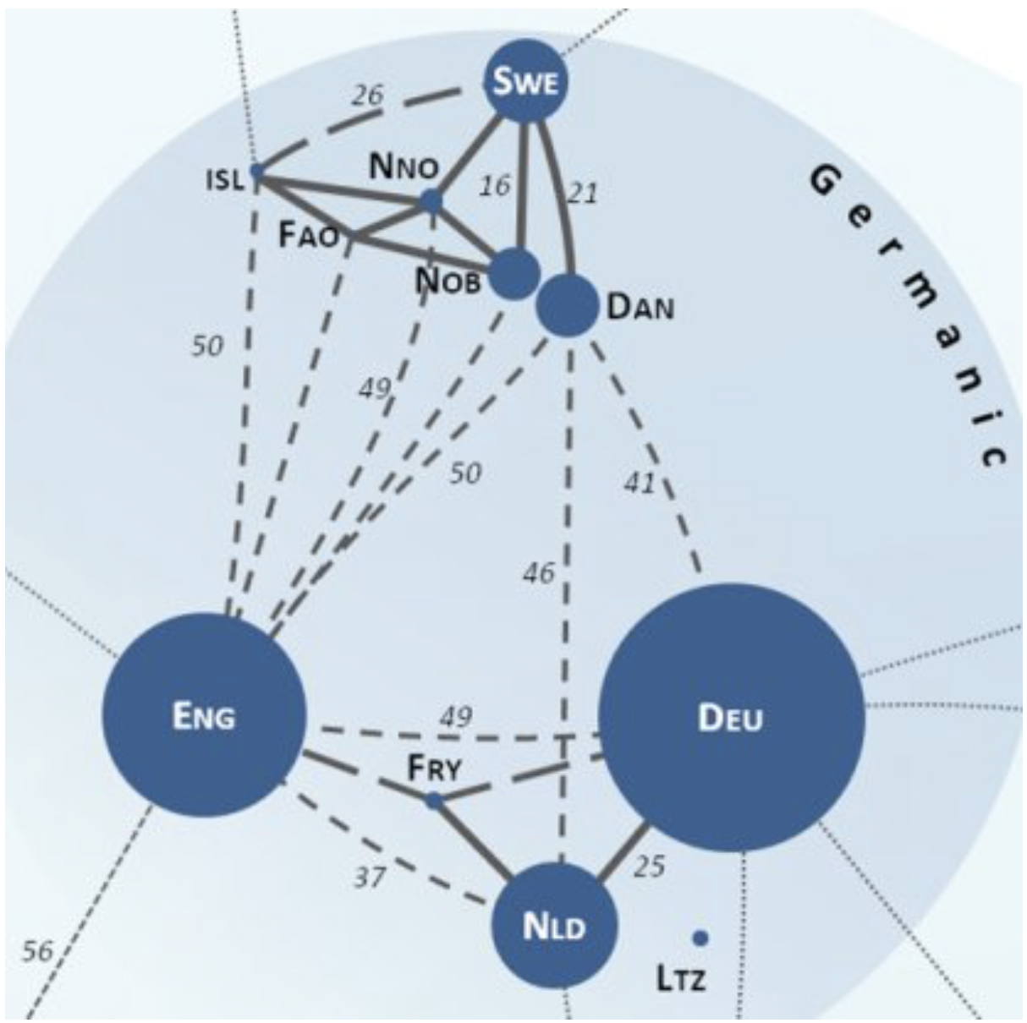
Sueca
Ingles recibió palabras
de 4+ idiomas:
Alemán
Francés
Sueca
Céltica
Griega
Céltica
4
3
Ingles
1
Alemán
2
Frances
Holandés

Slide 7
Inglés: ¿es fácil o difícil?
MAS FACIL
Gramática
Menos congugaciones
  Verbes (poco)
  Adjectivos (nada!)
Estructura de frases
  Mas rigide, por razon de la simplicidad gramatical
Empezar a hablar
MAS DIFICIL
Pronunciación
Orthografía
Vocabulario
Artículos
Perfecionar
  Muchos pequenias cosas de “estilo”
Eso es porque
el Inglés tiene
contribuciones
de muchas
lenguas diferentes

Slide 8

Idiomas: propriedades, dimenciones
GRAMATICA:
¿Es necesario el orden de las palabras en la frasa?
PRONUNCIACION
solo
verbos
verbos/
adjectivos
casi
todo
MENO
CONGUGACIONES/
DICLENSIONES
nada
MAS
CONGUGACIONES/
DICLENSIONES
Ingles
Español
Français
Português
Latin
Русский
Ελληνικα
mas libre
muy,
muy
libre
mas estricto
Ingles
Español
Français
Português
Latin
Русский
Ελληνικα
LENGUAS FONETICOS:
UNA LETRA = UN SONIDO
UN SONIDO = UNA LETRA
Directe: letras→ son
Reglas regulares
¡Menos reglas!
No hay
alfabeta!
한국어
Español/
Italiano
Francés
Ingles
Chino
(Coreano)

Slide 9
Diferencias:
Español
Puedes omitir mucho
  No sé!
  Esta con ella.
  Esta lloviendo
Sonidos puros
  Vocales pures/iguales
Sílabas:
  Casí todas ”abiertos”
    Terminen en vocal
  Impiezan en consonante
Vocales: no muchos variaciones
Letras:
  Pronunciation sencilla
  Idioma casí “fonética”
Ingles
No puedes caer casi nada!
  I do not know!
  It is with her. / He is with her.
  It is raining!
Dipthongs: “Hi!” – ja[i]
  Como Portugués, creo
Sílabas :
  “Apertos”: terminen in vocale
  “Cerrados”: terminen in consonante
  Empiezen con vocale/consonante
Vocales: muchas variaciones
Letras:
  La mismas letra puede haber multos pronunciaciones
    ¡O no se pronuncian!
  Idioma mucho non-phonetica

Slide 10
Dificultades
Articles: a, an, the, [none]
“Uncountable” things: cosas no contables
  Water, Energy, evidence, information
Sustantivos collectivos: “People are…”
Homonyms:
  Mismo orthografia, pronunciacion diferente
  Mismo pronunciacion, orthografia differente
  Cada idoma de origin tiene su mismo reglas:
    Combinaciones de letras → un son
    Light, bright, tight → “a[i]t”
  Hay competiciones grandes de orthografia en ingles para niños!
Muchas contraciones:
  Español: solo 2: de + el → del, a + el → al
  Inglés: muchas!
    It is → it’s ; he is → he’s
    you are → you’re ; what is → what’s

Slide 11
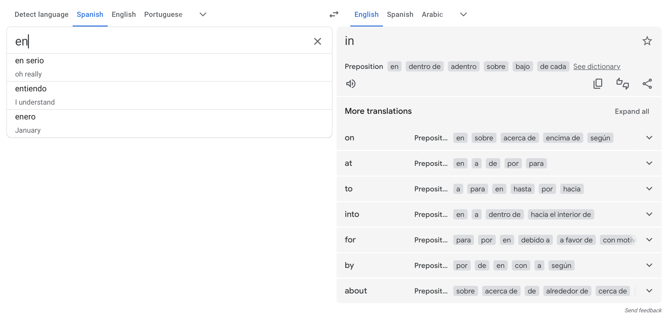
Sobrecarga
in
on
at
to
into
for
by
about
Mas facile para ti…
Mas difícile…
en
estar
ser
to be
para
por
Google Translate:
for

Slide 12
Consejo: sé perezoso
Sonidos neutros : “Ə” (schwa)
  a: uh
  the: thuh
Tragarse los finales de las palabras
  Fred (”d” casí no pronunciado)
  Sing (”ng” casí no pronunciado)
  Dificil:
    can ≠ can’t (muy sutil)
    do ≠ don’t (mas facíl)

Slide 13
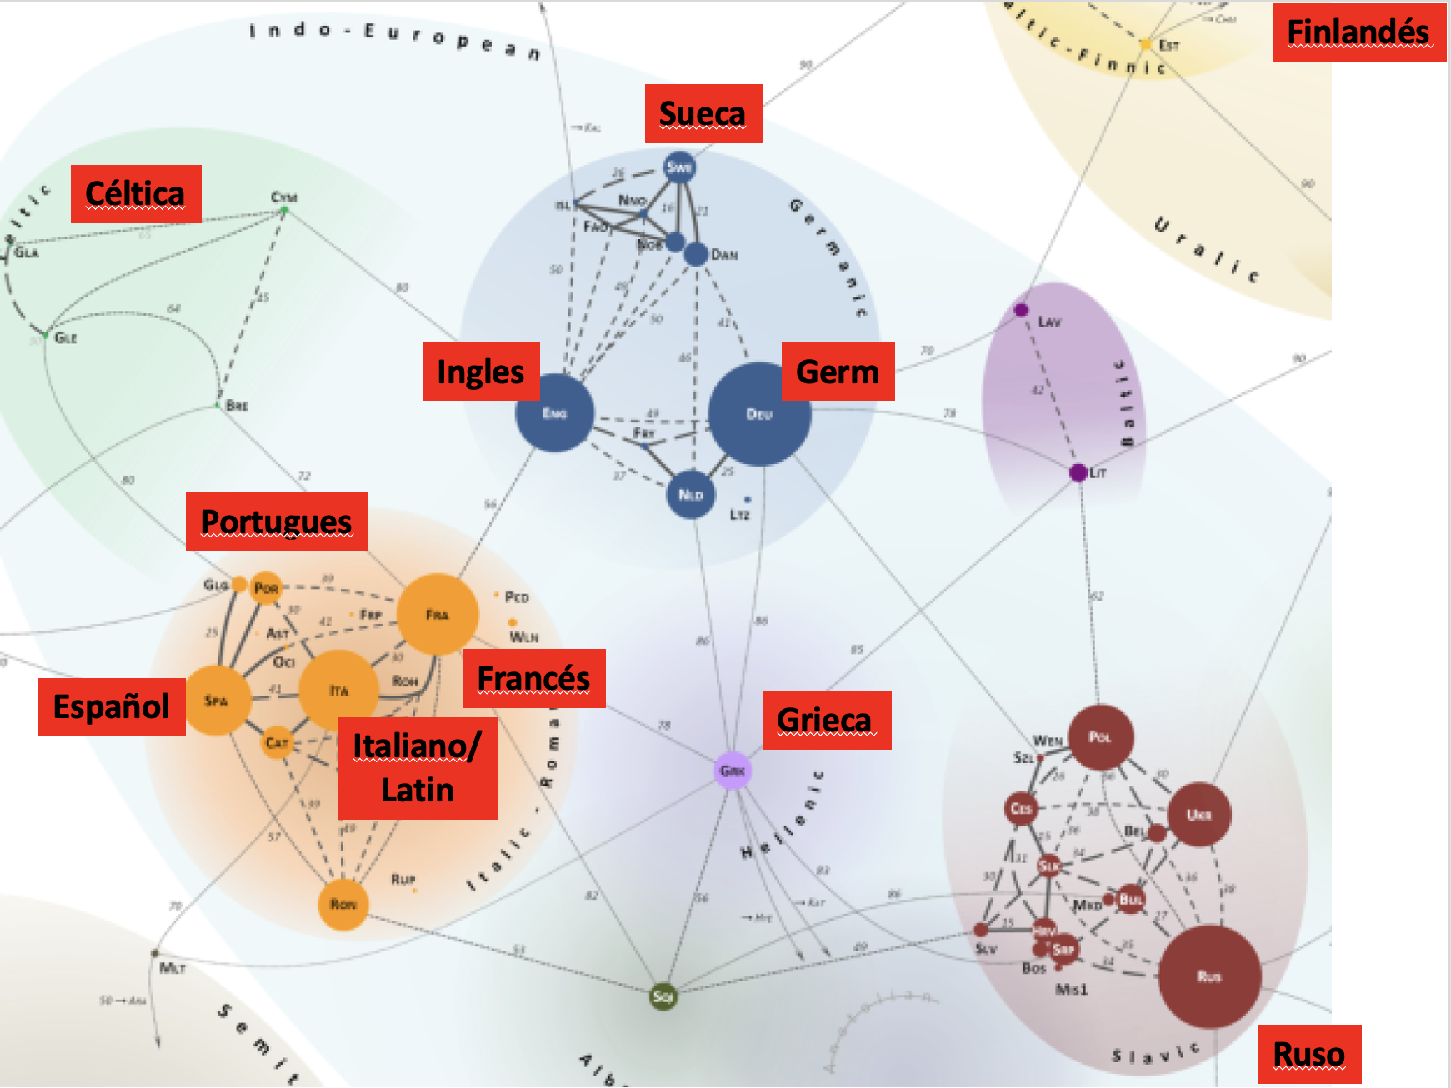
2024.11.10: Repaso
1. Aleman
2. Frances
3. Celtica
4. Griega
Ingles: origen: hay muchos padres
Mas Facile:
  Gramática: menos conjugaciones
  Orden de las palabras mas importante
Mas Dificil:
  Orthografia: complicada, memorización
  Pronunciation:
    busca patrones/combinaciones
    muchos diptongos, cada vocale tiene
    "corte" y "largo" y a veces "alternativo"
    hay reglas, pero hay tambien excepciones
Nuestro Foco
  vocabulario
  orden de palabras

Slide 14
Libro Gramatica Lección #1:
Los elementos principales de la oración
Typo #1: The plane arrived. El avion llegó. Llegó el avion.
  Intransitivo: S + V
Typo #2: John piloted the plane. Juan piloteó el avion.
  Transitivo: S + V + DO
  Con pronombres: He piloted it. El lo pilotó.
Typo #3: John bought Mary a ring. Juan compró un anillo para Maria
  Transitivo+: S + V + IO +DO
  Con pronombres: He bought her a ring.
  Opción#1: John bought a ring for Mary. He bought it for her.
    El IO puede ir con preposición.
  Opción#2: Ody can buy herself flowers. Ody can buy flowers for herself.

Slide 15
Bought: pronunciation + pasado
Today I buy. Today he buys. (+s for 1S) Present
Tomorrow I will buy. Tomorrow he will buy. Future
Yesterday I bought. Yesterday he bought. Past
Yesterday, I did buy. Yesterday he did buy. Past: ? or emphasis
Muchos ejemplos de verbos de pasado que no siguen reglas. Necesitas memorizarse.
Muchos plurales tambien no siguen reglas siempre.
one child, two ______ ?

Slide 16
Preguntas en Inglés
Necesitas invertir S + V
  Are you hungry?
  Is it sunny outside?
Complication: no puedes invertir todo: Arrived your plane?
Puedes solo invertir "to be" y verbos aydandos
    Did your plane arrive?
    Can you go to school for me?
    Did you do your homework?
    Do you have the money?
    Could you please open the door?
    Would you like to eat?
    Did you eat your breakfast?
    Have you ever been to Portugal?

Slide 17
Verbos auxiliares
do: questions, énfasis Do you know Mary?
can (could): poder Can you go? Could you help me?
may (might): permiso May I eat your cake? Might you be hungry?
will (would): futuro Will you be there? Would you like to go?
must (should): deber Must you be so difficult?
Should you really drink the beer?

Slide 18
Proxima Lección
Inglés para Latinos Capítulo #3
More, More More
Palabras para questiones:
  What? ¿ Qué?
  Which? ¿ Cuál?
  How? ¿ Cómo?
  How many? ¿Cuántos?
  Where? ¿ Dónde?
  When? ¿ Cuándo?
  Why? ¿ Por qué?
  Who? ¿ Quién?
  Whose? ¿ De quien?

Slide 19
Pronombres
Person | Subject | Object (D/I) | Possessive | Possessive pronoun | Reflexive
1S | I | me | my | mine | myself
2S | you (thee) | you | your (thy) | yours | yourself
3S | he, she, it | him, her, it | his, her, its | his, hers, ___ | himself, herself, itself
1P | we | us | our | ours | ourselves
2P | you (you all) | you | your | yours | yourselves
3P | they | them | their | theirs | themselves

Slide 20
2024.11.17 Ch3 Ingles Para Latinos
1) Repaso rapido
2) Algunos tiempos verbales
3) the (el, la, los, las)
4) a/an (un, una)
5) Plurales
6) There is / There are (hay)

Slide 21
Quick Review
Repaso Rapido
English: easier because of
  simple conjugations
English: harder because of
  vocabulary + pronunciation
  structure of sentences
Our strategy:
  learn important words
  learn example sentences to fill
Ingles: mas facil:
  conjugaciones sencillas
Ingles: mas dificil:
  vocabulario + pronunciation
  estructura de frases
Nuestra estrategia:
  aprender palabras importantes
  aprender frases exemplos para llenar

Slide 22
Libro Gramatica Lección #1:
Los elementos principales de la oración
Typo #1: The plane arrived. El avion llegó. Llegó el avion.
  Intransitivo: S + V
Typo #2: John piloted the plane. Juan piloteó el avion.
  Transitivo: S + V + DO
  Con pronombres: He piloted it. El lo pilotó.
Typo #3: John gave Mary a ring. Juan dió un anillo para Maria
  Transitivo con 2 obs: S + V + IO +DO
  Con pronombres: He gave her a ring.
  Opción#1: John gave a ring to Mary. He gave Mary a ring. He gave it to her.
  John bought a ring for Mary. He bought Mary a ring. He bought it for her.
    El IO puede ir con preposición.
  Opción#2: Ody can buy herself flowers. Ody can buy flowers for herself.

Slide 23
Some Verb tenses (Algunos Tiempos verbales)
PRESENT: I walk, you are here, she is a doctor, it hurts,
the shoes fit*, we are ready, they eat *se ajustan
PAST: I walked, you were here, she was a doctor, it hurt
the shoes fit, we were ready, they ate
FUTURE: I will walk, you will be here, she will be a doctor,
it will hurt, the shoes will fit, we will be ready,
they will eat
CONTINUOUS: I am walking, she is being a doctor, *estoy caminando
it is hurting, the shoes are fitting,
they are eating
PERFECT: I have walked, you have been here, she has been a doctor, *he caminado
it has hurt, the shoes have fit, we have been ready,
they have eaten
¡INTRODUCCION!

Slide 24
p26: the y a
vocalizado
[dh, like 𝜟] this, that, the, there,
though, thought
the: el, la, los, las
  se pronuncia: [dhǝ] o [dhi]
  algo especifico
  nunca no cambio
  es singular: the book, the school, the teacher
  es plural: the books, the schools, the teachers
a: un, una
  se prononca: [ay] o [ǝ]
  algo no specifico
  antes de vocale: an
  a pen, a book, a doctor
  an apple, an egg, an orange
"th"
no vocalizado
[th, like 𝛳] think, thing, path, bath, math,
thank, thread, three
youth, wealth, health

Slide 25
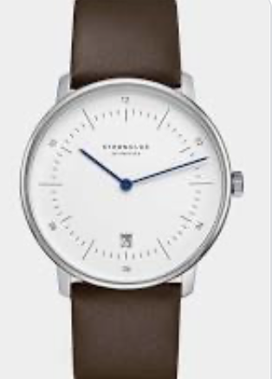
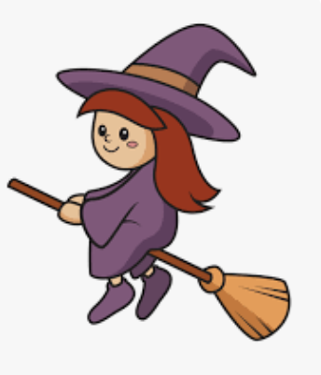
p28: plurales
s – termina non vocalizado
z - termina vocalizado
Normalmente, pon "s" al final:
  one taco, two tacos
  one dog, two dogs
A veces, pon "es"
  one watch, two watches
  one witch, two witches
Excepciones (viene de lenguas differentes)
  one man, two men
  one child, two children
  one fish, two fish
  one tooth, two teeth
Adjetivos: una buena amiga muchas buenas amigas
a good friend many good friends
¡no cambian adjectivos!

Slide 26
"Hay" ←→ There is/There are
Dummy Subjects = Sujetos de Maniquís
You have seen "it" (supongo que has visto "it")
It is raining. (Esta lloviendo.)
It's hot outside. (Hace calor afuera)
It is hard to see. (Es dificil ver.)
La palabra "there" = "allá"
pero, aqui es como "it"
no tienes que decir donde
quizas no hay donde
  "existe"
quizas hay ("here is...")

Slide 27
Dummy Subjects = Sujetos de Maniquís
You have seen "it" (supongo que has visto "it")
It is raining. (Esta lloviendo.)
It's hot outside. (Hace calor afuera)
It is hard to see. (Es dificil ver.)
"Hay" ←→ There is/There are
There is money.
There is a time for war, and a time for peace.
There is a big party tomorrow.
There is no money.
There are always problems.
There are many bathrooms in the house.
There are five chairs in the room.
There are lots of children everywhere.
There are the watches; you can see them!
The pencils and pens are there.
There are the pencils and pens!
👉

Slide 29
2024.11.17 Ch3 Ingles Para Latinos
1) Repaso rapido
2) Algunos tiempos verbales
3) the (el, la, los, las)
4) a/an (un, una)
5) Plurales
6) There is / There are (hay)

Slide 30
This/These ←→ Este(s)
This is a book. These are the books.
This is a pencil. These are the pencils.
This is a desk. ________
This is a chair. ________
This is a car. ________
aqui
That/Those ←→ Ese(s)
allá
That is a book. Those are the books.
That is a pencil. Those are the pencils.
That is a desk. ________
That is a chair. ________
That is a car. ________

Slide 32
Quick Review
Repaso Rapido
English: easier because of
  simple conjugations
English: harder because of
  vocabulary + pronunciation
  structure of sentences
Our strategy:
  learn important words
  learn example sentences to fill
Ingles: mas facil:
  conjugaciones sencillas
Ingles: mas dificil:
  vocabulario + pronunciation
  estructura de frases
Nuestra estrategia:
  aprender palabras importantes
  aprender frases exemplos para llenar

Slide 33
Prueba de N / 1000 palabras

Slide 34
Verbo: ser/estar
I am yo estoy/soi I'm I was
You are tu estás/eres You're You were
He is el está/es He's He was
She is ella está/es She's She was
It is - It's It was
We are nosotros estamos/somos We're We were
You all are ustes están/son You all are You all were
They are ellos/ellas están/son They're They were

Slide 35
Supply the form of the verb to be
I am
you are
he is
we are
they are
1) ¿Tienes hambre? ___ you hungry?
2) Estoy listo para comer. I ___ ready to eat. (contraction?)
3) ¿Cuando vuelven a casa? When ___ they coming home?
4) ¿Cuantos anos tiene Gustavo? How old ___ Gustavo?
5) ¿Cuanto es la saltena? How much ___ the salteña?
6) Diana esta lista para mirar la tele. Diana ___ ready to watch TV?
7) El sol esta en el cielo. The sun ___ in the sky.
8) Estan listos ir? ___ you all ready to go?

Slide 36
Acknowledgements (1)
I thank God, Who has always been there taking care of me. I see His love in every step I take. I was born in Cochabamba, Bolivia, and when I was very young, I left my home country to study medicine at the Federal University of the State of Rio de Janeiro in Brazil. I felt very honored, but the fear I had was immense. It was a challenge to carry on in spite of this fear, but I knew that God had a purpose for my life.
Years later, I got married and my first daughter Diana was born with very fragile health. In my quest to help her, I began to study everything I could, and I discovered the medicine that I practice today. This medicine takes a comprehensive approach to health, and it involves taking care of everything from lifestyle to thoughts. It was at that moment that I finally understood the overarching role of Neuroscience in our wellness.

Slide 37
Acknowledgements (2)
To share this new knowledge with my children, I had to translate it into more accessible language. So, I started telling stories that not only helped them fall asleep but also taught them valuable life lessons.
One day, my eight-year-old daughter said to me: "Mom, other children need to hear these stories. You could write a book, and I’ll draw the pictures!"
Today, after several years, this book has finally been born.

Slide 39
What a wonderful world w/lyricdsw

