Slide 1
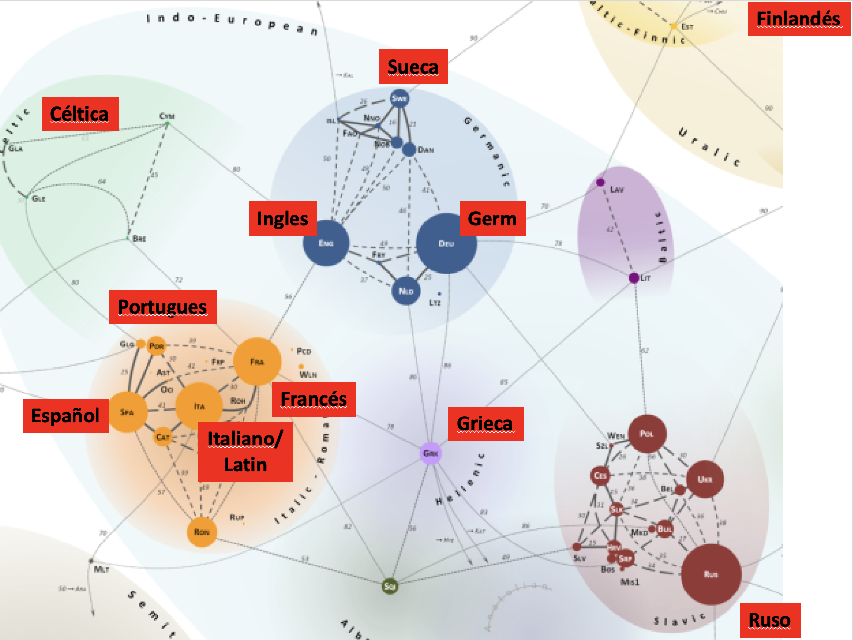
2024.11.10: Repaso
1. Aleman
2. Frances
3. Celtica
4. Griega
Ingles: origen: hay muchos padres
Mas Facile:
Gramática: menos conjugaciones
Orden de las palabras mas importante
Mas Dificil:
Orthografia: complicada, memorización
Pronunciation:
busca patrones/combinaciones
muchos diptongos, cada vocale tiene "corte" y "largo" y a veces "alternativo"
hay reglas, pero hay tambien excepciones
Nuestro Foco
vocabulario
orden de palabras

Slide 2
Libro Gramatica Lección #1: Los elementos principales de la oración
Typo #1: The plane arrived. El avion llegó. Llegó el avion.
Intransitivo: S + V
Typo #2: John piloted the plane. Juan piloteó el avion.
Transitivo: S + V + DO
Con pronombres: He piloted it. El lo pilotó.
Typo #3: John bought Mary a ring. Juan compró un anillo para Maria
Transitivo+: S + V + IO +DO
Con pronombres: He bought her a ring.
Opción#1: John bought a ring for Mary. He bought it for her.
El IO puede ir con preposición.
Opción#2: Ody can buy herself flowers. Ody can buy flowers for herself.

Slide 3
Bought: pronunciation + pasado
Today I buy. Today he buys. (+s for 1S) Present
Tomorrow I will buy. Tomorrow he will buy. Future
Yesterday I bought. Yesterday he bought. Past
Yesterday, I did buy. Yesterday he did buy. Past: ? or emphasis
Muchos ejemplos de verbos de pasado que no siguen reglas. Necesitas memorizarse.
Muchos plurales tambien no siguen reglas siempre.
one child, two ______ ?

Slide 4
Preguntas en Inglés
Necesitas invertir S + V
Are you hungry?
Is it sunny outside?
Complication: no puedes invertir todo: Arrived your plane?
Puedes solo invertir "to be" y verbos aydandos
Did your plane arrive?
Can you go to school for me?
Did you do your homework?
Do you have the money?
Could you please open the door?
Would you like to eat?
Did you eat your breakfast?
Have you ever been to Portugal?

Slide 5
Verbos auxiliares
do: questions, énfasis Do you know Mary?
can (could): poder Can you go? Could you help me?
may (might): permiso May I eat your cake? Might you be hungry?
will (would): futuro Will you be there? Would you like to go?
must (should): deber Must you be so difficult?
Should you really drink the beer?

Slide 6
Proxima Lección Inglés para Latinos Capítulo #3
More, More More
Palabras para questiones:
What? ¿ Qué?
Which? ¿ Cuál?
How? ¿ Cómo?
How many? ¿Cuántos?
Where? ¿ Dónde?
When? ¿ Cuándo?
Why? ¿ Por qué?
Who? ¿ Quién?
Whose? ¿ De quien?

Slide 7
Pronombres
Person | Subject | Object (D/I) | Possessive | Possessive pronoun | Reflexive
1S | I | me | my | mine | myself
2S | you (thee) | you | your (thy) | yours | yourself
3S | he, she, it | him, her, it | his, her, its | his, hers, ___ | himself, herself, itself
1P | we | us | our | ours | ourselves
2P | you (you all) | you | your | yours | yourselves
3P | they | them | their | theirs | themselves

